Slide 1
ATP
Adenosine triphosphate

Slide 2
Specification
Understand that a single molecule of ATP is a nucleotide derivative and is formed from ribose, adenine and three phosphate groups
Hydrolysis of ATP to ADP and inorganic phosphate
Hydrolysis of ATP can be coupled to energy requiring reactions within cells
Know that hydrolysis of ATP can be used to phosphorylate other compounds making them more reactive
ATP re synthesised by a condensation reaction of ADP and inorganic phosphate
Reaction catalysed by ATP synthase dueing respiration and photosynthesis

Slide 3
GCE Recall
Respiration releases energy
Energy from respiration is used for movement, protein synthesis, synthesis of amino acids in plants and maintenance of body temperature

Slide 4
Introduction
All living organisms require energy in order to remain alive
Energy initially comes from the sun
Plants use solar energy to combine water and carbon dioxide into complex organic molecules through photosynthesis

Slide 5
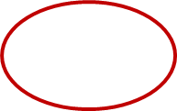
How is energy obtained in Living organisms?
A cell can’t get it’s energy directly from glucose
Plants obtain energy from the sun
Animals obtain energy from their food
How?
Respiration
In respiration the energy released from glucose is used to make ATP

Slide 6
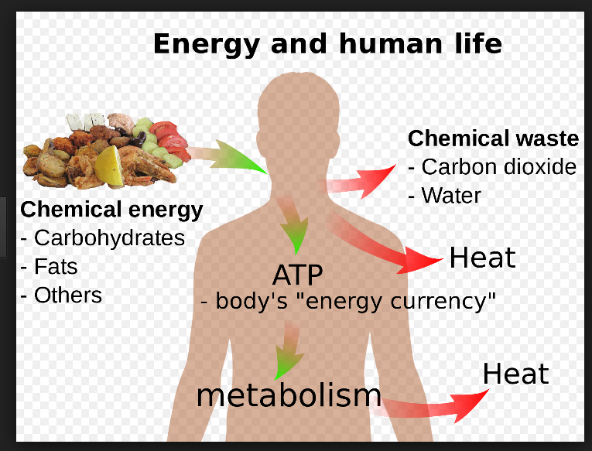
Energy and Human life
ATP is often described as the universal energy currency for organisms
Why?
Because all organisms from the simplest bacteria to humans use ATP

Slide 7
Structure of ATP
Phosphorylated macromolecule
It has three parts:-
Adenine-a Nitrogen containing organic base
Ribose-Pentose sugar
Phosphates-a chain of three phosphates

Slide 8
Bozeman video
https://www.youtube.com/watch?v=5GMLIMIVUvo

Slide 9
Simplified diagram of ATP
Adenine is a nitrogenous base
Adenine and ribose together are known as adenosine
Structure very similar to nucleic acid
Phosphate group composed of phosphorous and oxygen

Slide 10
How does ATP work?
Energy is stored in the bonds of ATP
The bonds between the phosphate groups are unstable (like a coiled spring)
The end phosphate is straining to break away from it’s partner as they are all negatively charged and repel each other
Low activation energy-which means they are easily broken
When they do break they release a considerable amount of energy
Only the terminal phosphate is removed
High energy state Low Energy state
Free energy

Slide 11
Equations
HYDROLYSIS
1. ATP+ H₂0 ADP +Pi + Energy
CONDENSATION
2. ADP +Pi + Energy ATP + H₂0
ATP HYDROLASE
ATP Synthase

Slide 12
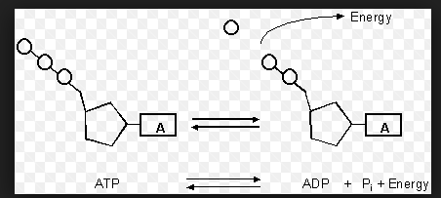
What is ADP?
Adenosine Diphosphate

Slide 13
Equation
Condensation
ATP synthase,
Mitochondria
Hydrolysis, ATP hydrolase

Slide 14
Synthesis of ATP from ADP
Occurs in three ways
Photosynthesis (photophosphorylation)
Respiration (oxidative phosphorylation)
When a phosphate group is transferred from a donor molecule to ADP (substrate level phosphorylation)

Slide 15
Roles of ATP
Soluble
Intermediate energy source of cells
It is not a good long term energy store as unstable
Cell does not store large quantities
Rapidly reformed from ADP and inorganic phosphate
Why is it better than glucose?
Releases less energy than glucose-in smaller more manageable quantities
Hydrolysis of ATP is a single reaction, the breakdown of glucose is a series of reactions and therefore energy release would take longer.

Slide 16
Function
Metabolic processes -used to build up macromoleceules
Movement-required for muscle contraction
Active transport-change shape carrier proteins
Secretion-lysosomes release cell products
Activation molecules-inorganic phosphate can be used to phosphorylate other compounds making them more reactive, lowering the activation energy.

Slide 17
Questions
ATP is useful in many biological processes. Explain why? (4 marks)
Write a simple equation to show how ATP is synthesised from ADP
Give two ways in which the properties of ATP make it a suitable source of energy in biological processes?.

