Slide 1
Collisions and Momentum
3.4.1.6 Momentum

Slide 2
Aims
Re-cap
Mathematical conservation of momentum
Problem solving in momentum
Elastic and Inelastic collisions

Slide 3
Question Re-Cap
A football has a mass of 0.40 kg. Initially it is moving to the left at 20 ms⁻¹, but then it is kicked. After the kick it is moving at 45º upwards and to the right with a speed of 30 ms⁻¹.
Find the impulse of the net force and the average net force, assuming a collision time of 0.010 s.

Slide 4
Answer

Slide 5
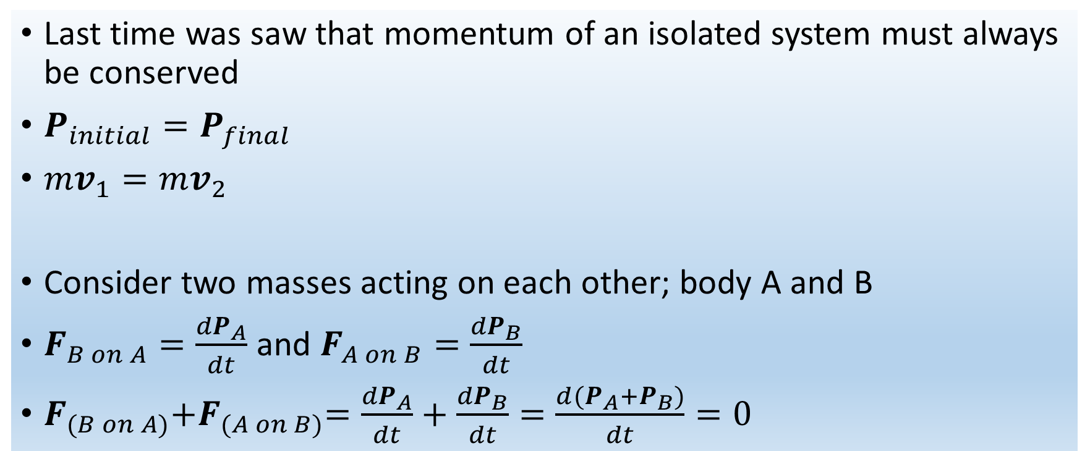
Conservation of Momentum
Last time was saw that momentum of an isolated system must always be conserved
$P_{initial}=P_{final}$
$mv_{1}=mv_{2}$
Consider two masses acting on each other; body A and B
$F_{B on A}=\frac{{dP}_{A}}{dt}$ and $F_{A on B}=\frac{{dP}_{B}}{dt}$
$F_{(B on A)}{+F}_{(A on B)}=\frac{{dP}_{A}}{dt}+\frac{{dP}_{B}}{dt}=\frac{d(P_{A}+P_{B})}{dt}=0$

Slide 6
Conservation of Momentum
If adding the momentum vectors of a system equals zero, the total momentum of the system is constant
This is the simplest form of the principal of conservation of momentum

Slide 7
Momentum Problem Solving

Slide 8
Question
A marksman holds a rifle of mass 3.00kg loosely so that it recoils. He fires a bullet of mass = 5.00g horizontally with a velocity of 300 ms⁻¹. What is the recoil velocity of the rifle? What are the final momentum and kinetic energy of the bullet and rifle?

Slide 9
Question
Two gliders with different masses move towards each other on an air track. After they collide, glider B has a final velocity of 2.0 ms⁻¹. What is the final velocity of glider A?

Slide 10
Elastic Collisions
An elastic collision is an encounter between two bodies in which the total kinetic energy of the two bodies after the encounter is equal to their total kinetic energy before the encounter.
Elastic collisions occur only if there is no net conversion of kinetic energy into other forms.
The collisions of atoms are elastic collisions.

Slide 11
Examples of elastic collisions
For macroscopic objects which come into contact in a collision, there is always some dissipation and they are never perfectly elastic. Collisions between hard steel balls as in the swinging balls apparatus are nearly elastic.
"Collisions" in which the objects do not touch each other, such as Rutherford scattering or the slingshot orbit of a satellite off a planet, are elastic collisions. In atomic or nuclear scattering, the collisions are typically elastic because the repulsive Coulomb force keeps the particles out of contact with each other.
Collisions in ideal gases are very nearly elastic, and this fact is used in the development of the expressions for gas pressure in a container.

Slide 12
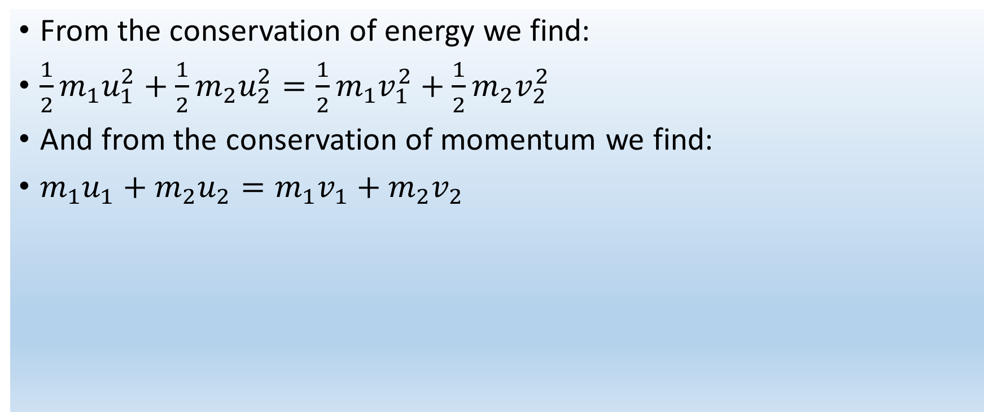
Elastic Collisions
From the conservation of energy we find:
$\frac{1}{2}m_{1}u_{1}^{2}+\frac{1}{2}m_{2}u_{2}^{2}=\frac{1}{2}m_{1}v_{1}^{2}+\frac{1}{2}m_{2}v_{2}^{2}$
And from the conservation of momentum we find:
$m_{1}u_{1}+m_{2}u_{2}=m_{1}v_{1}+m_{2}v_{2}$

Slide 13
Inelastic Collisions
An inelastic collision, in contrast to an elastic collision, is a collision in which kinetic energy is not conserved due to the action of internal friction.
In collisions of macroscopic bodies, some kinetic energy is turned into vibrational energy of the atoms, causing a heating effect, and the bodies are deformed.

Slide 14
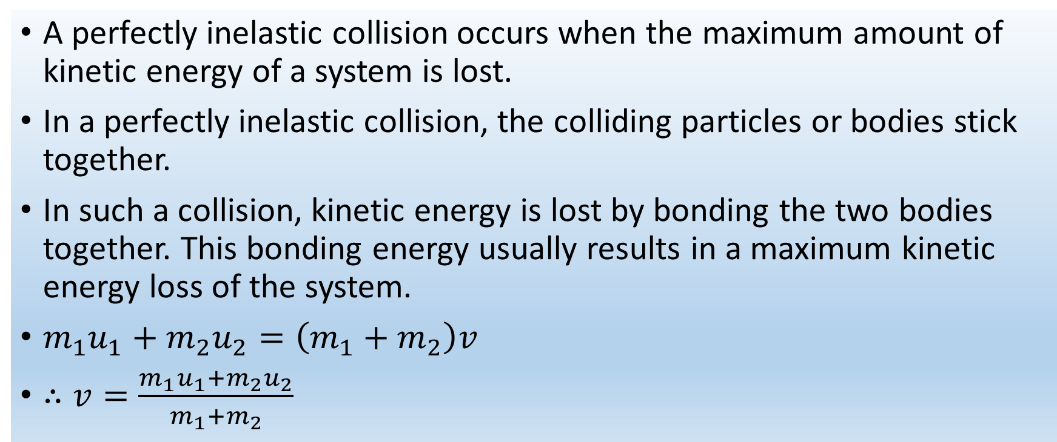
Perfectly inelastic collisions
A perfectly inelastic collision occurs when the maximum amount of kinetic energy of a system is lost.
In a perfectly inelastic collision, the colliding particles or bodies stick together.
In such a collision, kinetic energy is lost by bonding the two bodies together. This bonding energy usually results in a maximum kinetic energy loss of the system.
$m_{1}u_{1}+m_{2}u_{2}=\left(m_{1}+m_{2}\right)v$
$∴v=\frac{m_{1}u_{1}+m_{2}u_{2}}{m_{1}+m_{2}}$

Slide 15
Question
Two battling robots are fighting it out on a frictionless surface. Robot A with mass 20 kg initially moves at 2.0 ms⁻¹ parallel to the x-axis. It collides with robot B which has mass 12 kg and is initially at rest. After the collision, robot A moves at 1.0 ms⁻¹ in a direction that makes an angle of 30º with its initial direction. What is the final velocity of robot B?

Slide 16
Answer

Slide 17
Question
The figure shows a ballistic pendulum, a simple system for measuring the speed of a bullet. A bullet of mass m_{B} makes a completely inelastic collision with a block of wood of m_{W} which is suspended like a pendulum. After the impact, the block swings up to a maximum height y. In terms of y, m_{B}, m_{W}, what is the initial speed of the bullet?

Slide 18
Answer

Slide 19
Question (C² [chocolate and commendation]Challenge!!)

Slide 20
Answer

Slide 21
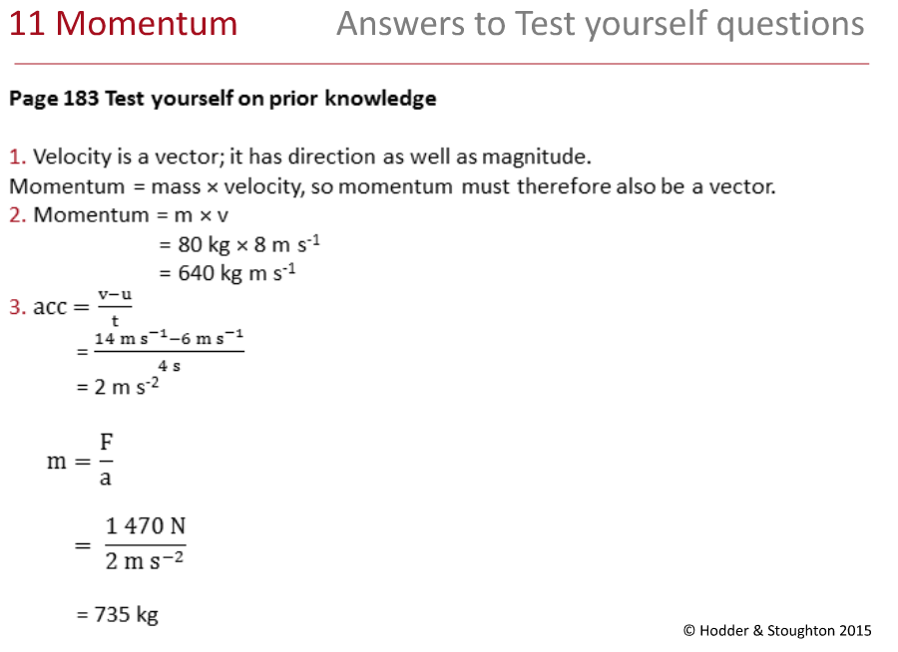
Book answers

Slide 22
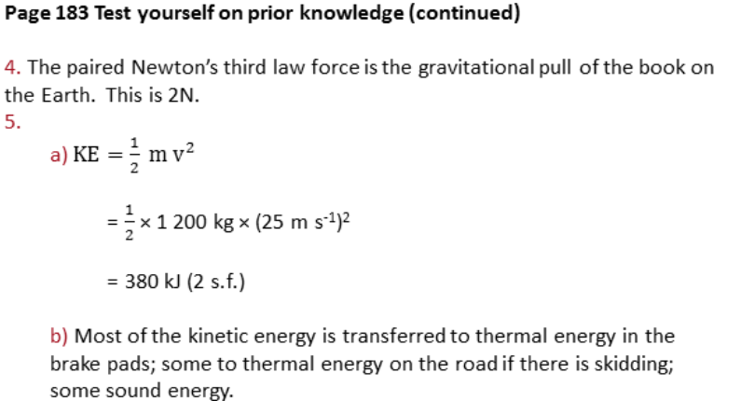
Book answers

Slide 23
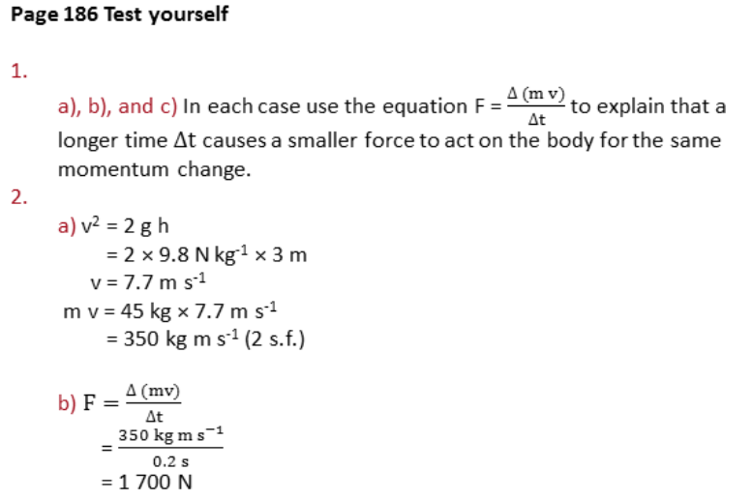
Book answers

Slide 24
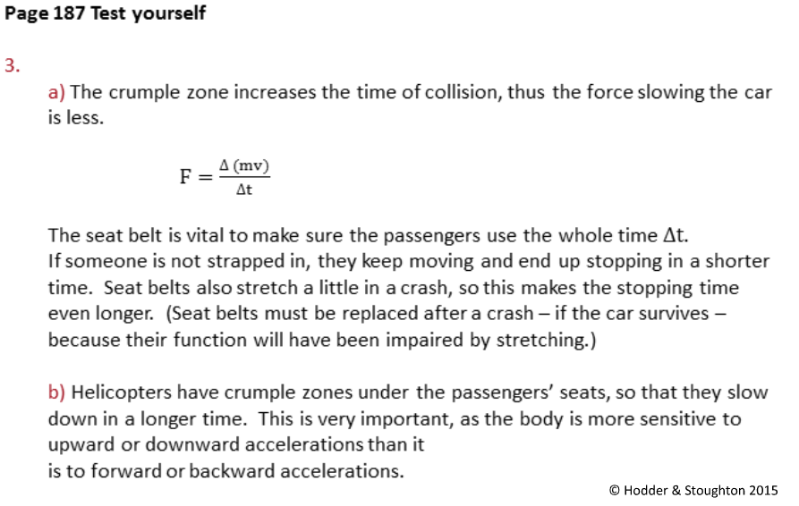
Book answers

Slide 25
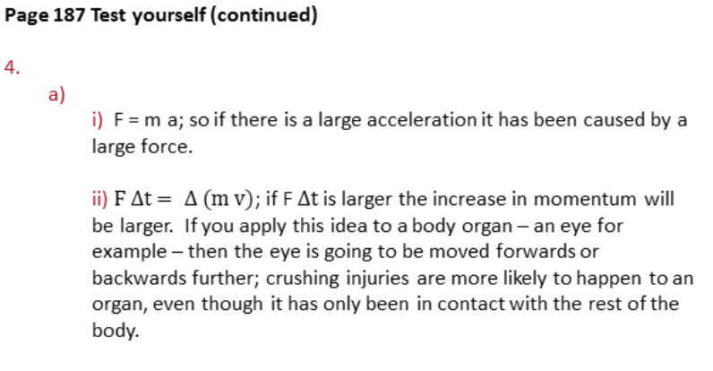
Book answers

Slide 26
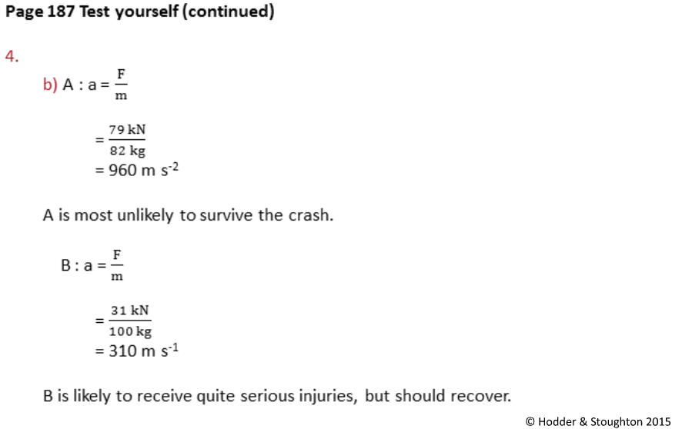
Book answers

Slide 27
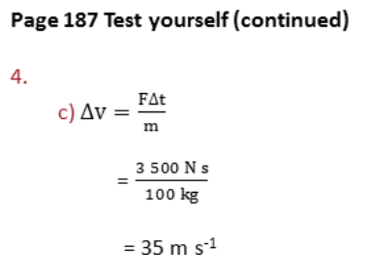
Book answers

Slide 28
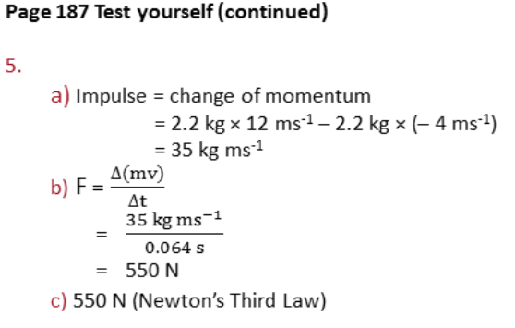
Book answers

Slide 29
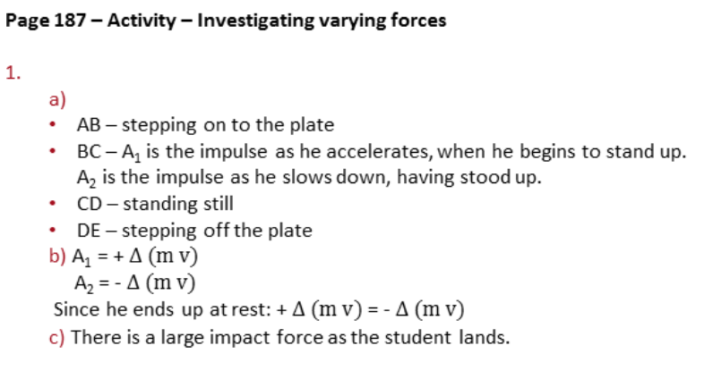
Book answers

Slide 30
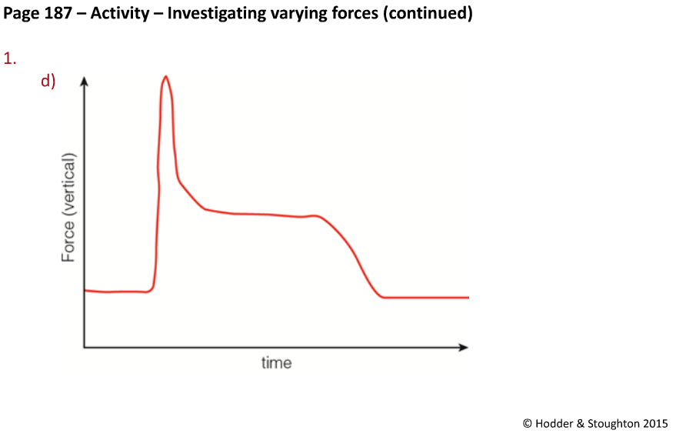
Book answers

Slide 31
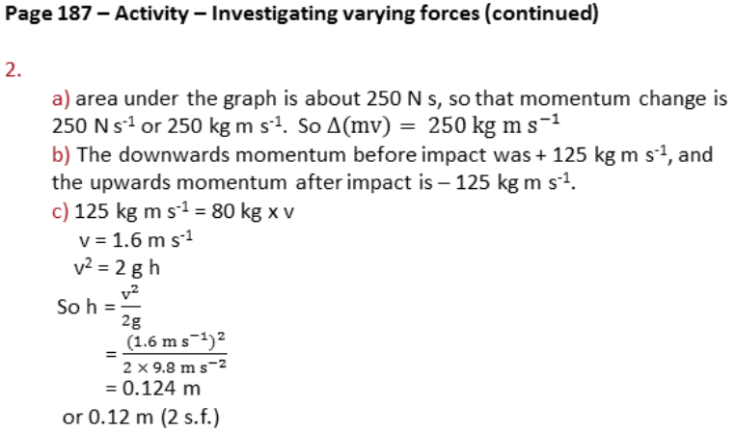
Book answers

Slide 32
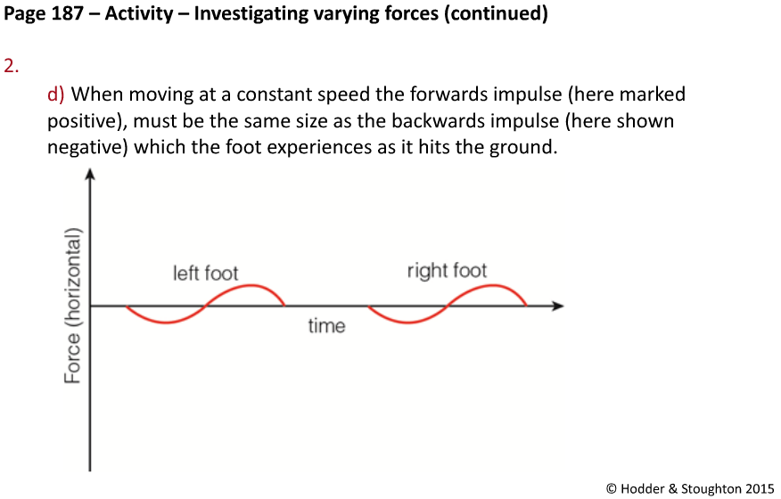
Book answers

Slide 33
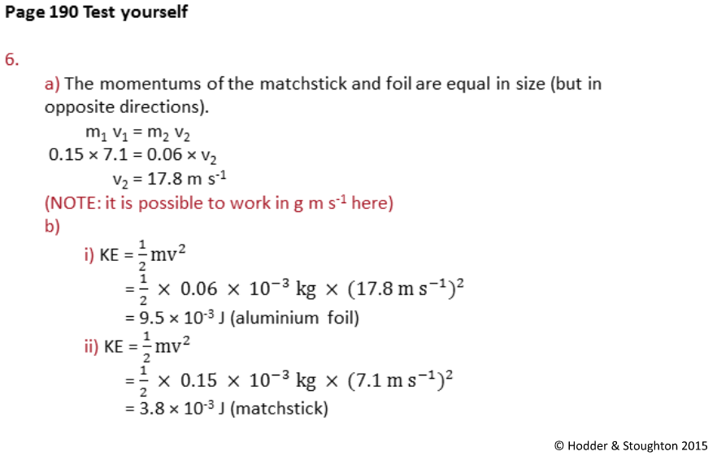
Book answers

Slide 34
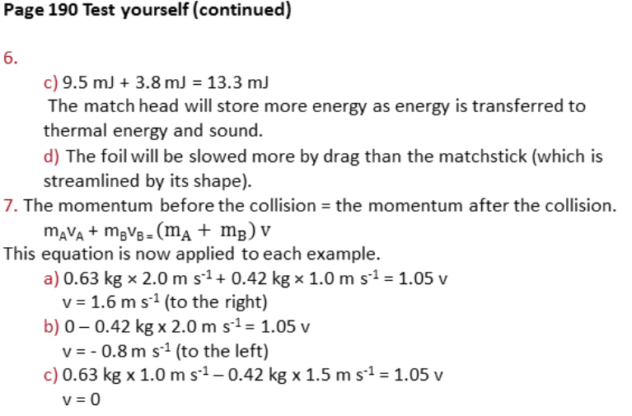
Book answers

Slide 35
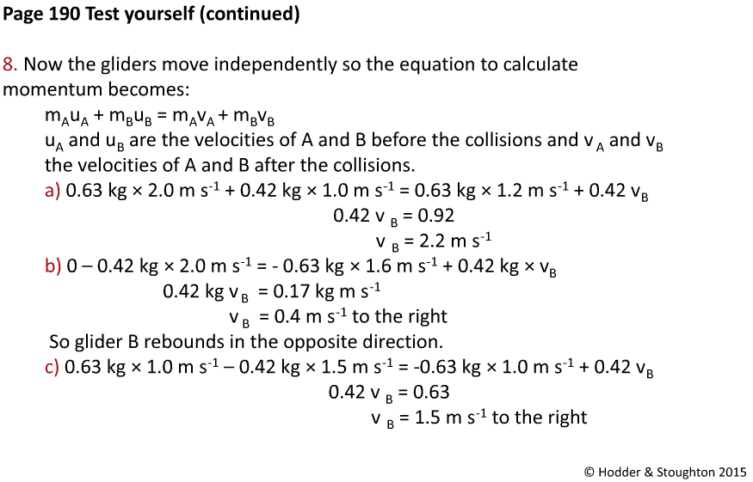
Book answers

Slide 36
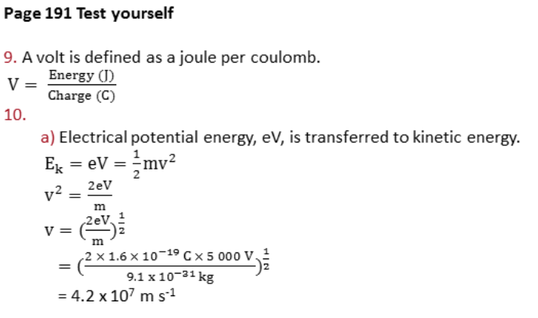
Book answers

Slide 37
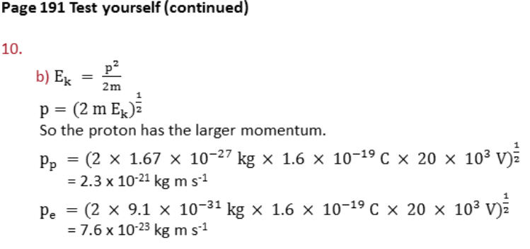
Book answers

Slide 38
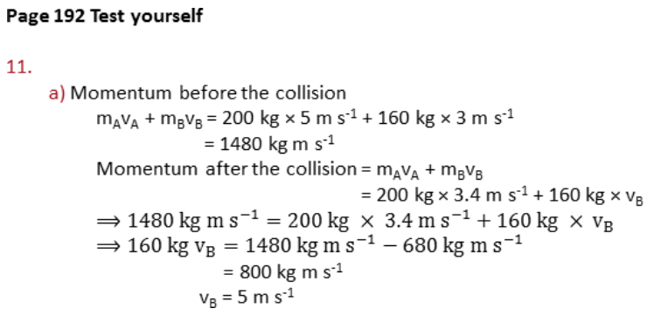
Book answers

Slide 39
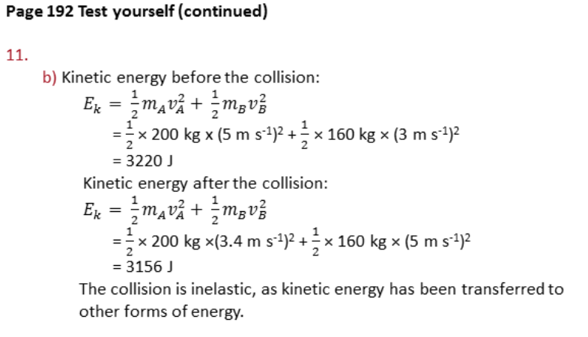
Book answers

Slide 40
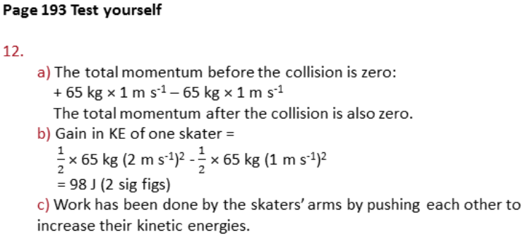
Book answers

Slide 41
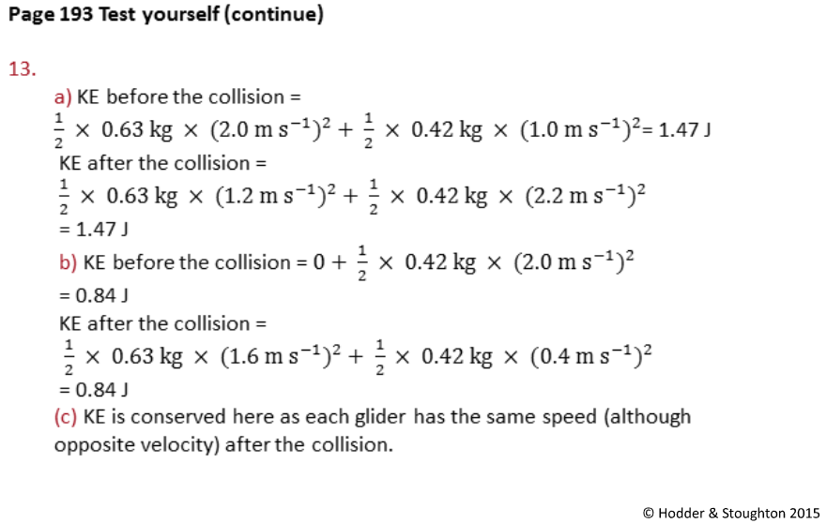
Book answers

Slide 42
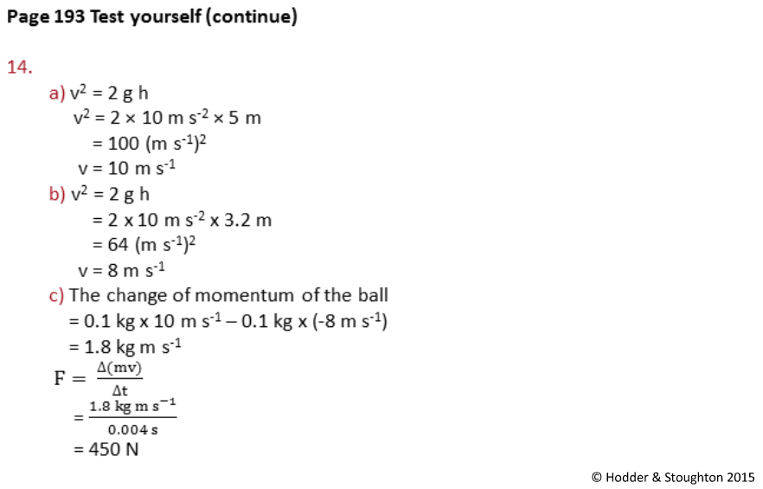
Book answers

Slide 43
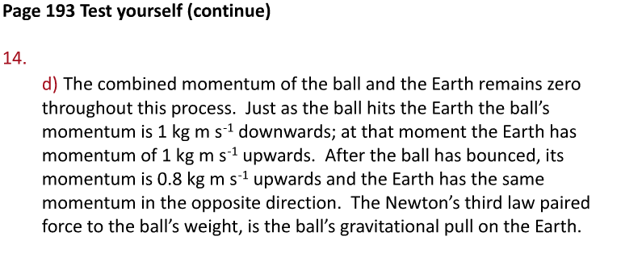
Book answers

Slide 44
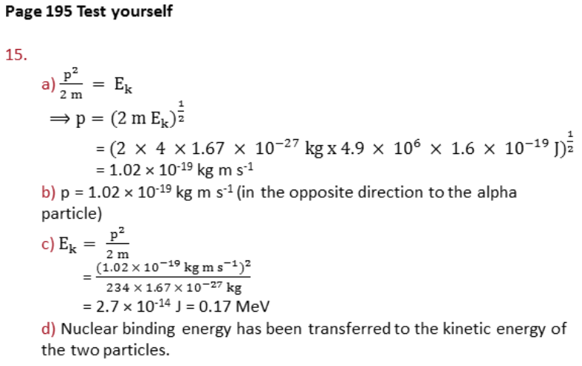
Book answers

Slide 45
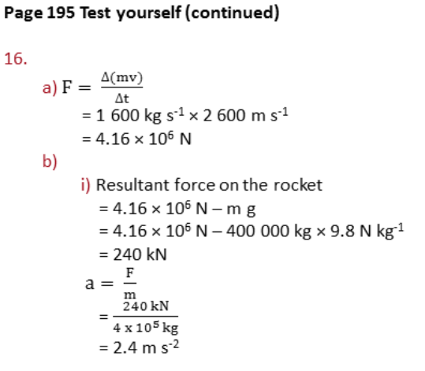
Book answers

Slide 46
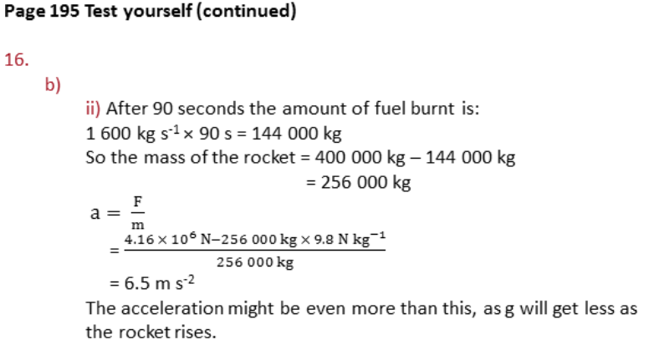
Book answers

