Slide 1
Power (P)
Power is the rate of transfer of energy.
power = energy transfer
time
P = ΔE
Δt
unit: watt (W)
power is a scalar quantity

Slide 2
Power is also the rate of doing work.
power = work done
time
P = ΔW
Δt

Slide 3
Question 1
Calculate the power of an electric motor that lifts a mass of 50 kg upwards by 3.0 m in 20 seconds.
g = 9.8 Nkg⁻¹
ΔE_{P} = m g Δh
= 50 kg x 9.8 Nkg⁻¹ x 3 m
= 1470 J
P = ΔE / Δt
= 1470 J / 20 s
power = 74 W

Slide 4
Question 2
Calculate the power of a car engine that exerts a force of 40 kN over a distance of 20 m for 10 seconds.
W = F s
= 40 kN x 20 m
= 40 000 x 20 m
= 800 000 J
P = ΔW / Δt
= 800 000 J / 10 s
power = 80 000 W

Slide 5
Complete:
Answers
energy transfer | work done | time | power
600 J | 600 J | 2 mins | 5 W
440 J | 440 J | 20 s | 22 W
28 800 J | 28 800 J | 2 hours | 4 W
2.5 mJ | 2.5 mJ | 50 μs | 50 W
600 J
5 W
440 J
20 s
28 800 J
28 800 J
2.5 mJ
50 W

Slide 6
Power and velocity
power = work done / time
but: work = force x displacement
therefore: power = force x displacement
time
but: displacement / time = velocity
therefore:
power = force x velocity
P = F v

Slide 7
Question
Calculate the power of a car that maintains a constant speed of 30 ms⁻¹ against air resistance forces of 2 kN
As the car is travelling at a constant speed the car’s engine must be exerting a force equal to the opposing air resistance forces.
P = F v
= 2 kN x 30 ms⁻¹
= 2 000 N x 30 ms⁻¹
power = 60 kW

Slide 8
Energy efficiency
Energy efficiency is a measure of how usefully energy is used by a device.
useful energy transferred by the device
efficiency =
total energy supplied to the device
As the useful energy can never be greater than the energy supplied the maximum efficiency possible is 1.0

Slide 9
Also:
useful work output
efficiency =
energy supplied
useful power output
efficiency =
power input
In all cases:
percentage efficiency = efficiency x 100

Slide 10
Complete
Answers
Input energy (J) | Useful energy (J) | Wasted energy (J) | Efficiency | Percentage efficiency
100 | 40
250 |  | 50
50 |  |  | 0.20
80 |  |  |  | 30%
 | 60 | 60
60
0.40
40%
200
0.80
80%
10
40
20%
24
56
0.30
120
0.50
50%

Slide 11
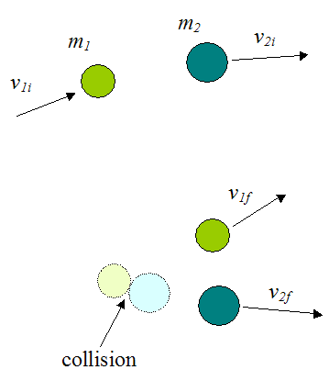
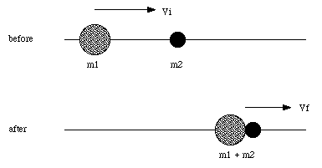
What’s the difference between these two collisions?
What is conserved, what isn’t?

Slide 12
Elastic collisions are those in which kinetic energy and momentum are conserved.
Inelastic collisions are those in which kinetic energy is not conserved by momentum is
Totally Inelastic collisions are those where colliding bodies stick together
Paritally Inelastic collisions are those where colliding bodies move apart and have less KE after collision

Slide 13
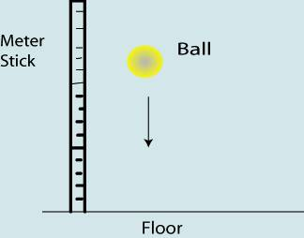
Describe three possible scenarios for this bouncing ball, stating:
how velocity changes
What is conserved
What isn’t conserved
Booster: suggest real life example of these collisions giving particular details about energy, momentum and velocity
Aspire: write a brief report of how elastic collisions demonstrated the existence of excited states in mercury atoms

