Slide 1
CW | Forces | 10/01/2017
Draw a 3 by 3 grid
Write down as many forces as you know
When I call out the definition for each one cross it off
Bingo if you get 3 up/down or across
From my learning today I will be able to:
Key: | State Newtons first two Laws of motion and equation
Boost: | Calculate the force for different example
Aspire: | Suggest how force can be measured
Objective

Slide 2
Types of force
1. Contact
Two bodies touch when their repulsive molecular forces (due to electrons) equal the force that is trying to bring them together. The thrust exerted by a rocket is a form of contact force.
2. Friction (also air resistance and drag forces)
When two bodies are in contact their attractive molecular forces (due to electrons and protons) try to prevent their common surfaces moving relative to each other.
3. Tension
The force exerted by a body when it is stretched. It is due to attractive molecular forces.
4. Compression
The force exerted by a body when it is compressed. It is due to repulsive molecular forces.
5. Fluid Upthrust
The force exerted by a fluid on a body because of the weight of the fluid that has been displaced by the body. Archimedes’ Principle states that the upthrust force is equal to the weight of fluid displaced.

Slide 3
6. Electrostatic
Attractive and repulsive forces due to bodies being charged.
7. Magnetic
Attractive and repulsive forces due to moving electric charges.
8. Electromagnetic
Attractive and repulsive forces due to bodies being charged. Contact, friction, tension, compression, fluid upthrust, electrostatic and magnetic forces are all forms of electromagnetic force.
9. Weak Nuclear
This is the force responsible for nuclear decay.
10. Electro-Weak
It is now thought that both the electromagnetic and weak nuclear forces are both forms of this FUNDAMENTAL force.
11. Strong Nuclear
This is the force responsible for holding protons and neutrons together within the nucleus. It is one of the FUNDAMENTAL forces.

Slide 4
12. Gravitational
The force exerted on a body due to its mass.
It is one of the FUNDAMENTAL forces.
The weight of a body is equal to the gravitational force acting on the body.
Near the Earth’s surface a body of mass 1kg in free fall (insignificant air resistance) accelerates downwards with an acceleration equal to g = 9.81 ms⁻²
From Newton’s 2nd law:
ΣF = m a
ΣF = 1 kg x 9.81 ms ⁻²
weight = 9.81 N
In general: weight = mg

Slide 5
Newton’s laws of motion
Newton’s laws of motion describe to a high degree of accuracy how the motion of a body depends on the resultant force acting on the body.
They define what is known as ‘classical mechanics’.
They cannot be used when dealing with:
speeds close to the speed of light
– requires relativistic mechanics.
(b) very small bodies (atoms and smaller)
– requires quantum mechanics

Slide 6
Newton’s first law of motion
A body will remain at rest or move with a constant velocity unless it is acted on by a net external resultant force.
Notes:
‘constant velocity’ means a constant speed along a straight line.
The reluctance of a body to having its velocity changed is known as its inertia.

Slide 7
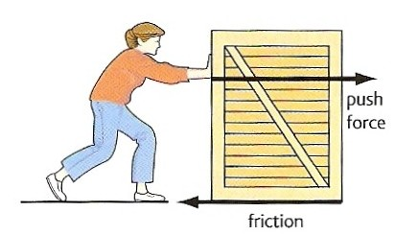
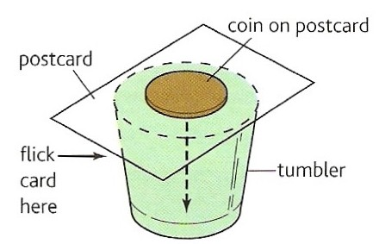
Examples of Newton’s first law of motion
Box stationary
The box will only move if the push force is greater than friction.
Box moving
If the push force equals friction there will be no net force on the box and it will move with a constant velocity.
Inertia Trick
When the card is flicked, the coin drops into the glass because the force of friction on it due to the moving card is too small to shift it sideways.

Slide 8
Newton’s second law of motion
The acceleration of a body of constant mass is related to the net external resultant force acting on the body by the equation:
resultant force = mass x acceleration
ΣF = m a

Slide 9
Question 1
Calculate the force required to cause a car of mass 1200 kg to accelerate at 6 ms ⁻².
ΣF = m a
ΣF = 1200 kg x 6 ms ⁻²
Force = 7200 N

Slide 10
Question 2
Calculate the acceleration produced by a force of 20 kN on a mass of 40 g.
ΣF = m a
20 000 N = 0.040 kg x a
a = 20 000 / 0.040
acceleration = 5.0 x 10⁵ ms ⁻²

Slide 11
Question 3
Calculate the mass of a body that accelerates from 2 ms ⁻¹ to 8 ms ⁻¹ when acted on by a force of 400N for 3 seconds.
acceleration = change in velocity / time
= (8 – 2) ms ⁻¹ / 3s
a = 2 ms ⁻²
ΣF = m a
400 N = m x 2 ms ⁻²
m = 400 / 2
mass = 200 kg

Slide 12
Answers
Complete:
Force | Mass | Acceleration
24 N | 4 kg | 6 ms ⁻²
200 N | 40 kg | 5 ms ⁻²
600 N | 30 kg | 20 ms ⁻²
2 N | 5 g | 400 ms ⁻²
5 μN | 10 mg | 50 cms ⁻²
24 N
40 kg
20
2 N
50

Slide 13
Types of force
1. Contact
Two bodies touch when their repulsive molecular forces (due to electrons) equal the force that is trying to bring them together. The thrust exerted by a rocket is a form of contact force.
2. Friction (also air resistance and drag forces)
When two bodies are in contact their attractive molecular forces (due to electrons and protons) try to prevent their common surfaces moving relative to each other.
3. Tension
The force exerted by a body when it is stretched. It is due to attractive molecular forces.
4. Compression
The force exerted by a body when it is compressed. It is due to repulsive molecular forces.
5. Fluid Upthrust
The force exerted by a fluid on a body because of the weight of the fluid that has been displaced by the body. Archimedes’ Principle states that the upthrust force is equal to the weight of fluid displaced.

Slide 14
6. Electrostatic
Attractive and repulsive forces due to bodies being charged.
7. Magnetic
Attractive and repulsive forces due to moving electric charges.
8. Electromagnetic
Attractive and repulsive forces due to bodies being charged. Contact, friction, tension, compression, fluid upthrust, electrostatic and magnetic forces are all forms of electromagnetic force.
9. Weak Nuclear
This is the force responsible for nuclear decay.
10. Electro-Weak
It is now thought that both the electromagnetic and weak nuclear forces are both forms of this FUNDAMENTAL force.
11. Strong Nuclear
This is the force responsible for holding protons and neutrons together within the nucleus. It is one of the FUNDAMENTAL forces.

Slide 15
12. Gravitational
The force exerted on a body due to its mass.
It is one of the FUNDAMENTAL forces.
The weight of a body is equal to the gravitational force acting on the body.
Near the Earth’s surface a body of mass 1kg in free fall (insignificant air resistance) accelerates downwards with an acceleration equal to g = 9.81 ms⁻²
From Newton’s 2nd law:
ΣF = m a
ΣF = 1 kg x 9.81 ms ⁻²
weight = 9.81 N
In general: weight = mg

Slide 16
Gravitational Field Strength, g
This is equal to the gravitational force acting on 1kg.
g = force / mass
= weight / mass
Near the Earth’s surface:
g = 9.81 Nkg⁻¹
Note: In most cases gravitational field strength is numerically equal to gravitational acceleration.

Slide 17
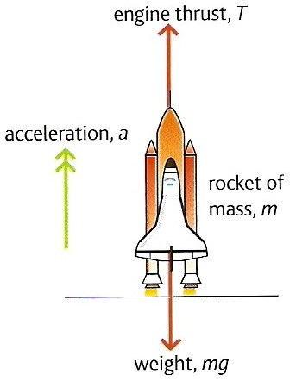
Rocket question
Calculate the engine thrust required to accelerate the space shuttle at 3.0 ms ⁻² from its launch pad.
mass of shuttle, m = 2.0 x 10 ⁶ kg
g = 9.8 ms ⁻²

Slide 18
Rocket question
ΣF = m a
where :
ΣF = (thrust – weight)
= T – mg
and so:
T – mg = ma
T = ma + mg

Slide 19
Rocket question
ma:
= 2.0 x 10⁶ kg x 3.0 ms ⁻²
= 6.0 x 10⁶ N
mg:
= 2.0 x 10⁶ kg x 9.8 ms ⁻²
= 19.6 x 10⁶ N
but: T = ma + mg
= (6.0 x 10⁶ N) + (19.6 x 10⁶ N)
Thrust = 25.6 x 10⁶ N

Slide 20
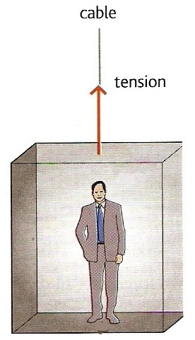
Lift question
A lift of mass 600 kg carries a passenger of mass 100 kg. Calculate the tension in the cable when the lift is:
(a) stationary
(b) accelerating upwards at 1.0 ms⁻²
(c) moving upwards but slowing down at 2.5 ms⁻²
(d) accelerating downwards at 2.0 ms⁻²
(e) moving downwards but slowing down at 3.0 ms⁻².
Take g = 9.8 ms⁻²

Slide 21
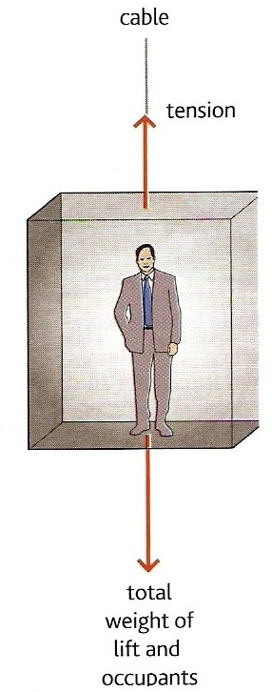
Let the cable tension = T
Mass of the lift = M
Mass of the passenger = m
(a) stationary lift
From Newton’s 1st law of motion:
A stationary lift means that resultant force acting on the lift is zero.
Hence:
Tension = Weight of lift and the passenger
T = Mg + mg
= (600kg x 9.8ms⁻²) + (100kg x 9.8ms⁻²)
= 5880 + 980
Cable tension for case (a) = 6 860 N

Slide 22
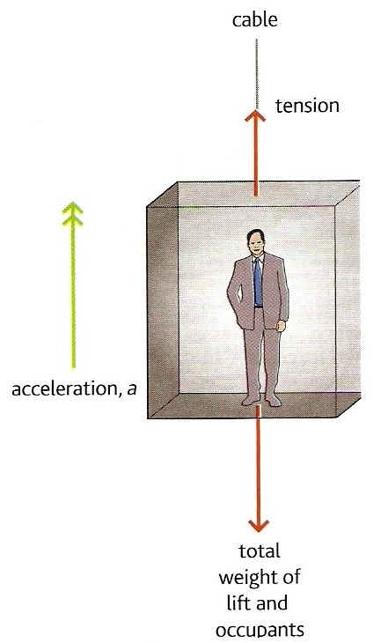
(b) accelerating upwards at 1.0 ms⁻²
Applying Newton’s 2nd law:
ƩF = (M + m) a
with
ƩF = Tension – Total weight
Therefore:
(M + m) a = T – (Mg + mg)
(600kg + 100kg) x 1.0 ms⁻²
= T – (5880N + 980N)
700 = T – 6860
T = 700 + 6860
Cable tension for case (b) = 7 560 N

Slide 23
(c) moving upwards but slowing down at 2.5 ms⁻²
Upward accelerations are positive in this question.
The acceleration, a is now
MINUS 2.5 ms⁻²
Therefore:
(M + m) a = T – (Mg + mg)
becomes:
(600kg + 100kg) x - 2.5 ms⁻²
= T – (5880N + 980N)
- 1750 = T – 6860
T = -1750 + 6860
Cable tension for case (c) = 5 110 N

Slide 24
(d) accelerating downwards
at 2.0 ms⁻²
Upward accelerations are positive in this question.
The acceleration, a is now
MINUS 2.0 ms⁻²
Therefore:
(M + m) a = T – (Mg + mg)
becomes:
(600kg + 100kg) x - 2.0 ms⁻²
= T – (5880N + 980N)
- 1400 = T – 6860
T = -1400 + 6860
Cable tension for case (d) = 5 460 N

Slide 25
(e) moving downwards but slowing down at 3.0 ms⁻²
This is an UPWARD acceleration
The acceleration, a is now
PLUS 3.0 ms⁻²
Therefore:
(M + m) a = T – (Mg + mg)
becomes:
(600kg + 100kg) x + 3.0 ms⁻²
= T – (5880N + 980N)
2100 = T – 6860
T = 2100 + 6860
Cable tension for case (e) = 8 960 N

Slide 26
State Newton’s first law of motion and give two examples of this law.
State the equation for Newton’s second law of motion.
Explain why a heavy object falls at the same rate as a heavy one

