Slide 1
CW |  | 24/05/2016
From my learning today I will be able to:
Key:
Boost:
Aspire:
Objective

Slide 2
Newton’s third law of motion
When a body exerts a force on another body then the second body exerts a force back on the first body that:
has the same magnitude
is of the same type
acts along the same straight line
acts in the opposite direction
as the force exerted by the first body.

Slide 3

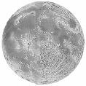
Examples of Newton’s third law of motion
1. Earth – Moon System
There are a pair of gravity forces:
A = GRAVITY pull of the EARTH to the LEFT on the MOON
B = GRAVITY pull of the MOON to the RIGHT on the EARTH
B
A
Notes:
Both forces act along the same straight line.
Force A is responsible for the Moon’s orbital motion
Force B causes the ocean tides.

Slide 4
2. Rocket in flight
There are a pair of contact (thrust) forces:
A = THRUST CONTACT push
of the ROCKET ENGINES
DOWN
on the EJECTED GASES
B = CONTACT push
of the EJECTED GASES
UP
on the ROCKET ENGINES
Note: Near the Earth there will also be a pair of gravity forces. If the rocket is accelerating upwards then the upward contact force B will be greater than the downward pull of gravity on the rocket.
A
B

Slide 5
3. Person standing on a floor
There are a pair of gravity forces:
A = GRAVITY pull of the EARTH
DOWN on the PERSON
B = GRAVITY pull of the PERSON
UP on the EARTH
And there are a pair of contact forces:
C = CONTACT push of the FLOOR
UP on the PERSON
D = CONTACT push of the PERSON
DOWN on the FLOOR
Note: Neither forces A & C nor forces D & B are Newton 3rd law force pairs as the are
NOT OF THE SAME TYPE
although all four forces will usually have the same magnitude.
A
D
C
B
EARTH

Slide 6
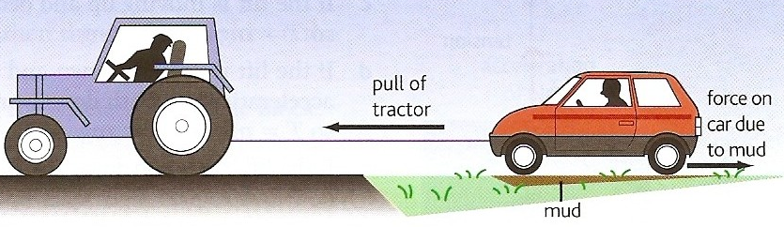
Tractor and car question
A tractor is pulling a car out of a patch of mud using a tow-rope as shown in the diagram opposite. Identify the Newton third law force pairs in this situation.
C₁
T₁ T₂
G₁
F₁ F₂
C₂
G₂
There are three pairs of GRAVITY forces between the tractor, rope, car and the Earth - for example forces G₁ & G₂.
There are two pairs of TENSION forces. The tractor exerts a TENSION force to the LEFT on the rope and the rope exerts an equal magnitude TENSION force to the RIGHT on the tractor. A similar but DIFFERENT magnitude pair exist between the rope and the car, T₁ & T₂.
There are eight pairs of CONTACT forces between the eight tyres and the ground - for example forces C₁ & C₂.
There are eight pairs of FRICTIONAL forces between the eight tyres of the tractor and car and the ground - for example forces F1 & F2.
For the tractor to succeed the tension force T₁ must be greater than the four frictional forces acting from the ground on the car’s four tyres.

Slide 7
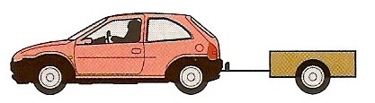
Trailer question
A car of mass 800 kg is towing a trailer of mass 200 kg. If the car is accelerating at 2 ms⁻² calculate:
(a) the tension force in the tow-bar
(b) the engine force required
Let the engine force = E
The tension force = T
Car mass = M
Trailer mass = m
Acceleration = a
The forces are as shown in the diagram.
The force acting on the trailer = T
= ma
= 200kg x 2 ms⁻²
Tension force in the tow-bar = 400 N
T
E
The resultant force acting on the car
ΣF = E – T
E – T = Ma
but: T = ma
Hence:
E – ma = Ma
E = Ma + ma
= (M + m) a
= (800kg + 200kg) x 2 ms⁻²
Engine force = 2000 N

Slide 8
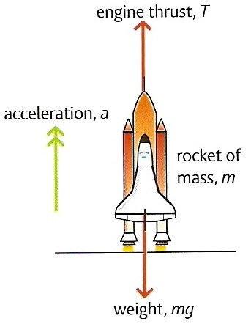
Rocket question
Calculate the engine thrust required to accelerate the space shuttle at 3.0 ms ⁻² from its launch pad.
mass of shuttle, m = 2.0 x 10 ⁶ kg
g = 9.8 ms ⁻²

Slide 9
Rocket question
ΣF = m a
where :
ΣF = (thrust – weight)
= T – mg
and so:
T – mg = ma
T = ma + mg

Slide 10
Rocket question
ma:
= 2.0 x 10⁶ kg x 3.0 ms ⁻²
= 6.0 x 10⁶ N
mg:
= 2.0 x 10⁶ kg x 9.8 ms ⁻²
= 19.6 x 10⁶ N
but: T = ma + mg
= (6.0 x 10⁶ N) + (19.6 x 10⁶ N)
Thrust = 25.6 x 10⁶ N

Slide 11
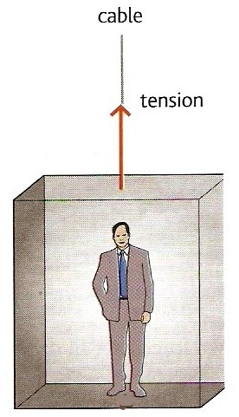
Lift question
A lift of mass 600 kg carries a passenger of mass 100 kg. Calculate the tension in the cable when the lift is:
(a) stationary
(b) accelerating upwards at 1.0 ms⁻²
(c) moving upwards but slowing down at 2.5 ms⁻²
(d) accelerating downwards at 2.0 ms⁻²
(e) moving downwards but slowing down at 3.0 ms⁻².
Take g = 9.8 ms⁻²

Slide 12
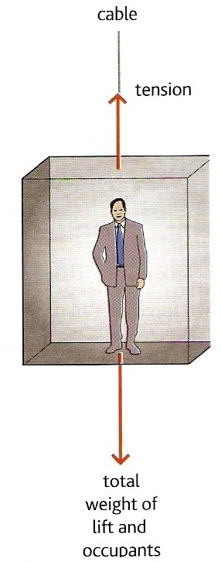
Let the cable tension = T
Mass of the lift = M
Mass of the passenger = m
(a) stationary lift
From Newton’s 1st law of motion:
A stationary lift means that resultant force acting on the lift is zero.
Hence:
Tension = Weight of lift and the passenger
T = Mg + mg
= (600kg x 9.8ms⁻²) + (100kg x 9.8ms⁻²)
= 5880 + 980
Cable tension for case (a) = 6 860 N

Slide 13
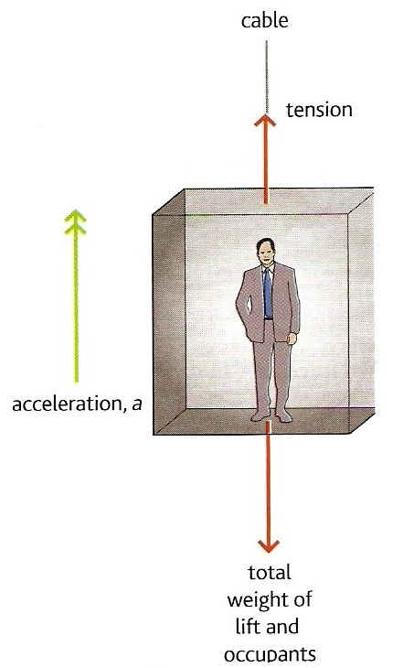
(b) accelerating upwards at 1.0 ms⁻²
Applying Newton’s 2nd law:
ƩF = (M + m) a
with
ƩF = Tension – Total weight
Therefore:
(M + m) a = T – (Mg + mg)
(600kg + 100kg) x 1.0 ms⁻²
= T – (5880N + 980N)
700 = T – 6860
T = 700 + 6860
Cable tension for case (b) = 7 560 N

Slide 14
(c) moving upwards but slowing down at 2.5 ms⁻²
Upward accelerations are positive in this question.
The acceleration, a is now
MINUS 2.5 ms⁻²
Therefore:
(M + m) a = T – (Mg + mg)
becomes:
(600kg + 100kg) x - 2.5 ms⁻²
= T – (5880N + 980N)
- 1750 = T – 6860
T = -1750 + 6860
Cable tension for case (c) = 5 110 N

Slide 15
(d) accelerating downwards
at 2.0 ms⁻²
Upward accelerations are positive in this question.
The acceleration, a is now
MINUS 2.0 ms⁻²
Therefore:
(M + m) a = T – (Mg + mg)
becomes:
(600kg + 100kg) x - 2.0 ms⁻²
= T – (5880N + 980N)
- 1400 = T – 6860
T = -1400 + 6860
Cable tension for case (d) = 5 460 N

Slide 16
(e) moving downwards but slowing down at 3.0 ms⁻²
This is an UPWARD acceleration
The acceleration, a is now
PLUS 3.0 ms⁻²
Therefore:
(M + m) a = T – (Mg + mg)
becomes:
(600kg + 100kg) x + 3.0 ms⁻²
= T – (5880N + 980N)
2100 = T – 6860
T = 2100 + 6860
Cable tension for case (e) = 8 960 N

Slide 17
State Newton’s first law of motion and give two examples of this law.
State the equation for Newton’s second law of motion.
Explain why a heavy object falls at the same rate as a heavy one

