Slide 1
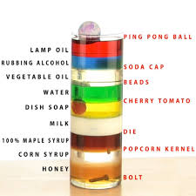
CW | Density | 31/08/2018
What’s happening here?
From my learning today I will be able to:
AO1: | Define Density and calculate it (C)
AO2: | Describe how to find density (B)
AO3: | Explain why objects are more dense than others and suggest the density of a Nucleus
Objective

Slide 2
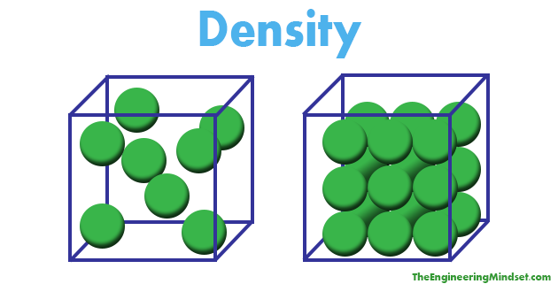

Slide 3
Density (ρ)
density = mass
volume
ρ = m / V
unit = kg m⁻³
Note: 1 g cm⁻³ is the same
as 1000 kg m⁻³

Slide 4
Question
Calculate the weight of a gold ingot of dimensions (20 x 10 x 4) cm
volume of gold = 800 cm³
= 0.0008 m³
mass = volume x density
= 0.0008 x 19 300 = 15.4 kg
weight = 15.4 x 9.81
weight of gold ingot = 152 N

Slide 5
Answers
Complete:
density | mass | volume
 | 240 g | 40 cm³
3000 kg m⁻³ | 4500 kg
0.80 g cm⁻³ |  | 80 cm³
 | 9 kg | 0.003 m³
6 g cm⁻³
1.5 m³
64 g
3 g cm⁻³

Slide 6
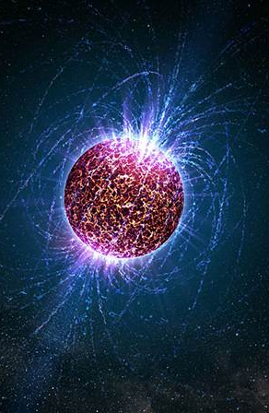
Neutron Stars
Neutron stars have a mass which is equivalent to around 1.4 times that of our sun. Yet their radius is only around 15 km.
What is the Density of a Neutron star?
Calculate the mass of a teaspoon of the neutron star?
Calculate how many people that is equivalent to?

Slide 7
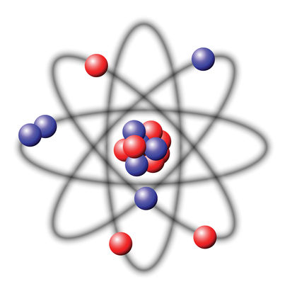
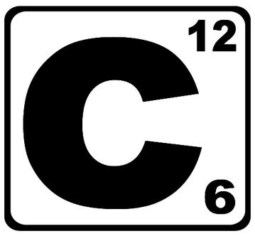
Density of the Nucleus
The radius of a carbon atom is 9x10⁻¹¹ m, while the radius of the nucleus is 33,000 times smaller.
Calculate the density of:
The Carbon atom
The Carbon Nucleus
How do these densities compare with the neutron star?
Assuming the average human has a mass of 70kg and assuming they are made of purely carbon, what volume would a human take up if all the empty space of each atom was removed?

Slide 8
Density examples
 | density / kg m⁻³ |  | density / kg m⁻³
Interstellar medium |  | iron
hydrogen |  | lead
helium |  | mercury
air |  | uranium
wood (average) |  | gold
lithium
water |  | Sun’s core
plastics |  | neutron star
aluminium |  | black hole
10⁻²⁵ to 10⁻¹⁵
7 900
0.0989
11 300
0.179
13 500
1.29
19 100
700
19 300
0.534
osmium
22 610
1000
150 000
850 to 1400
10¹⁷
2 700
> 4 x 10¹⁷

Slide 9
Page: 66: 7.2, 7.3, 7.5- 7.7, 7.9
Define what is meant by density, include the equation.
Calculate (a) the volume of copper that has a mass of 178 kg; (b) the mass of 14.4m³ of air; (c) the density of a solid of mass 2000kg and volume 3m³.
State the density of (a) a metallic solid; (b) water & (c) air
(a) Explain why a density of 1000 kgm⁻³ is the same as one of 1 g cm⁻³. (b) What is the density of water in g mm⁻³?
Explain how to measure the density of (a) a regular solid; (b) a liquid and (c) an irregular solid.

