Slide 1
Electric Circuits

Slide 2
Homework / Recap

Slide 3
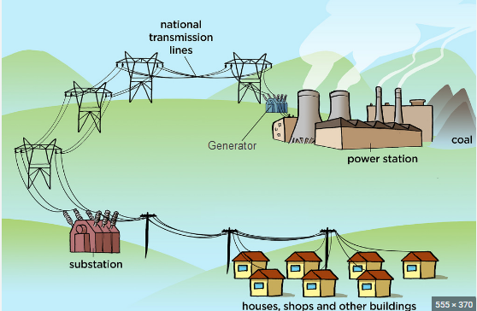
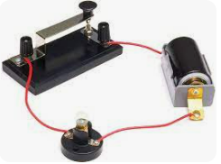
Purpose/function of circuits
Transport energy from a source energy store to do useful work

Slide 4
Objectives
Circuits
  Models
Define
  Voltage
  Potential difference
  Electromotive force
Calculate
  Voltage
  Power

Slide 5
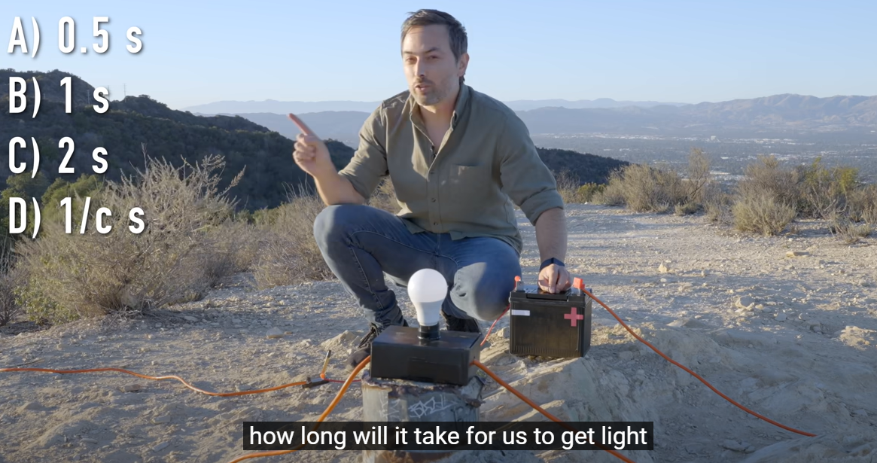
How Does Electricity Work? (Veritasium)
Use models: Particle/Electron model

Slide 6
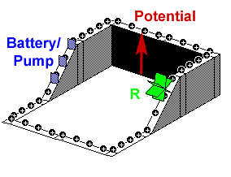
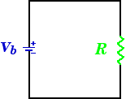
Water Pump Analogy simple

Slide 7
Voltage = Energy per Unit Charge

Slide 8
Voltage = Energy per Unit Charge
How much energy is transferred to each Coulomb of charge by a 1.5 Volt cell?
What Voltage is required to transfer 10 J of energy to each Coulomb of charge
How much current is required to transfer 18 J of energy per second to a device from 9 Volt battery

Slide 9
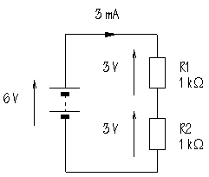
EMF / Potential difference
Electromotive Force
  Voltage across Cell
  “Push” Charge carriers
  Cells do “Work”
Potential difference
  Charge does work on component
EMFs = PDs in a series circuit

Slide 10
Resistance

Slide 11
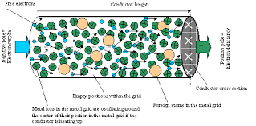
Resistance is a measure of the difficulty of making a current pass through a substance.
Resistance restricts the flow of charge so it makes the current smaller.
It is caused by the repeated collisions between the charge carriers and the positive ions of the substance.
Resistance simulation at Phet Resistance equation demo at Phet

Slide 12
Resistance indicates the potential difference needed to make 1 Amp of current flow.
resistance = p.d. across a component current through the component
R = V / I
resistance in measured in ohms (Ω)
potential difference in volts (V)
electric current in amperes (A)
Rearrange the formulas for V and I

Slide 13
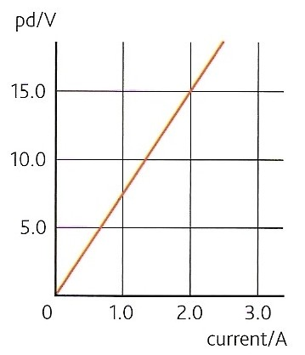
Ohm’s law
Ohm’s law states that the potential difference across an ohmic conductor is proportional to the current through it, provided the physical conditions do not change.
A graph of p.d. against current for a conductor obeying ohm’s law will be a straight line through the origin.
The gradient of such a graph is equal to the resistance of the conductor.
Physical conditions remaining constant include temperature and the dimensions of the conductor.

Slide 14
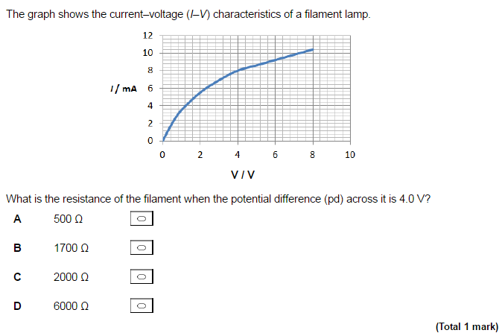

Slide 15
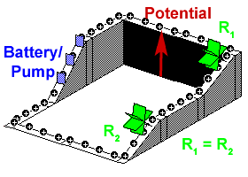
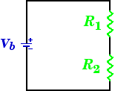
Water Pump Analogy two resistors

Slide 16
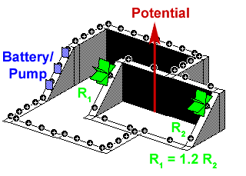
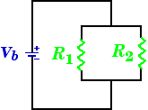
Water Pump Analogy parallel

Slide 17
Questions
1. Calculate the resistance of a device if a current of 250mA flows when a potential difference of 6V is applied
R = V / I
= 6V / 0.250A
= 24 Ω
2. Calculate the current that flows through a resistance of 4MΩ when 60V is applied across it
I = V / R
= 60 V / 4 000 000 Ω
= 0.000 015 A = 15 μA

Slide 18
Plenary
Potential Difference (p.d.)
Energy per Unit Charge
Resistance
Resistance = p.d. across a component current through the component
Ohm’s Law
p.d. across an ohmic conductor is proportional to the current through it, provided the physical conditions do not change
Resistance simulation at Phet Resistance equation demo at Phet

