Slide 1
Gravitational potential
From my learning today I will be able to:
Key: | To calculate gravitational potential
Boost: | Describe how to calculate orbital periods and radi
Aspire: | Apply this understanding to satellites

Slide 2
Gravitational potential difference (ΔV ) and Work (W)
When a mass, m is moved through a gravitational potential difference of ΔV the work done ΔW is given by:
ΔW = m x ΔV

Slide 3
Question
Calculate the minimum work required to lift an astronaut of mass 80kg from the Earth’s surface to the height of the ISS (300 km).
Earth radius, r = 6400 km
Earth mass, M = 6.0 x 10 ²⁴ kg
G = 6.672 x 10 ⁻¹¹ N m ² kg ⁻ ²

Slide 4
V = - G M / r
V at Earth surface: r = 6.4 x 10 ⁶ m
= - (6.672 x 10 ⁻¹¹) x (6.0 x 10 ²⁴ ) / 6.4 x 10 ⁶
= - 6.26 x 10 ⁷ Jkg⁻¹
V at ISS: r = 6.7 x 10 ⁶ m
= - 5.97 x 10 ⁷ Jkg⁻¹
ΔV = (6.26 – 5.97) x 10 ⁷ Jkg⁻¹ = 2.9 x 10 ⁶ Jkg⁻¹
ΔW = m x ΔV
= 80 kg x 2.9 x 10 ⁶ Jkg⁻¹
Work = 2.32 x 10 ⁸ J = 232 MJ

Slide 5
Further questions
(a) What work would be needed to remove the astronaut completely from the Earth’s gravitational field?
(b) If this work came from a conversion of initial kinetic energy (the astronaut is projected from the Earth’s surface), what would be the astronaut’s initial speed?

Slide 6
(a) ΔV = (6.26 – 0) x 10 ⁷ Jkg⁻¹ = 6.26 x 10 ⁷ Jkg⁻¹
ΔW = m x ΔV
= 80 kg x 6.26 x 10 ⁷ Jkg⁻¹
Work = 5.01 x 10 ⁹ J = 5 010 MJ
(b) ½ m v ² = ΔW = 5.01 x 10 ⁹ J
v² = (2 x 5.01 x 10 ⁹ J) / 80 kg
v² = (10.02 x 10 ⁹ J) / 80 kg
v² = 1.25 x 10 ⁸
speed, v = 1.12 x 10⁴ ms⁻¹ (11 kms⁻¹)
This is called the escape speed.

Slide 7
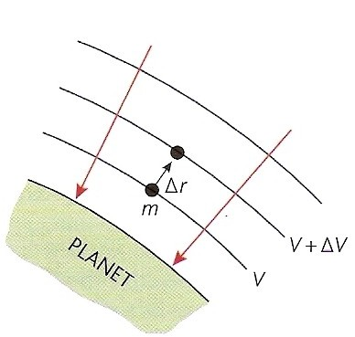
Potential gradient (ΔV / Δr)
This is the change in potential per metre at a point within a gravitational field.
potential gradient = ΔV
Δr
unit: J kg⁻¹ m⁻¹
Near the earth’s surface the potential gradient = 9.81 J kg⁻¹ m⁻¹
g = - ΔV
Δr
There is a negative sign because ΔV falls as Δr increases and it shows that g acts in the opposite direction to the potential gradient.

Slide 8
Gravitational acceleration and gravitational field strength
The definition of field strength: g = F / m
can be rearranged: F = mg
Newton’s 2nd law: ΣF = ma
If the only force acting on a mass is gravitational then:
ΣF = ma = mg and so: a = g
Therefore in a condition of free fall (only force gravity) the downward acceleration is numerically equal to the field strength.
Near the Earth’s surface:
Gravitational field strength, g = 9.81 Nkg⁻¹
Gravitational acceleration, (also called ‘g’) = 9.81 ms⁻²

Slide 9
Satellite Orbits
A satellite is a smaller mass orbiting a larger one. e.g. The Moon is a satellite of the Earth whereas the Earth is a satellite of the Sun.
In the simplest case the orbit is circular and the centripetal acceleration (v² / r ) of the satellite is numerically equal to the gravitational field strength (GM / r² ) of the larger mass at the position of the satellite.
Projectile & Satellite Orbits - NTNU

Slide 10
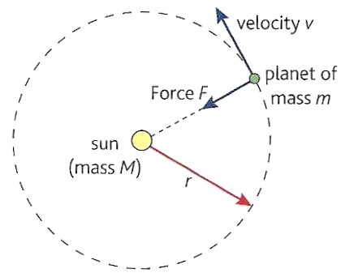
v ² = G M
r r²
rearranging gives:
v = √ (GM / r)
The orbital speed is inversely proportional to the square root of the orbital radius.
For example: Jupiter travels more slowly about the Sun than the Earth.

Slide 11
Centripetal acceleration also = r ω²
Where the angular speed ω = 2π / T
T = the period, the time for one complete orbit
Therefore centripetal acceleration = r 4π² / T²
But for an orbit: 4π² r = GM
T² r²
Hence:
T = √ (4π² r ³/GM)
The orbital period is directly proportional to the square root of the orbital radius cubed.
For example: Jupiter takes longer to orbit the Sun than the Earth.

Slide 12
Question
Calculate (a) the orbital speed and
(b) period of the International Space Station.
Earth radius, R = 6400 km
Orbital height of the ISS, H = 300 km
Earth mass, M = 6.0 x 10 ²⁴ kg
G = 6.672 x 10 ⁻¹¹ N m ² kg ⁻ ²

Slide 13
r = R + H = (6400 + 300)km = 6700 km = 6.7 x 10⁶ m
(a) Orbital speed
v = √ (GM / r)
= √ (6.672 x 10 ⁻¹¹ x 6.0 x 10 ²⁴ / 6.7 x 10⁶)
= √ (4.003 x 10 ¹⁴ / 6.7 x 10⁶)
= √ (5.975 x 10 ⁷)
orbital speed = 7.73 x 10³ ms⁻¹ = 7.73 kms⁻¹
(b) Orbital period
T = √ (4π² r ³ / GM)
= √ (4π² x (6.7 x 10⁶)³ ) / (6.672 x 10 ⁻¹¹ x 6.0 x 10 ²⁴)
= √ (1.187 x 10 ²² / 4.003 x 10 ¹⁴)
= √ (2.966 x 10 ⁷)
orbital period = 5.45 x 10³ s = 90.8 minutes = 1h 30 mins

Slide 14
Question
Calculate the orbital radius of an Earth satellite having an orbital period of 24 hours.
Earth mass, M = 6.0 x 10 ²⁴ kg; G = 6.672 x 10 ⁻¹¹ N m ² kg ⁻ ²
T = √ (4π² r ³ / GM)
rearranged becomes: r ³ = T ² GM / 4π²
r ³ = (24 x 60 x 60)² x (6.672 x 10 ⁻¹¹ x 6.0 x 10 ²⁴ ) / 4π²
r ³ = (86400)² x (4.003 x 10 ¹⁴) / 4π²
r ³ = (7.465 x 10 ⁹ ) x (4.003 x 10 ¹⁴) / 4π²
r ³ = 7.570 x 10 ²²
r = 4.23 x 10 ⁷ m = 42 300 km
This is 35 900 km above the Earth’s surface

Slide 15
Geosynchronous orbit
This is an orbit about the Earth where a satellite remains above a constant point on the Earth’s surface
Use: Satellite TV transmissions
Such an orbit will:
  HAVE A PERIOD OF 24 HOURS
  BE OF HEIGHT ABOUT 36 000 KM ABOVE THE EARTH’S SURFACE
  BE CIRCULAR
  BE EQUATORIAL (in the plane of the equator)
  BE IN THE SAME DIRECTION AS THE EARTH’S ROTATION

Slide 16
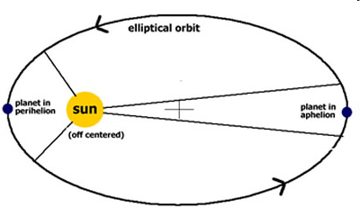
Orbits and energy
Most orbits are elliptical.
The total energy of the satellite remains constant so that at all times:
KE + PE = a constant
  at perihelion (closest approach) the KE is max and the PE min resulting in the satellite moving at its highest speed.
  at aphelion the PE is max and the KE is min - the satellite moves at its lowest speed.

