Slide 1
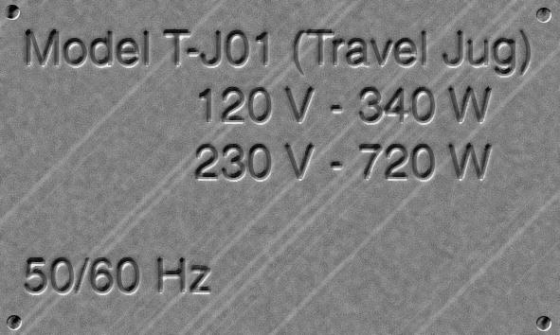
Travelling kettle
Kasim has to travel abroad as part of his work. Knowing that not all hotels provide a 'Welcome Tray' he buys a travel kettle so he can always make coffee for himself. The kettle is marked:
On the package is written: 'Takes less than 4 minutes to boil on 230 V and 7 minutes on 120 V'
1. Explain the meaning of the power rating: 720 W 2. Why would boiling some water in the kettle in New York (power supply: 120 V) take longer than in Belfast (power supply: 230 V).
3. Calculate the current through the element on each setting. 4. After his trip to New York, Kasim forgets to switch over the voltage setting to 230 V. Why might the kettle be damaged by leaving it at the 120 V setting? 5. Suggest a suitable fuse value to use in the plug to protect the kettle from overheating.

Slide 2
Answers
1. 720 J of energy is delivered per second to the kettle to heat the water and surroundings.
2. The water will take longer to heat up in New York since the energy is transferred more slowly.
3. 230 V setting you get 3.1 A; 120 V setting you get 2.8 A
4. Almost double the pd across the element will result in double the current, leading to 4 times the power and serious overheating which will damage the insulation.
5. 5 A fuse will stop too high a current flowing.

Slide 3
The power of electric lights varies widely, from a fraction of a watt for a torch bulb to several thousand watts for aircraft lights
In a darkened room, a number of different lamp bulbs, all running at 12V, can be seen to give very different brightnesses. Their power can be measured in the following way:
Use an ammeter and a voltmeter to measure the current I through the lamp and the potential difference V across the lamp. The current is the rate of flow of charge in coulomb per second. The potential difference is the energy in joule per coulomb of charge flowing. Thus the power in joule per second is the current multiplied by the potential difference -> P = I V
12 V
A
V

