Slide 1

CW | Resistance | 26/05/2016
What does this picture show?
How does it relate to electricity ?
What does each part represent?
From my learning today I will be able to:
Key: | State Ohms law and what resistance is D/C
Boost: | Describe what causes Resistance and calculate resistance C/B
Aspire: | Explain an experiment to investigate resistance B/A
Objective

Slide 2
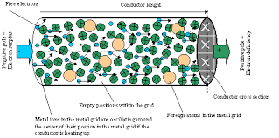
Resistance is a measure of the difficulty of making a current pass through a substance.
Resistance restricts the flow of charge so it makes the current smaller.
It is caused by the repeated collisions between the charge carriers and the positive ions of the substance.
Resistance simulation at Phet Resistance equation demo at Phet

Slide 3
Resistance indicates the potential difference needed to make 1 Amp of current flow.
resistance = p.d. across a component current through the component
R = V / I
resistance in measured in ohms (Ω)
potential difference in volts (V)
electric current in amperes (A)
Rearrange the formulas for V and I

Slide 4
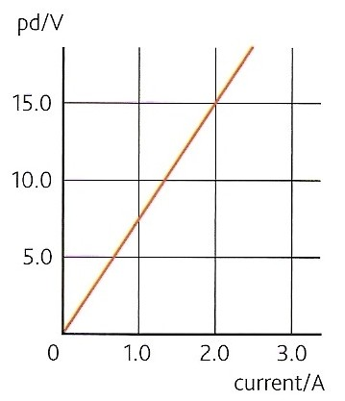
Ohm’s law
Ohm’s law states that the potential difference across an ohmic conductor is proportional to the current through it, provided the physical conditions do not change.
A graph of p.d. against current for a conductor obeying ohm’s law will be a straight line through the origin.
The gradient of such a graph is equal to the resistance of the conductor.
Physical conditions remaining constant include temperature and the dimensions of the conductor.

Slide 5
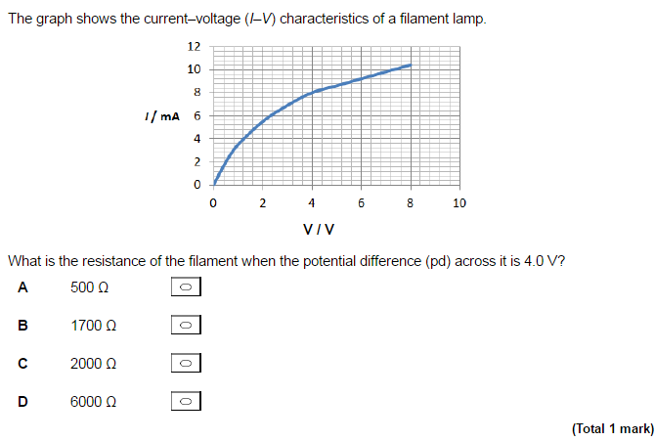

Slide 6
Questions
1. Calculate the resistance of a device if a current of 250mA flows when a potential difference of 6V is applied
R = V / I
= 6V / 0.250A
= 24 Ω
2. Calculate the current that flows through a resistance of 4MΩ when 60V is applied across it
I = V / R
= 60 V / 4 000 000 Ω
= 0.000 015 A = 15 μA

Slide 7
Answers:
Complete:
resistance | voltage | current
 | 12 V | 2 A
10 kΩ |  | 4 mA
460 Ω | 230 V
 | 6 V | 300 μA
2 GΩ |  | 4 nA
6 Ω
40 V
0.5 A
20 kΩ
8 V

Slide 8
A resistor is a component designed to have a certain fixed resistance. You are going to measure the resistance of a fixed resistor experimentally and compare your value with the nominal value.
Set up the basic circuit. Connect up the ammeter and resistor in series with variable power supply.
Connect a voltmeter in parallel with the resistor.
Switch on the circuit and adjust the power pack to control the current.
Vary the current and note the ammeter and voltmeter readings.
A
V
5. Aim to get at least 6 readings (and check readings) fairly evenly spaced between 4 V and 0 V. Do check that 0 V reading – don't just assume it must be 0 A!
6. Will it make any difference to the conduction properties of the resistor if the current is reversed? To find out disconnect the coil and reverse it in the circuit and repeat the experiment.
7. Plot your results in a graph of pd against current and find the gradient.
8. Repeat for different resistors.
Notes:
Fendt Ohm’s law simulation
Experiment 2

Slide 9



Complete the worksheet
What is resistance? Give the equation defining resistance and a sample resistance calculation.
What is Ohm’s law? How can Ohm’s law be verified graphically?
Draw a circuit diagram and explain how resistance can be measured.

Slide 10
Homework for Next lesson
Read through Page 206 and 207 make notes
Answer questions on page 207
Finish the exam questions and answer worksheet questions

Slide 11
Summary
Resistance - the voltage needed to push the electrons through it.
  high resistance if a high voltage is needed to push the charge carriers.
  low resistance if a small voltage is needed to push the charge carriers.
If a component needs 1 Volt to produce a current of 1 Amp, it is said that the resistance of that component is 1 Volt per Amp or 1 Ohm.
R = V/I

