Slide 1
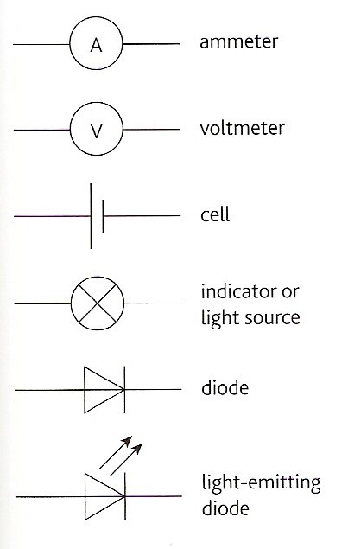
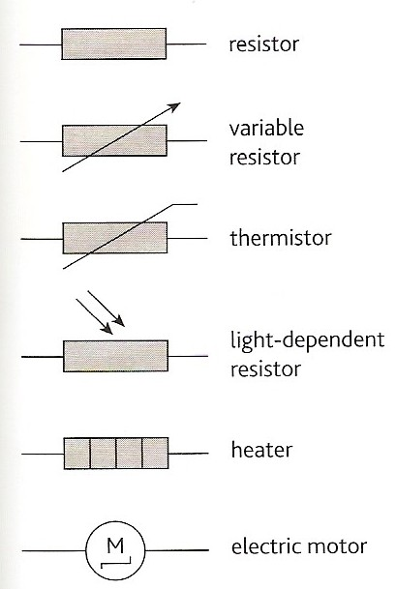
CW | Components and their Characteristics | 27/05/2016
State what each component is
Describe their use?
From my learning today I will be able to:
Key: | State characteristics for different components D/C
Boost: | Describe the shapes of each graph C/B
Aspire: | Explain the shape of graph for filament light bulb B/A
Objective

Slide 2
Component notes
Cell - a source of chemical energy
Battery - a combination of cells
Indicator - to show the state of a circuit (on or off) also used for a filament bulb but not an LED
Resistor - a component designed to have resistance
Thermistor - resistance decreases with increasing temperature
Crocodile Physics Simulations: Thermistor LDR Diode FB Diode RB

Slide 3
Light-dependent resistor (LDR) - resistance decreases with increasing illumination
Diode - allows current to flow in one direction only. The allowed, ‘forward’, direction is indicated by the arrow on the symbol
Light-emitting diode (LED) - emits light when diode conducts
Crocodile Physics Simulations: Thermistor LDR Diode FB Diode RB

Slide 4
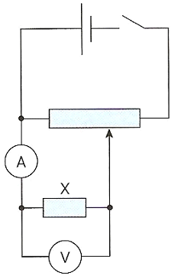
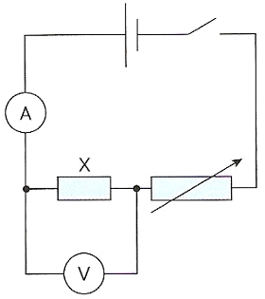
To study ohms law either of the circuits shown below can be used.
  Variable resistor control
  Potential divider control
  This is less complicated but lower range of values obtained than with potential divider control
  This is the best option but more complicated

Slide 5



Components and their Characteristics
Use the print outs to make notes on each component
How does I vary with V
Explain why this is
Illustrate the graphs
Explain what happens the resistance for each
Suggest why the filament lamp graph is the shape it is

Slide 6
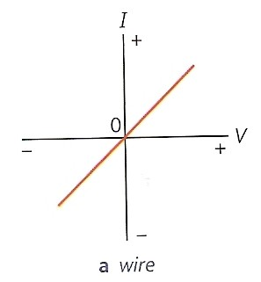
Wire (and fixed resistors)
Straight line through the origin.
Obeys Ohm’s law.
Note: With I-V graphs, a greater gradient means a lower resistance

Slide 7
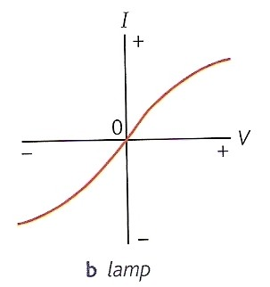
Filament Lamp
Resistance increases at higher currents (due to increasing temperature).
Does not obey Ohm’s law.

Slide 8
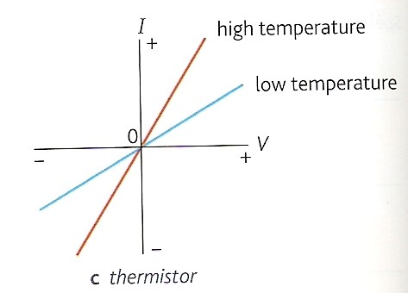
Thermistor
Resistance decreases with increasing temperature.
Obeys Ohm’s law if the temperature remains constant.

Slide 9
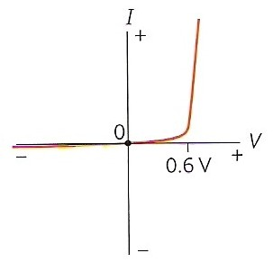
Silicon diode
Reverse direction (reverse-biased)
Very high resistance, the current is typically below 1μA
Forward direction (forward-biased)
With p.d.s below about 0.6V resistance is high. With p.d.s above 0.6V the resistance falls rapidly to a few ohms and the current increases rapidly.
Turn-on voltage
0.6V is known as the turn-on voltage. Different types of diode have different turn-on voltages, LEDs are typically about 1.5V.
Crocodile Physics Simulations: Diode FB Diode RB

Slide 10
Diode – resistor IV combinations
Sketch the IV characteristics of the diode-resistor combinations shown below.
5Ω
5Ω
I
I
combination
diode
+ 0.6
V
diode
+ 0.6
V
combination
resistor
resistor

Slide 11
Current (A)
Current (A)
Current (A)
Voltage (V)
Voltage (V)
Voltage (V)
Which is which?
Filament Lamp
Resistor / wire
Light emitting diode / LED
Light dependent resistor / LDR
Thermistor
Current (A)
high temperature
Current (A)
light
low temperature
dark
Voltage (V)
Voltage (V)

Slide 12
Resistance and temperature
1. Metallic conductors
Resistance increases relatively slowly with temperature
They are said to have a ‘positive temperature coefficient’
Positive ions within the conductor vibrate more with increasing temperature
Charge carriers (conduction electrons) cannot pass through the conductor as easily when a p.d. is applied

Slide 13
2. Semiconductors
Resistance decreases relatively quickly with temperature
Said to have a ‘negative temperature coefficient’
The number of charge carriers increase far more rapidly with temperature than the impedance caused by the more quickly vibrating positive ions
Application - the thermistor - used to sense temperature changes

Slide 14
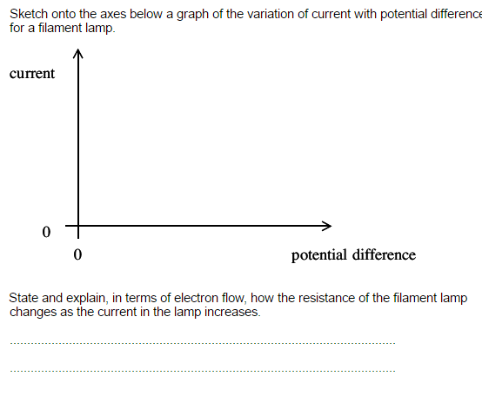

Slide 15
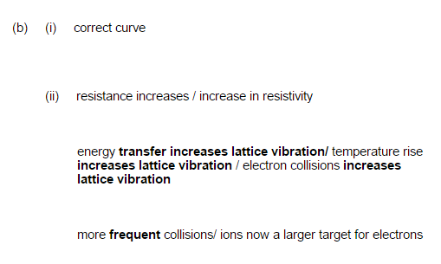

Slide 16
Complete the worksheet
Sketch and explain the shapes of the characteristic curves of (a) a metal wire; (b) a lamp; (c) a thermistor & (d) a diode
What is (a) a battery; (b) resistor; (c) thermistor; (d) LDR; (e) diode & (f) LED?
Describe and explain the resistance variation with temperature of (a) metallic conductors & (b) semiconductors
What is the purpose of a characteristic curve? Explain, with the aid of a circuit diagram, how one can be produced

Slide 17
Homework for Next lesson
Read 209 – 211 and make notes
Answer question on page 211
Complete Exam Questions from class

Slide 18
Summary
Ohmic component
  Current is proportional to potential difference
  the graph is a straight line through the origin
  resistance is constant.
Filament lamp
  resistance of its filament increases as it gets hotter.
Thermistor
  resistance decreases as it gets hotter.
LDR
  resistance decreases as it gets brighter.
A semiconductor diode
  only conducts well in the forward direction
  very little current flows in the reverse direction.

