Slide 1
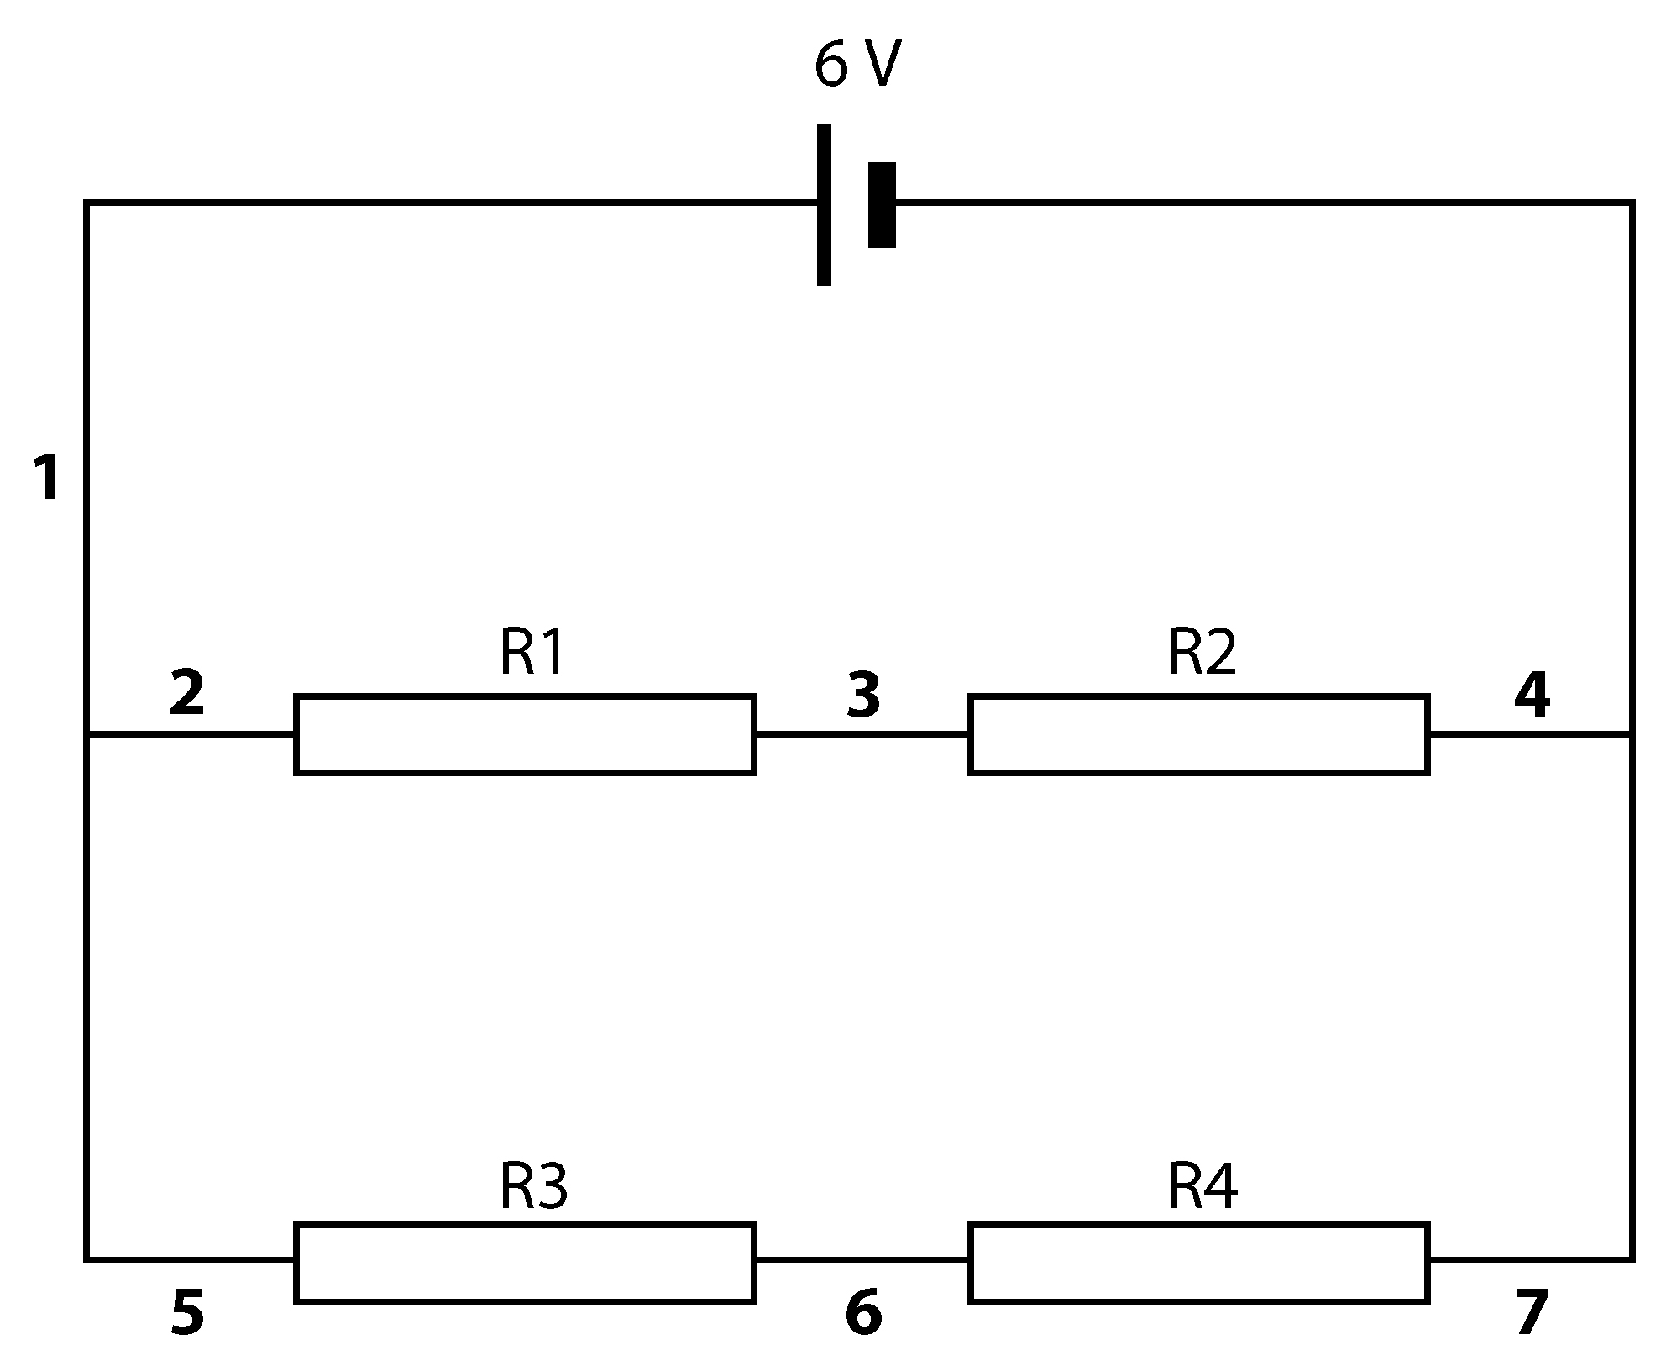
If all the resistors in the circuit are 10 Ω resistors:
a what is the potential difference between points 2 and 4?
b what is the potential difference between points 5 and 7?
c what is the potential difference between points 2 and 5?
d The current at point 1 is 0.6 A. What is the current at point 3?
e What is the current at point 6?
The resistors in the circuit have the following values: R1 = 10 Ω, R2 = 20 Ω, R3 = 15 Ω, R4 = 15 Ω
a What is the potential difference between points 2 and 4?
b What is the potential difference across R1?
c What is the potential difference across R2?
d What is the potential difference across R3?
e How does the current at point 3 compare with the current at point 6?
R1 and R2 are both 10 Ω so the total resistance in that branch is 20 Ω. R3 and R4 are both 20 Ω.
a What is the potential difference across points 2 to 4?
b What current is flowing between points 2 and 4?

