Slide 1
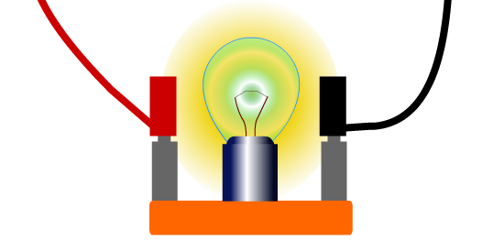
CW | More about Resistance - Heating Effects | 18/10/2016
Look at the filament lamp here, the current passing through the filament is the same as the current passing through the leads.
So why does the filament glows and heats up while the leads do not?

Slide 2
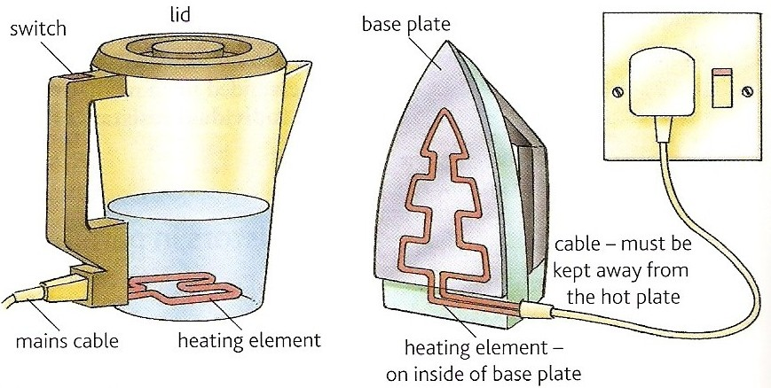
The heating effect of an electric current
In your homework you read up on the heating effects of a wire due to current. Now answer this 6 mark question to apply you knowledge:
Explain in terms of Resistance, power and current how a kettle and Iron operate.
(6 Marks)
Heating effect of resistance Phet

Slide 3
Peer assess your partners work

Slide 4
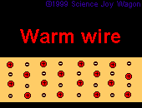
The charge carriers collide with the positive ions of the metal. The charge carriers lose their kinetic energy in the collision and gain thermal energy.
The higher the resistance of the component, the hotter and the brighter it will get.

Slide 5
Power and resistance
Revision of previous work
When a potential difference of V causes an electric current I to flow through a device the electrical energy converted to other forms in time t is given by:
E = I V t
but: power = energy / time
Therefore electrical power, P is given by:
P = I V

Slide 6
The definition of resistance: R = V / I
rearranged gives: V = I R
substituting this into P = I V gives:
P = I ² R
Also from: R = V / I
I = V / R
substituting this into P = I V gives:
P = V ² / R
Heat energy transferred by a component due to its resistance is
W = I²xRxt

Slide 7
Question 1
Calculate the power of a kettle’s heating element of resistance 18Ω when draws a current of 13A from the mains supply.
P = I ² R
= (13A)² x 18Ω
= 169 x 18
= 3042W
or = 3.04 kW

Slide 8
Question 2
Calculate the current drawn by the heating element of an electric iron of resistance 36Ω and power 1.5kW.
P = I ² R gives:
I ² = P / R
= 1500W / 36 Ω
= 41.67
= I ² !!!!
therefore I = √ ( 41.67)
= 6.45 A

Slide 9
Starting a car problem
A car engine is made to turn initially by using a starter motor connected to the 12V car battery.
If a current of 80A is drawn by the motor in order to produce an output power of at least 900W what must be the maximum resistance of the coils of the starter motor?
Comment on your answer.

Slide 10
Power supplied by the battery:
P = I V
= 80 A x 12 V
= 960 W
Therefore the maximum power allowed to be lost due to resistance
= 960 W – 900 W
= 60 W
P = I ² R gives:
R = P / I ²
= 60 W / (80 A)²
= 60 / 6400
= 0.009375 Ω
maximum resistance = 9.38 mΩ

Slide 11
Comment:
This is a very low resistance.
It is obtained by using thick copper wires for both the coils of the motor and for its connections to the battery.
‘Jump-leads’ used to start cars also have to be made of thick copper wire for the same reason.

Slide 12
The heating element inside a kettle has a resistance of 17.7Ω. The kettle works from the mains 230V.
How much energy does the kettle give off in one minute?
I = V/R = 230V/17.7Ω = 13A
W = I² x R x t = 13² x 17.7 x 60 = 179,322 Joules
about 180 kJ

Slide 13
3V
In the circuit here, calculate:
The power supplied by the battery
The power dissipated by each resistor
2Ω
4Ω
9Ω
Answer
R_{T} = 3.6 Ω
I = V/R = 3/3.6 = 0.83A
P = I²R = 0.83² x 3.6 = 2.5 Watt OR P = IV = 0.83x3 = 2.5Watt
I_{9Ω} = V/R = 3/9 = 0.33A
P_{9Ω} = I²R = 0.33² x 9 = 1 Watt
I_{2Ω} = 0.83-0.33 = 0.5A P_{2Ω} = I²R = 0.5² x 2 = 0.5 Watt
I_{4Ω} = 0.83-0.33 = 0.5A P_{4Ω} = I²R = 0.5² x 4 = 1 Watt

Slide 14
In the circuit here, there are two identical bulbs in parallel. Calculate:
The power supplied by the battery
The power dissipated by each bulb
The resistance of each bulb
The energy transferred by one bulb in 5 seconds
12V
I = 4A
Answer
P = IV = 12 x 4 = 48 Watt
I_{bulb} = 2A
P_{bulb} = IV = 2 x 12 = 24Watt
P_{bulb} = I²R
R = P_{bulb}/I² = 24/2² = 6Ω
d. W = Pt = 24 x 5 = 120 Joules

Slide 15
Summary
Connecting components in series increases the total resistance.
The total resistance of components in parallel is always less than any of individual resistances.
The resistance of a metal wire increases with temperature since the increased lattice vibrations obstruct the movement of the charge carriers and so reduce their velocity.
The higher the resistance of a component, the hotter and the brighter it will get when current passes through it.
P = I V
P = I² R
W = I²Rt

Slide 16
Quantity | Symbol | Definition | S.I. unit | Comments | Equations
potential difference | V | Is the energy transferred to the component by each unit of charge. | volt (V) | Can be referred to as voltage. | V = W / Q
 |  | When 1 Coulomb of charge (6.24x10¹⁸ electrons) transfer 1 Joule of energy, it is said that the potential difference is 1 Volt. |  | also use mV and kV | V = IR
charge | Q | Is a s a fundamental property of some types of particles (e.g. protons and electrons). | coulomb (C) |  | Q = It
current | I | Is the rate of flow of charge. | amp (A) | also use mA | I = Q/t
 |  | One Amp flows when one Coulomb of charge passes a certain point in a circuit in one second. |  |  | I = V/R I = P/V
energy | W | Is the ability to do work. | joule (J) | also use kJ, MJ | W = Pt
 |  |  |  |  | W = VQ
time | t |  | second (s)
resistance | R | The resistance of a component indicates the voltage needed to push one Amp through it. | Ohm (Ω) | also use kΩ or MΩ | R = V/I
 |  | If a component needs 1 Volt to produce a current of 1 Amp, it is said that the resistance of that component is 1 Volt per Amp or 1 Ohm. |  |  | R = V²/P R = P/I²
Power | P | The rate of energy transfer. | Watt (W) | Also use kW or MW | P = W/t
 |  |  |  |  | P = IV
 |  |  |  |  | P = I² R

Slide 17
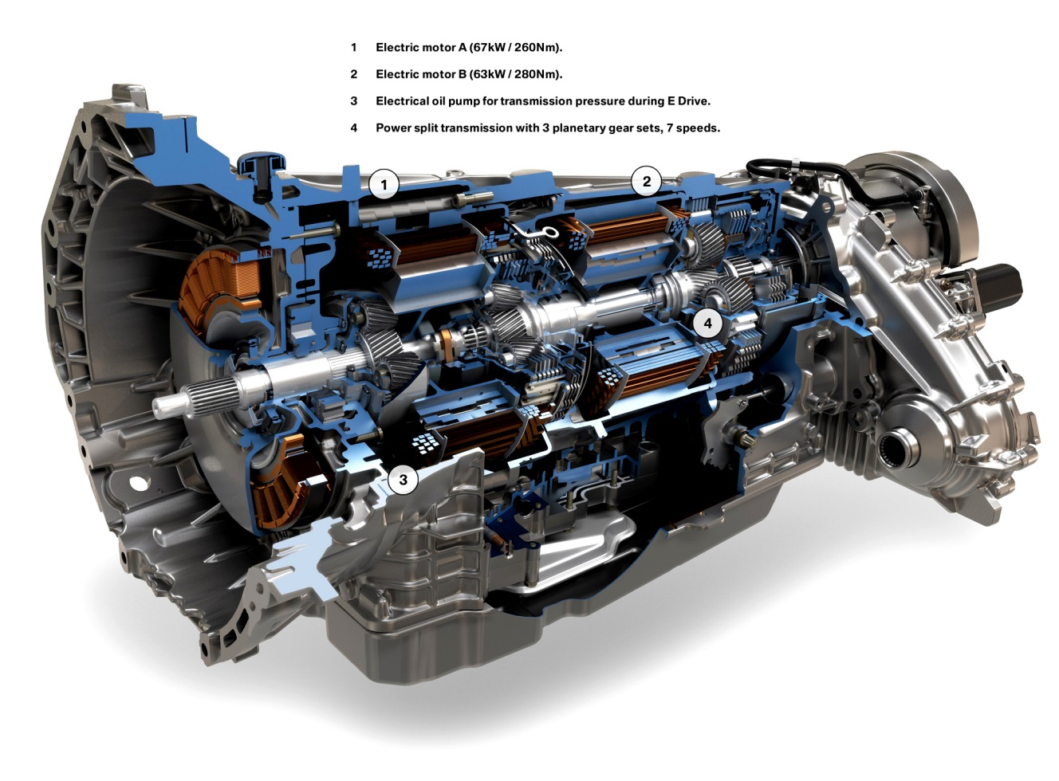
A car engine is made to turn initially by using a starter motor connected to the 12V car battery. If a current of 100A is drawn by the motor in order to produce an output power of at least 1100W what must the maximum resistance of the coils of the starter motor? Comment on your answer.

