Slide 1
CW | Emf and internal resistance | 26/05/2016
From my learning today I will be able to:
Key:
Boost:
Aspire:
Objective

Slide 2
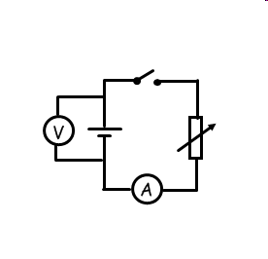
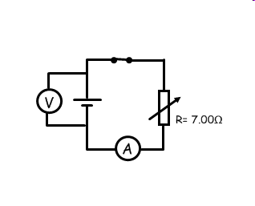

When the cell is supplying no current, voltage across the cell (terminal pd) is equal to the Emf.
I = 0.2A
I = 0.4A
I = 0 A
V = 1.4 V
V = 1.3 V
V = 1.5 V= Emf
lost volts = 1.5-1.4 = 0.1 V
lost volts = 1.5-1.3= 0.2 V
When the cell supplies current, the terminal pd (the pd available for the rest of the circuit) decreases, the larger the current you draw, the smaller the terminal pd.
Some of the Emf voltage is lost (transferred as heat energy in the cell).

Slide 3
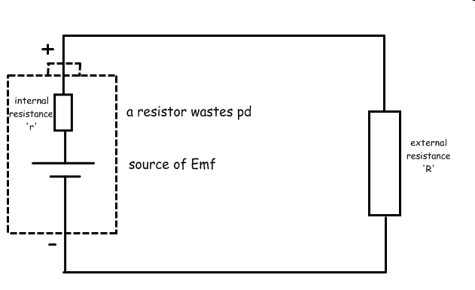

An electrical cell is made from either metal or chemicals, which themselves have some resistance. This resistance is called the internal resistance of the cell (r).
Inside the cell, energy is put into the circuit by the cell (the emf ξ) but some of this energy is taken out of the circuit by the internal resistor.
So the pd available to the rest of the circuit = Emf - lost volts

Slide 4
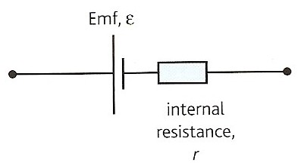
Emf, electromotive force (ε):
The electrical energy given per unit charge by the power supply.
Internal resistance (r):
The resistance of a power supply, also known as source resistance.
It is defined as the loss of potential difference per unit current in the source when current passes through the source.
ε = E
Q

Slide 5
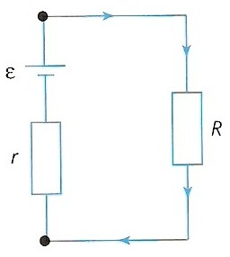
Equation of a complete circuit
The total emf in a complete circuit is equal to the total pds.
Σ (emfs) = Σ (pds)
For the case opposite:
ε = I R + I r
or
ε = I ( R + r )

Slide 6
Terminal pd (V )
The pd across the external load resistance, R is equal to the pd across the terminals of the power supply. This called the terminal pd V.
therefore,
ε = I R + I r
becomes:
ε = V + I r (as V = I R )
or
V = ε - I r

Slide 7
Lost volts (v)
I r , the lost volts, is the difference between the emf and the terminal pd
ε = V + I r
becomes: ε = V + v
that is:
emf = terminal pd + lost volts
This equation is an example of the conservation of energy.
The energy supplied (per coulomb) by the power supply equals the energy supplied to the external circuit plus the energy wasted inside the power supply.
Resistance wire simulation – has internal resistance and lost volts

Slide 8
Question 1
Calculate the internal resistance of a battery of emf 12V if its terminal pd falls to 10V when it supplies a current of 6A.
ε = I R + I r
where I R = terminal pd = 10V
so: 12 V = 10 V + (6A x r )
(6 x r ) = 2
r = 2 / 6
internal resistance = 0.333 Ω

Slide 9
Question 2
Calculate the current drawn from a battery of emf 1.5V whose terminal pd falls by 0.2V when connected to a load resistance of 8Ω.
ε = I R + I r
where I r = lost volts = 0.2V
1.5 V = (I x 8 Ω) + 0.2V
1.5 – 0.2 = (I x 8)
1.3 = (I x 8)
I = 1.3 / 8
current drawn = 0.163 A

Slide 10
Question 3
Calculate the terminal pd across a power supply of emf 2V, internal resistance 0.5Ω when it is connected to a load resistance of 4Ω.
ε = I R + I r
where I R = terminal pd
2 V = (I x 4 Ω) + (I x 0.5 Ω )
2 = (I x 4.5)
I = 2 / 4.5
= 0.444 A
The terminal pd = I R
= 0.444 x 4
terminal pd = 1.78 V

Slide 11
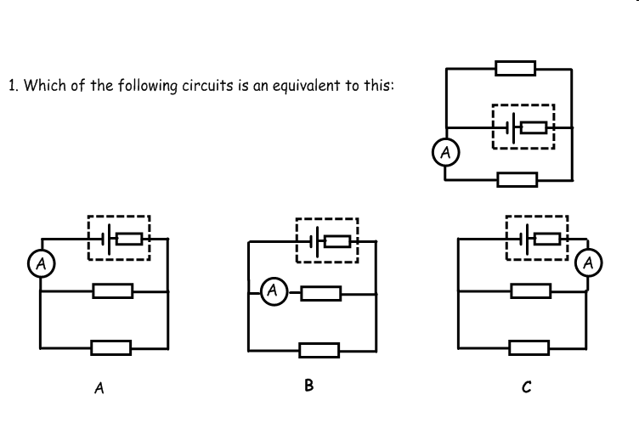

Slide 12
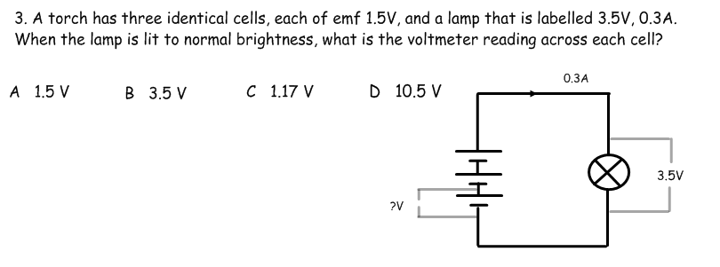
4. The resistance of the lamp in the above question is:
A 11.7 Ω B 1.05 Ω C 1.5 Ω D 1.17Ω
5. The internal resistance of the battery in the above question is:
A 1.1 Ω B 2.2 Ω C 3.3 Ω D 1.17Ω

Slide 13
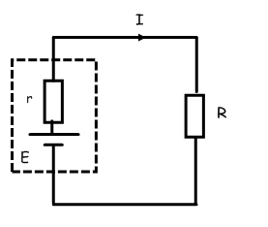
Using the symbols in the circuit here, what is the formula for the power dissipated in the external resistance?
A Iξ² B I²R C Ir D I(r+R)
ξ
What is the formula the power dissipated in the internal resistance?
A Ir² B I²r C I ξ D I(r+R)²

Slide 14
Answers:
Complete:
ε / V | I / A | R / Ω | r / Ω | terminal pd / V | lost volts / V
6 | 2 | 2
12 |  | 1 | 0.5
1.5 | 0.050 |  | 2
 | 10 |  | 1 | 220 | 10
 | 100 | 0.015 |  |  | 0.5
1
4
2
8
8
4
28
1.4
0.1
230
22
2
0.005
1.5

Slide 15
Define what is meant by (a) emf; (b) terminal pd and (c) internal resistance.
Explain the meaning of the terms in the equation, ε = I R + I r . Explain how this equation illustrates the conservation of energy in a complete circuit.
Explain why it is important that a 12V car battery should have a very low internal resistance in order to deliver a current of about 100A to a car’s starter motor.
Calculate the internal resistance of a battery of emf 6V if its terminal pd falls to 5V when it supplies a current of 3A.
Describe an experiment to measure the internal resistance of a cell. Include a circuit diagram and explain how the value of r is found from a graph.

