Slide 1
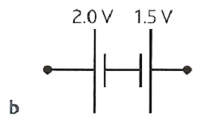
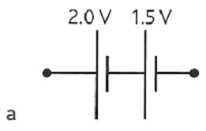
CW |  | 19/10/2016
Whats the total EMF?
Why?
Objective

Slide 2
Single cell circuit rules
1. Current drawn from the cell:
= cell emf total circuit resistance
2. PD across resistors in SERIES with the cell:
= cell current x resistance of each resistor
3. Current through parallel resistors:
= pd across the parallel resistors resistance of each resistor

Slide 3
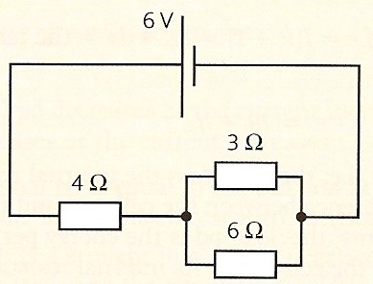
Single cell question
Calculate the potential difference across and the current through the 6 ohm resistor in the circuit below.
Total resistance of the circuit
= 8 Ω in series with 12 Ω in parallel with 6 Ω
= 8 + 5.333
= 13.333 Ω
Total current drawn from the battery
= V / R_{T}
= 9V / 13.333 Ω
= 0.675 A
pd across 8 Ω resistor = V₈ = I R₈
= 0.675 A x 8 Ω
= 5.40 V
therefore pd across 6 Ω (and 12 Ω) resistor, V₆
= 9 – 5.4
pd across 6 Ω resistor = 3.6 V
Current through 6 Ω resistor = I₆ = V₆ / R₆
= 3.6 V / 6 Ω
current through 6 Ω resistor = 0.600 A
9 V
12 Ω
8 Ω

Slide 4
Cells in series
TOTAL EMF
Case ‘a’ - Cells connected in the same direction
Add emfs together
In case ‘a’ total emf = 3.5V
Case ‘b’ - Cells connected in different directions
Total emf equals sum of emfs in one direction minus the sum of the emfs in the other direction
In case ‘b’ total emf = 0.5V in the direction of the 2V cell
TOTAL INTERNAL RESISTANCE
In both cases this equals the sum of the internal resistances
Phet DC Circuit Construction Simulation

Slide 5
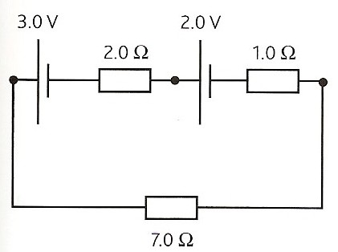
Question on cells in series
In the circuit shown below calculate the current flowing and the pd across the 8 ohm resistor
Both cells are connected in the same direction.
Therefore total emf = 1.5 + 6.0
= 7.5V
All three resistors are in series.
Therefore total resistance
= 4.0 + 3.0 + 8.0
= 15 Ω
Current = I = ε_{T} / R_{T}
= 7.5 / 15
current = 0.5 A
PD across the 8 ohm resistor
= V₈ = I x R₈
= 0.5 x 8
pd = 4 V
1.5 V
6.0 V
4.0 Ω
3.0 Ω
8.0 Ω

Slide 6
Calculate the current in the circuit.
Note the cells polarity
emf =3V, r = 1Ω
2Ω
10Ω
emf =5V, r = 1Ω
emf =2V, r = 1Ω
The total emf is 3+5-2 = 6V
The total resistance = 1 + 2 + 1 + 1 + 10 = 15Ω
Current = V /R = 6V/15Ω = 0.4 Amp

Slide 7
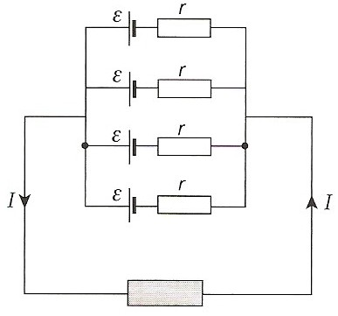
Identical cells in parallel
For N identical cells each of emf ε and internal resistance , r
The current through the whole circuit is I
Total emf = ε
Total internal resistance = r / N
The lost volts = I r / N and so cells placed in parallel can deliver more current for the same lost volts due to the reduction in internal resistance.

Slide 8
1.5V
r = 1Ω
a
b
I = .8A
There are 4 cells in parallel, each one has an emf of 1.5V and an internal resistance of 1Ω. Find the equivalent pd across all the cells.
The pd across all the cells (between points a and b) = ξ - Ir/n
1.5 – (0.8x1/4) = 1.3V

Slide 9
Car battery question
A car battery is made up of six groups of cells all connected the same way in series.
Each group of cells consist of four identical cells connected in parallel.
If each of the 24 cells making up the battery have an emf of 2V and internal resistance 0.01Ω calculate the total emf and internal resistance of the battery.
Each cell group consists of 4 cells in parallel.
Therefore emf of each group = 2V
Internal resistance of each group
= 0.01Ω / 4 = 0.0025Ω
There are 6 of these cell groups in series. Therefore total emf of the battery
= 6 x 2V
total emf = 12V
Internal resistance of the battery
= 6 x 0.0025Ω
total internal resistance = 0.015 Ω

Slide 10
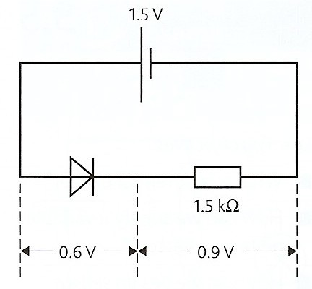
Diodes in circuits
In most electrical circuits a silicon diode can be assumed to have the following simplified behaviour:
Applied pd > 0.6V in the forward direction
diode resistance = 0
diode pd = 0.6V
Applied pd < 0.6V or in the reverse direction
diode resistance = infinite
diode pd = emf of power supply

Slide 11
Diode question
Calculate the current through the 5.0 kΩ resistor in the circuit below.
Applied pd across the diode is greater than 0.6V in the forward direction and so the diode resistance = 0 Ω
and diode pd, V_{D} = 0.6V
therefore the pd across the resistor, V_{R} = 2.0 – 0.6
= 1.4 V
current = I = V_{R} / R
= 1.4 / 5000
= 0.000 28 A
current = 0.28 mA
2.0 V
5.0 kΩ
V_{D}
V_{R}

Slide 12
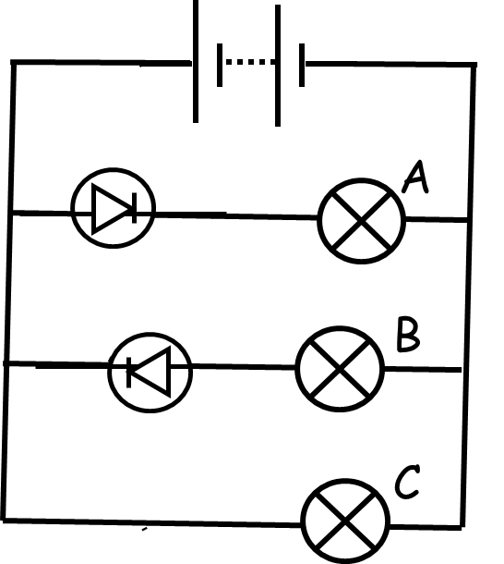
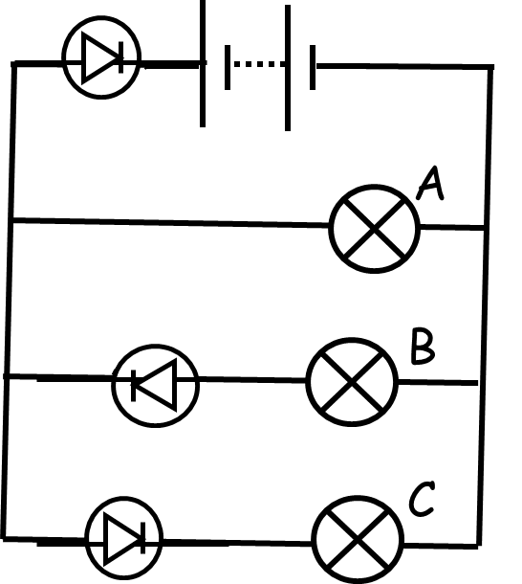
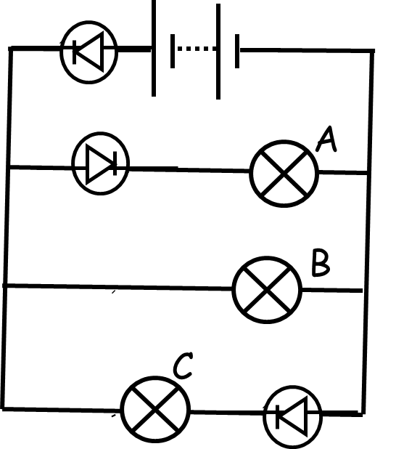
Which bulb will light up?
1.
2.
3.
4.
5.
6.

Slide 13
1.5 V
A diode has a pd of 0.6 V whenever a current passes through it regardless of the value of the current.
Calculate the current in this circuit.
10Ω
0.6 V
0.9 V
We can calculate the current in the circuit I = 0.9V/10 Ω = 0.09A

Slide 14
State the rules for dealing with circuits containing a single cell.
State the rules for combining cells (a) in series and (b) identical cells in parallel.
Explain how solar cells, each of emf 0.45V and internal resistance 20Ω, could be combined to make a battery of emf 18V and internal resistance 40 Ω
Describe the simplified way in which a silicon diode behaves in a circuit.
Copy a modified version of figure 4 on page 224 In your version the cell should have emf 3V and the resistor have a value of 800Ω. Calculate in this case the pd across the resistor and the current through the diode.

