Slide 1
CW | The potential divider | 01/11/2016
From my learning today I will be able to:
Key: | Describe what a Potential divider is
Boost: | Calculate voltages
Aspire: | Apply understanding to explain applications
Objective

Slide 2
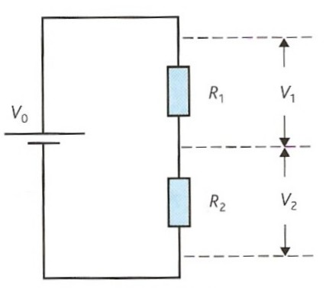
A potential divider consists of two or more resistors connected in series across a source of fixed potential difference
It is used in many circuits to control the level of an output.
For example:
  volume control
  automatic light control
Fendt – potential divider

Slide 3
Potential divider theory
In the circuit opposite the current, I flowing in this circuit = V_{o} / (R₁ + R₂ )
But the pd across, V₁ = I R₁
and so; V₁ = V_{o} R₁ / (R₁ + R₂ )
Likewise, V₂ = I R₂
and so; V₂ = V_{o} R₂ / (R₁ + R₂ )
Dividing the two equations yields:
V₁ / V₂ = R₁ / R₂
The potential differences are in the same ratio as the resistances.
Fendt – potential divider

Slide 4
Potential divider question
Calculate the pd across R₂ in the circuit opposite if the fixed supply pd, V_{o} is 6V and R₁ = 4kΩ and R₂ = 8kΩ
The pd across, V₂
= V_{o} R₂ / (R₁ + R₂ )
= 6V x 8kΩ / (4kΩ + 8kΩ)
= 6 x 8 / 12
pd = 4 V

Slide 5
You are given a battery with an emf of 21 V, and a selection of resistors: 100Ω, 200Ω, 300Ω, 400Ω, 500Ω, 600Ω, 700Ω, 800 Ω, 900Ω and 1 kΩ.
Draw a potential divider circuit that will give you an output voltage of 3V. Label the voltage and resistor values on your diagram.
R1 = 600 Ω
V1 = 18V
Input voltage V_{in} = 21 V
R2 = 100 Ω
V_{out} = 3V

Slide 6
You are given a battery with an emf of 10 V, and a selection of resistors: 100Ω, 200Ω, 300Ω, 400Ω, 500Ω, 600Ω, 700Ω, 800 Ω, 900Ω and 1 kΩ.
Draw a potential divider circuit that will give you an output voltage of 2V. Label the voltage and resistor values on your diagram.
R1 = 800 Ω
V1 = 8V
Input voltage V_{in} = 10 V
R2 = 200 Ω
V_{out} = 2V

Slide 7
You are given a battery with an emf of 15 V, and a selection of resistors: 100Ω, 200Ω, 300Ω, 400Ω, 500Ω, 600Ω, 700Ω, 800 Ω, 900Ω and 1 kΩ.
Draw a potential divider circuit that will give you an output voltage of 1.5V. Label the voltage and resistor values on your diagram.
R1 = 900 Ω
V1 = 13.5V
Input voltage V_{in} = 15 V
R2 = 100 Ω
V_{out} = 1.5V

Slide 8
You are given a battery with an emf of 400 V, and a selection of resistors: 100Ω, 200Ω, 300Ω, 400Ω, 500Ω, 600Ω, 700Ω, 800 Ω, 900Ω and 1 kΩ.
Draw a potential divider circuit that will give you an output voltage of 25V. Label the voltage and resistor values on your diagram.
R1’ = 800 Ω
V1 = 375V
Input voltage V_{in} = 400 V
R1 = 700 Ω
R2 = 100 Ω
V_{out} = 25V

Slide 9
A series circuit is connected as shown in the diagram
1. What is the potential difference between A and B?
2. An additional resistor of 100 W is connected between the 50 W resistor and the cells. What is the potential difference between A and B now?
3. The additional 100 W resistor is now connected in parallel with the first 100 W resistor. What is the potential difference between A and B now?
4. A potential divider is made from a 4 kW and a 6 kW resistor connected in series with a 20 V supply. Draw a diagram of the arrangement. What four values of potential difference can be tapped off?
5. A student puts a 12 Ω variable resistor in series with a 6 V battery, expecting to get a variable potential difference.
The voltmeter is a high resistance digital multimeter. Explain why the circuit won't work. Draw a circuit which would work.

Slide 10
Answers
1. 100 W / (50 W + 100 W) x 6 V = 4 V
2. 100 W / (50 W + 100 W + 100 W) x 6 V = 2.4 V
3. Resistance of parallel combination = 50 W. So the 6 V supply potential difference splits equally between the two 50 W and pd across AB is 3 V.
4. Resistance of whole potential divider is 10 kW
5. The resistance has been connected as a variable resistor. The multimeter has an extremely high resistance so that wherever one moves the sliding contact the pd is set up across the voltmeter which always reads 6 V! The redrawn diagram should show the ends of the resistance connected across the battery

Slide 11
Answers:
Complete:
V₀ / V | R₁ / Ω | R₂ / Ω | V₁ / V | V₂ / V
12 | 5000 | 5000
12 | 9000 | 1000
 | 1000 |  | 1.2 | 10.8
230 |  | 500 |  | 46
9 | 400 |  |  | 6
6
6
10.8
1.2
12
9000
2000
184
800
3

Slide 12
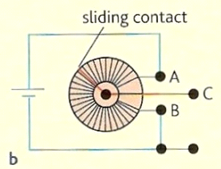
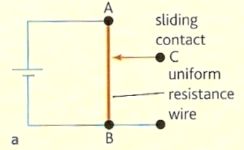
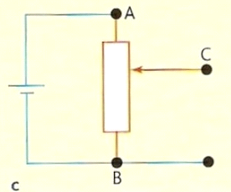
Supplying a variable pd
In practice many potential dividers consist of a single resistor (e.g. a length of resistance wire) split into two parts by a sliding contact as shown in diagram ‘a’ opposite.
In order to save space this wire is usually made into a coil as shown in diagram ‘b’.
Diagram ‘c’ shows the circuit symbol of a potential divider.
Fendt – potential divider

Slide 13
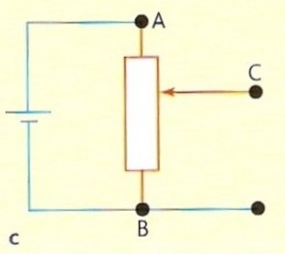
Output variation of pd
The output pd is obtained from connections C and B.
This output is:
- maximum when the slider is next to position A
- minimum (usually zero) when the slider is next to position B

Slide 14
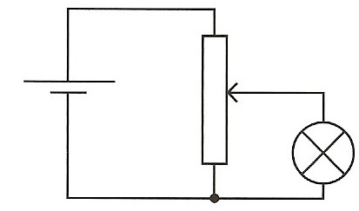
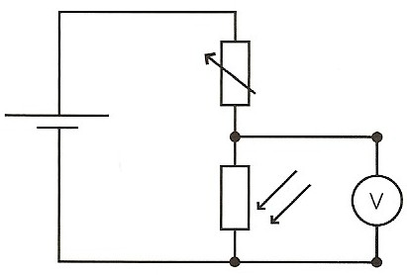
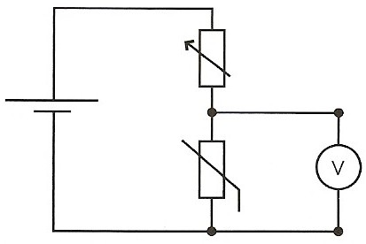
Use the handouts to explain how different components can be used to make a sensor circuit
Describe how each component operates, and explain how the circuits work to sense changes in the environment
Explain the application of each component and how they operate to be used in these scenarios
Create a circuit for a robot which replicates the human senses – Suggest Currents and voltages

Slide 15
Controlling bulb brightness
As the slider of the potential divider is moved upwards the pd across the bulb increases from zero to the maximum supplied by the cell.
This allows the brightness of the bulb to be continuously variable from completely off to maximum brightness.
This method of control is better than using a variable resistor in series with the bulb. In this case the bulb may still be glowing even at the maximum resistance setting.
The volume level of a loudspeaker can be controlled in a similar way.

Slide 16
Temperature sensor
At a constant temperature the source pd is split between the variable resistor and the thermistor.
The output of the circuit is the pd across the thermistor.
This pd is measured by the voltmeter and could be used to control a heater.
If the temperature falls, the resistance of the thermistor increases.
This causes the output pd to increase bringing on the heater.
The setting of the variable resistor will determine how quickly the output pd increases as the temperature falls.

Slide 17
Light sensor
At a constant level of illumination the source pd is split between the variable resistor and the LDR.
The output of the circuit is the pd across the LDR.
This pd is measured by the voltmeter and could be used to control a lamp.
If the light level falls, the resistance of the LDR increases.
This causes the output pd to increase bringing on the lamp.
The setting of the variable resistor will determine how quickly the output pd increases as the light level falls.

Slide 18
Summary
In potential divider, the pd across each resistor as a proportion of the source pd is the same as the resistance of the resistance of the resistor in proportion to the total resistance.
The potential divider can be used :
  to supply a pd with is fixed at any value between zero and the source pd
  to supply a variable pd. This is called a potentiometer
  to supply a pd that varies with a physical condition such as temperature of light intensity.

Slide 19
Explain the operation of a potential divider.
Explain how a potential divider can be used to control the brightness of a lamp of the volume level of an amplifier.
Draw circuit diagrams and explain how a potential divider is used in (a) a temperature sensor and (b) a light sensor.

