Slide 1

Lesson 12 Circuit rules
What are the rules for series and parallel circuits?
What are the principles behind these rules?
How do we use the rules in circuits?

Slide 2
Circuit rules
Kirchhoff’s first law
This states that the total current flowing into a point is equal to the current flowing out of that point. In other words, the charge does not leak out or accumulate at that point. Charge that flows away must be replaced. Conservation of charge principle.
1.50A
2A
3A
0.50A
1.25A
1A
0.75A

Slide 3
Circuit rules
Kirchhoff’s second law
This states that around any closed loop in a circuit, the sum of the potential differences (voltages) across all components is zero. Any charge that starts and ends up at the same point must have gained as much energy as it lost. Conservation of energy principle.
the electrons gain 12V at the battery
the electrons lose 9V at this resistor
the electrons lose 3V at this bulb

Slide 4
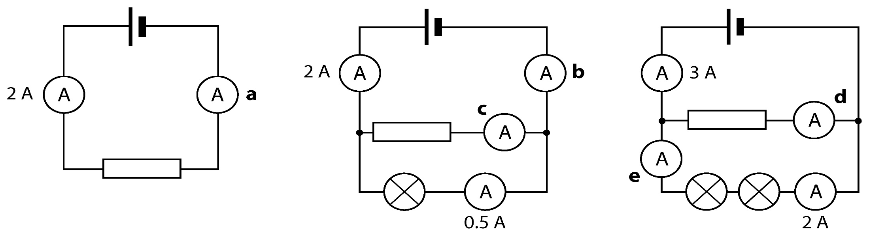
Write down the readings you would expect on the ammeters in the circuits below.

Slide 5
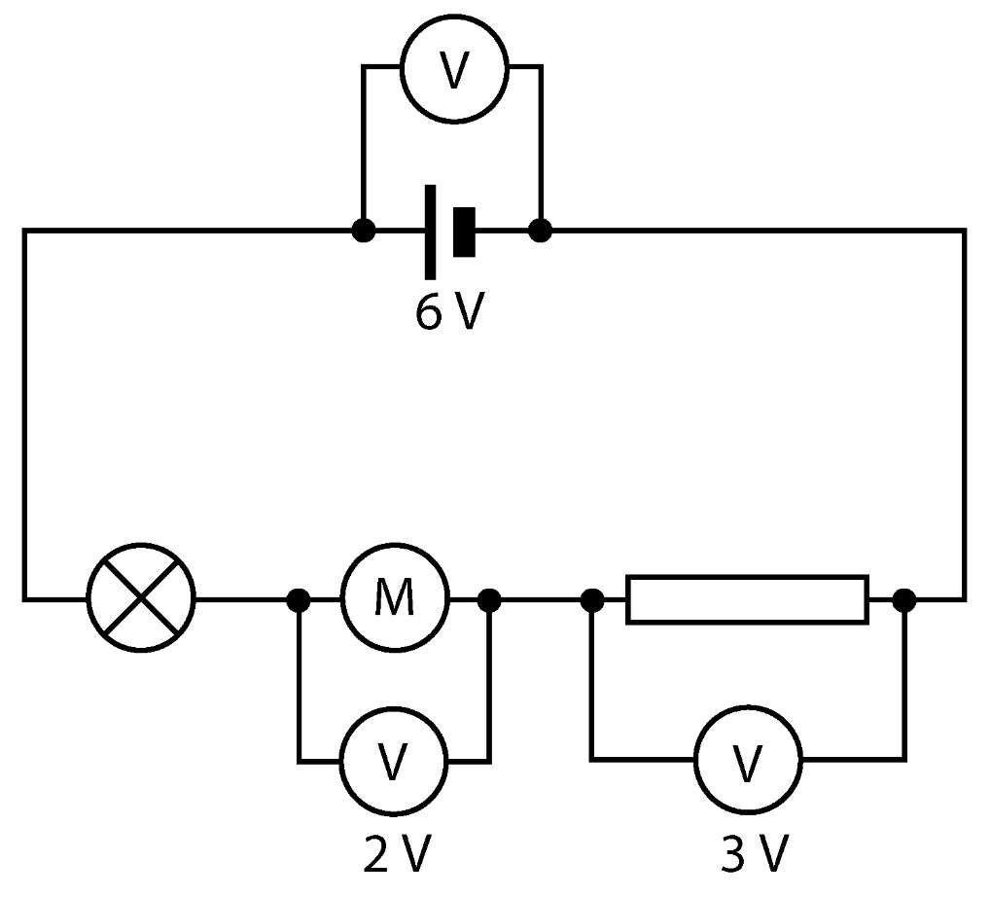
a Draw a circle around the voltmeter that is measuring the emf of the cell.
b Is the motor or the resistor transferring the most energy?
c What is the potential difference across the lamp?

Slide 6
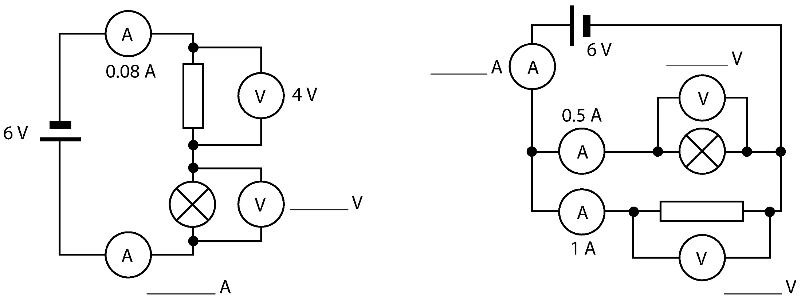
Write the missing potential differences and currents on these circuit diagrams.

Slide 7
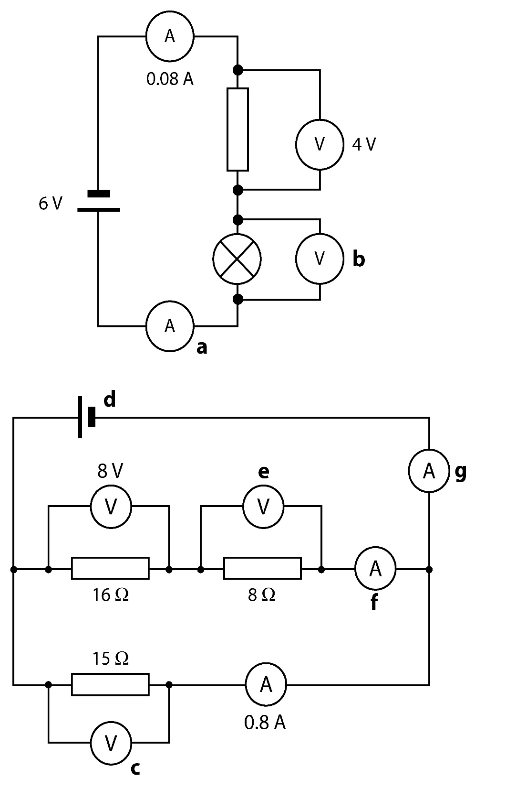
  Write the missing potential differences and currents on these circuit diagrams. Show your working for any calculations. (Hint: work out your answers in the order of the letters.)

Slide 8
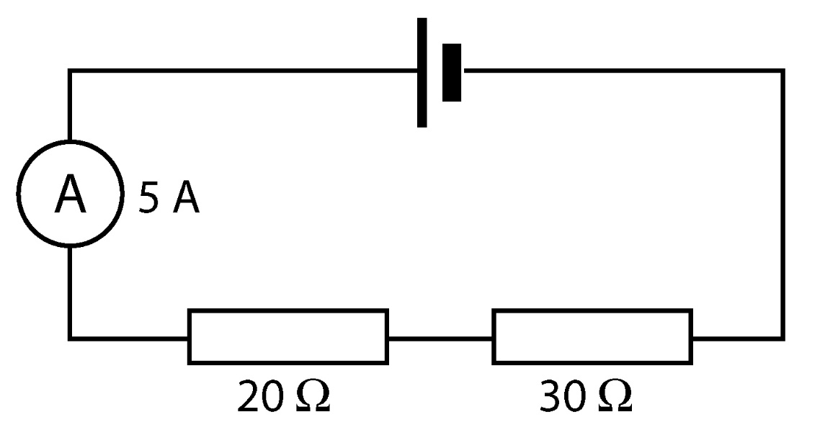
Calculate the potential difference supplied by the cell in this circuit.

Slide 9
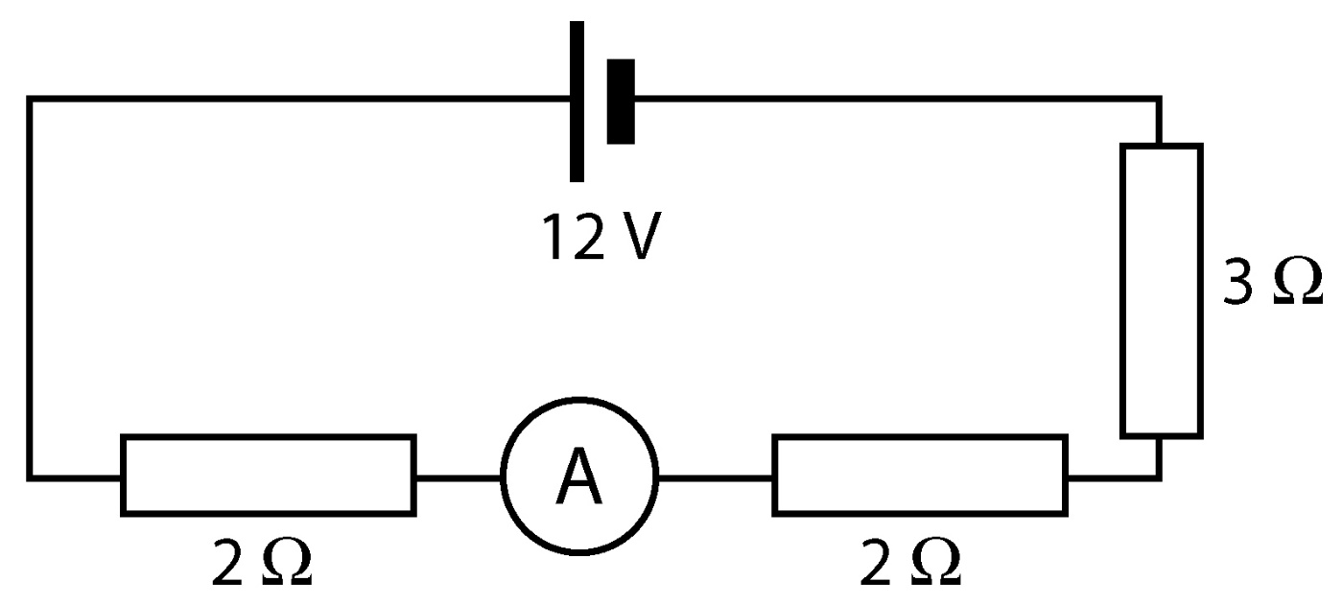
Calculate the current in this circuit.

Slide 10
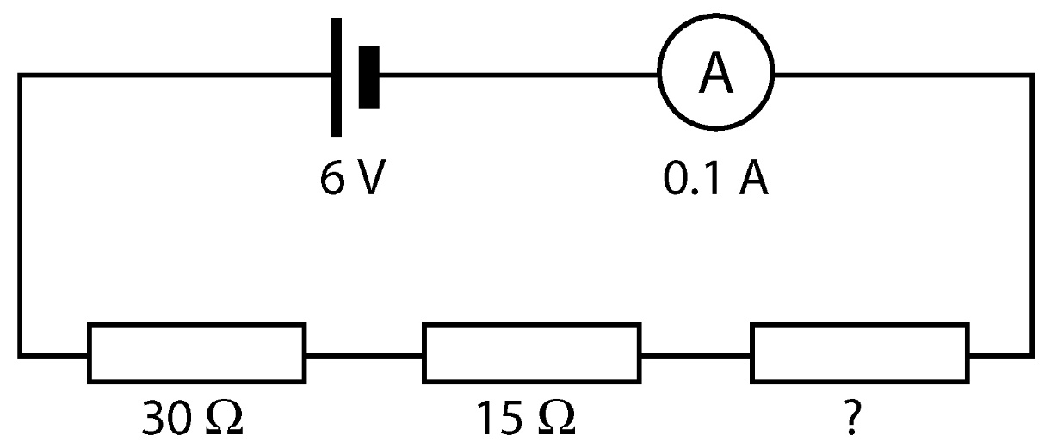
Calculate the missing resistance in this circuit.

Slide 11
Circuit rules
Both Kirchhoff’s laws lead to the following rules:
Series circuit rules
Rule 1: In a series circuit the current is the same all the way round the circuit.
Rule 2: In a series circuit the voltage is shared between the components in the circuit in ratios of their resistances. the higher resistance components will get a bigger share of the voltage.
Parallel circuit rules
Rule 1: In a parallel circuit the current splits up to go down different routes. The total current through the cell is the sum of all the separate currents
Rule 2: In a parallel circuit the voltage is the same across each route.
Rule 3:In a parallel circuit the current through a route depends on the resistance. If it has a big resistance only a small current will flow along it.

Slide 12
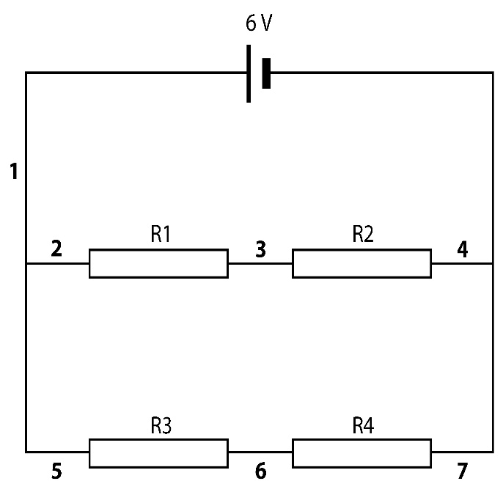
If all the resistors in the circuit are 10 Ω resistors:
a what is the potential difference between points 2 and 4?
b what is the potential difference between points 5 and 7?
c what is the potential difference between points 2 and 5?
d The current at point 1 is 0.6 A. What is the current at point 3?
e What is the current at point 6?
The resistors in the circuit have the following values: R1 = 10 Ω, R2 = 20 Ω, R3 = 15 Ω, R4 = 15 Ω
a What is the potential difference between points 2 and 4?
b What is the potential difference across R1?
c What is the potential difference across R2?
d What is the potential difference across R3?
e How does the current at point 3 compare with the current at point 6?
R1 and R2 are both 10 Ω so the total resistance in that branch is 20 Ω. R3 and R4 are both 20 Ω.
a What is the potential difference across points 2 to 4?
b What current is flowing between points 2 and 4?

