Slide 1
CW | Waves and Vibrations | 02/10/2018
From my learning today I will be able to:
Key: | Describe two types of waves
Boost: | Explain their propagation
Aspire: | Suggest how objects become polarized
Objective

Slide 2
Waves
A wave is a means of transferring energy and momentum from one point to another without there being any transfer of matter between the two points.

Slide 3
Describing Waves
Mechanical or Electromagnetic
Mechanical waves are made up of particles vibrating.
e.g. sound – air molecules; water – water molecules
All these waves require a substance for transmission and so none of them can travel through a vacuum.
Electromagnetic waves are made up of oscillating electric and magnetic fields.
e.g. light and radio
These waves do not require a substance for transmission and so all of them can travel through a vacuum.

Slide 4
Describing Waves
3. Longitudinal or Transverse
Longitudinal waves are waves where the direction of vibration of the particles is parallel to the direction in which the wave travels.
e.g. sound
vibrations
wave direction
LONGITUDINAL WAVE

Slide 5
Describing Waves
Transverse waves are waves where the direction of vibration of the particles or fields is perpendicular to the direction in which the wave travels.
e.g. water and all electromagnetic waves
Test for a transverse wave:
Only TRANVERSE waves undergo polarisation.
vibrations
wave direction
TRANSVERSE WAVE

Slide 6

Polarisation
The oscillations within a transverse wave and the direction of travel of the wave define a plane. If the wave only occupies one plane the wave is said to be plane polarised.

Slide 7
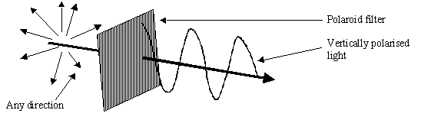
Polarisation
Light from a lamp is unpolarised. However, with a polarising filter it can be plane polarised.

Slide 8
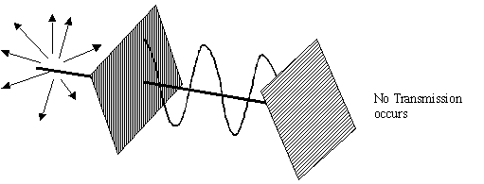
Polarisation
If two ‘crossed’ filters are used then no light will be transmitted.

Slide 9
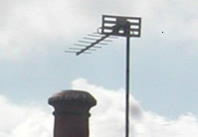
Aerial alignment
Radio waves (and microwaves) are transmitted as plane polarised waves. In the case of satellite television, two separate channels can be transmitted on the same frequency but with horizontal and vertical planes of polarisation.
In order to receive these transmissions the aerial has to be aligned with the plane occupied by the electric field component of the electromagnetic wave.
The picture shows an aerial aligned to receive horizontally polarised waves.

Slide 10
What are (a) mechanical & (b) electromagnetic waves. In what ways are they different?
(a) What is meant by polarisation? (b) What is the difference between plane polarised and unpolarised light? (c) How can unpolarised light be changed into plane polarised light? (d) What type of waves can display polarisation effects?
Draw diagrams and explain what is meant by (a) transverse and (b) longitudinal waves. Give two examples of each type.

