Slide 1
CW |  | 24/05/2016
From my learning today I will be able to:
Key:
Boost:
Aspire:
Objective

Slide 2
The Cathode Ray Oscilloscope (CRO)
electron gun
Y plates
cathode
fluorescent screen
electron beam
anode
X plates
An electron gun at the left end of a glass tube emits a beam of electrons towards a fluorescent screen at the other end of the tube.
Wherever the electron beam hits the screen, light is emitted from that spot.
The electron beam can be deflected by either the X plates or the Y plates if there was a potential difference across them.
With no potential difference across the deflection plates, the spot on the screen stays in the same position.
If a pd is applied across the X plates, the spot deflects horizontally. A pd across the Y plates makes the spot deflect vertically.

Slide 3
The Cathode Ray Oscilloscope (CRO)
electron gun
Y plates
cathode
fluorescent screen
electron beam
anode
X plates
To display a wave:
The X plates are connected to the oscilloscope’s time base circuit, which means it moves at constant speed horizontally across the screen. It can be calibrated (adjusted) so for example it moves one centimetre every millisecond.
The Y plates are connected to the input pd (the pd to be measured). The vertical displacement of the spot is proportional to the pd applied to the Y plates, the Y input can be calibrated in volts per centimetre or volts per division using the Y-sensitivity or the Y-gain button.

Slide 4
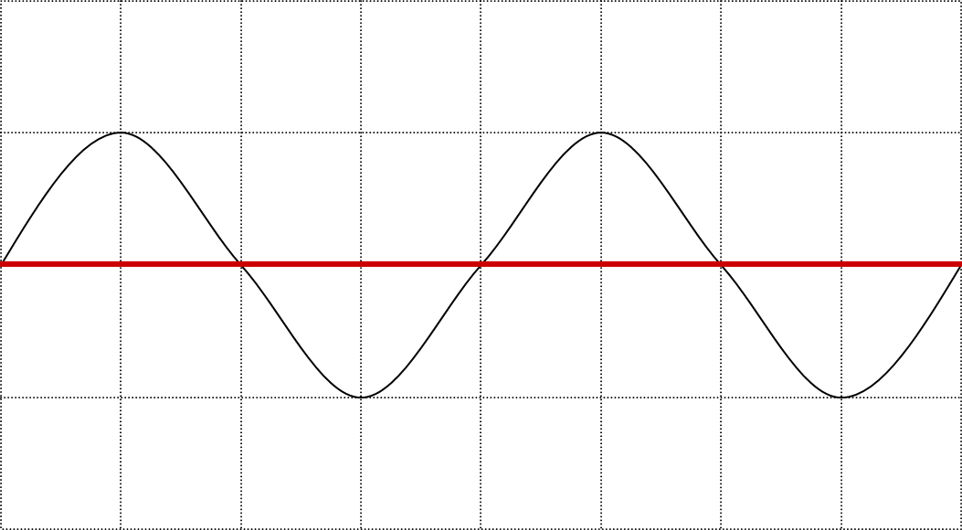
Y-axis
setting:
5.0 V per division
X-axis (timebase) setting: 50 ms per division
Find the amplitude, the period and the frequency of the above trace
Amplitude =
Period T =
Frequency f =
one division = 5.0 V
4 divisions = 200 ms = 0.2 s
1 / T = 1 / (0.2 s) = 5 Hz

Slide 5
To familiarise yourself with the CRO, carry out the following experiment. You will need: a CR0, a battery pack, a high current power supply, and a microphone and leads.
Switch on your oscilloscope and adjust the controls to give a straight line across the centre of the screen.
The Y gain should be set at 1V / division and the time base set at 1 ms / division,
1. Connect one 1.5 V cell to the Y inputs and adjust the Y gain, if necessary, so that the line moves up 1.5 divisions. After this do not alter the Y gain.
2. Now connect two cells and then three cells. Record the line deflection each time.
3. Reverse the leads and repeat number two.
4. Now connect the 1 V ac supply from the high current power supply to the Y inputs.
If the signal source and oscilloscope both have earthed terminals make sure that the earthed lead of the oscilloscope (often black) is connected to the earthed terminal of the supply (often yellow), or you will short out the signal generator through the CRO.
Record the size and shape of the trace. Repeat with the 2 V ac input and then the dc input, recording the trace each time. You must have a steady trace for each experiment.
5. With the 2 V ac connected try increasing the Y gain. Then try varying the variable-control. Record the results.
6. Now connect a microphone to the Y inputs and talk into it.

Slide 6
Answer the following questions:
1. In what ways is an oscilloscope a voltmeter?
2. What does an oscilloscope offer which a voltmeter does not?
3. An oscilloscope is set to 0.5 V / cm vertically and 1 s / cm horizontally.
(a) Sketch the trace that would be seen if a 1.5 V cell was connected to the y-input.
(b) Sketch the trace that would be seen if a square wave signal of frequency 1 Hz and amplitude 0.5 V (positive and negative) is connected to the input.
4. With the timebase switched off an alternating voltage moves the spot on the screen up and down once in 0.20 s. Its range of movement is 4.0 cm and the y-gain is set at 20 mV / cm
(a) What is the amplitude of the signal?
(b) What is the frequency of the signal?

Slide 7
Answers
For an oscilloscope deflection is proportional to potential difference.
Can display variation of potential difference with time, giving a graphical display. It can do this even with very rapid variations. With many oscilloscopes two signals can be displayed at the same time, on separate voltage against time graphs. Often the two signals can be plotted against each, as an “X-Y” plot.
Sketch
4 20 mV cm-1 x 4 cm = 80 mV. Amplitude is half this so 40 mV. Time for one oscillation is 0.2 s so f= 1 / 0.2 s = 5 Hz

Slide 8
Using an Oscilloscope to measure the speed of ultrasound
The oscilloscope is attached to an ultrasound transmitter and an ultrasound receiver.
The oscilloscope can be used to trigger the transmitter to produce a short pulse of ultrasonic waves. The ultrasound receiver can be used to detect the transmitted pulse.
The oscilloscope will show both pulses on its screen with a time difference between them.
The time difference is the time taken for the pulse to travel the distance between the transmitter and the receiver.
Demonstration: speed of sound in air, Focus Educational Software,

Slide 9
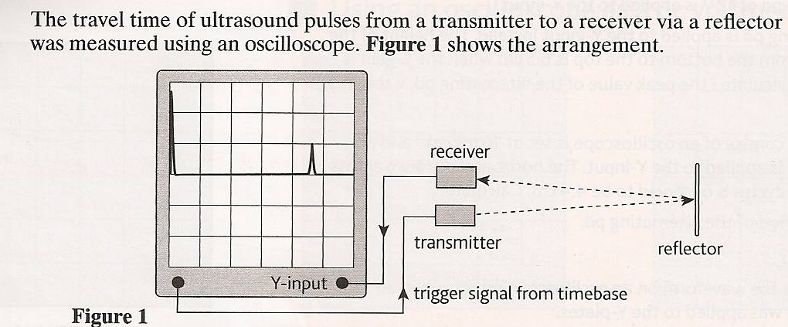
The oscilloscope is attached to an ultrasound transmitter and an ultrasound receiver.
The oscilloscope can be used to trigger the transmitter to produce a short pulse of ultrasonic waves. The ultrasound receiver can be used to detect the reflected pulse.
The oscilloscope will show both pulses on its screen with a time difference between them.
The time difference is the time taken for the pulse to travel the distance between the transmitter and the receiver.

Slide 10
The screen is marked with a cm grid. The time base of the oscilloscope was 2.0ms cm⁻¹.
Calculate the time taken by each pulse to travel from the transmitter to the receiver.
Calculate the speed of ultrasound if the distance between the receiver and the reflector is 1.53 m.
Time = 2.0ms cm⁻¹ x 4.5cm = 9 ms = 9x10⁻³ s
Speed = distance /time
Speed = (1.53x2)/9x10⁻³ = 340 ms⁻¹

Slide 11
The trace of an oscilloscope is displaced vertically by 0.9cm when a pd of 4.5 V is applied to the Y-input. Calculate:
i. the Y-gain of the oscilloscope
ii. The displacement of the spot when a pd of 12 V is applied to the Y-input
a. i. the Y-gain of the oscilloscope = 4.5V/0.9cm = 5.0 Vcm⁻¹
ii. When 12 V is applied, the displacement = 12V/5Vcm⁻¹ = 2.4cm

Slide 12
b. An alternating pd is applied to the Y-input instead. The height of the waveform from the bottom to the top is 6.5 cm when the Y-gain is 0.5Vcm⁻¹. Calculate:
i. the peak value of the alternating pd
ii. The rms pd
the peak value of the alternating pd:
The amplitude of the wave = 6.5/2 = 3.25cm
The peak pd = 3.25cm x 0.5Vcm⁻¹ = 1.63 V
ii. The rms pd =
V_{rms}= √ ½ V_{o}
V_{rms}= √ ½ x 1.625 = 1.15V

Slide 13
2. The time base control of an oscilloscope is set at 10ms cm⁻¹ and an alternating pd is applied to the Y-input. The horizontal distance across two complete cycles is observed to be 4.4 cm. Calculate:
The time period of the alternating pd,
its frequency
a. The horizontal distance across two complete cycles = 4.4 cm.
The horizontal distance across one complete cycles = 2.2 cm.
Time period = 10ms cm⁻¹ x 2.2cm = 22ms = 22x10⁻³ s
frequency = 1/T
frequency = 1/22x10⁻³ = 45.5 Hz

Slide 14
3. The y-gain of the oscilloscope in the figure here is 5.0 Vcm⁻¹
Calculate the peak pd and the rms pd.
The time base setting of the oscilloscope was 5ms cm⁻¹. Calculate its time period and the frequency.
1 cm
1 cm
a. Amplitude = 2.5cm
V_{o} = 2.5 cm x 5.0 Vcm⁻¹ = 12.5V
V_{rms}= √ ½ V_{o}
V_{rms}= √ ½ x 12.5
V_{rms}= 8.8 V
b. length of one cycle is 2cm
T = 2cm x 5ms cm⁻¹ = 10ms = 10x10⁻³ s
f = 1/T
f = 1/ 10x10⁻³ = 100 Hz

