Slide 1
Particle Zoo
AQA particle Physics

Slide 2
Aim
To have a model that coherently explains the universe
But today
Introduce the standard model of particles
Understand why we classify, sort, name and create properties

Slide 3
Matter
Hadrons
Leptons
Forces
Baryons
Mesons
Charged
Neutrinos
Gravity
Strong
Weak
EM
Quarks
Anti-Quarks

Slide 4
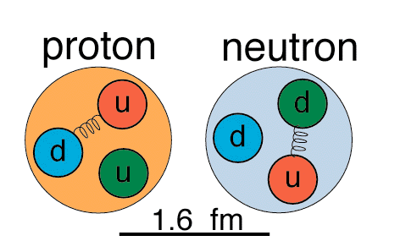
Are protons and neutrons fundamental?
(By fundamental, I mean are they indivisible?
The answer is NO !
Protons and neutrons are made of smaller objects called quarks!
Protons
2 “up” quarks
1 “down” quark
Neutrons
1 “up” quark
2 “down” quarks

Slide 5
Quarks
Quark | up | down | strange | Antiup | Anti down | Anti strange
Charge | +2/3 | -1/3 | -1/3 | -2/3 | +1/3 | +1/3
Strangeness | 0 | 0 | -1 | 0 | 0 | +1

Slide 6
The 6 Quarks, when & where…
Quark | Date | Where | Mass [GeV/c²] | Comment
up, down | - | - | ~0.005, ~0.010 | Constituents of hadrons, most prominently, proton and neutrons.
strange | 1947 | - | ~0.2 | discovered in cosmic rays
charm | 1974 | SLAC/ BNL | ~1.5 | Discovered simultaneously in both pp and e⁺e⁻ collisions.
bottom | 1977 | Fermi- lab | ~4.5 | Discovered in collisions of protons on nuclei
top | 1995 | Fermi-lab | ~175 | Discovered in pp collisions

Slide 7
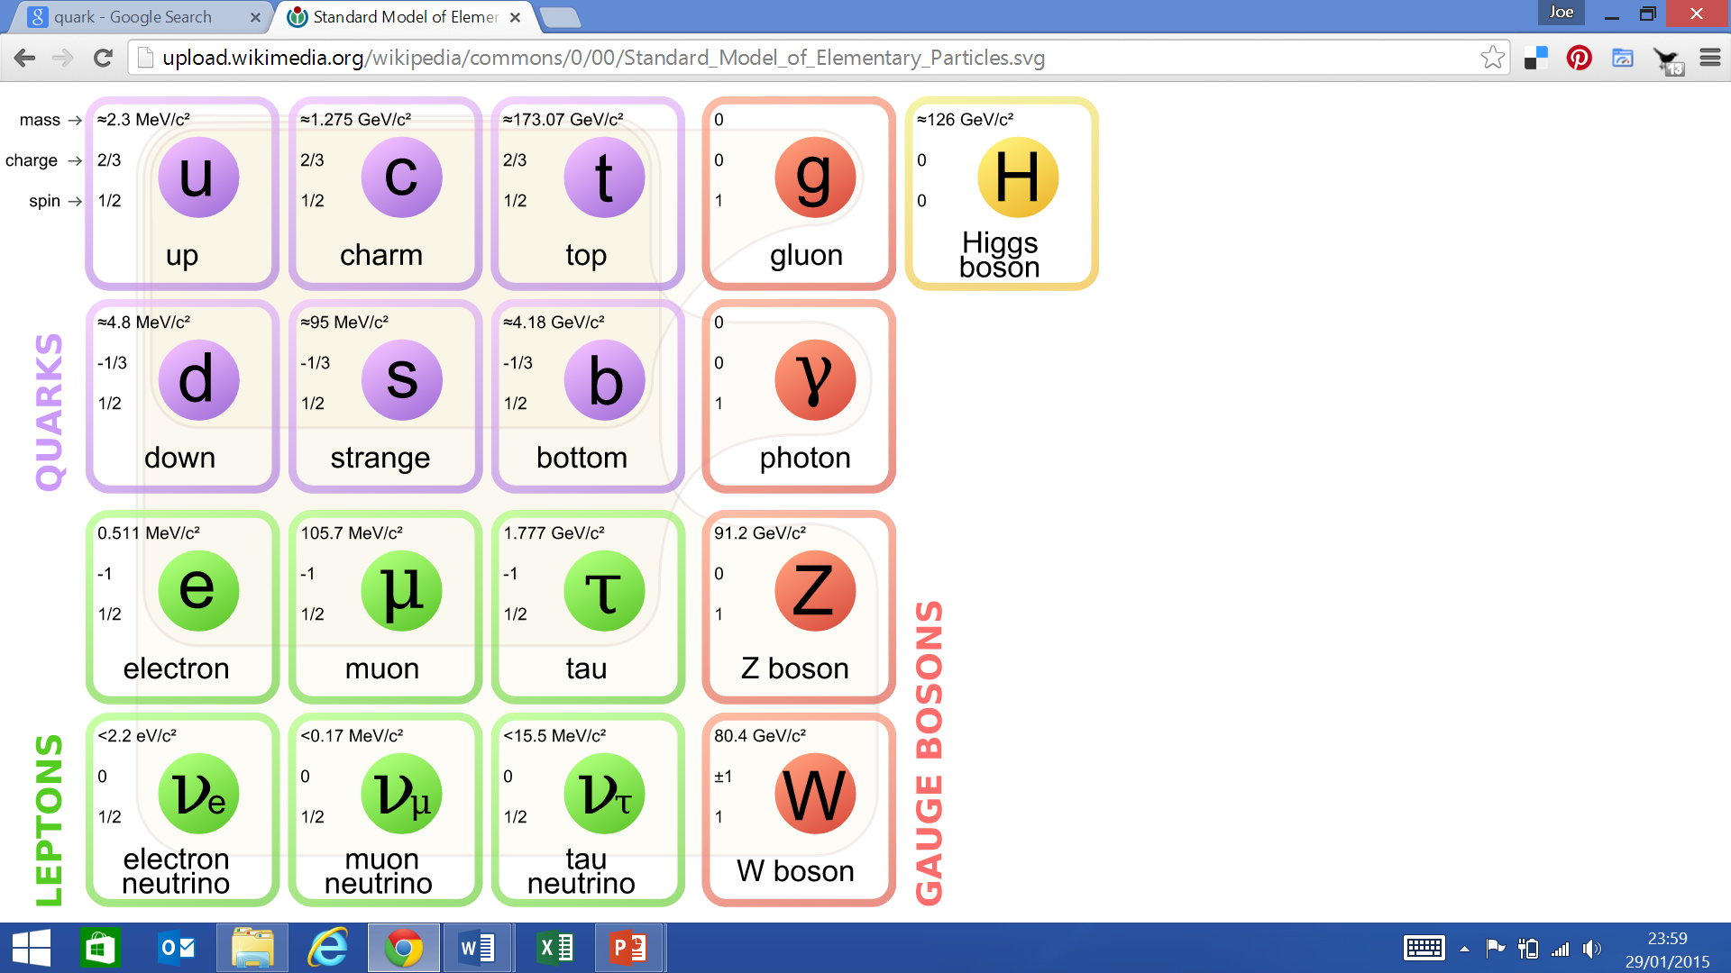

Slide 8
Quark Confinement
Hadron Jail
q
Quarks are “confined” inside hadrons (baryons or
mesons). We do not see them as “free” particles (like
electrons, for example).
This is a result of the “strong force” which
we will discuss later…

Slide 9
Hadrons -> Baryons and Mesons
Baryons (Anti-Baryons)
  3 quarks or (3 anti-quarks)
  up down strange
  Must have integer charge
Mesons
  Quark + Anti quark
  Naturally: up down strange
  Must have integer charge
Quark | up | down | strange | Antiup | Anti down | Anti strange
Charge | +2/3 | -1/3 | -1/3 | -2/3 | +1/3 | +1/3
Strangeness | 0 | 0 | -1 | 0 | 0 | +1

Slide 10
Let’s make baryons!
Quark
up
down
strange
Charge Q
+2/3
-1/3
-1/3
Mass
~5 [MeV/c²]
~10 [MeV/c²]
~200 [MeV/c²]
u
u
u
d
d
d
Proton
Neutron
Q = +1
M=938 MeV/c²
Q = 0
M=940 MeV/c²
Note: The neutron can be turned into a proton by simply replacing a
“d” quark by a “u” quark!
Notes:
In all cases, you will see that I have given the quarks inside baryons the colors red, green, and blue.
This is because quarks also have an intrinsic “color charge”, or simply “color” for short. We will
get into this in more detail later when we discuss the strong interaction.
For now, assume that all baryons must have 1 RED, 1 GREEN and 1 BLUE quark.
Taken together, the RED, GREEN, and BLUE produce an object which has no color
(ie., it’s colorless). This is the same idea as the visible light be composed of the
full spectrum of colors in the rainbow.

Slide 11
Let’s make some more baryons !
Quark
up
down
strange
Q
+2/3
-1/3
-1/3
Mass
~5 [MeV/c²]
~10 [MeV/c²]
~200 [MeV/c²]
u
u
u
d
s
d
s
u
s
d
s
d
Lambda (Λ)
Sigma (Σ⁺)
Sigma (Σ⁰)
Sigma (Σ⁻)
Q = 0
M=1116 MeV/c²
Q = +1
M=1189 MeV/c²
Q = 0
M=1192 MeV/c²
Q = -1
M=1197 MeV/c²
Notes:
Here, Q means “the value of the electric charge”
Note that the Lambda and Sigma_0 have the same quark content, but have different masses.
How can this be?
The answer is beyond the scope of this course. If you would like a deeper explanation, I encourage you to talk
to the instructor.

Slide 12
Some Baryons with u,d,s quarks
Baryon | Symbol | Makeup | Mass (MeV/c²) | Q |  | Lifetime
proton | p | uud | 938 | +1 |  | > 10³³ yrs
neutron | n | ddu | 940 | 0 |  | 920 s
Lambda | Λ⁰ | uds | 1116 | 0 |  | 2.6x10⁻¹⁰ s
Sigma | Σ⁺ | uus | 1189 | +1 |  | 0.8x10⁻¹⁰ s
Sigma | Σ⁰ | uds | 1192 | 0 |  | 6.0x10⁻²⁰ s
Sigma | Σ⁻ | dds | 1197 | -1 |  | 1.5x10⁻¹⁰ s
Xi | Ξ⁰ | uss | 1315 | 0 |  | 2.9x10⁻¹⁰ s
Xi | Ξ⁻ | dss | 1321 | -1 |  | 1.6x10⁻¹⁰ s
You should be able to read and extract information from a table like this
Notes:
I DO NOT EXPECT YOU TO MEMORIZE THESE TABLES !!!!
But, you should know how to read them, and understand
what the items are.
I do expect that you understand what the various columns mean, so that you
can read the table and extract information from it if so asked.
For example, you might be asked for the quark content of a Xi-, or the
lifetime of the proton, or the mass of a Lambda particle. You should be able to
extract this information from this (or a similar) table.

Slide 13
A few More Baryons
Baryon | Symbol | Makeup | Mass (MeV/c²) | Q |  | Lifetime
Delta | Δ⁺⁺ | uuu | 1232 | +2 |  | 0.6x10⁻²³ s
Delta | Δ⁺ | uud | 1232 | +1 |  | 0.6x10⁻²³ s
Delta | Δ⁰ | udd | 1232 | 0 |  | 0.6x10⁻²³ s
Delta | Δ⁻ | ddd | 1232 | -1 |  | 0.6x10⁻²³ s
Omega | Ω⁻ | sss | 1672 | -1 |  | 0.8x10⁻¹⁰ s
Notes:
I DO NOT EXPECT YOU TO MEMORIZE THESE TABLES !!!!
But, you should know how to read them, and understand
what the items are.

Slide 14
Mesons
Mesons are also in the hadron family.
They contain a quark and an anti-quark
d
d
u
s
What’s the charge
of this particle?
What’s the charge
of this particle?
Q=+1, and it’s
called a π⁺
Q= 0, this strange
meson is called a K⁰
Notes:
It is difficult to show here, but the two quarks inside mesons must have opposite color.
The quark can be either RED, GREEN, or BLUE. Choose one..
If we choose GREEN, then the anti-quark’s color is “ANTI-GREEN”. How do
we draw anti-green? Sorry, I’m not sure how, but try and keep in mind that the
quark and antiquark in a a meson are one of (or some combination) of these
colors combinations:
Quark + Antiquark
------ ------------
RED + ANTIRED
BLUE + ANTIBLUE
GREEN + ANTIGREEN

Slide 15
Some Mesons with u,d,s quarks
Meson | Symbol | Makeup | Mass (MeV/c²) | Q | Lifetime
Pion+ | π⁺ |  | 140 | +1 | 2.6x10⁻⁸ s
Pion- | π⁻ |  | 140 | -1 | 2.6x10⁻⁸ s
Pion-0 | π⁰ |  | 135 | 0 | 8.4x10⁻¹⁷ s
Kaon+ | Κ⁺ |  | 494 | +1 | 1.2x10⁻⁸ s
Kaon- | Κ⁻ |  | 494 | -1 | 1.2x10⁻⁸ s
Notes:
I DO NOT EXPECT YOU TO MEMORIZE THESE TABLES !!!!
But, you should know how to read them, and understand
what the items are.
You can see that the Pion-0 and Eta-0 have lifetimes which are extremely short
compared to the other particles (about a factor of 10 billion times shorter).
This is because these particles decay through the electromagnetic interaction,
whereas the others decay through the weak interaction.
We will discuss interactions and particle decays in more detail later…

