Slide 1
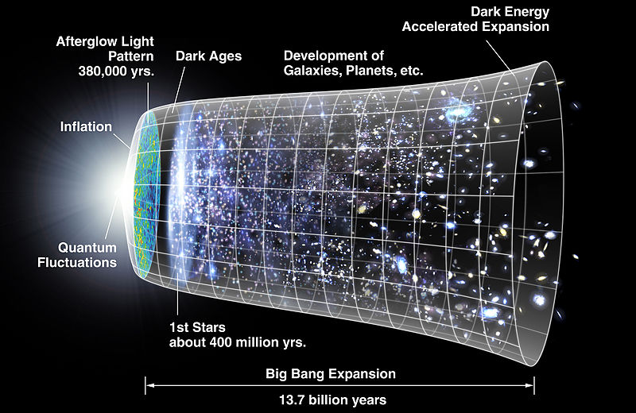
CW | Uncertainty | 07/03/2017
The universe is 13.73 ± 0.12 billion years old
What size is the uncertainty?
Is this significant?
From my learning today I will be able to:
AO1: | State and describe: Reading, Measurement, Uncertainty (C)
AO2: | Describe sources of error and calculate uncertainty/precentage error in different scenarios (B)
Aspire: | Combine errors (A/A*)
Objective

Slide 2
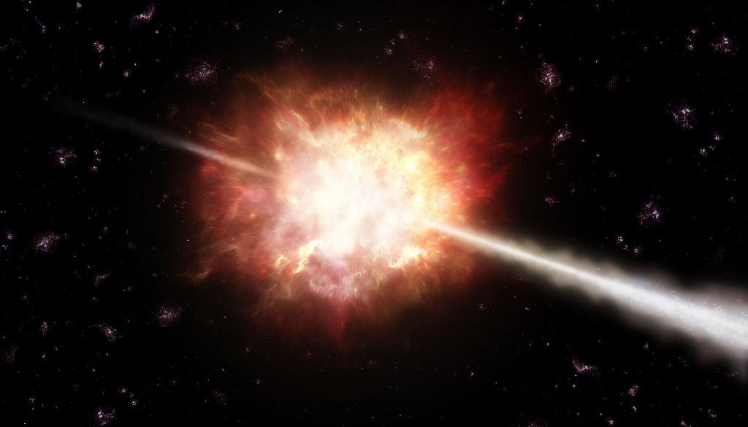
What are Uncertainties?
What do you think this is?
It is very old!
It is GRB 090429B and is thought to be the remnants of one of the first stars born after the Big Bang.
It is 13,140,000,000 ± 20,000,000 years old

Slide 3
Give some examples of each

Slide 4
Pick 3 from each side and explain why they are grouped in each one

Slide 5
Uncertainty in Readings
Given as Half the smallest value it can read
What would it be for this thermometer?

Slide 6
Uncertainty in Measurements
Since there are 2 areas, it is double half of the smallest value
What is it for a ruler?

Slide 7
What is the uncertainty?
Notes:
4.3%

Slide 8
What is the uncertainty?
Notes:
0.20%

Slide 9
What is the uncertainty?
Notes:
0.26%

Slide 10
What is the uncertainty?
Notes:
0.0022%

Slide 11
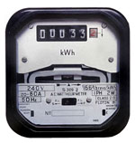
What is the uncertainty?
Notes:
3.0%

Slide 12
What is the uncertainty?
Notes:
0.27%

Slide 13
Uncertainties in given values
If you’re give a number, then assume the uncertainty is Plus/ minus 1 of the smallest decimal place given.
What would they be for:
1.01
101
2045.3453
700021000
203090000.0

Slide 14
Uncertainties in Repeated measurements
Repeating a measurement is a method for reducing the uncertainty.
If measurements are repeated, the uncertainty can be calculated by finding half the range of the measured values.

Slide 15
Calculating Percentage Uncertainties
Reading on meter =
12.6 V
Finest division =
0.2 V
%Uncertainty = Uncertainty x 100
Reading Taken
% Uncertainty = (0.2/12.6) x 100 =
1.6 %

Slide 16
Calculate the percentage uncertainties for the following measurements:
1.
3. 100m record of 9.6 s
1%
0.3%
4. Extension of 0.002m (2mm)
50%
5. Extension of 0.045m (45mm)
2.
2%
0.03%

Slide 17
Quote the average Value with its uncertainty calculate percentage uncertainty

Slide 18
Multiple instances of measurements
For example:
measuring the thickness of several sheets of paper together rather than one sheet
timing several swings of a pendulum.
The uncertainty of each measurement will be the uncertainty of the whole measurement divided by the number of sheets or swing

Slide 19
Uncertainties in given values
Uncertainties in Repeated measurements
Percentage Uncertainty
Multiple instances of measurements

Slide 20
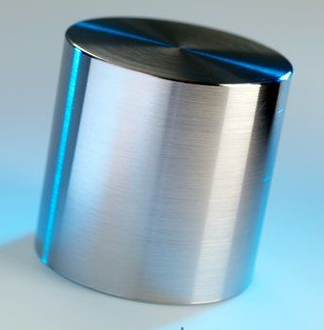
Combining Uncertainties
Suppose I want to work out the density of the block…
Mass (kg)
Density
=
Volume (m³)
Mass = 0.500 ± 0.001 kg
Volume = (6.25 ± 0.25) x 10⁻⁵ m³
To Work out the uncertainty in the density, I have to combine the uncertainty in the mass with the uncertainty in the volume

Slide 21
How do we do it?
Work out the Percentage Uncertainty in the volume and the mass.
2. Then add these together.

Slide 22
Work it out…
Answer…
4.2%

Slide 23
THE RULES
What happens in the formula | What to do to calculate uncertainties
A x B or A ÷ B | Add percentage uncertainty of A with percentage uncertainty in B
A=B+C | Add uncertainty of b and c
A^{n} | Multiply the percentage uncertainty by n

Slide 24
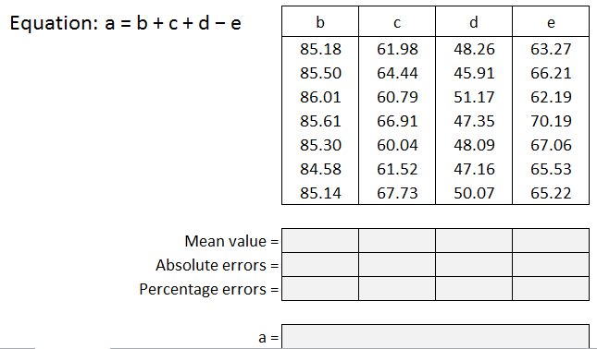

Slide 25
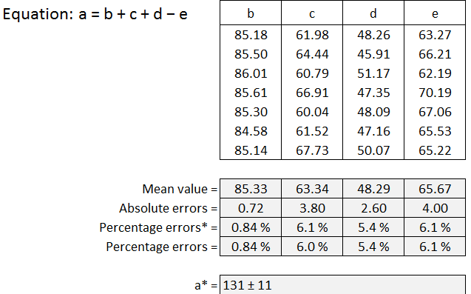

Slide 26
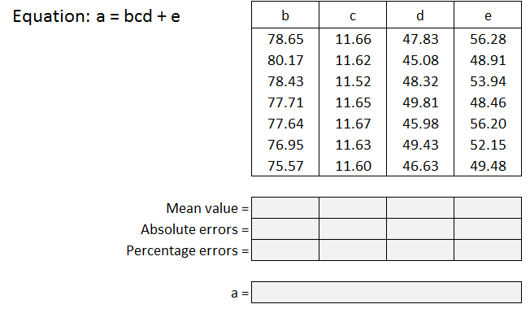

Slide 27
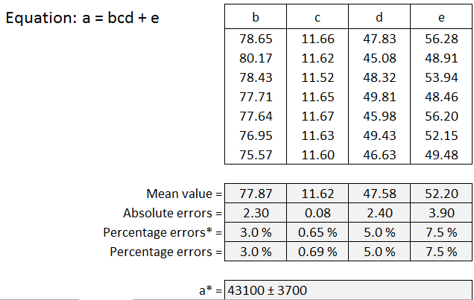

Slide 29
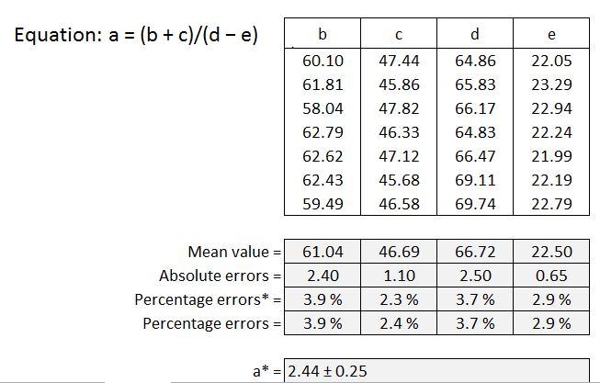

Slide 30
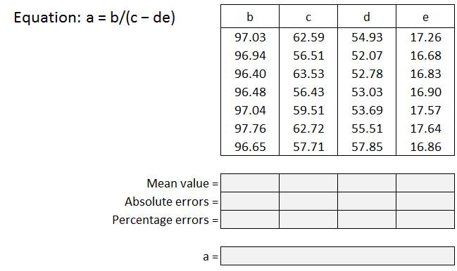

Slide 31
