Slide 1
 | Thermal Physics | 08/06/2022
Heat:
Because it’s hot!
Heat is energy transferred from a hot body to a cold body….
…or, transferred due to temperature difference.
Heating mechanisms:
Conduction
Convection
Radiation

Slide 2
Not Heat:
Because it’s not hot (initially)!
The thermal energy (internal energy) is produced (converted) by doing mechanical work against friction.
So this is:
Work.

Slide 3
Internal energy
Definition is based on kinetic theory ideas….
… in other words a molecular description of thermal energy.
The internal energy is the sum of the Kinetic and Potential energies of the molecules in a system.
The symbol used for internal energy is U.
The internal energy of a body can be increased either by heating it, or by doing work on it.

Slide 4
The First Law of Thermodynamics
Strictly speaking this only features in the ‘Engineering Physics’ Option topic, however, there is a simple question using this at the start of the eBook core chapter on Thermal Physics.
It is essentially a statement of conservation of energy, specific to internal energy changes. If the change of internal energy is ΔU, then:
ΔU = Q – W
Where Q is the heat supplied to the system and W is the work done BY it: Sometimes you may see ΔQ and ΔW, but these symbols are consistent with the AQA formula sheet.

Slide 5
A note on sign convention:
In the equation: ΔU = Q – W, you will see that Q is the heat supplied TO the system, and so increases the internal energy, but W is the work done BY the system, and so decreases the internal energy.
This explains the minus sign for the W term.
However, different A level specifications, textbooks and websites might have different sign conventions, so be wary!
The idea expressed in the law, i.e. conservation of energy, however, must remain the same.

Slide 6
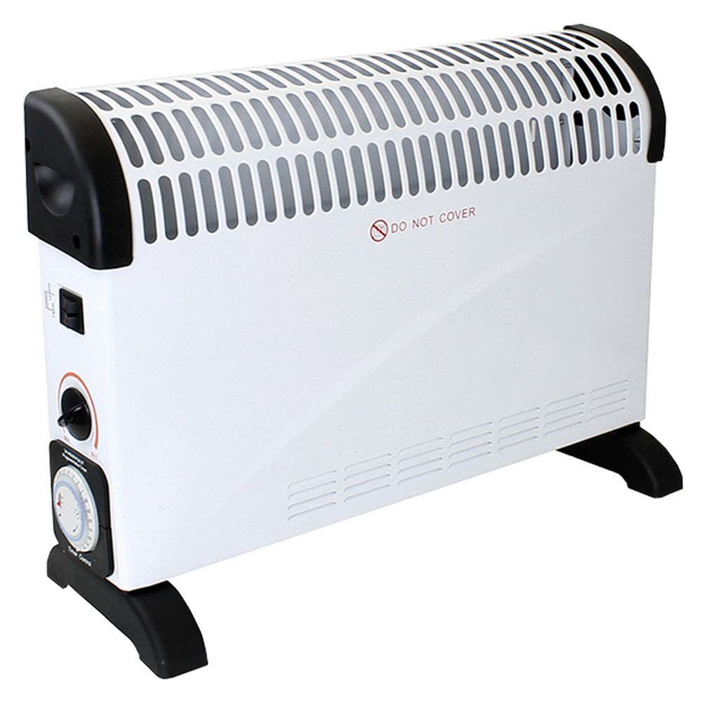
Constant Temperature:
If a fixed system or body remains at a constant temperature, then its internal energy must be constant.
Considering the electric heater I mentioned earlier, if this is at a stable operating temperature, then ΔU = 0.
This means 0 = Q – W, or in other words W = Q.
In this example, our sign convention means the both Q and W are negative. Work is being done by the electrical element, at the same rate as which heat is being dissipated to the surroundings, to keep the heater at a constant temperature.

Slide 7
Temperature:
OK – so what about temperature. The two following pictures might give some insight into the difference between internal energy and temperature.
✓
Highest Temperature:
Largest Internal energy:
✓

Slide 8
Temperature:
A ‘Woolley’ non scientific description of temperature might be a ‘degree of hotness’.
Again, Kinetic Theory (which you will study in more detail later) gives us an insight into temperature.
Temperature is related to the mean kinetic energy of the molecules.
This is clearly different to internal energy, which is related to the total kinetic energy of the molecules.
The ice bath clearly has more internal energy, because it has many more molecules.

Slide 9
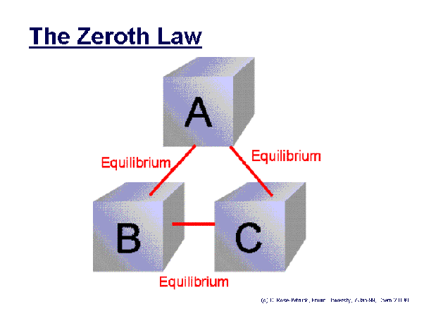
The Zeroth law of thermodynamics:
A brief aside to this obscurely named law – don’t worry, you would not be expected to know this!
This law talks about thermal equilibrium: Two systems are in thermal equilibrium if there is no net heat transfer between them.
The law states that if two thermodynamic systems are each in thermal equilibrium with a third one, then they are in thermal equilibrium with each other.
In other words, some property (i.e. temperature) must be the same for all.
This law was not stated until after the first law, but due to its more fundamental nature, it was felt that it ought to be numbered before the first law, hence the zeroth law!!!

Slide 10
Temperature Scales:
You should know (and hopefully do already) about 2 temperature scales!
The Celsius scale, which measures temperature in ºC.
This is a centigrade scale (because it is divided into 100 divisions between the fixed points), and is often simply called this by the general public.
The other is the absolute or ‘Kelvin’ scale, which measures in K (no degrees sign).
You probably also know that a temperature interval of 1 K is the same as a temperature interval of 1 ºC.

Slide 11
Practical Thermometers:
All laboratory thermometers measure temperature in degrees Celsius (unless you find one old enough to measure in Fahrenheit).
They all work through employing a thermometric property.
This is quite simply something that changes with temperature.
The most common type is a bulb of mercury (or spirit) which expands up a thin glass tube.
Others, however, include the resistance of pure metals, the e.m.f. of a thermocoulpe, or the pressure or volume of a fixed mass of gas

Slide 12
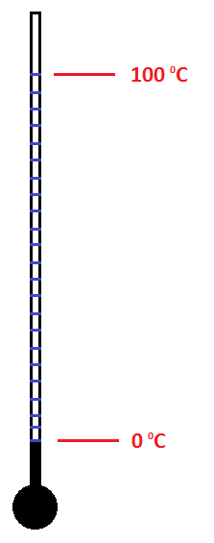
How to make (calibrate) a Celsius thermometer:
Place the thermometer at the lower fixed point (ice/water equilibrium) and mark 0 ºC.
Place the thermometer at the upper fixed point (steam above boiling water) and mark 100 ºC.
Divide the scale into 100 evenly spaced divisions!

Slide 13
Do all types of thermometer read the same temperature?
The simple answer to this is no!
Two properly calibrated thermometers will agree at the fixed points.
However, at temperatures in between, there could be small variations in temperature due to the way in which the thermometric property varies with temperature.
Once upon a time there were lots of questions where you had to calculate and compare different temperature readings from the thermometric properties.
These are now no longer set!

Slide 14
The Kelvin Temperature Scale:
The fixed points for this are absolute zero and the triple point of water.
Absolute zero (0 K or -273.15 ºC) is the lowest temperature theoretically that exists. In kinetic theory terms it is when molecular motion ceases.
The triple point of water (273.16 K or 0.01 ºC) is the only temperature at which water can co-exist in all 3 phases (ice, water and water vapour), and is chosen because it is more accurately reproducible.

Slide 15
Relationship between the two scales:
As already stated, a temperature interval is the same on each scale. We can therefore write the relationship as:
T / K = θ / ºC + 273
The ‘offset’ of 273 is normally used to the nearest degree, which tends to be consistent with the significant figures used in most questions.
Note that it is usually the convention to use θ for Celsius temperature and T for Kelvin temperature.

