Slide 1
 | Specific Heat Capacity (SHC) | 07/06/2020
As a reminder:
Q = m c Δθ
Typical SHC values:
  Copper = 385 J kg⁻¹ K⁻¹
  Steel = 490 J kg⁻¹ K⁻¹
  Lead = 130 J kg⁻¹ K⁻¹
  Aluminium = 910 J kg⁻¹ K⁻¹
  Water = 4180 J kg⁻¹ K⁻¹ (usually taken as 4200 J kg⁻¹ K⁻¹ to 2 s.f.)
So, with the possible exception of Aluminium, water has an SHC which is typically an order of magnitude higher than most metals.

Slide 2
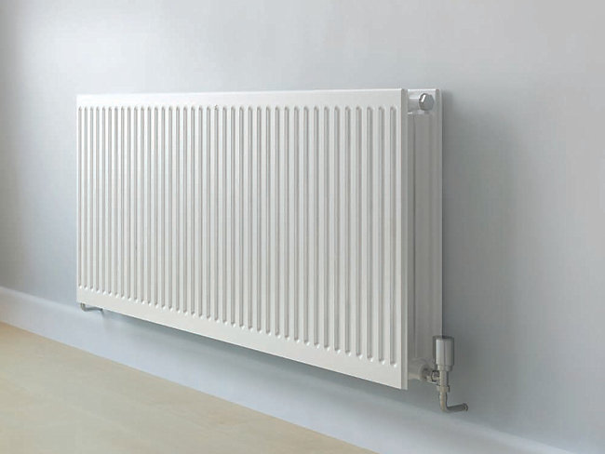
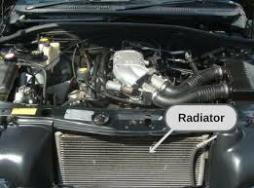
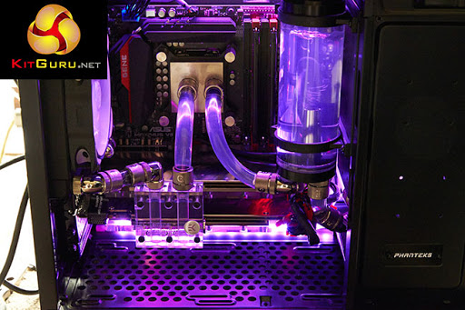
Significance of high SHC of water:
Water is very effective for heat transfer, e.g.
  Central heating systems
  As a coolant, typically for car engines
  Water cooled computer!!!

Slide 3



Swimming in the sea:
  Feels cold in May
  Feels warmer in September
Climatic variation:
  Siberia – very cold (-50ºC) in winter, but can be warm in the summer.
  The desert gets cold at night!
  Range of Average temperatures:
    Funchal, Madeira: 14 – 25 ºC
    Marrakesh, Morocco: 6 – 38 ºC

Slide 4


(Total) Heat Capacity, C:
An idea you may meet - used in some of the older textbook questions.
Used to represent the total amount of energy required to heat a system through a unit temperature rise, hence measured in J K⁻¹.
If we consider an aluminium saucepan of mass, m_{al} , SHC, c_{al} …
Filled with water of mass, m_{w} , SHC, c_{w} …
Then the total energy to heat the system by Δθ is:
      Q = m_{al} c_{al} Δθ + m_{w} c_{w} Δθ
  Factorising Q = (m_{al} c_{al} + m_{w} c_{w}) Δθ
  The term in the brackets is the (total) heat capacity, in other words
            C = Σ m c

Slide 5
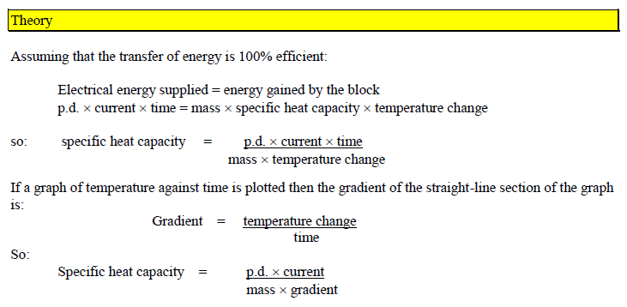
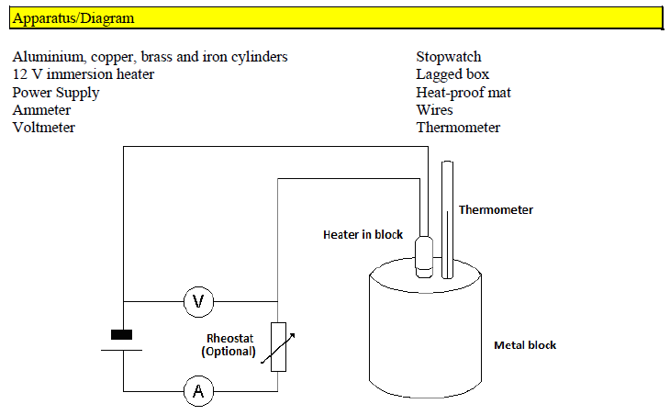
Measurement of SHC of various metals (2nd year Experiment)

Slide 6
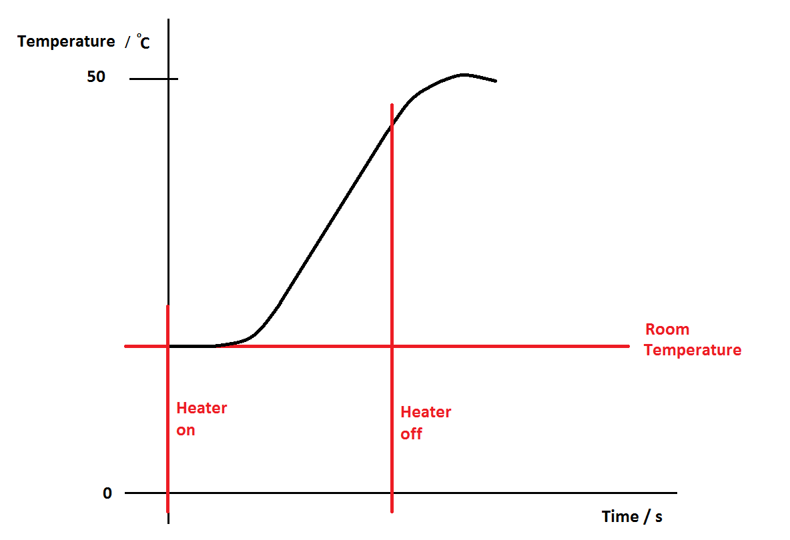
Measurement of SHC of various metals (2nd year Experiment)

Slide 7
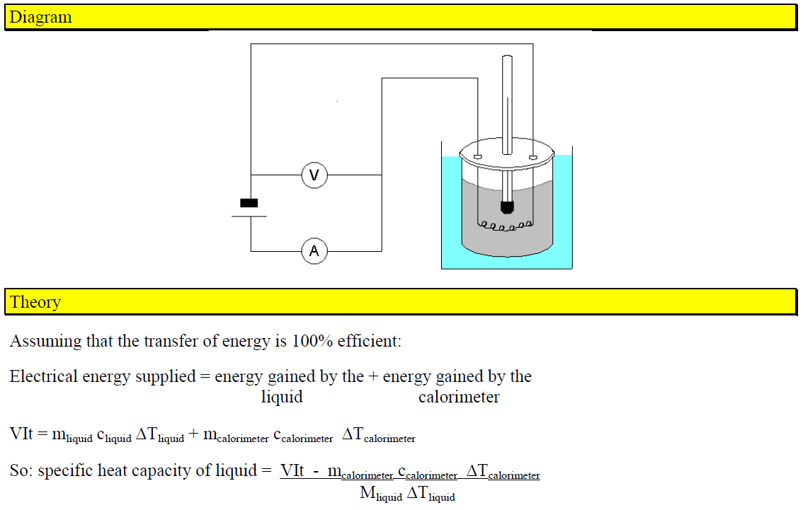
Measurement of SHC of liquids (2nd year Experiment)

Slide 8

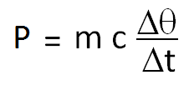
Time issues:
You should already have met simple questions that ask you to calculate the time for heating.
If we take the equation: Q = m c Δθ and divide both sides by time, we get:
Now the left hand side, the rate of transfer of heat, is the power, so we can also write:

Slide 9
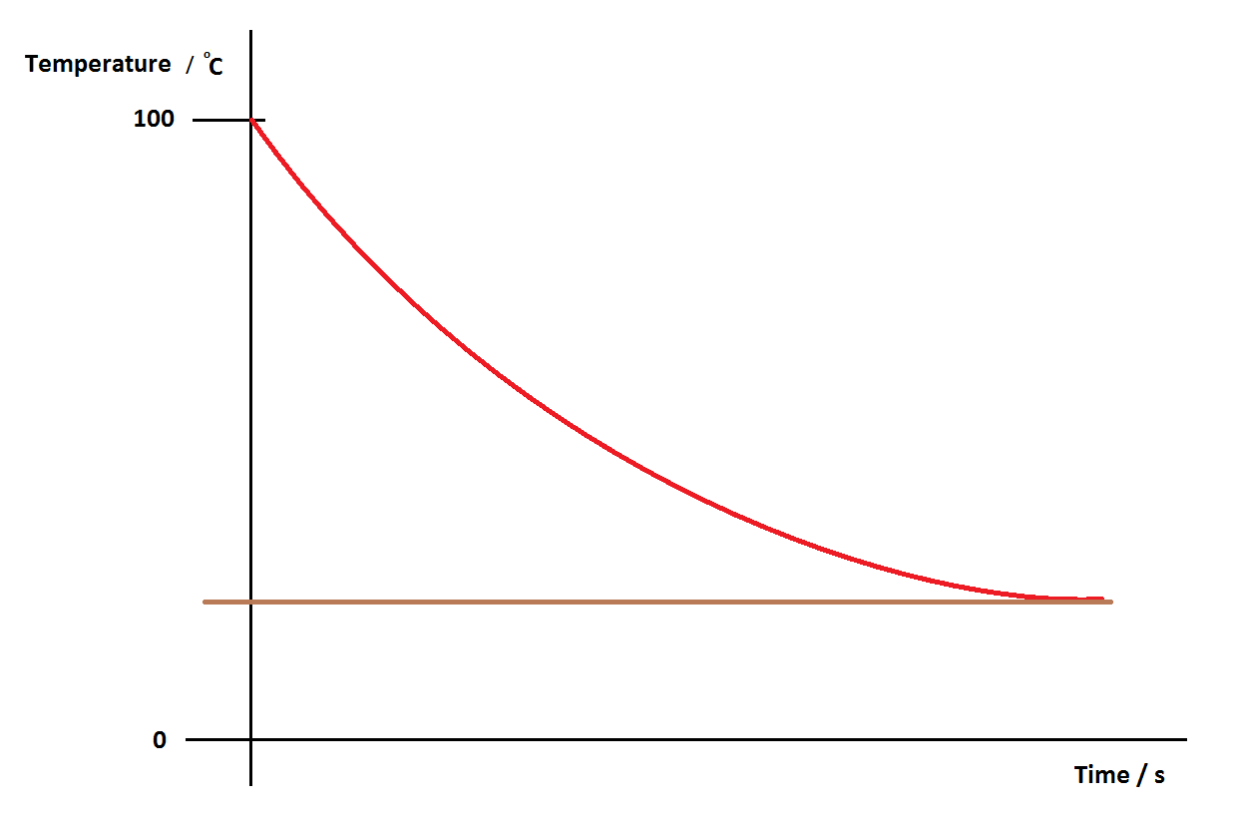
Cooling:
This will be discussed in more detail in the next video.
The graph shows a typical curve for water cooling from 100 ºC to room temperature.

Slide 10
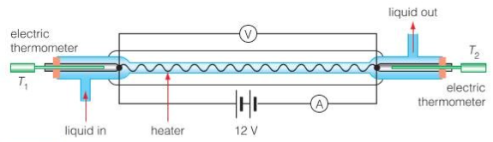

Continuous flow methods:
A more sophisticated calorimetry technique.
Water is passed in at one temperature, and comes out at a higher temperature.
As the temperature of the various parts of the apparatus stay the same, there is no need to consider the heat capacity of the apparatus.
In this case, it is more appropriate to write the equation as:
where m/t is the mass flow rate through the apparatus.
A full treatment can be found on page 63 in the Hodder eBook.

Slide 11
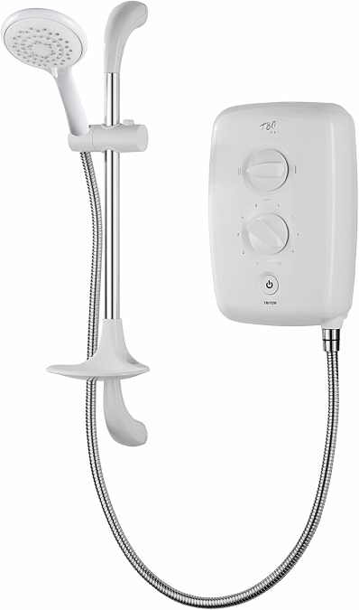
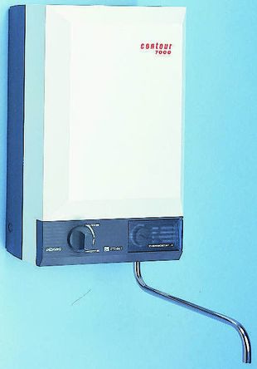
The ‘Electric Shower’ Problem:
A similar situation to the continuous flow experiment that often comes up in problems.
May not be a shower; it can be any type of water heater that heats the water as it passes through it – we have one in the Physics lab.
The equation is the same:
Electric showers of this type are certainly a problem!!!

Slide 12
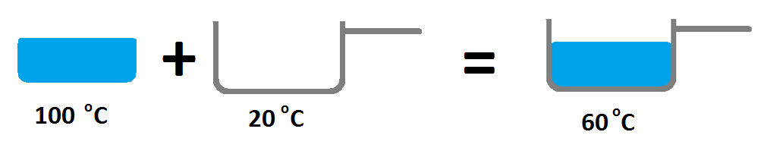

Method of Mixtures Calculations:
I you didn’t know anything about SHC, you might expect that if you took 500 g of boiling water from a kettle at 100 ºC and poured it into a 500 g saucepan at 20 ºC, the final temperature might be the average (60 ºC).
In reality, due to the much higher SHC of water, the final equilibrium temperature would be about 93 ºC.

Slide 13
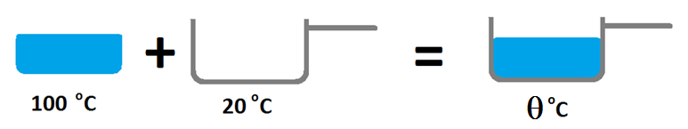
To do the calculation properly we need to look at the energy transfer.
Assuming no losses to the surroundings we have:
Heat lost by water = Heat gained by saucepan
Note in this case it is correct to use the term heat, as then energy is transferred due to the temperature difference.
Using θ for the final temperature we can write:
m_{w} c_{w} (100 – θ) = m_{p} c_{p} (θ – 20)

Slide 14
m_{w} c_{w} (100 – θ) = m_{p} c_{p} (θ – 20)
In this simple example, the mass of water, m_{w} and the mass of the pan m_{p} were both 500 g, so the m terms cancel:
c_{w} (100 – θ) = c_{p} (θ – 20)
  Using c_{w} = 4200 J kg⁻¹ K⁻¹ and c_{p} = 400 J kg⁻¹ K⁻¹ (for a typical metal gives):
  4200 x (100 – θ) = 400 x (θ – 20)
  This can be solved to give θ = 93 ºC.
  Method of mixture techniques can also be used to measure an unknown SHC of either a liquid or a solid, providing the other is known.

