Slide 1
 | Latent Heat | 13/05/2020
The term Latent means ‘hidden’.
Latent heat is normally introduced by looking at how substances cool.
This topic lends itself to lots of demos.
Normally we would start by looking at cooling curves.
The changes associated with latent heat are ‘hidden’ because the temperature of the substance stops dropping as it cools.
Lets look at some cooling curves now….

Slide 2
Specific Latent Heat of Fusion
The Specific Latent Heat of Fusion is the energy required to change unit mass (1 kg) of a substance from solid to liquid without change of temperature.
The ‘without change of temperature’ bit can also sometimes be expressed as ‘at constant temperature’ or ‘at the melting point’.
Specific Latent Heat of Vaporisation
This is defined in a very similar way – see if you can state it yourself:
The Specific Latent Heat of Vaporisation is the energy required to change unit mass (1 kg) of a substance from liquid to gas without change of temperature.

Slide 3
The Equation:
This is very simple: Q = m l
Where Q is the latent heat, m is the mass and l is the specific latent heat.
NOTE there is no Δθ term in this equation – the temperature does not change!
The unit of l is simply J kg⁻¹, again no ‘per kelvin’ term.
Specific, in this context, always means per unit mass.

Slide 4
Physical Interpretation:
You have already met the idea that in Kinetic Theory, temperature is related to the kinetic energy of the molecules.
When a substance melts or vaporises at constant temperature, the kinetic energy of the molecules does not change.
However, extra energy is put in to ‘break bonds’ or ‘separate the molecules’.
In this way, the latent heat can be thought of as changing the potential energy component of the internal energy.

Slide 5
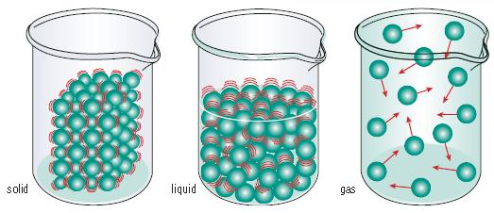
For Water:
Specific Latent Heat of Fusion = 3.34 x 10⁵ J kg⁻¹
Specific Latent Heat of Vaporisation = 2.26 x 10⁶ J kg⁻¹
SHC = 4200 J kg⁻¹ K⁻¹

