Slide 1
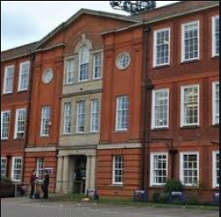
Welcome to Godalming College
Your Future Starts Here!

Slide 2
Introduction to TODAY
Welcome
Brief introduction to the colleges expectations
Your timetable
Photo and Lanyard – visit to IT
Orientation around the College
Start Lessons!

Slide 3
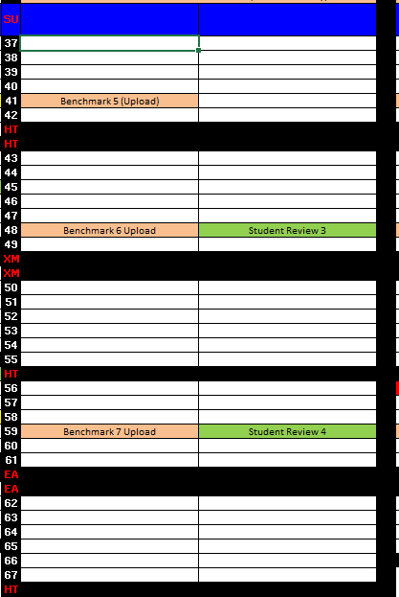
Tracking your Progress
Benchmark Assessments
Student Reviews

Slide 4
The Student Code of Conduct
Cause for Concern
Teacher to 14-16 Co-ordinator
As a Godalming College student I agree to abide by following seven obligations at all times:
To attend, and be punctual to, all timetabled commitments and fulfil all other College obligations.
To produce work, which reflects my best efforts, and is to the best of my ability.
To complete all pieces of work and administrative deadlines set by staff.
To wear my lanyard with my student ID at all times on the College premises.
You must ensure mobile phones are turned off and out of sight in lessons unless instructed otherwise by a member of staff
Under no circumstances, bring into College, or consume, or be under the influence of alcohol, illegal drugs or intoxicants of any kind.
To be responsible and considerate in and out of lessons, showing respect, at all times, to all members of the College community, as well as to members of our local community.
First Formal Warning
14-16 Co-ordinator
Second Formal Warning
14-16 Co-ordinator
Assistant Principal Warning
Assistant Principal
Principal for Exclusion
Principal

Slide 5
Timetable:
08:45 – Start
2:30 - Finish
 | PERIOD 1 | BREAK | PERIOD 2 | LUNCH | PERIOD 3 | BREAK | PERIOD 4
TUES – ChildCare | 0845-10:15 | 10:15-10:45 | 10:45-1:00 | 12:15-13:00 | 13:00-14:30
THUR – ChildCare | 0845-10:15 | 10:15-10:45 | 10:45-1:00 | 1230-13:00 | 13:00-14:30

