Slide 1
AQA
    AS Level
      Computer Science
      Paper 2
Input-output devices
  Unit 5
  Computer organisation
  and architecture

Slide 2
Objectives
Learn the main characteristics and principles of:
Barcode readers
Digital cameras
Laser printers
RFID
Understand the purpose and suitability of these devices

Slide 3
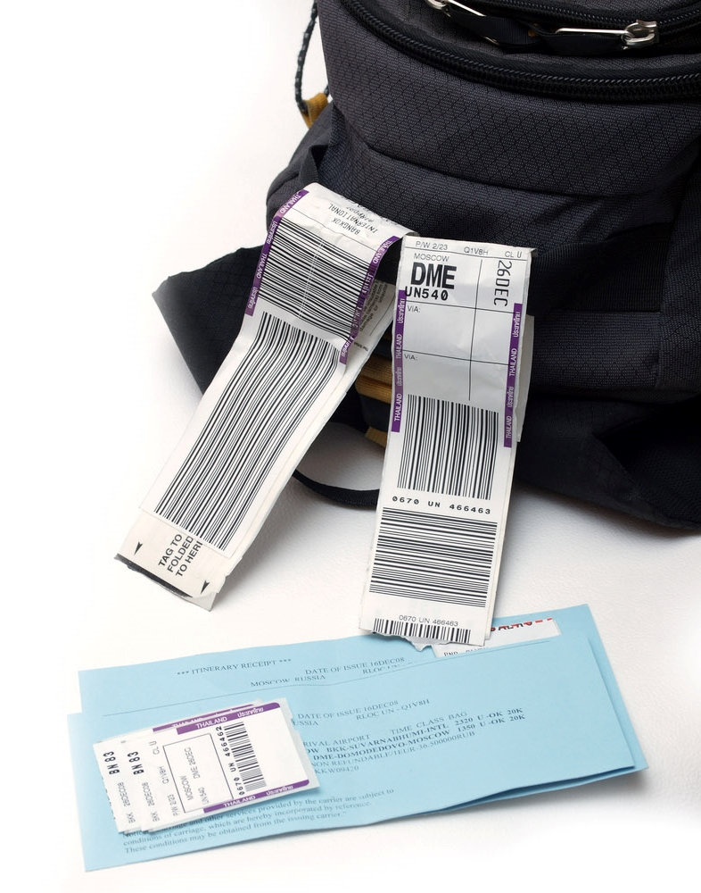
Uses of barcodes
Airline baggage tracking
Product labelling
Parcel delivery and shipment
Ticketing and identification

Slide 4
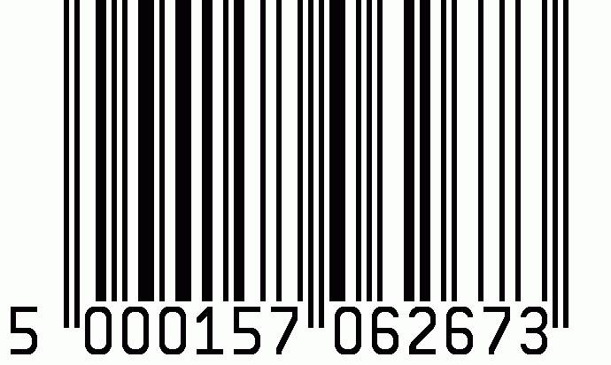
Scan here using a smartphone:

Slide 5
Barcode readers
Barcode readers typically work on the principle of reflected light
Light from a laser is directed at a pattern and a sensor detects the intensity of light that bounces back
  A black bar will absorb more light and be less reflective giving a binary reading of 1
  A white bar will be more reflective with a binary reading of 0
  The pattern of 0s and 1s creates a unique identity

Slide 6
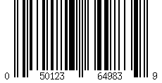
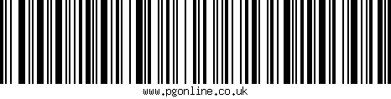
Barcode readers
Two common types of barcode system:
  Universal Product Code version ‘A’
  (UPC-A) / European Article Number
  (EAN)
  Used in retail and warehousing
  Code 128
  Used in transport and
  shipment tracking
Code 128 can represent letters and numbers whilst UPC-A and EAN can only represent numeric digits

Slide 7
UPC-A / EAN systems
This uses long guard bars to show the start and end of the barcode and also central guard bars to distinguish left uniquely from right
  UPC-A / EAN uses seven bar elements to form four alternating dark and light bars of varying thicknesses to represent each data item between the guard bars
Left:
Manufacturer
number
Right:
Product
number

Slide 8
UPC-A barcode anatomy
Start
Check digit
Left Right
Guard bars
 |  |  |  |  |  |  | 3
 |  |  |  |  |  |  | 3

Slide 9
Reading retail barcodes
Visually, a grouping of two or more adjacent bars appear as a single wide bar
  Right hand codes are the inverse of left hand codes
  Left hand codes all have an odd number of black bars. Right hand codes all have an even number
  How could this be useful?
 |  |  |  |  |  |  | 0
 |  |  |  |  |  |  | 1
 |  |  |  |  |  |  | 2
 |  |  |  |  |  |  | 3
 |  |  |  |  |  |  | 4
 |  |  |  |  |  |  | 5
 |  |  |  |  |  |  | 6
 |  |  |  |  |  |  | 7
 |  |  |  |  |  |  | 8 |  |  |  | 0
 |  |  |  |  |  |  | 9
Left Right

Slide 10
QR (Quick Response) codes
QR codes are 2D barcodes and can be read by smartphones or tablets
They can contain:
  Links to websites or
  Information
Try scanning these codes as examples:

Slide 11
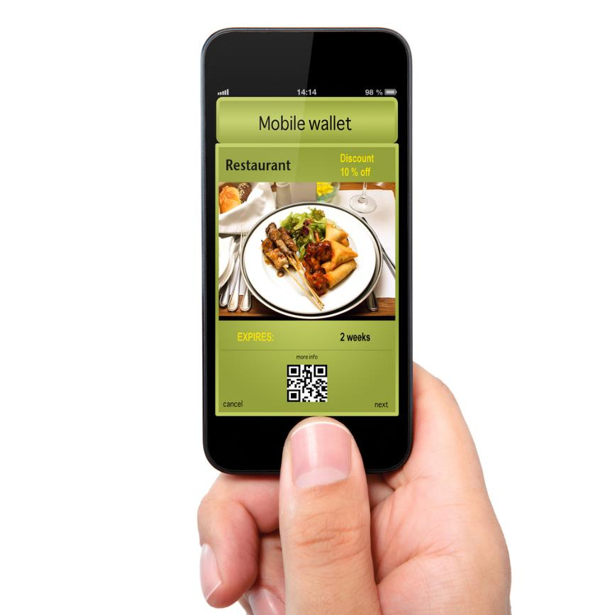
Uses of QR codes in society
Common uses include:
  Restaurant coupons
  Mobile concert tickets
  Estate agency boards
  Business cards
  Tourist information
  Advertising posters

Slide 12
Worksheet 5
Complete Task 1 questions 1 to 3 to read and create a barcode manually
 |  |  |  |  |  |  | 0
 |  |  |  |  |  |  | 1
 |  |  |  |  |  |  | 2
 |  |  |  |  |  |  | 3
 |  |  |  |  |  |  | 4
 |  |  |  |  |  |  | 5
 |  |  |  |  |  |  | 6
 |  |  |  |  |  |  | 7
 |  |  |  |  |  |  | 8 |  |  |  | 0
 |  |  |  |  |  |  | 9
Left Right

Slide 13
Digital cameras
A camera works in much the same way as a scanner
When a digital camera captures an image it breaks up what it sees through its lens into a grid of pixels
  The shutter opens to let light onto a Charge-Coupled Device (CCD) or Complementary Metal Oxide Semiconductor (CMOS) sensor at the back of the lens
  The intensity of light is measured by millions of tiny sensors (one per pixel) arranged in a grid on the sensor
  Light levels for each pixel are represented as binary values
  This information is now stored as an image in the camera’s memory

Slide 14
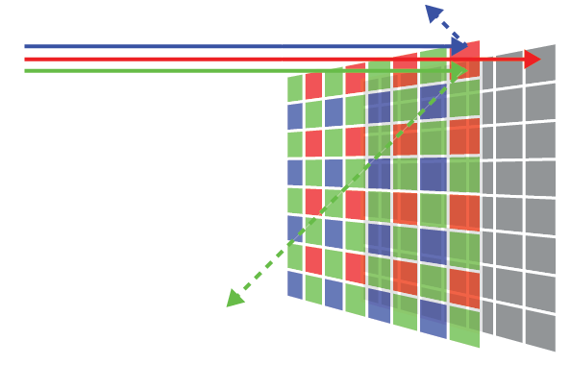
Sensing colour
Red, Green or Blue filters are used with different sensors in the camera to separate out these wavelengths
The intensity of each of these colours falling on the sensors is measured and stored to aggregate an RGB value

Slide 15
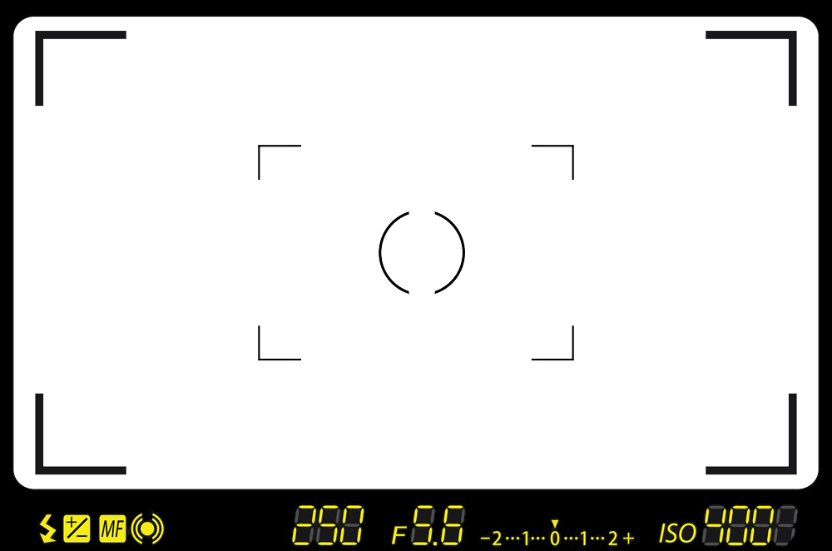
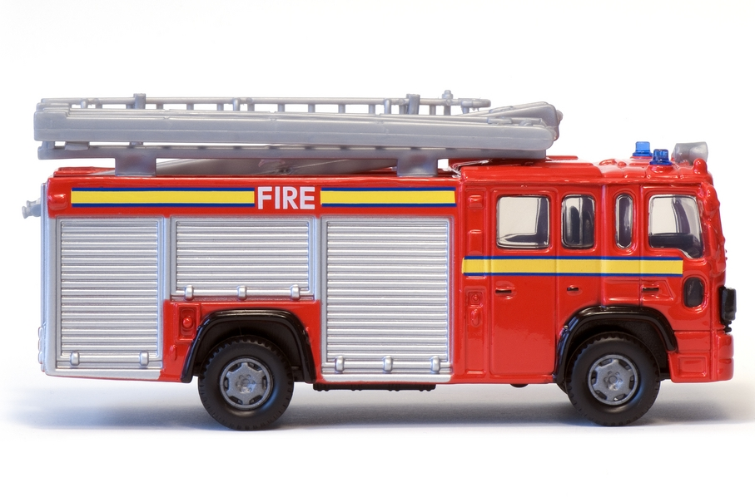
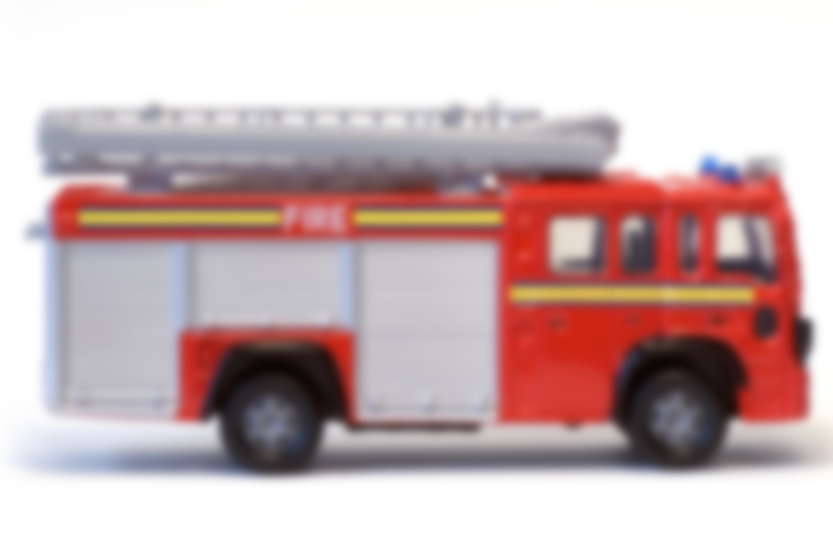
What a camera sensor sees

Slide 16
Approximating an image

Slide 17
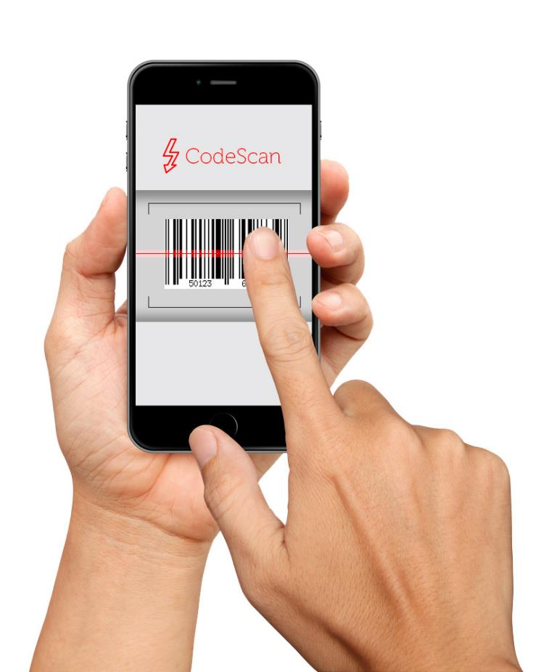
Camera-based readers
Where might a camera be used to read a barcode rather than a traditional scanner?
How might a CCD device be used to recognise a barcode or text characters?

Slide 18
Worksheet 5
Try the questions in Task 2

Slide 19

Laser printers
Laser printers use dry powdered ink called toner
  A print drum is given a negative static charge
  A laser shines a reverse image of the page at the drum
  Laser light reverses the charge on the drum
  Toner is charged negatively and sticks to positively charged image
  Toner is transferred from drum to the paper and fused using a heat roller

Slide 20
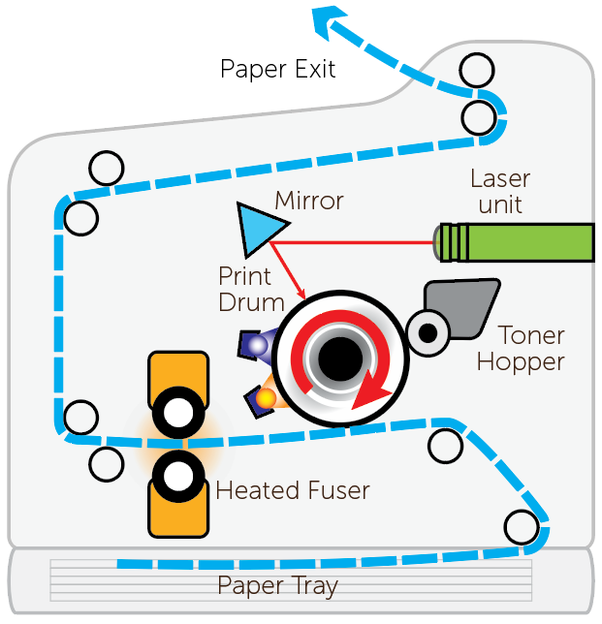
Inside a laser printer

Slide 21
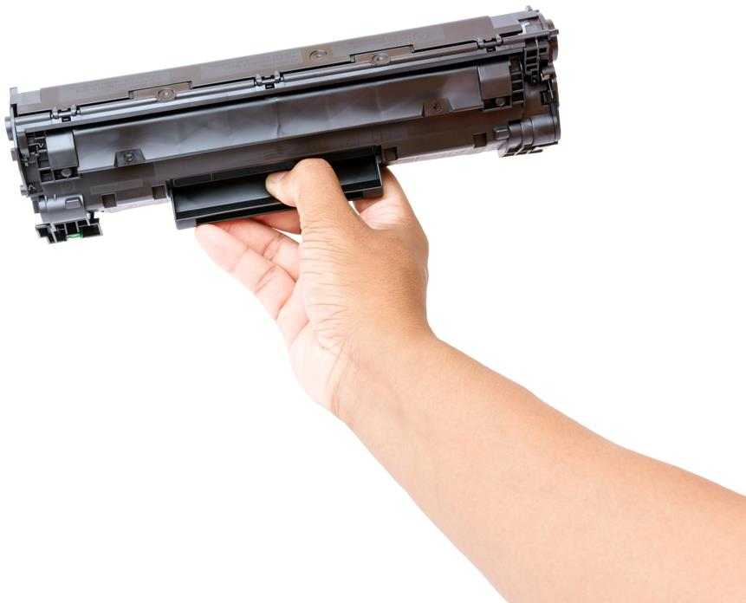
Worksheet 5
Now complete Task 3 on Worksheet 5

Slide 22
Steps in laser printing
Order | Steps
6 | As printer drum rotates a laser beam scans across it removing the negative charge in certain areas; this leaves positively charged areas which match the text or images to be printed
12 | At the very end of the printing process, a discharge lamp removes the electric charge from the drum making it ready for the next page
4 | Data sent to printer and then stored in a printer buffer
1 | Data to be printed is first sent to the printer driver
8 | Positively charged sheet of paper is then rolled over the drum
11 | Paper goes through a fuser which bonds the ink making a permanent copy
3 | Printer driver checks the status of the printer (e.g. is the printer out of toner?)
2 | Printer driver puts data into a format that the printer can process
7 | Printer drum is coated with negatively charged toner; it only sticks to the positively charged parts of the drum
5 | Printing process starts by giving printer drum a negative charge
9 | Toner on the drum now sticks to the paper producing exact copy of the text and images
10 | To prevent paper sticking to the drum, the electric charge is removed once the page has been printed

Slide 23
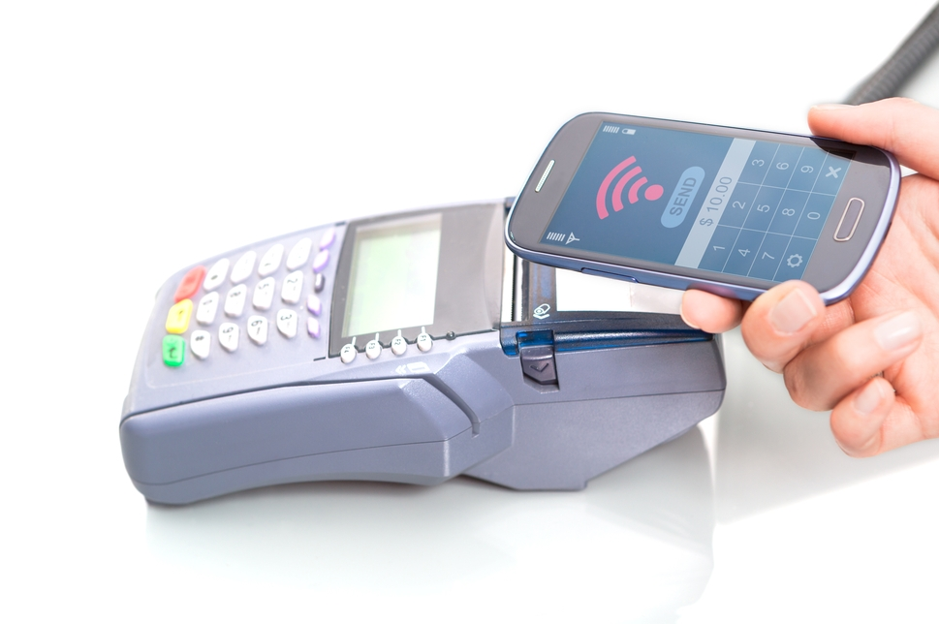
Radio Frequency ID (RFID)
RFID systems use a transponder and a receiver
  The powered receiver emits radio frequency energy
  The transponder antenna in the bank card, mobile phone or tag becomes energised by radio waves
  The transponder can then send data
  to the receiver

Slide 24
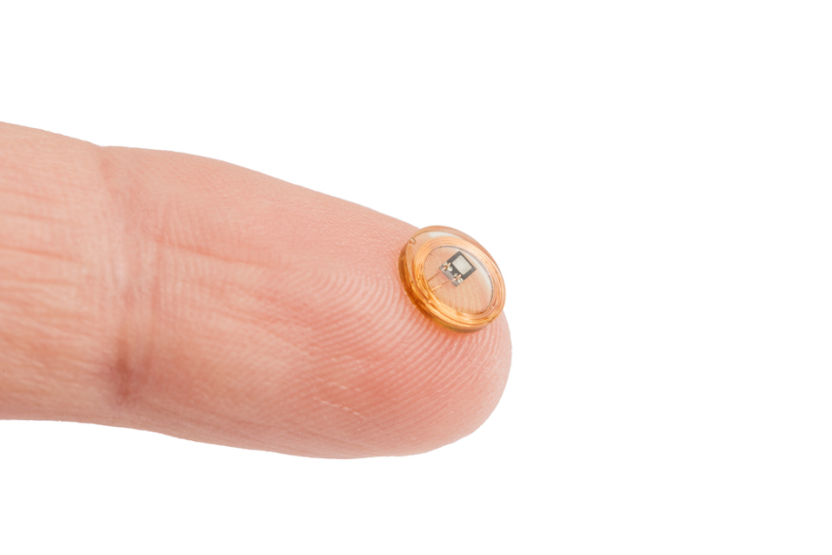
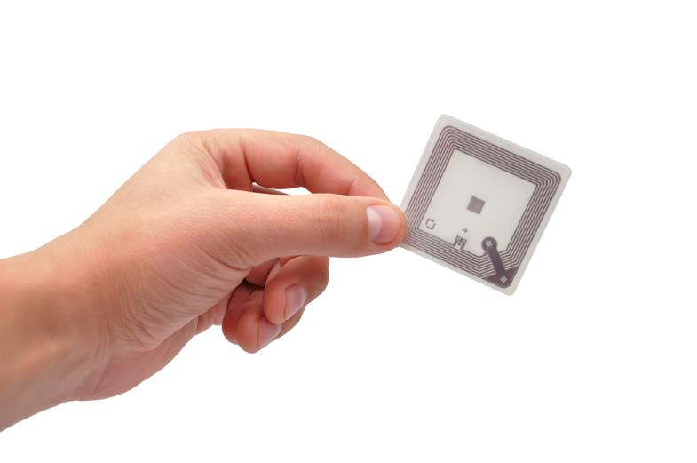
Uses of RFID tags
Security control points or identification of people, animals, goods or valuables
Shipping and supply chain tracking for goods
Banking and fast-payment systems
As a potential replacement for barcode systems

Slide 25
Passive and active tags
Passive transponders, used in bank cards for example, have no power source themselves and rely on the radio waves from the receiver for their energy
  Transponders need to be placed very close to the receiver
Active tags use a larger, battery powered beacon which can broadcast its own signal to receivers up to 300m away
  These are more useful for larger items that are not placed on a receiver by hand, for example in shipping, toll stations, warehousing and control points

Slide 26
RFID chips
Complete Task 4 of Worksheet 5

Slide 27
Plenary
Suggest suitable applications for each device:
Device | Application
Barcode scanner
Camera scanner
Digital camera
Laser printer
Passive RFID tag
Active RFID tag

