Slide 1
AQA
    AS Level
      Computer Science
      Paper 2
Secondary storage devices
  Unit 5
  Computer organisation
  and architecture

Slide 2
Objectives
Explain the need for secondary storage within a computer system
Know the main characteristics and principles of operations of:
Hard disk drives (HDD)
Optical disks
Solid-State Disks (SSD)
Understand the purposes and suitability of these devices

Slide 3
Primary and secondary storage
Primary storage is volatile and usually refers to RAM
Secondary storage refers to non-volatile storage
  Magnetic storage such as the hard disk
  Optical storage that uses laser light such as CD-ROM
  Solid state devices using Flash memory

Slide 4
Secondary storage devices
Different technologies have evolved for saving data
Each of these have their own advantages and disadvantages in terms of:
  Durability
  Read / write speed
  Capacity
  Portability and
  Cost

Slide 5
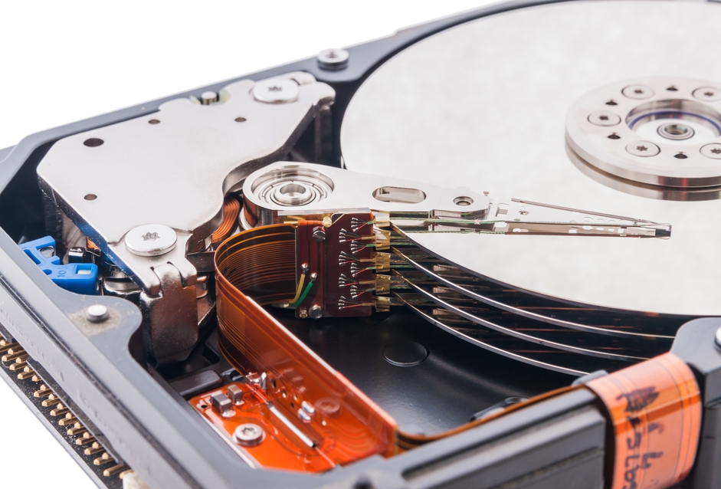
Inside a hard disk

Slide 6
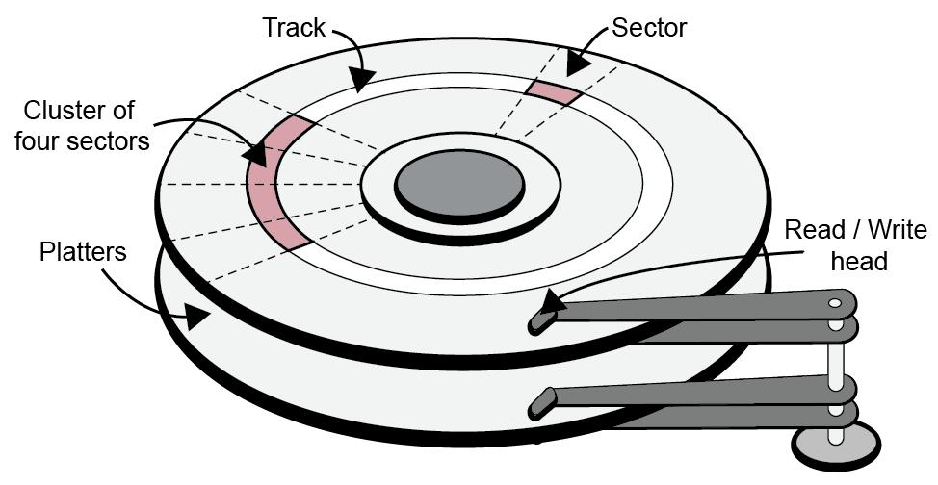
Tracks, sectors and platters
Concentric tracks are created on a magnetic disk
Disk spins at high speed: 3,600 – 7,200rpm
Spinning platters are each read by drive heads
  Data is read or written as sector moves under the head

Slide 7
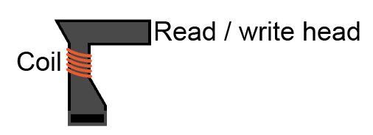
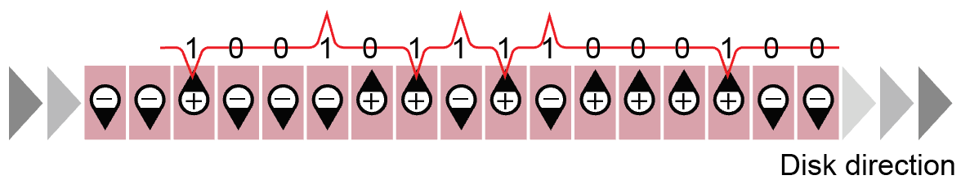
Magnetic storage devices
Positive or negative polarisation of magnetic particles creates a binary pattern on the disk
  Changes from negative to positive, or vice-versa creates electromagnetic pulses
  Each pulse (or change) is read as a 1. Anything else is a 0
  What would the next two binary readings be?

Slide 8
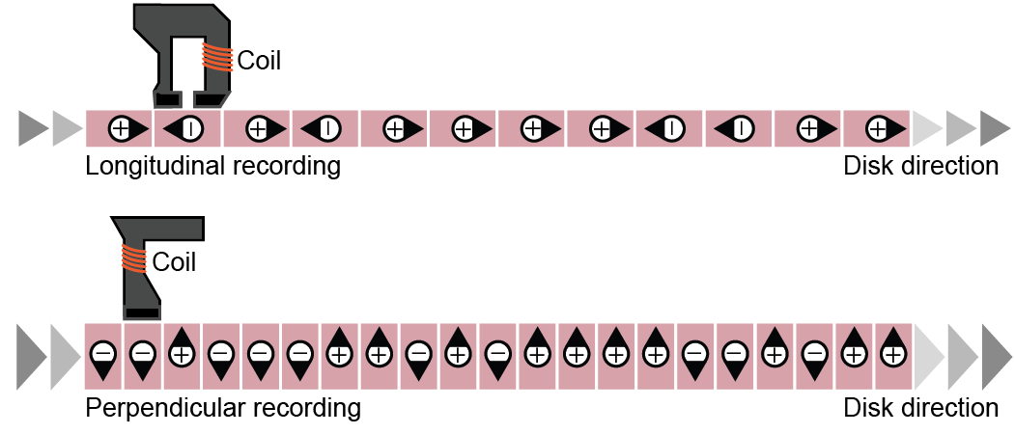
Development of HDDs
Fitting more data in the same physical space has required technological changes
  More densely packed platters
  Smaller magnetic parts and read/write heads
  Perpendicular over longitudinal recording – which is better?

Slide 9
Disk latency
Latency is the time taken to read/write disk data
This includes:
  Seek delay - the time the head takes to move across the disk
  Rotational delay - the time the disk takes to move to the correct sector underneath the read/write head
  Transfer time to move the actual data

Slide 10
Worksheet 6
Complete Task 1 Hard drive operation

Slide 11
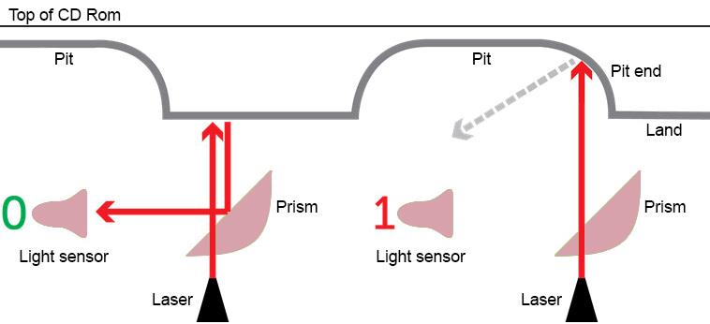
CDs work on similar principles
A high powered laser “burns” pits into the CD surface
  A low-powered laser detects the reflection from pits and lands
  Only a pit end or start deflects the laser light to be read as a binary 1 by the light sensor

Slide 12
Optical disk formats
Optical disks are available as:
  Read only
  Recordable and
  Re-writable formats
Each format uses slightly different techniques to achieve a differential between a ‘pit’ and a ‘land’
  Recordable formats use a transparent dye that becomes opaque when heated by a laser
  Re-writable formats use a laser to change the state of a phase-change alloy and a magnet to set the new state

Slide 13
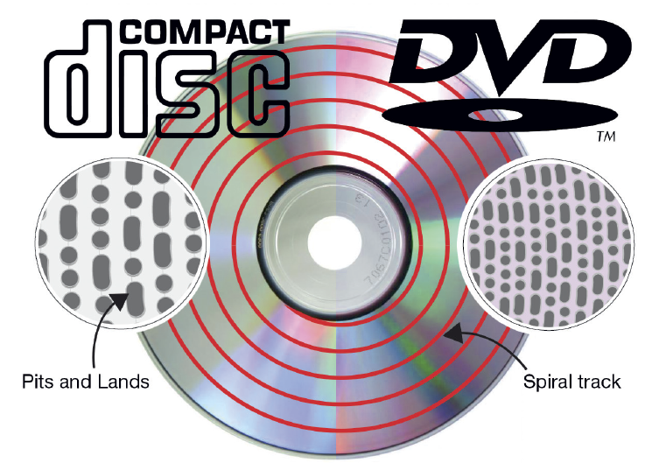
CDs, DVDs and BluRay
Why are the capacities of these discs different given they are all the same physical size?
  Different laser wavelengths ‘burn’ smaller pits
  The spiral track can therefore be more tightly wound, creating a longer track

Slide 14
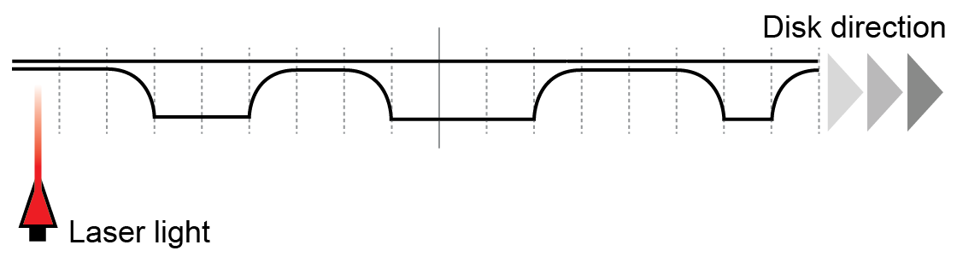
Worksheet 6
Complete Task 2 Reading a CD-ROM

Slide 15
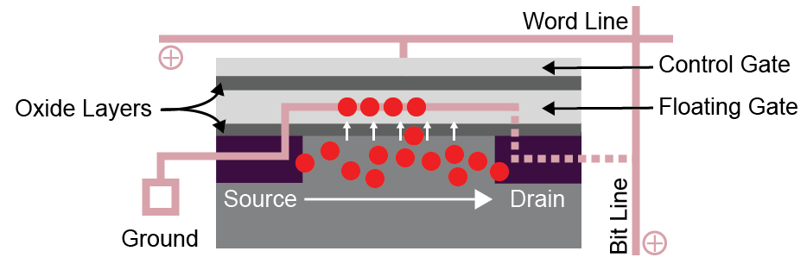
NAND flash memory cells
Flash memory contains no moving parts
Floating gate transistors trap and store a charge
  The charge is retained without power

Slide 16
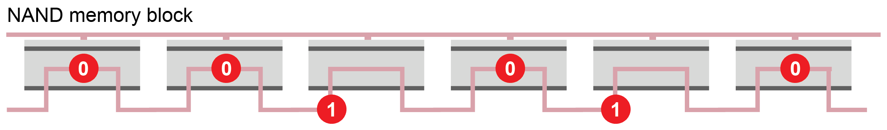
Combining flash memory cells
Cells are combined in blocks
  An electron trapped inside the middle layer reads as a 0, outside the middle is read as a 1
  Data must be read, deleted or written in blocks
  Data cannot be overwritten without being erased first
How would you change the value of one bit in
a block?

Slide 17
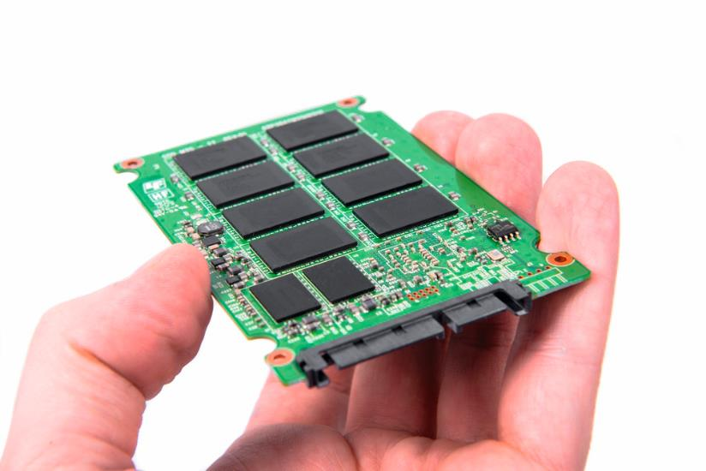
Inside a Solid State Disk (SSD)
A Solid State Disk comprises millions of NAND flash memory cells
Cells are also managed by a controller that organises pages and blocks of memory
  These are arranged within an array of chips on a circuit board

Slide 18
Solid State Disks
The advantages of an SSD over a traditional Hard Disk are as follows:
  Faster access speed as there is no moving read/write head
  Lower power consumption
      Extended battery life in portable devices
      Devices stay cooler
  Less susceptible to damage
  Silent in operation
  Lighter in weight

Slide 19
Flash memory
Complete Task 3 on Worksheet 6

Slide 20
Capacity and access speed
The development of solid state media is moving very quickly and set to replace traditional hard drives in most instances
Media | Capacity | Access speed
Hard disk | 512 GB – 4 TB | Fast
CD-ROM | 650 – 700 MB | Medium
DVD | 4.7 – 9.4 GB | Medium
BluRay Disk | 25 – 50 GB | Medium
Solid State Disk | 4 GB – 16 TB | Very fast

Slide 21

Military data storage systems
What storage medium is best suited to field combat?
Why?

Slide 22
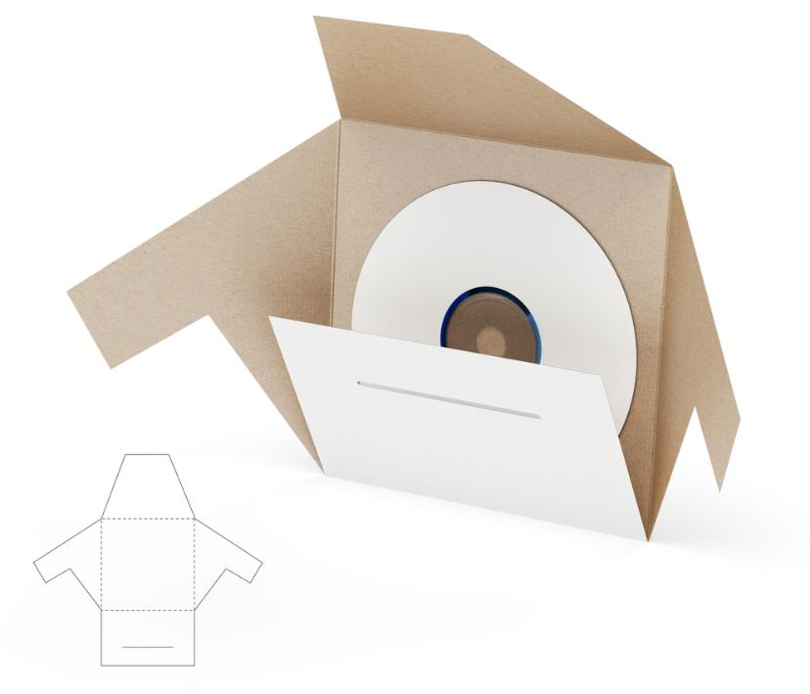
Software mailing
Often best suited to optical disks
Cheap to manufacture and distribute
Robust during carriage
Lightweight

Slide 23
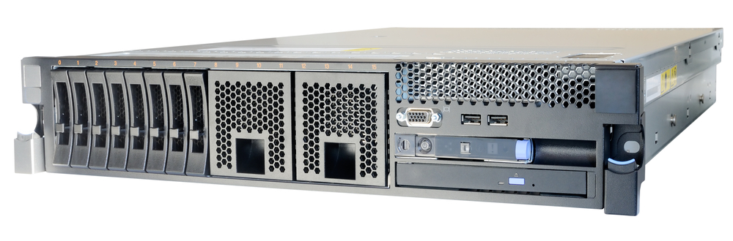
Company server data
Hard disks have very high capacity
Fast read and write speeds
Relatively cheap storage per TB

