Slide 1
AQA
    AS Level
      Computer Science
      Paper 2
Internal computer hardware
  Unit 5
  Computer organisation
  and architecture

Slide 2
Objectives
Identify the internal components of a computer system
Understand the role of the processor, main memory, buses and I/O controllers
Describe how these components are connected and how communication is controlled between them
Determine the most appropriate computer architecture for a given application
Understand the concept of addressable memory
Describe the stored program concept

Slide 3
What is a computer system?
A computer system is any device that can take a set of inputs and process them into useful outputs
Barcode reader
Translate to digits, validate, look up
Product code, name, price
Touchscreen presses
Characters encoded
Text message displayed
Input
Process
Output

Slide 4
Worksheet slide
Complete Task 1 of Worksheet 1

Slide 5
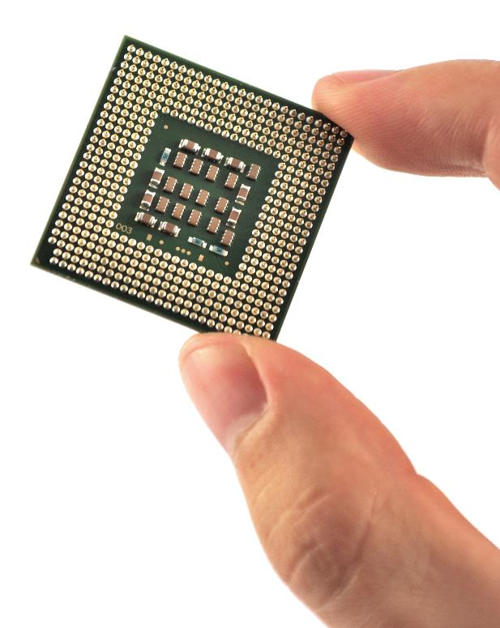
Internal hardware components
A computer system incorporates all of the hardware and software required to operate it
The hardware includes the Central Processing Unit (CPU), input, output and storage devices
In this lesson we will be looking in more detail at the CPU

Slide 6
Parts of the CPU
The CPU contains the following components:
  Processor
  Main memory
  Address, control and data buses
  Input/Output (I/O) controllers
How do the processor components communicate with each other? What is a “bus”? What is a “controller”?

Slide 7
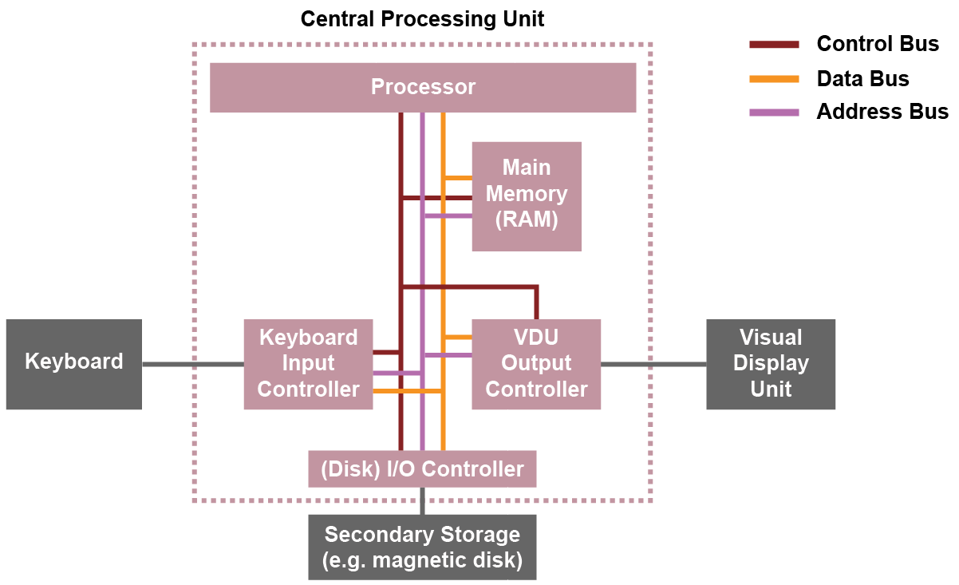
Inside the CPU

Slide 8
I/O controllers
External devices such as printers, scanners, microphones etc. are produced by different manufacturers
They cannot be directly connected to the processor
An I/O controller for each peripheral device acts as an interface between the device and the computer

Slide 9
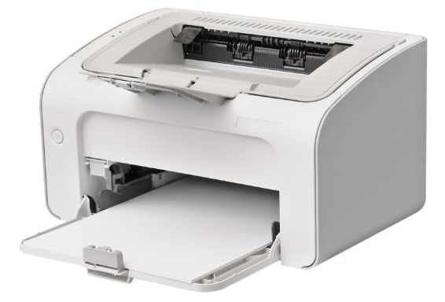
Device drivers
The software that interacts directly with the I/O controller is called a device driver
When you install a new device (e.g. a new printer) you must install the device driver for it

Slide 10
Tasks of an I/O controller
The controller converts the signals received from a peripheral device into a format the computer can process, and vice versa
It receives I/O requests from the CPU, and then sends device-specific control signals to the device it is controlling
It also manages the data flow to and from the device, freeing the CPU to get on with other tasks

Slide 11
Sending information via buses
The control bus is used to send control signals between each I/O controller and the processor, as well as between the processor and memory
The data bus sends data between CPU components
The address bus sends memory addresses from the processor to CPU components

Slide 12
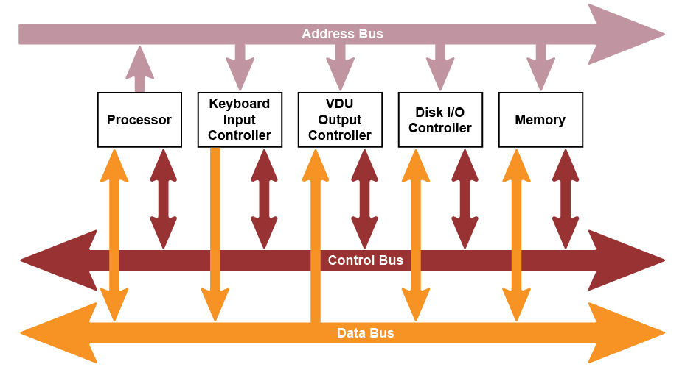
System buses
The system bus comprises three separate buses:

Slide 13
Control signals include…
Memory read: causes data from the addressed location to be placed on the data bus
Memory write: causes data on the data bus to be written into the addressed location
Bus request: indicates that a device is requesting use of the data bus
Bus grant: indicates that the CPU has granted access to the data bus
Clock: used to synchronise operations

Slide 14
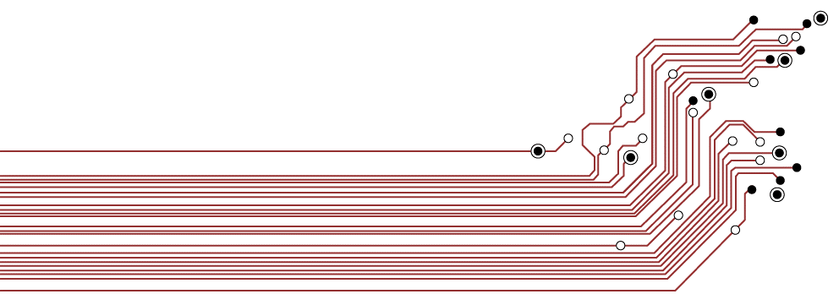
What is a bus?
Buses in a computer consist of a series of wires that transfer data signals between internal components
They typically consist of 8, 16, 32 or 64 lines

Slide 15
Words
Memory is divided up in equal units called words
Word length is usually 8, 16, 32 or 64 bits
Each word has a separate memory address
  What would be the memory capacity in bytes of a machine with an 8-line address bus and a word length of 8 bits?
Address | Data or instruction
00000000 | 01101001
00000001 | 01101100
00000010
00000011 | 10011111

Slide 16
Data bus
The data bus is bi-directional as data can be sent both ways along the bus
The width of the data bus is defined by the number of wires or lines it contains
If the data bus is the same width as a computer word, data can be transferred to and from memory in a single operation
  If it is 16 lines and a word is 32 bits, it will require two memory access and data transfer operations
Bus width affects overall system performance

Slide 17
Address bus
This bus carries the address of a memory location in one direction from the processor to I/O controllers and memory
It may, for example, be the address of the next instruction to be processed, or data referred to in the instruction
The width of the address bus determines the maximum possible memory addresses of the system
A 32-bit bus can carry 2³² (4GiB) addresses

Slide 18
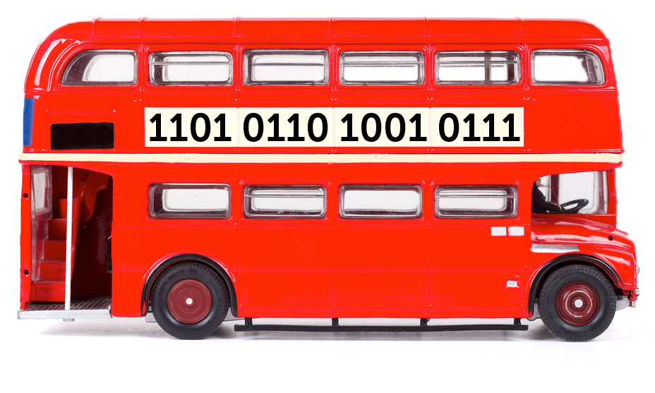
Worksheet 1
Complete Task 2 - System buses

Slide 19
Main memory
Main memory stores data and instructions that are to be processed
The number of memory addresses is constrained by the width of the address bus
  How many unique addresses would you have with an address bus width of 16 bits?
Each address can store a fixed number of bits determined by the type of processor
The smallest addressable unit is called a word

Slide 20
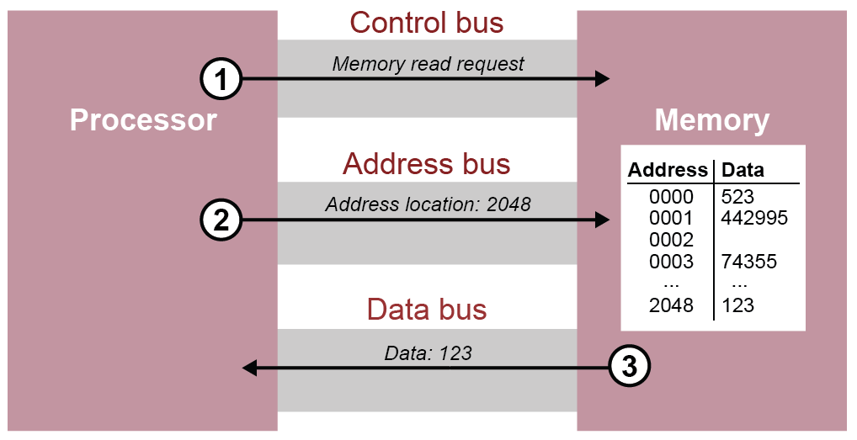
Reading data from memory

Slide 21
Worksheet 1
Complete Task 3 - Word length

Slide 22
Multipurpose machines
Early computers were able to calculate an output using fixed instructions. They could perform only one set of instructions
A general purpose computer can perform many different tasks at different times
Their programming is not fixed
To achieve this, computers are designed to allow data and instructions to be stored – this is called the stored program concept

Slide 23
Stored program concept
Machine code instructions are loaded into main memory to be executed by the processor
The instructions are fetched one at a time and executed immediately by the processor in a sequential order

Slide 24
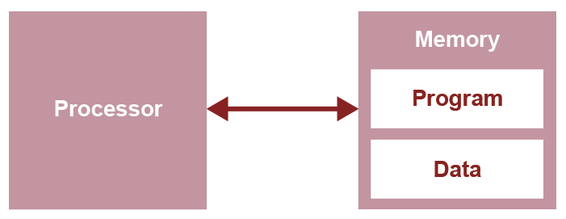
John von Neumann
The most common implementation of this concept is the von Neumann architecture
Instructions and data are stored in a common main memory and transferred using a single shared bus
  What compromises might there be with a shared bus?

Slide 25
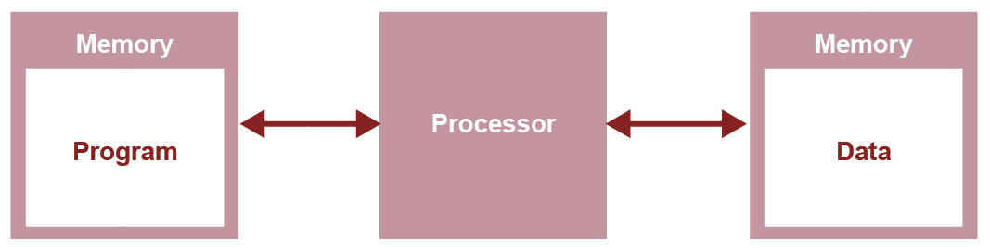
Harvard architecture
An alternative model separates the data and instructions into separate memories using different buses
  Program instructions and data are no longer competing for the same bus

Slide 26
Programs and data buses
Program instructions and data may be stored in unequal quantities
A Harvard architecture means that different sized memory spaces and word lengths can be used for data and instructions
  This architecture is most commonly used with embedded systems performing specialist functions rather than general purpose machines

Slide 27
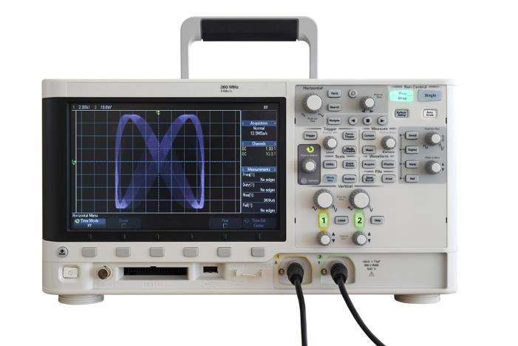
A comparison
Owing primarily to cost and programming complexity, almost all general purpose computers are based on von Neumann’s principles
  Harvard principles are usually used with specialist embedded systems such as digital signal processing where speed takes priority over the complexities of design

Slide 28
Worksheet slide
Complete Task 4 on Worksheet 1

