Slide 1
Computer Architecture Revision

Slide 2
Q1
Describe four steps that a processor goes through during the fetch stage of the Fetch-Execute cycle.
You must explain the purpose of each step.
(Total 8 marks)

Slide 3
Description | Explanation
Contents of the Program Counter / PC transferred to the Memory Address Register / MAR | so that the PC can be updated // to enable the memory address to be transferred along the address bus/to the memory
Contents of MAR placed onto address bus | so the correct location in the main memory will be accessed
Contents of addressed memory location/value received on data bus loaded into the Memory Buffer Register / MBR | not all fetches will be for instructions so cannot be loaded directly into Current Instruction Register / CIR // the value will only be present transiently on the bus so must be stored in a register // the MBR is used to cope with the speed difference between the processor and the main memory
(Contents of) PC is incremented | so that the next instruction in the sequence can be fetched
The contents of the MBR is copied to the CIR | so that if data is fetched/written during the execute phase it does not overwrite the instruction // because the control unit uses the instruction from the CIR
Max 4 for descriptions, Max 4 for explanations, Max 8

Slide 4
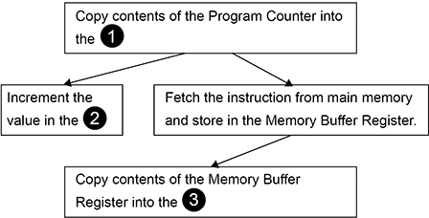
Q2
The diagram below describes the fetch part of the Fetch-Execute cycle. Some of the names of registers have been omitted from the figure and replaced with the numbers 1 to 3
State the full names of the registers that should appear in the diagram where the numbers are.

Slide 5
Q2
Number | Full Name of Register
1 | Memory Address Register NE. MAR
2 | Program Counter NE. PC
3 | Current Instruction Register NE. CIR, IR A. Instruction Register
1 mark: Two registers correctly named OR
2 marks: All three registers correctly named

