Slide 1
AQA
    AS Level
      Computer Science
      Paper 2
Number systems
  Data representation

Slide 2
Objectives
Categorise numbers as natural, integer, rational, irrational, real or ordinal
Understand how a number’s base affects its value
Convert between decimal, binary and hexadecimal number systems

Slide 3
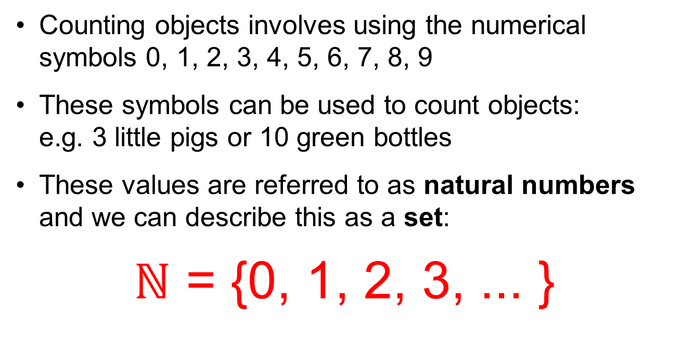
Numbers for counting
Counting objects involves using the numerical symbols 0, 1, 2, 3, 4, 5, 6, 7, 8, 9
These symbols can be used to count objects:
e.g. 3 little pigs or 10 green bottles
These values are referred to as natural numbers and we can describe this as a set:
$ℕ$ = {0, 1, 2, 3, ... }

Slide 4
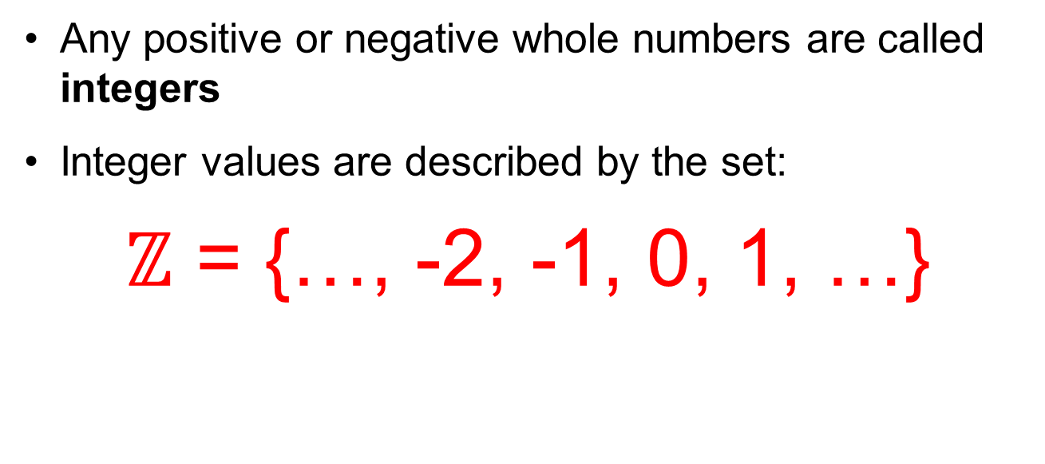
Whole numbers
Any positive or negative whole numbers are called integers
Integer values are described by the set:
$ℤ$ = {…, -2, -1, 0, 1, …}

Slide 5
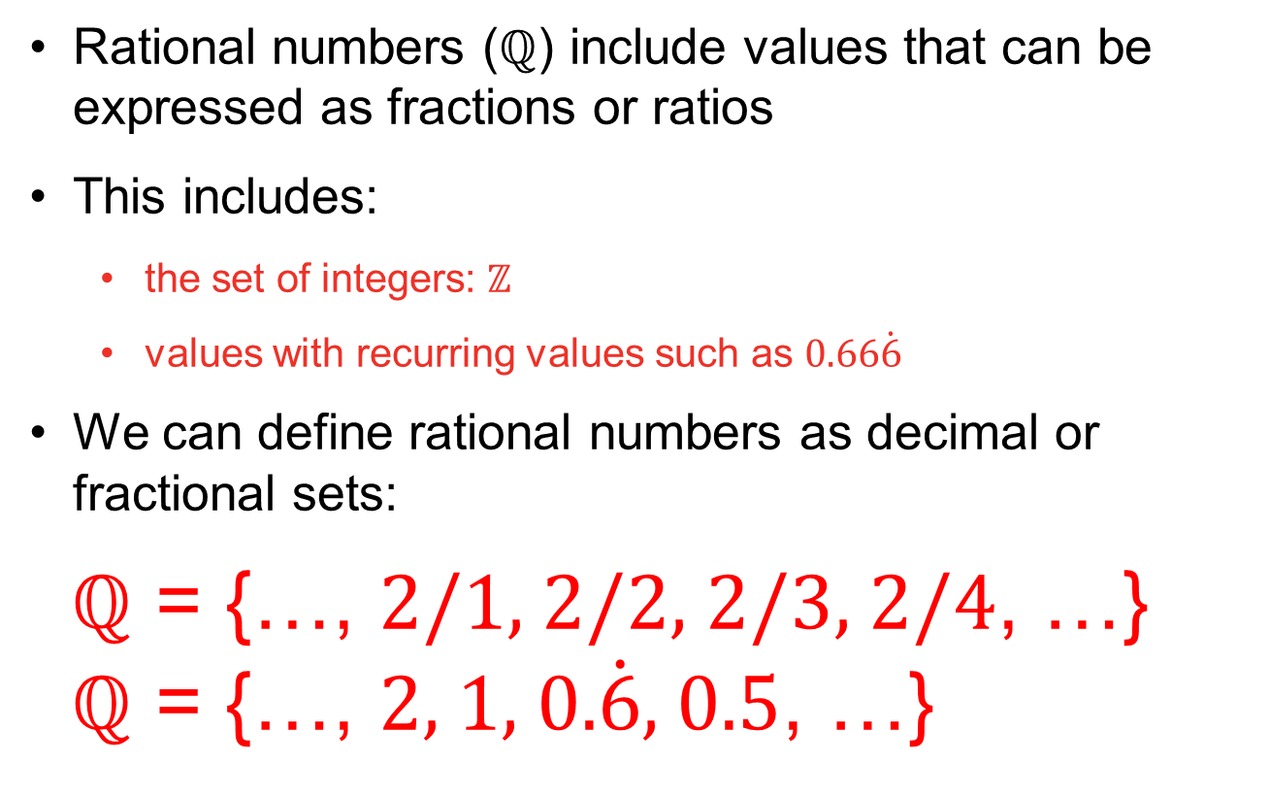
Rational numbers
Rational numbers ($ℚ$) include values that can be expressed as fractions or ratios
This includes:
  the set of integers: $ℤ$
  values with recurring values such as 0.66$\dot{6}$
We can define rational numbers as decimal or fractional sets:
$ℚ$ = {…, 2/1, 2/2, 2/3, 2/4, …}
$ℚ$ = {…, 2, 1, 0.$\dot{6}$, 0.5, …}

Slide 6
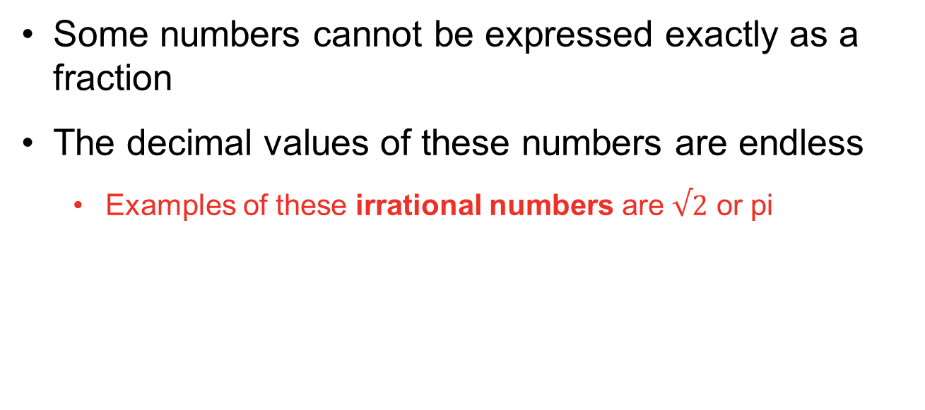
Irrational numbers
Some numbers cannot be expressed exactly as a fraction
The decimal values of these numbers are endless
  Examples of these irrational numbers are $√2$ or pi

Slide 7
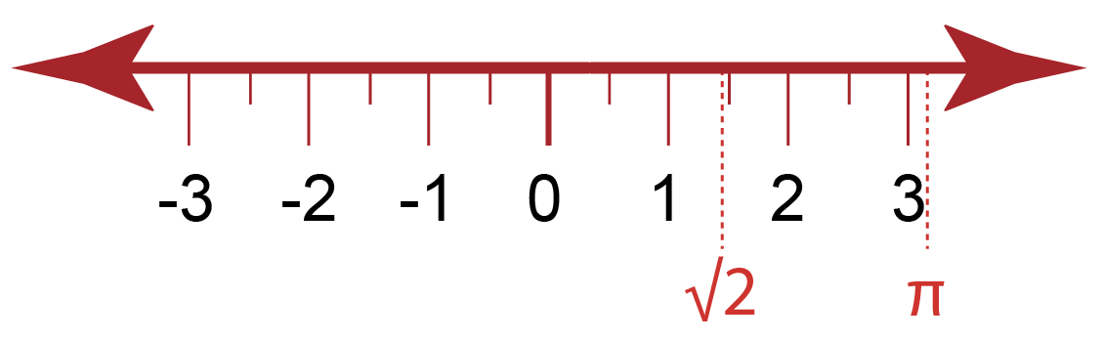
Real numbers
If a number is either rational, (an integer or a fraction) or irrational, it is considered to be a
real number ℝ
A real number is used for measurement

Slide 8
Order
As an extension of this, numbers can be used to describe the position in which values appear
For example, in an ordered list of names…
…Belinda would be second, Diane fourth, and so on
These values are called ordinal numbers
Adam | Belinda | Colin | Diane | Eric

Slide 9
Activity
Complete Worksheet 1, Task 1 on number theory

Slide 10
Binary number system
The binary number system uses only two digits:
0 and 1
To understand how this works, it is helpful to look first at the fundamentals of the denary or decimal system, which uses digits 0..9

Slide 11
Number symbols
The decimal number system uses a combination of just ten symbols to represent any number
Number systems are referred to by their base; that is, the number of symbols used to construct values
Decimal is base 10 and the base may be referred to as a subscript
  In decimal the number 11, for example, may be written as 11₁₀
  In binary, it would be written as 11₂ and hexadecimal as 11₁₆
  11₁₀, 11₂ and 11₁₆ all represent different values

Slide 12
Base 2
Numbers which use base 2 are commonly referred to as binary numbers
Can you see a pattern in the binary values?
Denary | Binary
1 | 1
2 | 10
3 | 11
4 | 100
5 | 101
6 | 110
7 | 111
8 | 1000
9 | 1001
10 | 1010
11 | 1011

Slide 13
Place value
In any counting system, the position of the value determines its contribution to the overall total
Therefore 183₁₀ represents the value of
one hundred, eight tens and three units
Base^{position} | 10² | 10¹ | 10⁰
Place value | 100 | 10 | 1
Number | 1 | 8 | 3
Digit value | 100x1 | 10x8 | 1x3

Slide 14
The binary system
Binary works the same way, except the base used is 2 instead of 10
Therefore 1 0 1 1 0 1 1 1₂ represents
128 + 32 + 16 + 4 + 2 + 1 which is equivalent to 183₁₀
Base^{position} | 2⁷ | 2⁶ | 2⁵ | 2⁴ | 2³ | 2² | 2¹ | 2⁰
Place value | 128 | 64 | 32 | 16 | 8 | 4 | 2 | 1
Number | 1 | 0 | 1 | 1 | 0 | 1 | 1 | 1
Digit value | 128x1 | 0 | 32x1 | 16x1 | 0 | 4x1 | 2x1 | 1x1

Slide 15
Converting from decimal
The place value table is useful to aid conversion from decimal to binary
  Convert 159₁₀ to binary
Place value | 128 | 64 | 32 | 16 | 8 | 4 | 2 | 1
Number | 1 | 0 | 0 | 1 | 1 | 1 | 1 | 1
1. Can 128 be used to make some of 159?
2. If it can, use it by setting bit value to 1, (0 if not)
3. If value used subtract from starting value,
eg. 159 – 128 = 31
4. Repeat using value from step 3

Slide 16
Activity
Complete Task 2 in Worksheet 1

Slide 17
Hexadecimal – Base 16
Number systems with bases above 10 often still use 0 to 9 but require extra symbols for values past 9
An example of this is base 16 which is referred to as the hexadecimal number system
Hexadecimal uses letters for the values 10 to 15
0 | 1 | 2 | 3 | 4 | 5 | 6 | 7 | 8 | 9 | 10 | 11 | 12 | 13 | 14 | 15
0 | 1 | 2 | 3 | 4 | 5 | 6 | 7 | 8 | 9 | A | B | C | D | E | F

Slide 18
Hexadecimal values
The rules of place value work in the same way:
Therefore the equivalent of 3F5₁₆ in decimal is
(256x3) + (16x15) + 5 = 768 + 240 + 5 = 1013₁₀
What is A3₁₆ in decimal?
Base^{position} | 16² | 16¹ | 16⁰
Place value | 256 | 16 | 1
Number | 3 | F (or 15) | 5
Digit value | 256 x 3 | 16 x 15 | 1 x 5

Slide 19
Denary to hex conversion
Converting to two-digit hexadecimal numbers
Divide the number by 16, and add the remainder
What is 27₁₀ in hexadecimal?
43 | ÷ | 16 | = | 2 remainder 11
11 |  |  | = | B
 |  |  | = | 2B

Slide 20
Significant powers
Work out the following powers of 2:
Why is the answer to 2⁴ significant?
2⁰ =
2¹ =
2² =
2³ =
2⁴ =

Slide 21
Significance of 16
16 is the fourth power of 2
This means that base 16 numbers can be translated from 4 consecutive bits of a binary value
This makes it simple to translate binary numbers into hexadecimal values and back again
 |  | 8 | 4 | 2 | 1 | 8 | 4 | 2 | 1
216 | = | 1 | 1 | 0 | 1 | 1 | 0 | 0 | 0
 | = | D |  |  |  | 8

Slide 22
Activity
Complete Task 3 on Worksheet 1

Slide 23
Why use hex?
A hexadecimal value is much easier to read and remember than a string of binary digits
It is quicker to write or type, since a hex digit takes up only one character, not four
There is less chance of making an error when typing hex characters than a string of 1s and 0s
It is used to define colours, in MAC addresses, in assembly languages and machine code
It is very easy to convert to and from binary

Slide 24
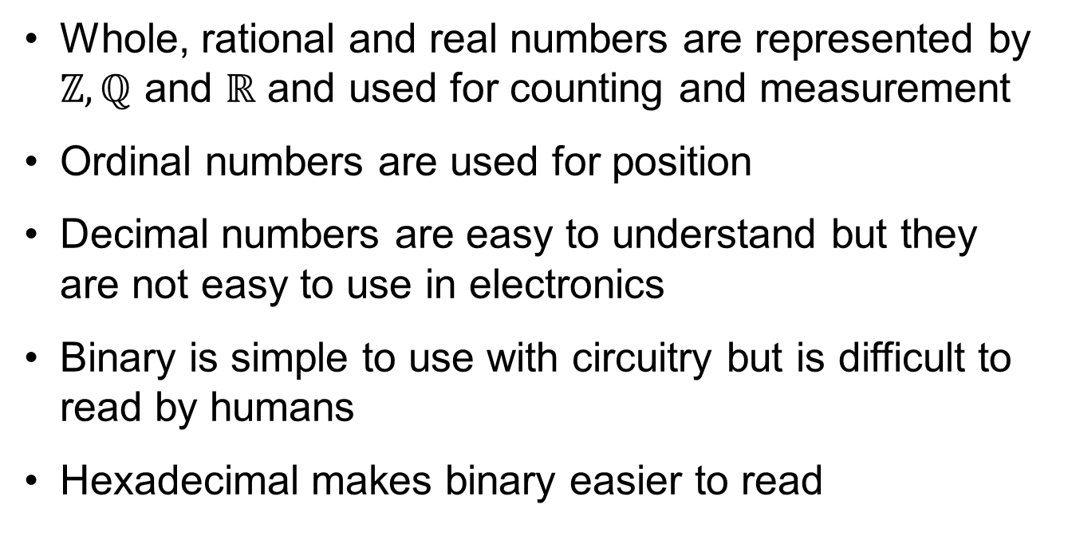
Plenary
Whole, rational and real numbers are represented by $ℤ, ℚ$ and ℝ and used for counting and measurement
Ordinal numbers are used for position
Decimal numbers are easy to understand but they are not easy to use in electronics
Binary is simple to use with circuitry but is difficult to read by humans
Hexadecimal makes binary easier to read

