Slide 1

Binary Arithmetic
Computer Science A Level

Slide 2
Binary Arithmetic
Add & multiply together two unsigned binary numbers
Use two’s complement to represent positive and negative numbers
Use two’s complement to perform binary subtraction
Understand how fractions can be represented in binary
Use fixed point binary to represent a real number, in a given number of bits

Slide 3
Binary Arithmetic
All computer instructions are based on the fundamental arithmetic operators – what are they?
Notes:
Addition, Subtraction, Multiplication and Division
Also comparison or Boolean operations, e.g. equal to, greater than, less than etc.

Slide 4
Denary Addition
How would you add together 19 and 17?
1
What about 103 and 12?
1
9
+
1
7
=
3
6
Notes:
Addition, Subtraction, Multiplication and Division
Also comparison or Boolean operations, e.g. equal to, greater than, less than etc.
Talk about carrying 10’s, 100’s etc

Slide 5
The rules of binary addition:
0+0 = 0
0+1 = 1
1+0 = 1
1+ 1 =…….?
1+1+1 = …..?
Notes:
1+1 = 0 c1
1+1+1 = 1 c1

Slide 6
Worked Example:
128 | 64 | 32 | 16 | 8 | 4 | 2 | 1
0 | 1 | 1 | 1 | 1 | 0 | 1 | 1 | 123
0 | 1 | 1 | 0 | 1 | 0 | 0 | 0 | 104
 |  |  |  |  |  |  | 1
Start on the RIGHT 1+0 = 1

Slide 7
Worked Example:
0 | 1 | 1 | 1 | 1 | 0 | 1 | 1
0 | 1 | 1 | 0 | 1 | 0 | 0 | 0
 |  |  |  |  |  | 1 | 1
Same again 1+0 = 1

Slide 8
Worked Example:
0 | 1 | 1 | 1 | 1 | 0 | 1 | 1
0 | 1 | 1 | 0 | 1 | 0 | 0 | 0
 |  |  |  |  | 0 | 1 | 1
0+0 = 1

Slide 9
Worked Example:
0 | 1 | 1 | 1 | 1 | 0 | 1 | 1
0 | 1 | 1 | 0 | 1 | 0 | 0 | 0
 |  |  |  | 0 | 0 | 1 | 1
 |  |  | 1
1+1 = 0, c1 so enter a 0 into the column and carry 1 to the next column.

Slide 10
Worked Example:
0 | 1 | 1 | 1 | 1 | 0 | 1 | 1
0 | 1 | 1 | 0 | 1 | 0 | 0 | 0
 |  |  | 0 | 0 | 0 | 1 | 1
 |  | 1 | 1
1+0+1 = 0, c1 so enter a 0 into the column and carry 1 to the next column.

Slide 11
Worked Example:
0 | 1 | 1 | 1 | 1 | 0 | 1 | 1
0 | 1 | 1 | 0 | 1 | 0 | 0 | 0
 |  | 1 | 0 | 0 | 0 | 1 | 1
 | 1 | 1 | 1
1+1+1 = 1, c1

Slide 12
Worked Example:
0 | 1 | 1 | 1 | 1 | 0 | 1 | 1
0 | 1 | 1 | 0 | 1 | 0 | 0 | 0
 | 1 | 1 | 0 | 0 | 0 | 1 | 1
1 | 1 | 1 | 1
Same again – 1+ 1+ 1

Slide 13
Worked Example:
0 | 1 | 1 | 1 | 1 | 0 | 1 | 1 | 123
0 | 1 | 1 | 0 | 1 | 0 | 0 | 0 | 104
1 | 1 | 1 | 0 | 0 | 0 | 1 | 1 | 227
1 | 1 | 1 | 1
0+0+1 = 1

Slide 14
Take 5 minutes to research OVERFLOW errors – what are they and how are they caused?

Slide 15
Binary addition
Complete Worksheet 3, Task 1

Slide 16
Denary Multiplication
How would you multiply together 1485 and 46?
Notes:
Introduce binary multiplication through a demonstration of long multiplication in the ordinary decimal system. Show how 1485 x 46 needs to be worked out as a series of separate multiplications with the results added together. Explain the four simple rules of multiplication. Work through the multiplication 1010₂ x 101₂. Note that for each digit in the multiplier, the multiplicand is shifted along one place to the left and appended to with trailing zeros. The results are added together to find the answer.

Slide 17
Denary Multiplication
 |  | 1 | 4 | 8 | 5
x |  |  |  | 4 | 6
 |  | 8 | 9 | 1 | 0
 | 5 | 9 | 4 | 0 | 0
 | 6 | 8 | 3 | 1 | 0
 | 1 | 1
Step 1: 1485 multiplied by 6
Step 2: 1485 multiplied by 40
(or 4 with a zero at the end)
Step 3: Add the answers from steps 1 and 2
Notes:
Introduce binary multiplication through a demonstration of long multiplication in the ordinary decimal system. Show how 1485 x 46 needs to be worked out as a series of separate multiplications with the results added together. Explain the four simple rules of multiplication. Work through the multiplication 1010₂ x 101₂. Note that for each digit in the multiplier, the multiplicand is shifted along one place to the left and appended to with trailing zeros. The results are added together to find the answer.

Slide 18
The rules of binary multiplication:
0x0 = 0
0x1 = 0
1x0 = 0
1x1 = 1
Anything multiplied by 0 always gives 0

Slide 19
Worked Example:
Step 2 – multiply the top row by the bottom right number – 1
1x1 = 1
0x1 = 0
1x1 = 1
1 | 0 | 1
1 | 0 | 1
1 | 0 | 1

Slide 20
Worked Example:
Step 3 – add a 0 (think Tens and Units….)
Then….
Multiply the top row by the second number on the bottom row, in this case, 0
 | 1 | 0 | 1
 | 1 | 0 | 1
 | 1 | 0 | 1
0 | 0 | 0 | 0

Slide 21
Worked Example:
Step 4 – add 2 x 0’s on the next row (think Tens and Units….)
Multiply the top row by the third number on the bottom row, in this case, 1
1x1 = 1
0x1 = 0
1x1 = 1
 |  | 1 | 0 | 1
 |  | 1 | 0 | 1
 |  | 1 | 0 | 1
 | 0 | 0 | 0 | 0
1 | 0 | 1 | 0 | 0

Slide 22
 |  | 1 | 0 | 1
 |  | 1 | 0 | 1
 |  | 1 | 0 | 1
 | 0 | 0 | 0 | 0
1 | 0 | 1 | 0 | 0
1 | 1 | 0 | 0 | 1
 | 1
Add together the resulting numbers, using the same binary addition rules as before.
Quick double check – convert all of the numbers to denary and see if your answer is correct.

Slide 23
Binary addition
Complete Worksheet 3, Task 2

Slide 24
Two’s Complement
So far, we have dealt with ‘unsigned’, i.e., ‘positive’ binary numbers.
But binary numbers can be negative too…
Two’s Complement allows representation of positive and negative integers in binary form.

Slide 25
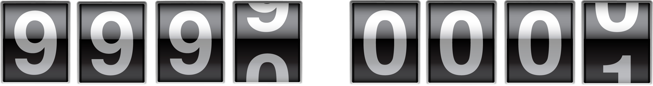
Two’s Complement
  Turning back 1 from 0000 is 9999, or -1 mile
  Turning forward 1 from 0000 is 0001, or +1 mile

Slide 26
Two’s Complement
11111101 | = | -3
11111110 | = | -2
11111111 | = | -1
00000000 | = | 0
00000001 | = | 1
00000010 | = | 2
00000011 | = | 3
Negative two’s complement numbers always begin with 1, positive with 0

Slide 27
Two’s Complement
In Two’s Complement, the MSB (Most Significant Bit – i.e. the leftmost bit) indicates whether the number will be positive or negative.
-128 | 64 | 32 | 16 | 8 | 4 | 2 | 1
Negative two’s complement numbers always begin with 1, positive with 0
How would you store +117 on this line?

Slide 28
Two’s Complement
In Two’s Complement, the MSB (Most Significant Bit – i.e. the leftmost bit) indicates whether the number will be positive or negative.
-128 | 64 | 32 | 16 | 8 | 4 | 2 | 1
0 | 1 | 1 | 1 | 0 | 1 | 0 | 1
Negative two’s complement numbers always begin with 1, positive with 0
What about -117?

Slide 29
Two’s Complement
In Two’s Complement, the MSB (Most Significant Bit – i.e. the leftmost bit) indicates whether the number will be positive or negative.
-128 | 64 | 32 | 16 | 8 | 4 | 2 | 1
1 | 0 | 0 | 0 | 1 | 0 | 1 | 1
Negative two’s complement numbers always begin with 1, positive with 0

Slide 30
Two’s Complement
Using 2’s Complement, how would you prove that -3 + 3 = 0?

Slide 31
Two’s Complement
Using 2’s Complement, how would you prove that -3 + 3 = 0?
-128 | 64 | 32 | 16 | 8 | 4 | 2 | 1
1 | 1 | 1 | 1 | 1 | 1 | 0 | 1
0 | 0 | 0 | 0 | 0 | 0 | 1 | 1
0 | 0 | 0 | 0 | 0 | 0 | 0 | 0
1 | 1 | 1 | 1 | 1 | 1 | 1 | 1
-3
+3
0
Carry

Slide 32
Two’s Complement
2’s Comp can be used to subtract binary numbers.
For instance: 12-3 should be the same as 12+ -3

Slide 33
Two’s Complement
12-3
Step 1 – convert the first number into binary:
 |  |  | 16 | 8 | 4 | 2 | 1
 |  |  | 0 | 1 | 1 | 0 | 0
Make sure you keep the 0 at the front to show that it is a positive number.

Slide 34
Two’s Complement
12-3
Step 2 – convert the second number into binary:
 |  |  |  | 8 | 4 | 2 | 1
 |  |  |  | 0 | 0 | 1 | 1
Then into two’s complement: ( flip + 1)
 |  |  |  | 8 | 4 | 2 | 1
 |  |  |  | 1 | 1 | 0 | 1

Slide 35
Two’s Complement
12-3
Put the two numbers together for subtraction – make sure that they are the same number of bits, by adding 0’s at the beginning of a positive number, or 1’ at the beginning of a negative number.
+12 | 0 | 1 | 1 | 0 | 0
-3 | 1 | 1 | 1 | 0 | 1
9 | 0 | 1 | 0 | 0 | 1
1 | 1 | 1

Slide 36
Two’s Complement
Complete Task 3 on Worksheet 3

Slide 37
Fixed Point Binary
So far, we have looked at whole numbers.
Numbers with a decimal or fractional part can also be represented in Two’s Complement:
-16 | 8 | 4 | 2 | 1 | 1/2 | 1/4 | 1/8

Slide 38
Fixed Point Binary
So far, we have looked at whole numbers.
Numbers with a decimal or fractional part can also be represented in Binary:
So 6 ½ (6.5) would be shown as:
-16 | 8 | 4 | 2 | 1 | 1/2 | 1/4 | 1/8
0 | 0 | 1 | 1 | 0 | 1 | 0 | 0
How would you show 6.75?

Slide 39
Fixed Point Binary
So far, we have looked at whole numbers.
Numbers with a decimal or fractional part can also be represented in Binary:
So 6 ½ (6.5) would be shown as:
-16 | 8 | 4 | 2 | 1 | 1/2 | 1/4 | 1/8
0 | 0 | 0 | 1 | 1 | 1 | 1 | 0
How would you show -6.5?

Slide 40
Fixed Point Binary
So far, we have looked at whole numbers.
Numbers with a decimal or fractional part can also be represented in Binary:
So 6 ½ (6.5) would be shown as: -16+8+1+1/2
-16 | 8 | 4 | 2 | 1 | 1/2 | 1/4 | 1/8
1 | 1 | 0 | 0 | 1 | 1 | 0 | 0
What is the biggest positive number you could store using this method?

Slide 41
Floating Point Binary
To store a bigger range of numbers, it is necessary to ‘float’ the decimal point in the number. This builds on your knowledge of Two’s Complement and Fixed-Point Binary.
A floating-point number is made up of two parts – written in the form a.aa x 2^{b}
Look up what a and b represent and how they are used in floating point binary.

Slide 42
Floating Point Binary
Using what you have found, see if you can calculate the denary value for the floating-point binary number 0010101010110, where 9 bits are used for the mantissa followed by 4 bits for the exponent.
NB As either value could be negative, two’s complement is usually used for both, but this will always be stated in the question.

Slide 43
Floating Point Binary – worked example
Split the binary into the mantissa and the exponent: 0.010101010110
Calculate the denary value of the exponent 0110 = 6
Use this value to move the decimal point 6 places to the right – so the mantissa becomes 0010101.01

Slide 44
Floating Point Binary – worked example
64 | 32 | 16 | 8 | 4 | 2 | 1 | 1/2 | 1/4 | 1/8 | 1/16
0 | 0 | 1 | 0 | 1 | 0 | 1 | 0 | 1 | 0 | 0
= 21.25

Slide 45
Two’s Complement
Complete Task 4 on Worksheet 3

Slide 47
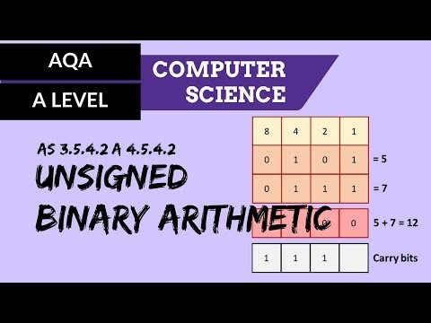
Additional Resources

Slide 48

Additional Resources

Slide 49
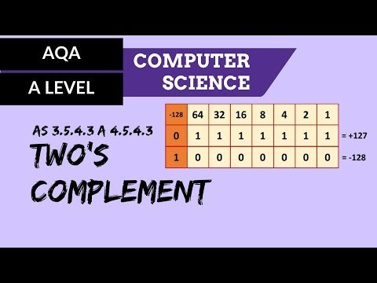
Additional Resources

Slide 50
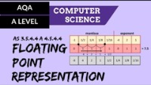
Additional Resources

