Slide 1
AQA
    AS Level
      Computer Science
      Paper 2
Role of an operating system
  Unit 4
  Hardware
  and software

Slide 2
Objectives
Understand the need for, and functions of an operating system
Understand that the role of an operating system is to hide the complexities of operation from the user
Understand the importance of resource management and processor scheduling

Slide 3
What is an operating system?
Common operating systems include:
  Windows
  OS X
  Linux
Can you name any others?
What is the role of an operating system?

Slide 4
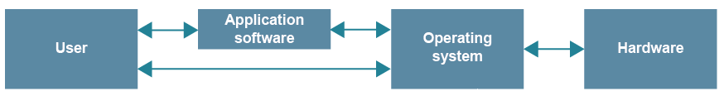
Operating Systems (OS)
An OS forms a bridge between the physical hardware of a computer and the user or application software
  A user cannot communicate directly with computer hardware
  Where is the OS stored on a computer?
  How is it able to run when the machine is switched on?

Slide 5
Hiding the complexities of operation
The true complexities of operations are hidden from the end user via an Application Programming Interface (API)
Users can issue commands or simply click a mouse to perform complex operations without having to know how they are carried out, e.g.
  load and save files
  record and play sounds
  switch between several tasks

Slide 6


API
An API acts a bit like a waiter in a restaurant
You, the user, look at the menu and give the waiter (the API) your request
The waiter takes the request to the kitchen (the operating system)
The kitchen sends back the prepared dish via the waiter

Slide 7
Functions of an OS
Behind the scenes of the virtual machine created by the OS, the following functions are provided:
  Memory management
  Processor scheduling
  Backing store management
  Peripheral management of IO devices

Slide 8
Memory management
A PC allows many processes to be running at the same time
You could be listening to music, writing a program, checking your emails from time to time, printing a document and have a web browser running in the background
The OS allocates memory to each process
If there is not enough memory, a program may be swapped out of memory onto disk or “virtual memory” and reloaded when activated

Slide 9
Processor scheduling
The OS Controls which programs can send data to the processor to be processed
Instructions from multiple operations are queued
  The processor executes small parts of each operation in turn so that programs appear to run simultaneously
  This is known as multi-tasking

Slide 10
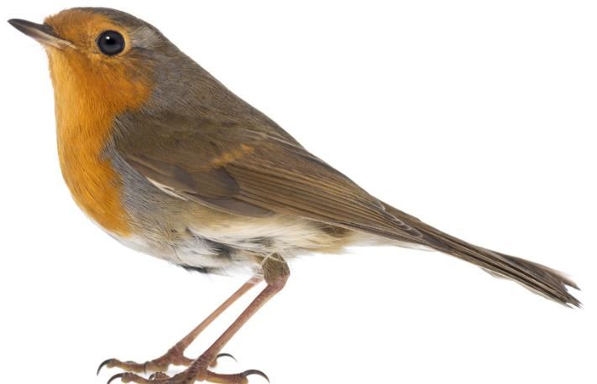
The scheduler
The scheduler is the operating system module responsible for ensuring that processor time is used as efficiently as possible
There are different scheduling algorithms
  Round Robin – each process in turn has use of the processor for a given time slice
  Shortest job next
  Priority system

Slide 11
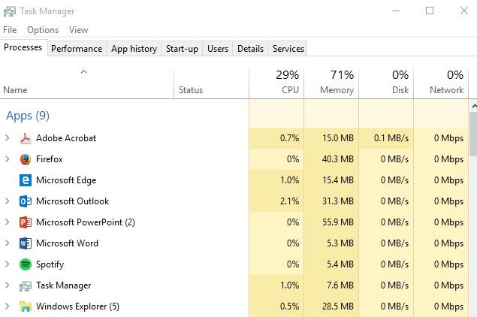
Task manager
Windows Task Manager shows the processes that are currently running and the allocation of resources

Slide 12
Backing store management
The OS keeps track of where all files are stored on hard disk or external drives, and where space is free to be used if the user performs a save operation
  Files can be listed, moved, deleted, protected from unauthorised access
  What else can you do with a file?

Slide 13
IO device management
Communicates with I/O devices via the I/O controller, part of the CPU
Checks that a required output device is switched on and ready to receive data
Deals with processor ‘interrupts’
  e.g. an “Out of paper” message from a printer
  What other examples of interrupts can you think of?

Slide 14
Role of an OS
Complete the questions on Worksheet 2

