Slide 1
AQA
    AS Level
      Computer Science
      Paper 2
Programming language translators
  Unit 4
  Hardware
  and software

Slide 2
Objectives
Understand the role of an assembler, compiler and interpreter
Explain the difference between compilation and interpretation, and describe situations when each would be appropriate
Explain why an intermediate language such as bytecode is produced as the final output by some compilers and how it is subsequently used
Understand the difference between source and object (executable) code

Slide 3
Translating assembly code
All programs have to be translated into machine code before they can be run
Assembly language is translated into machine code by a program called an assembler
Typically, one assembly code instruction is translated into one machine code instruction
Each type of processor has its own assembly code and assembler program

Slide 4
Source code and object code
The assembly code program is the input to the assembler
This is known as the source code
The output is the machine code instructions produced by the assembler, called the object code
The object code can be saved and run whenever needed

Slide 5
Uses of assembly code
Assembly code is used when a program needs to execute as fast as possible, occupy as little space as possible or manipulate individual bits and bytes
Typical uses include embedded systems, real-time systems, sensors, mobile phones, device drivers and interrupt handlers
The object code, rather than the source code, is saved and run when required

Slide 6
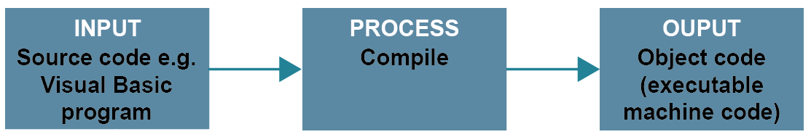
Compilers
A compiler is a program that translates a high-level language such as Visual Basic or Delphi into object code
Different hardware platforms need different compilers to translate the source code into the machine code that the computer understands

Slide 7
The compilation process
A compiler is a complex program which has several phases such as lexical analysis, syntactic analysis, and semantic analysis, going through the whole program at each stage
  It produces intermediate code, optimises it, then generates the machine code
  It will not generate the machine code it there are any errors in the program
  What kind of errors might it find?

Slide 8
Errors detected by the compiler
The compiler will find errors such as syntax errors or missing subroutines
When all errors of this kind have been corrected, the compiler will produce relocatable code, since it does not know the absolute addresses where the object code will be loaded
The object code can then be saved and the compiler does not need to be present to run the object code

Slide 9
Advantages of a compiler
Once a program has been compiled, the object code can be distributed and the compiler is not needed to run the program
The object code runs faster than interpreted code
The object code is more secure, as machine code cannot easily be read and copied by someone wishing to modify the code and sell it as their own product

Slide 10
Interpreters
The third type of translator is an interpreter
An interpreter translates high-level instructions into an intermediate form, which it then executes
No object code is produced
An interpreter will typically scan through a program and report syntax errors
  Once these are removed, it will execute instructions up to the point where it encounters an error
What are the advantages of an interpreter?

Slide 11
Advantages of an interpreter
An interpreter is useful in education because it allows students to program interactively using “Interactive mode”
It is useful during development when a programmer may want to test a small piece of code without recompiling the whole program
Both compilers and interpreters are available for most high-level languages

Slide 12
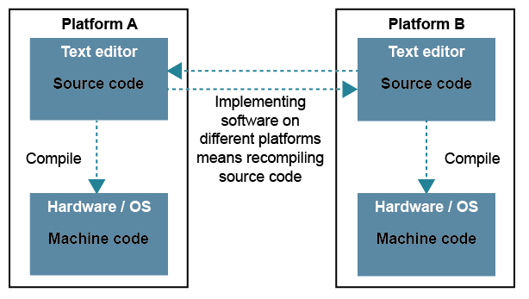
Portability
Machine code produced by a compiler for Platform A (for example, a PC using an x86 based processor) cannot be run on Platform B (e.g. an Apple)

Slide 13
Bytecode
Some compilers such as the Java compiler compile the source code into an intermediate form known as bytecode
The bytecode file is portable, because each computer that can run Java has a JVM or Java Virtual Machine (which is itself a program), that understands bytecode and converts it into the machine code required for that particular computer

Slide 14
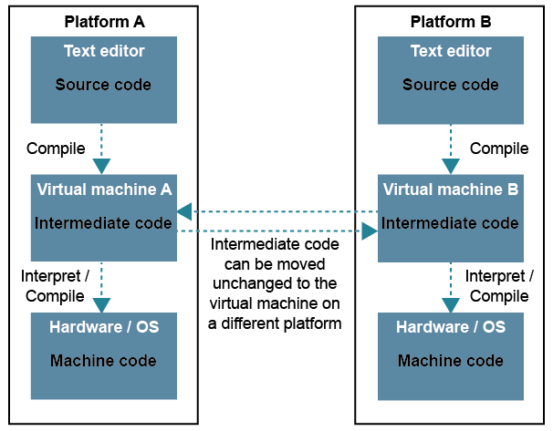
Bytecode

Slide 15
Using bytecode
Once the bytecode for a particular subroutine or method has been translated into machine code, the machine code is retained for the next time that code is required, so the translation does not have to be done again.
  If a particular subroutine or method is never used at runtime, it is never compiled to machine code

Slide 16
Worksheet 4
Now try the questions in Task 1 of the worksheet

Slide 17
Plenary
What are the differences between compilation and interpretation?
Describe a situation when each would be appropriate
Explain why an intermediate language such as bytecode is produced as the final output by some compilers, and how it is subsequently used
What is the difference between source and object code?

