Slide 1
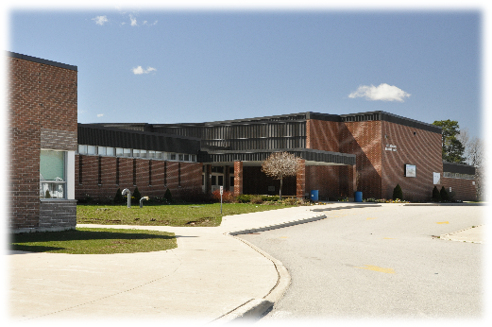
Hardware and software
Understand the need for and attributes of different types of software
In pairs or small groups, read the following scenarios and list sensible application software categories that would be required. For each one, make sure to justify your choice in the context of the scenario.
SCENARIO 1: A large secondary school that includes a sixth-form (12-18) specialising in media studies.

Slide 2

Hardware and software
Understand the need for and attributes of different types of software
In pairs or small groups, read the following scenarios and list sensible application software categories that would be required. For each one, make sure to justify your choice in the context of the scenario.
SCENARIO 2: A GP surgery.

Slide 3

Hardware and software
Understand the need for and attributes of different types of software
In pairs or small groups, read the following scenarios and list sensible application software categories that would be required. For each one, make sure to justify your choice in the context of the scenario.
SCENARIO 3: A personal accountancy company.

Slide 4
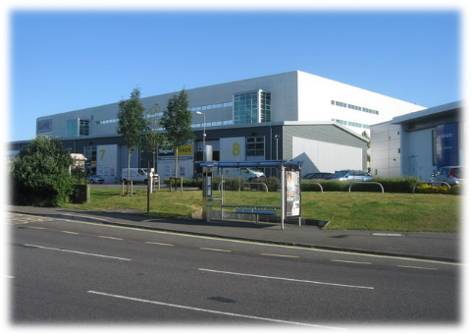
Hardware and software
Understand the need for and attributes of different types of software
In pairs or small groups, read the following scenarios and list sensible application software categories that would be required. For each one, make sure to justify your choice in the context of the scenario.
SCENARIO 4: A video game development studio.

Slide 5
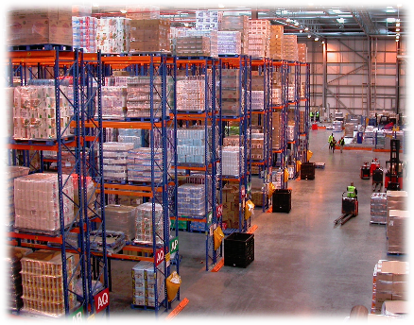
Hardware and software
Understand the need for and attributes of different types of software
In pairs or small groups, read the following scenarios and list sensible application software categories that would be required. For each one, make sure to justify your choice in the context of the scenario.
SCENARIO 5: An online-only food retailer.

