Slide 1
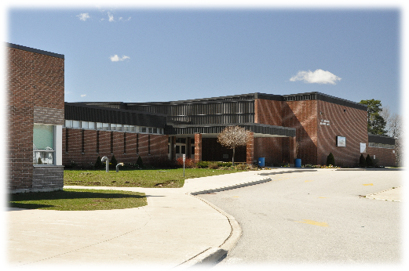
Hardware and software
Understand the need for and attributes of different types of software
In pairs or small groups, read the following scenarios and list sensible application software categories that would be required. For each one, make sure to justify your choice in the context of the scenario.
SCENARIO 1: A large secondary school that includes a sixth-form (12-18) specialising in media studies.

Slide 2
Hardware and software
Understand the need for and attributes of different types of software
In pairs or small groups, read the following scenarios and list sensible application software categories that would be required. For each one, make sure to justify your choice in the context of the scenario.
SCENARIO 1: A large secondary school that includes a sixth-form (12-18) specialising in media studies.
Database management software to keep track of students details.
Communications software to keep parents up to date via email.
Multimedia, graphics and video editing software to meet the needs of the specialisation at sixth-form.
Web browser to enable students to carry out research and teachers to gather resources for lessons.
Most standard other desktop application categories, as the school is likely to teach most of them or need them for coursework and projects.
Accept other categories if they come with a sensible justification in the context.

Slide 3

Hardware and software
Understand the need for and attributes of different types of software
In pairs or small groups, read the following scenarios and list sensible application software categories that would be required. For each one, make sure to justify your choice in the context of the scenario.
SCENARIO 2: A GP surgery.

Slide 4
Hardware and software
Understand the need for and attributes of different types of software
In pairs or small groups, read the following scenarios and list sensible application software categories that would be required. For each one, make sure to justify your choice in the context of the scenario.
SCENARIO 2: A GP surgery.
Database management software to keep track of patient details and appointments.
Word processing software to write letters to send to patients and NHS colleagues, notices for the waiting room, etc.
Communication software to allow GPs to email patients and NHS colleagues.
Web browser to allow staff to connect to online NHS services.
Accept other categories if they come with a sensible justification in the context.

Slide 5

Hardware and software
Understand the need for and attributes of different types of software
In pairs or small groups, read the following scenarios and list sensible application software categories that would be required. For each one, make sure to justify your choice in the context of the scenario.
SCENARIO 3: A personal accountancy company.

Slide 6
Hardware and software
Understand the need for and attributes of different types of software
In pairs or small groups, read the following scenarios and list sensible application software categories that would be required. For each one, make sure to justify your choice in the context of the scenario.
SCENARIO 3: A personal accountancy company.
Database management software to keep track of clients’ personal details.
Spreadsheet software for calculations such as tax returns.
Word processors to write and send out letters to clients.
Communication software to email clients and schedule appointments.
Accept other categories if they come with a sensible justification in the context.

Slide 7
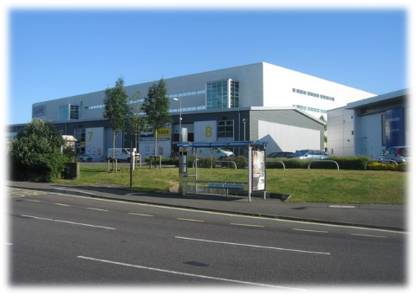
Hardware and software
Understand the need for and attributes of different types of software
In pairs or small groups, read the following scenarios and list sensible application software categories that would be required. For each one, make sure to justify your choice in the context of the scenario.
SCENARIO 4: A video game development studio.

Slide 8
Hardware and software
Understand the need for and attributes of different types of software
In pairs or small groups, read the following scenarios and list sensible application software categories that would be required. For each one, make sure to justify your choice in the context of the scenario.
SCENARIO 4: A video game development studio.
Word processor software to write reports on progress, minutes of meetings, document design decisions, etc.
Photo and graphics editing software to produce and manipulate graphics for the games being developed.
Communication software to email other members of the organisation, contact potential clients, etc.
Gaming software to be able to play and test games.
Development and coding tools to write and produce the computer games.
Accept other categories if they come with a sensible justification in the context.

Slide 9
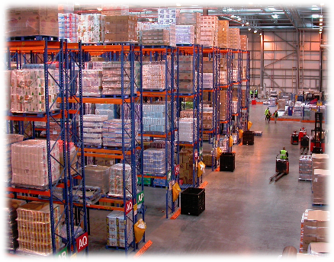
Hardware and software
Understand the need for and attributes of different types of software
In pairs or small groups, read the following scenarios and list sensible application software categories that would be required. For each one, make sure to justify your choice in the context of the scenario.
SCENARIO 5: An online-only food retailer.

Slide 10
Hardware and software
Understand the need for and attributes of different types of software
In pairs or small groups, read the following scenarios and list sensible application software categories that would be required. For each one, make sure to justify your choice in the context of the scenario.
SCENARIO 5: An online-only food retailer.
Database management software to keep track of sales, orders, deliveries, etc.
Photo, video and graphics software to produce and manipulate eye-catching multimedia content for the company website and social media.
Communications software to email order confirmation, delivery information, etc.
Web browser to create an easy online interface for browsing and ordering goods.
Accept other categories if they come with a sensible justification in the context.

