Slide 1
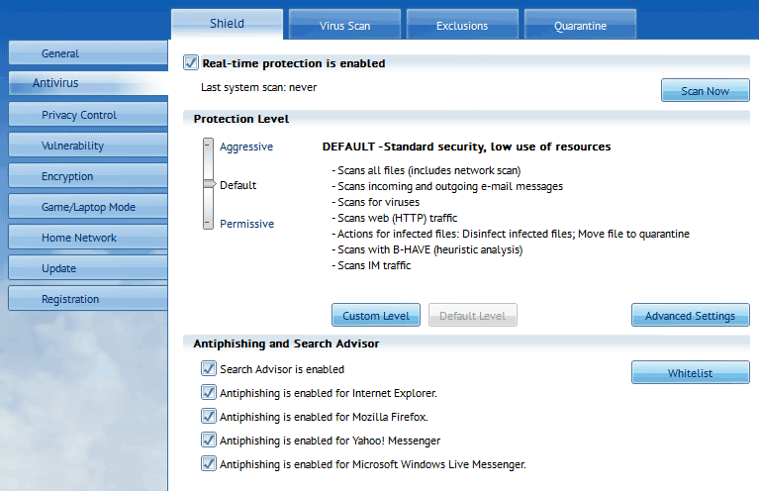
Hardware and software
Understand the need for and functions of the following system software:
• operating systems (OS) • utility programs • libraries • translators (compiler, assembler, interpreter)
Know that the OS handles resource management, managing hardware to allocate processors, memories and I/O devices among competing processes
What types of software utilities are these screenshots representing?

Slide 2
Hardware and software
Understand the need for and functions of the following system software:
• operating systems (OS) • utility programs • libraries • translators (compiler, assembler, interpreter)
Know that the OS handles resource management, managing hardware to allocate processors, memories and I/O devices among competing processes
What types of software utilities are these screenshots representing?
Anti-virus programs

Slide 3
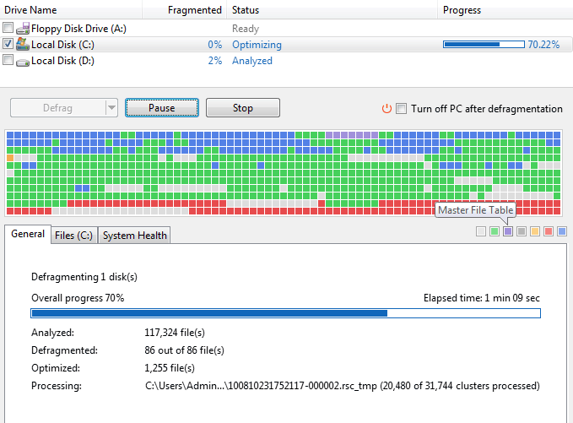
Hardware and software
Understand the need for and functions of the following system software:
• operating systems (OS) • utility programs • libraries • translators (compiler, assembler, interpreter)
Know that the OS handles resource management, managing hardware to allocate processors, memories and I/O devices among competing processes
What types of software utilities are these screenshots representing?

Slide 4
Hardware and software
Understand the need for and functions of the following system software:
• operating systems (OS) • utility programs • libraries • translators (compiler, assembler, interpreter)
Know that the OS handles resource management, managing hardware to allocate processors, memories and I/O devices among competing processes
What types of software utilities are these screenshots representing?
Disk defragmenters

Slide 5
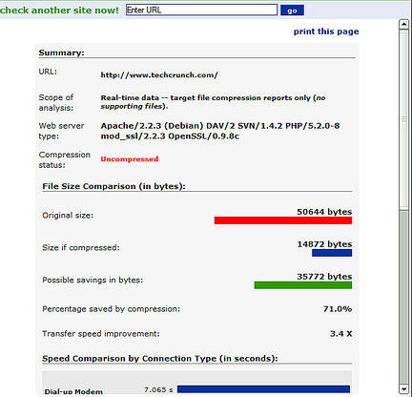
Hardware and software
Understand the need for and functions of the following system software:
• operating systems (OS) • utility programs • libraries • translators (compiler, assembler, interpreter)
Know that the OS handles resource management, managing hardware to allocate processors, memories and I/O devices among competing processes
What types of software utilities are these screenshots representing?

Slide 6
Hardware and software
Understand the need for and functions of the following system software:
• operating systems (OS) • utility programs • libraries • translators (compiler, assembler, interpreter)
Know that the OS handles resource management, managing hardware to allocate processors, memories and I/O devices among competing processes
What types of software utilities are these screenshots representing?
Compression

Slide 7
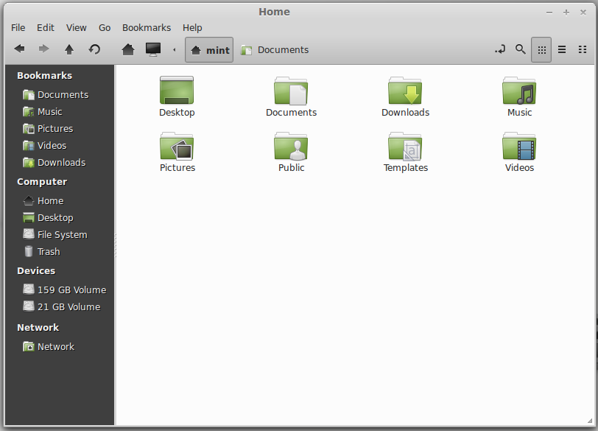
Hardware and software
Understand the need for and functions of the following system software:
• operating systems (OS) • utility programs • libraries • translators (compiler, assembler, interpreter)
Know that the OS handles resource management, managing hardware to allocate processors, memories and I/O devices among competing processes
What types of software utilities are these screenshots representing?

Slide 8
Hardware and software
Understand the need for and functions of the following system software:
• operating systems (OS) • utility programs • libraries • translators (compiler, assembler, interpreter)
Know that the OS handles resource management, managing hardware to allocate processors, memories and I/O devices among competing processes
What types of software utilities are these screenshots representing?
File managers

Slide 9
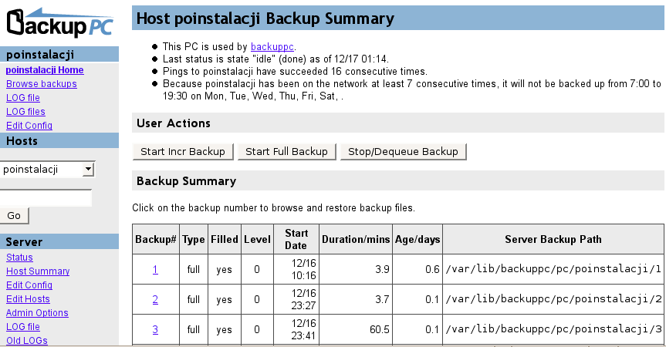
Hardware and software
Understand the need for and functions of the following system software:
• operating systems (OS) • utility programs • libraries • translators (compiler, assembler, interpreter)
Know that the OS handles resource management, managing hardware to allocate processors, memories and I/O devices among competing processes
What types of software utilities are these screenshots representing?

Slide 10
Hardware and software
Understand the need for and functions of the following system software:
• operating systems (OS) • utility programs • libraries • translators (compiler, assembler, interpreter)
Know that the OS handles resource management, managing hardware to allocate processors, memories and I/O devices among competing processes
What types of software utilities are these screenshots representing?
Backup Utilities

