Slide 1
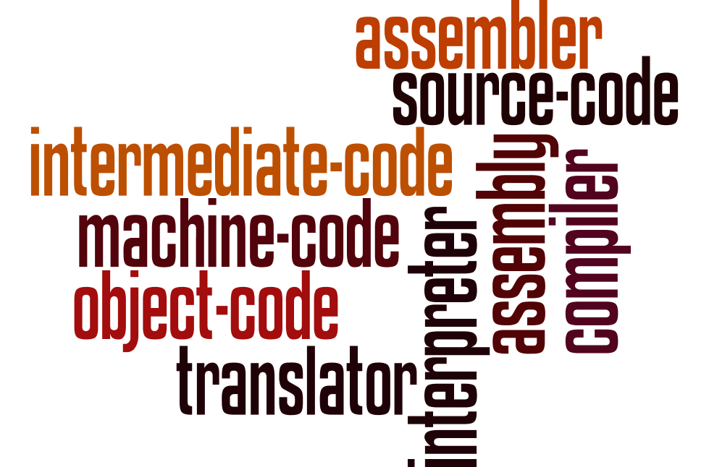
Programming languages and translators
Understand the role of each of the following: • assembler • compiler • interpreter
Explain the differences between compilation and interpretation
Describe situations in which each would be appropriate
Using all the words in this word wall, create a diagram to show how all the concepts link together.

Slide 2





Programming languages and translators
Understand the role of each of the following: • assembler • compiler • interpreter
Explain the differences between compilation and interpretation
Describe situations in which each would be appropriate
Low-level language
Assembly
Translator
(Assembler)
Machine code
(Binary)
High level-language
Translator (Interpreter)
Source
code
Translator
(Compiler)
Object
code
Intermediate
code
Interpreter

