Slide 1
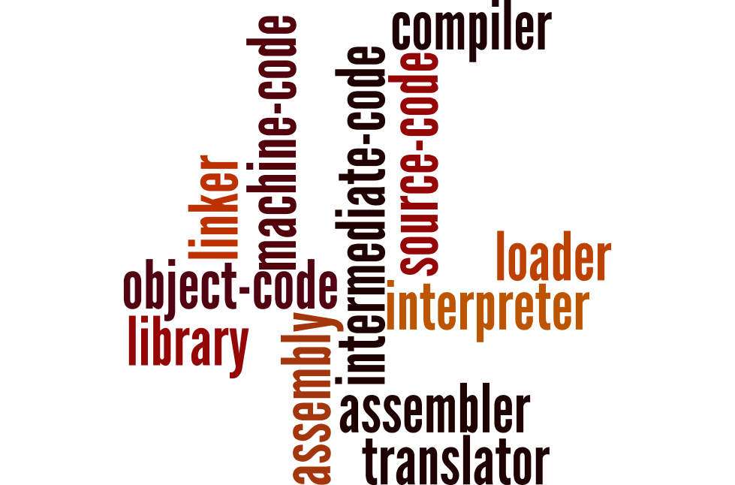
Programming languages and translators
Understand the role of each of the following: • assembler • compiler • interpreter
Explain the differences between compilation and interpretation
Describe situations in which each would be appropriate.
Using all the words in this word wall, create a diagram to show how all the concepts link together.

Slide 2







Programming languages and translators
Understand the role of each of the following: • assembler • compiler • interpreter
Explain the differences between compilation and interpretation
Describe situations in which each would be appropriate.
Low-level language
Assembly
Translator
(Assembler)
Machine code
(Binary)
High-level language
Translator
(Interpreter)
Library
Source
code
Translator
(Compiler)
Object
code
Linker/Loader
Intermediate
code
Interpreter

