Slide 1
AQA
    AS Level
      Computer Science
      Paper 2
Communication methods
  Unit 6
  Communication: Technology and consequences

Slide 2
Objectives
Define serial and parallel transmission methods
Discuss the advantages of serial over parallel transmission
Define and compare synchronous and asynchronous data transmission
Define baud rate, bit rate, bandwidth, latency, protocol
Differentiate between baud rate and bit rate
Understand the relationship between bit rate and bandwidth

Slide 3
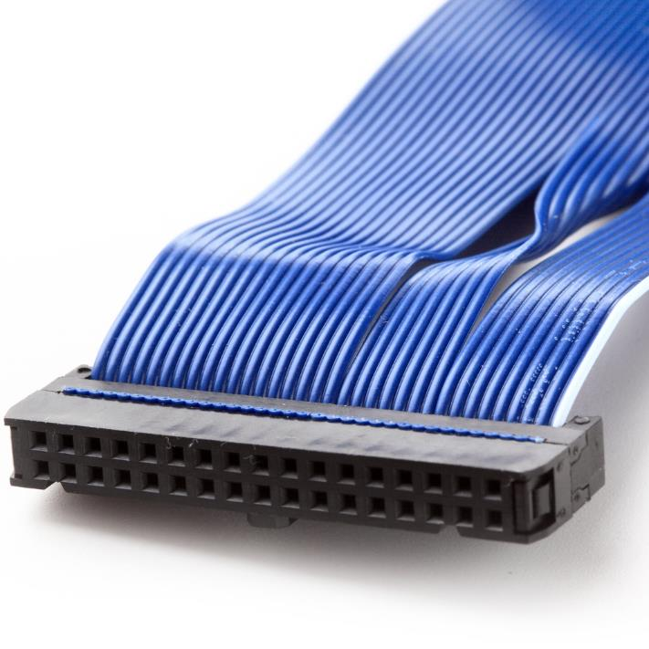

Serial versus Parallel data transmission
Serial data cables include the USB (Universal Serial Bus)
Parallel cables are a ribbon of several smaller cables used primarily for connecting internal components

Slide 4
Serial versus Parallel data transmission
Serial data transmission: bits are sent one after another along the same data line
  This means that only one line is needed to transmit data in one direction. (Two lines are required for two-way communication, plus a common signal ground wire)
Parallel data transmission: several bits (e.g. one byte of data) are sent simultaneously along separate lines or channels
  This means that an 8-bit block of data will require 8 data channels, plus some extra for control information

Slide 5

A short history of data communications
In the early days of computing, vast amounts of data were sent via serial connections
  Using serial communication, bits are sent one after the other
  For two-way communication, an extra line is required
  Serial connections were reliable but slow

Slide 6

Parallel data transmission
Makers began using parallel connections
  Multiple bits are sent simultaneously
  For two-way communication, twice the number of lines are required

Slide 7
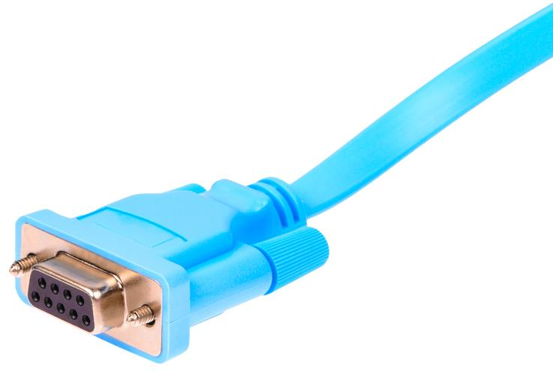
Which do you think is faster?
Serial, or
Parallel?

Slide 8
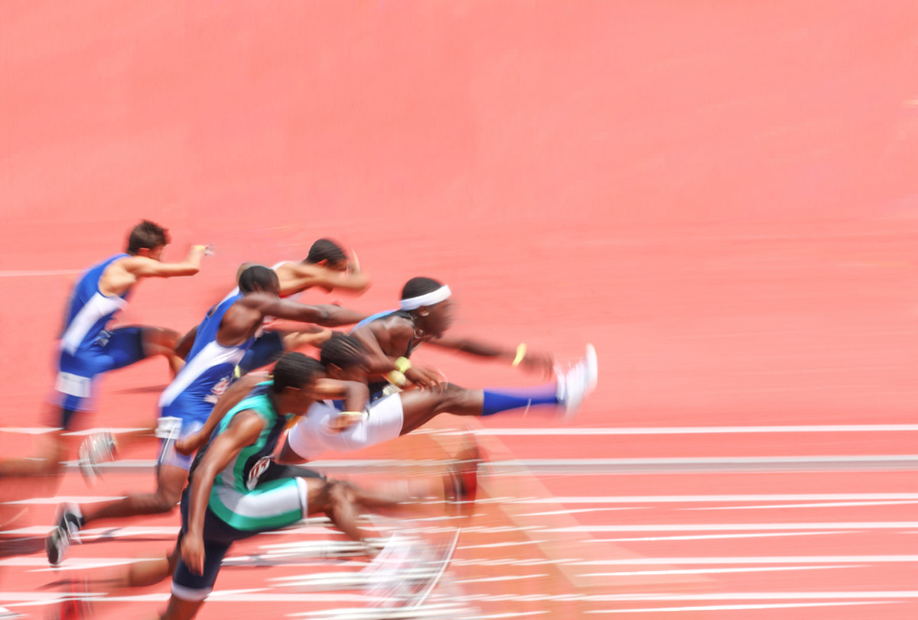
Problems with parallel data transmission
As speeds of transmission got higher and higher, parallel connections developed problems

Slide 9
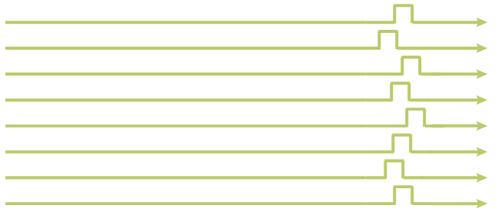
The problem of skew
As each individual wire has slightly different properties, bits travel at slightly different speeds along each of the wires. This produces a problem known as skew
  What does this tell us about how and when parallel transmission can be used?

Slide 10
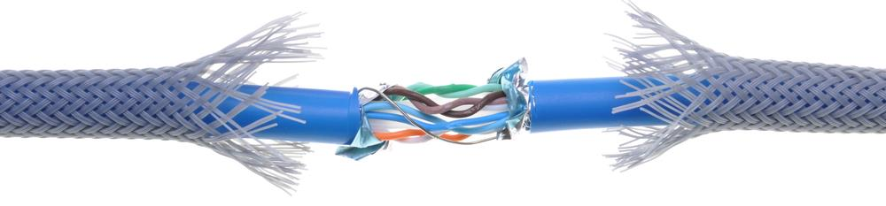
The problem of crosstalk
This refers to electromagnetic interference between two adjacent channels or parallel wires
It gets more pronounced as the frequency (speed of transmission) increases
  If the data is corrupted, it has to be retransmitted

Slide 11

Serial vs parallel transmission
Parallel transmission can be used only over very short distances of up to about 2m
Serial transmission is reliable over very long distances at very high frequencies

Slide 12

Serial vs parallel connectors
Serial connectors such as USB (Universal Serial Bus) connectors are much smaller and cheaper than parallel connectors
A PC has several USB ports for connecting peripherals

Slide 13
Worksheet 1
Try Task 1 on the worksheet

Slide 14
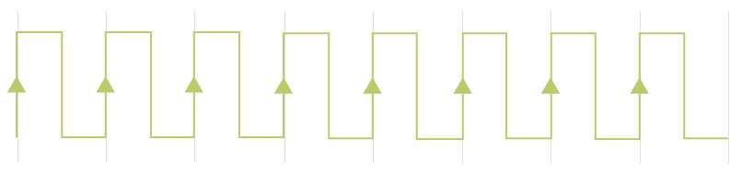

Synchronous transmission
Synchronous data transmission: all data transfers are timed to coincide with an internal clock pulse
The data is sent as one long stream or block of data, with no gaps in the transmission
The receiver counts the bits and reconstructs bytes
1 | 1 | 0 | 1 | 1 | 0 | 0 | 1

Slide 15
Asynchronous transmission
Using asynchronous data transmission, each byte is sent separately the moment it is available instead of waiting for a clock signal
Each byte is preceded by a start bit and ends with a stop bit or stop ‘period’ – a short time gap between each set of bits
Stop bit
Start bit
 | 0 | 1 | 1 | 0 | 1 | 1 | 0 | 0 | 1
Parity bit

Slide 16
The parity bit
The parity bit or check bit is added as the 8th bit as a form of error detection
  Odd or even parity may be used
  This bit is set to a 1 or 0 to make the total number of 1s or 0s in the byte (including the parity bit) odd or even depending on the machine
Does the diagram show odd or even parity being used?
Stop bit
Start bit
 | 0 | 1 | 1 | 0 | 1 | 1 | 0 | 0 | 0
Parity bit

Slide 17

Asynchronous transmission
Asynchronous transmission is relatively slow owing to the increased number of bits being sent
It is a cheap and effective form of serial transmission well suited to low-speed connections such as keyboard and mouse

Slide 18

Latency
Have you ever listened to a broadcast where the newsreader in the studio asks a question, and the foreign correspondent looks blank for a few seconds before responding?

Slide 19
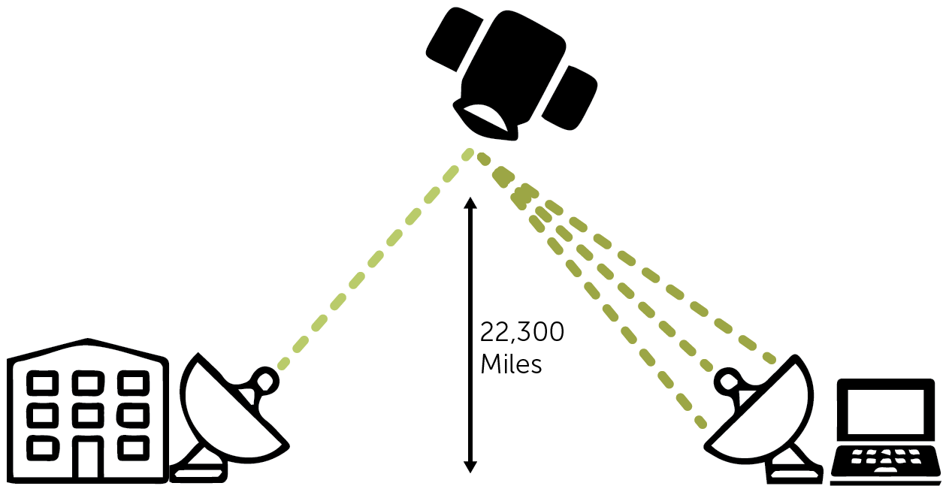
Latency
Geostationary satellites orbit 22,300 miles above the Earth
Latency is the time delay between the moment the first byte or packet of a communication starts and when it is received at its destination

Slide 20
Protocol
All communications between devices require that the devices agree on the format of the data
The set of rules relating to communication between devices is called a protocol
What rules or standards need to be devised to allow equipment from different suppliers to communicate successfully?

Slide 21
Protocol
The protocol needs to define, for example:
  Standards for physical connections and cabling
  The rate of transmission (bit rate or baud rate)
  Data format
  Whether transmission is synchronous or asynchronous
  Error checking procedures, e.g. odd or even parity
Any pieces of equipment which use the same communication protocol can be linked together

Slide 22
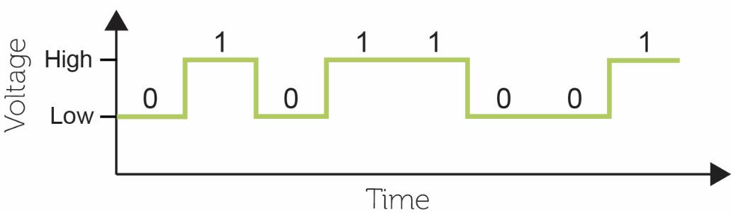
Speed of transmission
Bit rate is the number of bits (0's and 1's) transmitted in one second over a wired or wireless data link
Using baseband, at each signal change one bit is transmitted
The faster the signal change, the greater the number of bits per second (bps)

Slide 23
Bit rate and baud rate
Bit rate is the number of bits (0's and 1's) transmitted in one second over a wired or wireless data link
Baud rate is the rate at which the signal in a communications channel changes state
It is usually measured in megabits per second (Mbit/s)
  So in baseband transmission, if the baud rate is 1Mbit/s, what is the bit rate?

Slide 24
Bit rate and baud rate
Baseband carries one signal at a time. A bit is represented by a high or low voltage in the cable
  In baseband, bit rate is the same as baud rate
  At each signal change, one symbol is transmitted
  A symbol in this case is 1 bit
How can bit rate and baud rate be different?

Slide 25
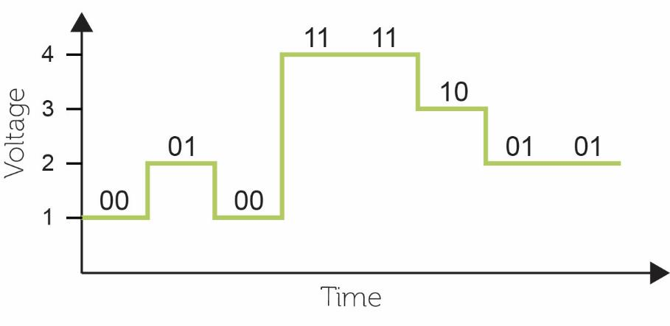
Bit rate and baud rate
Broadband carries multiple signals on a fixed carrier wave. Bits are sent as variations on the wave
  Here, a symbol is 2 bits, so the bit rate is twice the baud rate
  At each signal change, 2 bits are transmitted

Slide 26
Relationship between bit rate and baud rate
Baud rate is the rate at which the signal changes
Bit rate is bits per second
One symbol may encode 1,2, 4, 8, 16, 32… bits
Bit rate = baud rate x number of bits per signal
If the signal changes one million times a second, and 8 bits are encoded on each signal, what is the bit rate, and what is the baud rate?

Slide 27
Bit rate and bandwidth
Bandwidth is a measure of the maximum capacity of a communications channel
In computer networks, the term bandwidth is used as a synonym for data transfer rate
  It is usually expressed in bps, Mbps or Gbps
  There is a direct relationship between bandwidth and bit rate
  Think of a pipe carrying water – the greater the width of the pipe, the more water can flow through it, but it doesn’t necessarily flow any faster

Slide 28

How much bandwidth?
Instant messaging may require only 1,000bps
An HD video transmission requires about 4Mbs
Digital TV can use a bandwidth of about 19Mbps to broadcast several channels simultaneously

Slide 29
Worksheet 1
Complete Task 2

Slide 30
Recap of terms
Latency The time delay between initiating a transmission and it being received
Protocol A set of rules relating to communication between devices
Baud rate The rate at which a signal in a communications channel changes state
Bit rate The number of bits per second (bps) that are transferred between devices
Bandwidth A measure of the maximum capacity of a given communication channel, usually measured in bps

