Slide 1


Wireless Networks

Slide 2
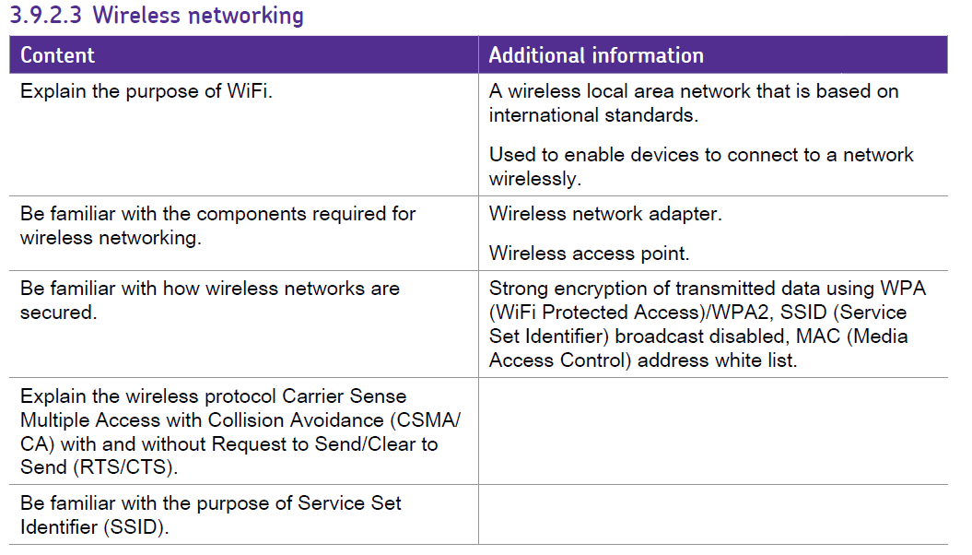
What we need to cover…….

Slide 3
What’s the difference ?
Give examples of wired and wireless communication….
Wired
Wireless

Slide 4
Big Differences!
Wired:
  Uses cable to physically connect devices…
  Signals are limited to traveling along those cables.
Wireless:
  Uses electromagnetic radiation (usually radio waves)
  Signal is broadcast from Access Points and then travels by many unknown paths (reflected/diffracted etc..)
  Any device with a Wireless Network Adaptor in range can receive the signal.

Slide 5
Wi-Fi or IEEE 802.11x
Quick Research Project:
Who are the WiFi Alliance? What do they do?
Who are the IEEE? What are IEEE standards?
Specifically what are the 802. standards?
Who are the ITU (an agency of the UN)?

Slide 6
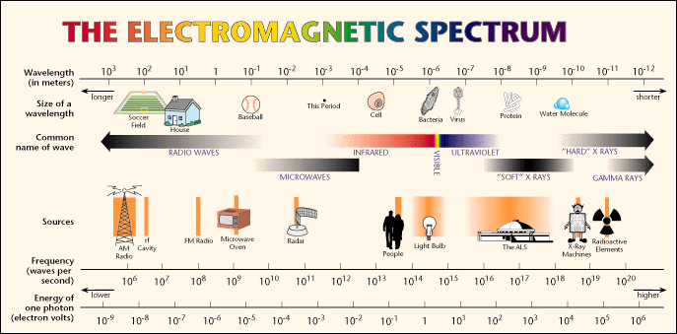
The Wireless Spectrum
Continuum of electromagnetic waves
  Data, voice communication
  Arranged by frequencies: Lowest to highest - Spans 9 KHz and 300 GHz
Wireless services associated with one area
ITU oversees international frequencies
  Air signals propagate across borders

Slide 7
Key Terms:
SSID (service set identifier)
  As shown, names like eduroam or 2WIRE619
  A sequence of up to 32 bytes. Often organized to be readable characters.
  Can be hidden to provide basic security
MAC
  Media Access control
  Uniquely identifies a network interface
  (wireless or wired)

Slide 8
Wireless Security
Year | Protocol | Name | Encryption Modes
1999 | WEP | Wireless Encrypted Protocol | 64 to 128bit shared key
2003 | WPA | Wireless protected Access | 256bit Pre-Shared Key (PSK) Temporal Key Integrity Protocol (TKIP) Advanced Encryption Services (AES)
2006 | WPA2 | Wireless protected Access 2 | AES Counter Cypher Mode Protocol (CCMP)
 |  | MAC White LIST | Only allows devices with MAC addresses on the list to connect.
Whilst you don’t need to know the details of each protocol researching them will help you understand the main considerations in securing wireless

Slide 9
Multi-transmitter Interference Problem
Similar to multi-path or noise
Two transmitting stations will constructively/destructively interfere with each other at the receiver
Receiver will “hear” the sum of the two signals (which usually means garbage)

Slide 10
Medium Access Control
Protocol required to coordinate access
  I.E. transmitters must take turns
Similar to talking in a crowded room
Also similar to hub based Ethernet

Slide 11
Carrier Sense Multiple Access (CSMA)
Procedure
  Listen to medium and wait until it is free (no one else is talking)
  Wait a random back off time then start talking
Advantages
  Fairly simple to implement
  Functional scheme that works
Disadvantages
  Can not recover from a collision
  (inefficient waste of medium time)

Slide 12
CSMA/CA
CSMA/CA (Collision Avoidance) is the MAC method used in a wireless LAN. Wireless stations cannot detect collisions (i.e. the whole packets will be transmitted anyway).
Basic CSMA/CA operation:
Wait for free medium
Wait a random time (backoff)
Transmit frame
If collision, the stations do not notice it
Collision => erroneous frame => no ACK returned
CSMA/CA rule: Backoff before collision

Slide 13
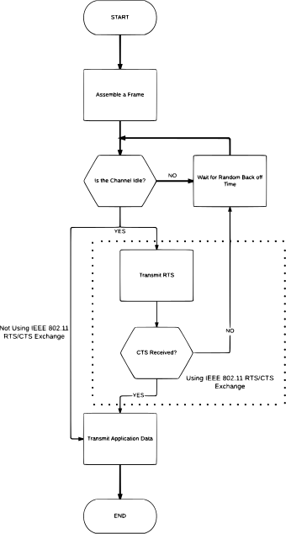

Slide 14
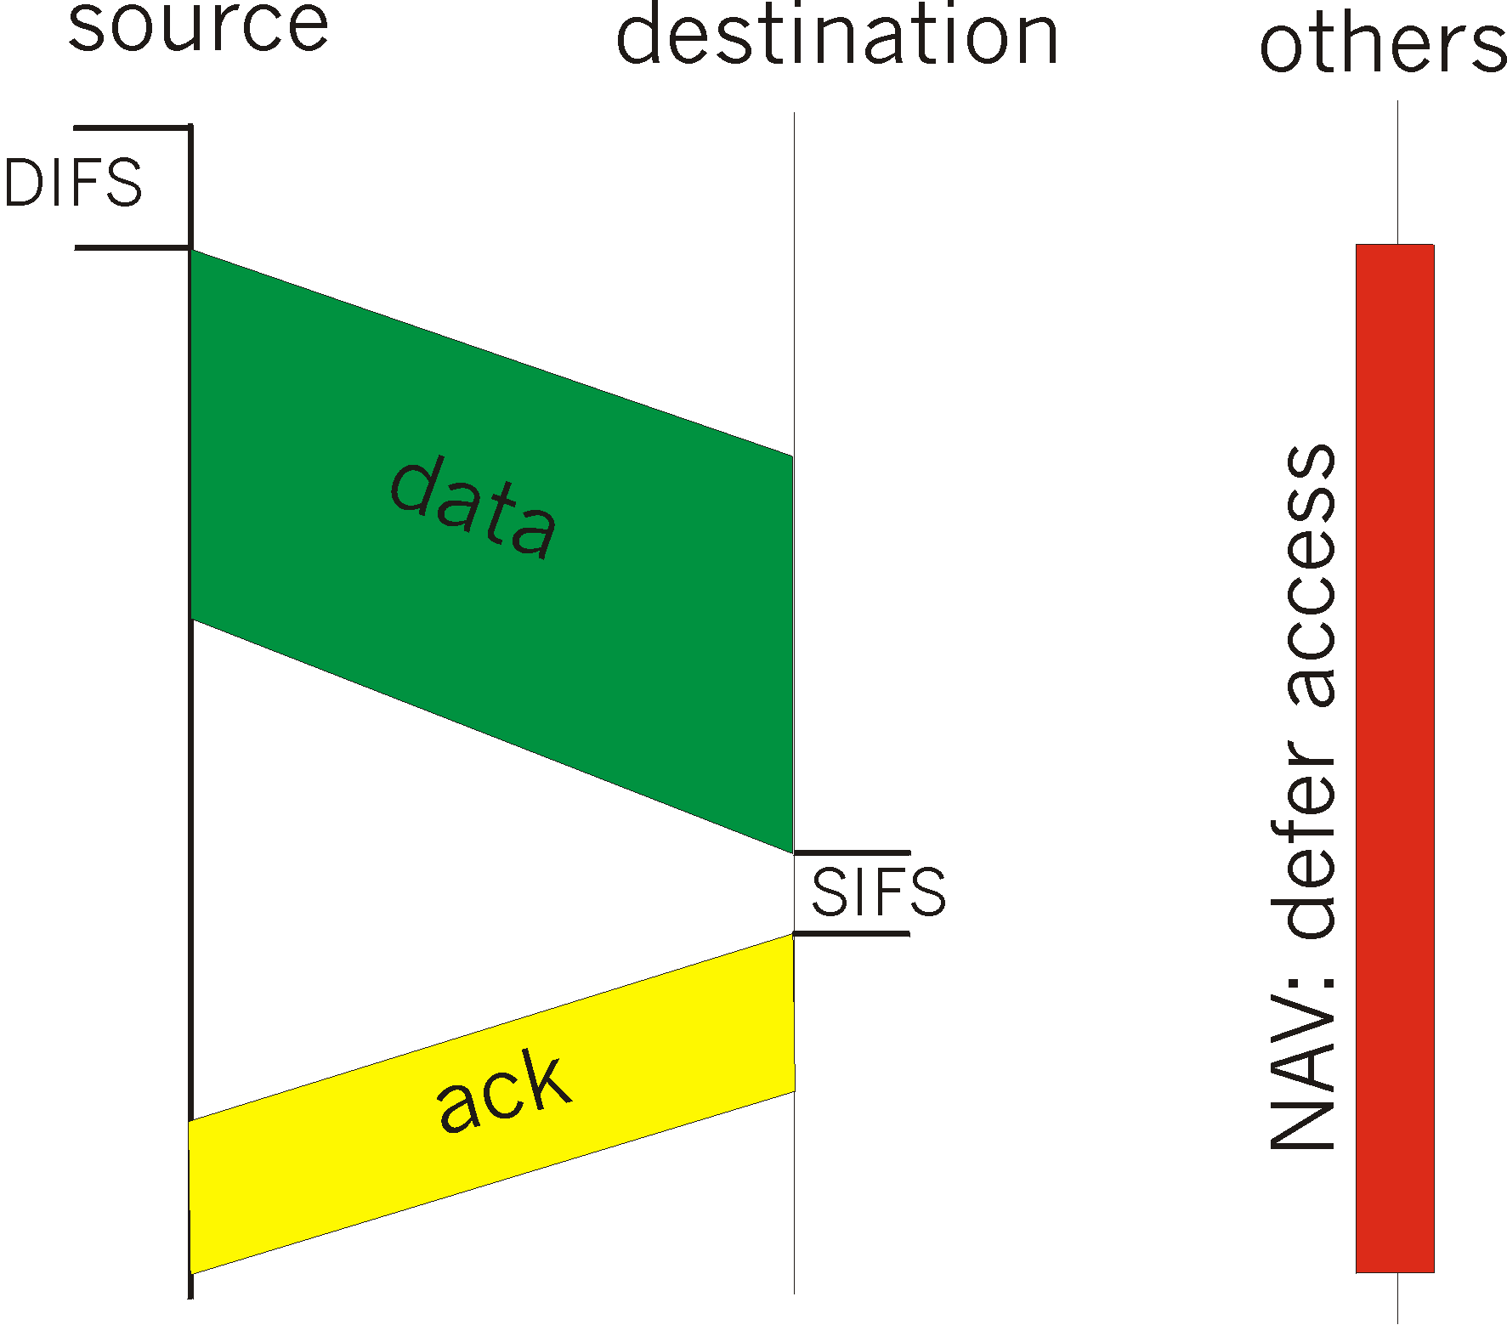
IEEE 802.11 MAC Protocol: CSMA/CA
802.11 CSMA: sender
- if sense channel idle for DISF sec.
then transmit entire frame (no collision detection)
-if sense channel busy
then binary backoff
802.11 CSMA receiver
- if received OK
return ACK after SIFS
(ACK is needed due to hidden terminal problem)

Slide 15
Collision avoidance mechanisms
Problem:
  two nodes, hidden from each other, transmit complete frames to base station
  wasted bandwidth for long duration !
Solution:
  small reservation packets

Slide 16
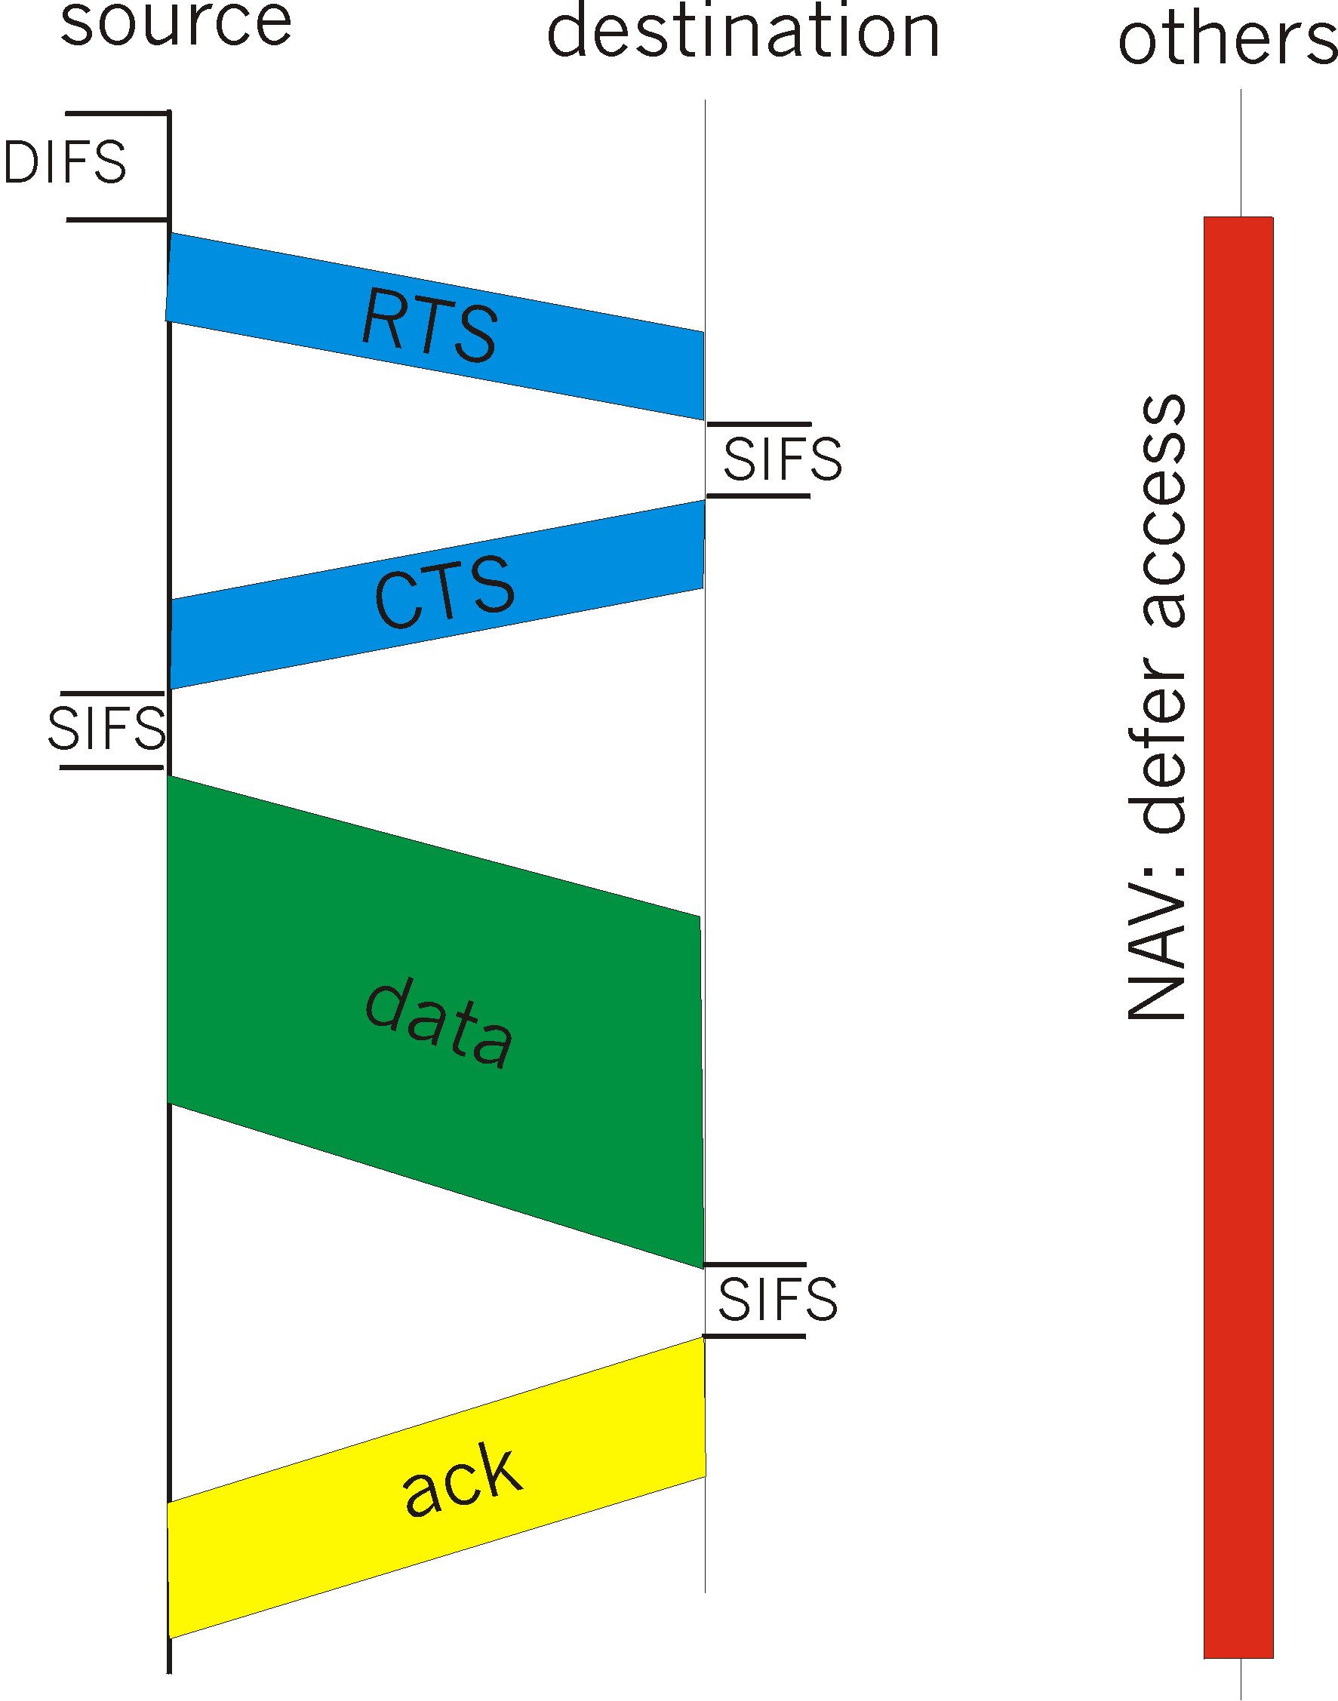
Collision Avoidance: RTS-CTS exchange
RTS and CTS short:
  collisions less likely, of shorter duration
  end result similar to collision detection
IEEE 802.11 allows:
  CSMA
  CSMA/CA: reservations
  polling from AP

