Slide 1
Communication

Slide 2

Glossary of Terms
Create a Glossary of terms and their definitions

Slide 3
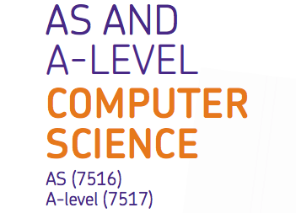
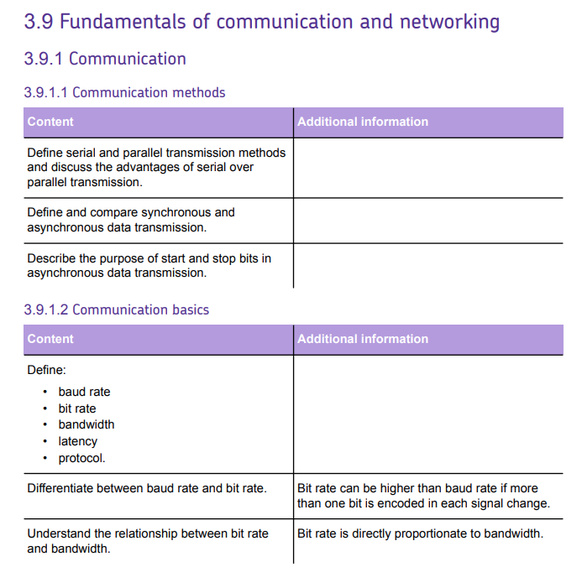

Slide 4
1 Communication Methods

Slide 5
What does Data Transmission mean?

Slide 6
What does Data Transmission mean?
Data transmission is the process of sending digital or analog data over a communication medium to one or more computing, network, communication or electronic devices.
It enables the transfer and communication of devices in a point-to-point, point-to-multipoint and multipoint-to-multipoint environment.
Data transmission is also known as digital transmission or digital communications.

Slide 7
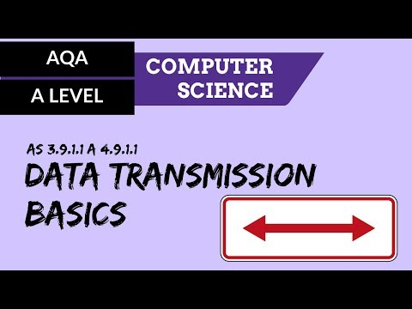
This video introduces the concepts of serial and parallel transmission, and the differences between synchronous and asynchronous transmission methods.

Slide 8
Task
Research the following terms and their relationship to each other:
Serial
Parallel
Synchronous
Asynchronous

Slide 9
Communication Methods
Serial Transmission
  Sends and receives data one bit at a time in sequence
  Serial connections are used to connect most of the peripherals to the computer, e.g. mouse and keyboard.
  Serial cables connect computers together to form a network.
  Speed of transmission depends on the cabling. USB is high speed, serial network cables can reach speeds of 1Gbps.

Slide 10
Communication Methods
Parallel Transmission
  Uses a number of wires to send a number of bits simultaneously. The more wires there are, the more data can be sent at any one time.
  Also used in buses. A 32-bit parallel connection, for example, may connect the processor and memory together.

Slide 11
Serial v Parallel
What are the advantages of parallel transmission over serial transmission ?

Slide 12
Serial v Parallel
What are the advantages of serial transmission over parallel?
It is easier to program;
Fewer, smaller connectors are needed, therefore it is also cheaper.
More reliable over greater distances.
Less ‘Crosstalk’.

Slide 13
Serial v Parallel
Although parallel transmission can transfer data faster, it requires more transmission channels than serial transmission.
This means that data bits can be out of sync, depending on transfer distance and how fast each bit loads.
A simple of example of where this can be seen is with a voice over IP (VOIP) call when distortion or interference is noticeable. It can also be seen when there is skipping or interference on a video stream.

Slide 14
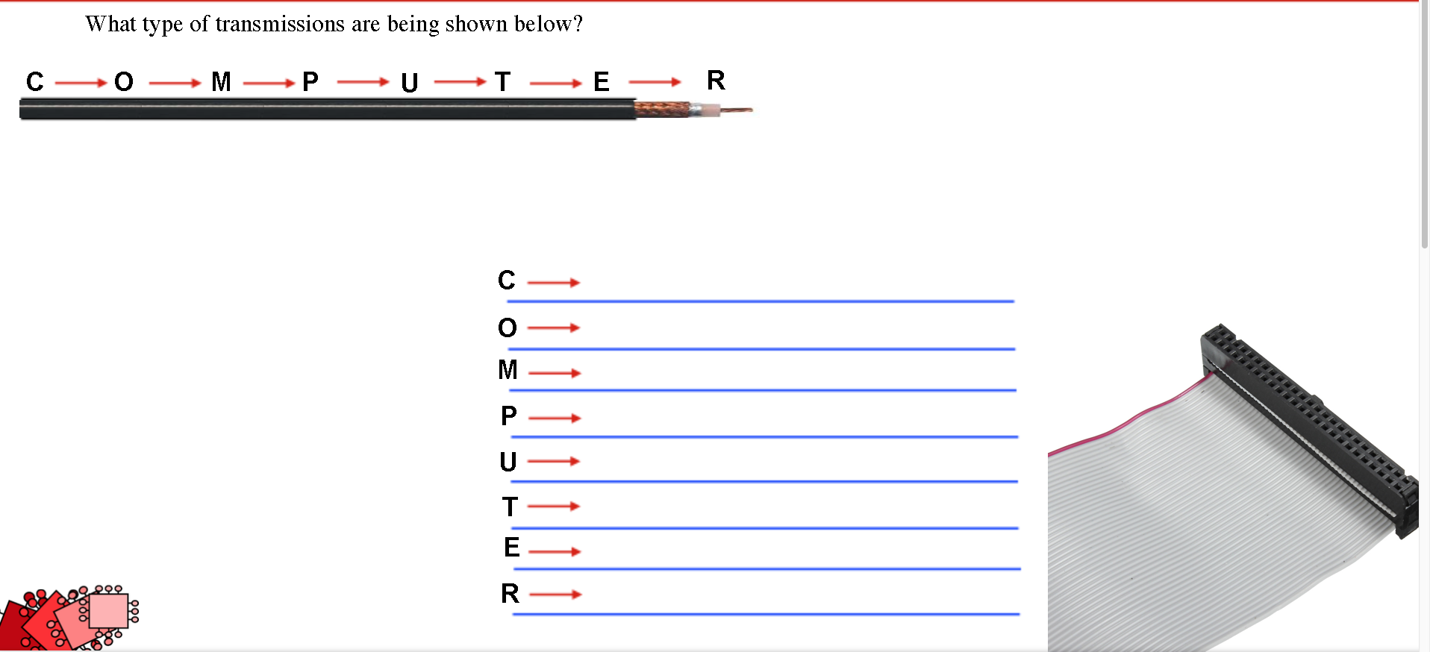
Serial v Parallel

Slide 15
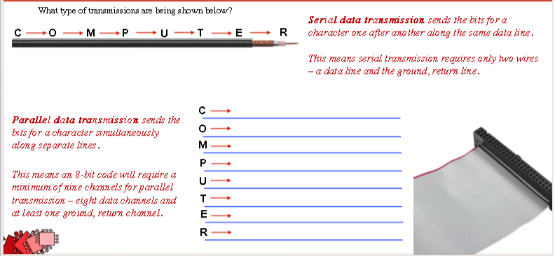
Serial v Parallel

Slide 16
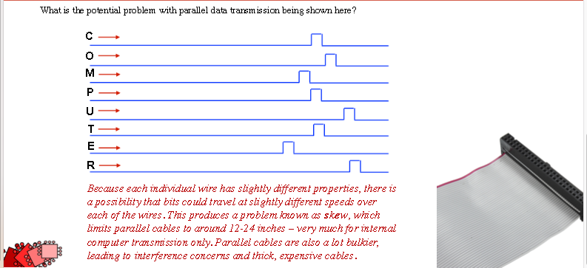

Slide 17
Communication Methods
Transmission has two ADDITIONAL classifications:
Synchronous
and
Asynchronous

Slide 18
Communication Methods
Synchronous
Serial
Asynchronous
Communication Methods
Synchronous
Parallel
Asynchronous

Slide 19
Communication Methods
Synchronous Data Transmission
  Data bits are transmitted as a continuous stream in time with a master clock.
  Data transmitter and receiver use a synchronized clock frequency; therefore, start bits, stop bits, and gaps are not needed.
  Data moves faster and timing errors are less frequent because the transmitter and receiver time is synced.
  Usually more expensive than Asynchronous transmission

Slide 20
Communication Methods
Asynchronous Data Transmission
  Data bits can be sent at any point in time.
  Stop bits and start bits are used between data bytes to synchronize the transmitter and receiver and to ensure that the data is transmitted correctly.
  The time between sending and receiving data bits is not constant, so gaps are used to provide time between transmissions.

Slide 21
Start & Stop Bits (Asynchronous only)
The start bit is used to signal the beginning of a frame.
The stop bit is used to signal the end of a frame.
The data is contained in the data bits and the parity bit is an extra bit that is often used to detect transmission errors.

Slide 22
Asynchronous Data Transmission
Direction of Transmission
10000101111011000010111111111111
a
a
a
Start Bit
a = 1100001
a = 1100001
Parity Bit
Stop Bit
Next character
Mark (Idle) bits

Slide 23
Asynchronous Data Transmission
How does ADT work?
Make sure that you fully understand the process, including the use of parity bits, start bits and stop bits.
Direction of Transmission
10000101111011000010111111111111
a
a
a
Start Bit
a = 1100001
Parity Bit
a = 1100001
Stop Bit
Next character
Mark (Idle) bits

Slide 24
Synchronous v Asynchronous
  The advantage of using the asynchronous method is that no synchronization is required between the transmitter and receiver devices.
  It is also a more cost effective method.
  A disadvantage is that data transmission can be slower, but this is not always the case.

Slide 25
2 Communication Basics
Key Terms

Slide 26
Key Terms you should know
Baud Rate
Bit Rate
Bandwidth
Latency
Protocol

Slide 27
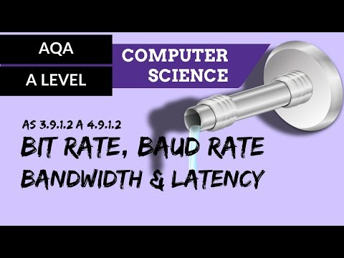

Slide 28
Baud rate
Baud rate is another term used to describe the speed at which data can be transmitted.
One baud represents one electronic state change per second.
An electronic state change may be a change in frequency of the carrier wave , a change in voltage, a change in amplitude or a shift of a waveform .

Slide 29
Bit
rate
Bit rate is the term used to describe the speed at which a particular transmission is taking place.
It is closely linked to the bandwidth because the bit rate will be limited by how much bandwidth is available.
Bit rate is measured in bits per second (bps).
Where bandwidth refers to the frequencies and the capacity that is available, Bit rate refers to the speed of data transfer.

Slide 30

Bit Rate and Bandwidth
Bandwidth and Bit rate are not the same thing!
The bit rate that can be achieved is directly proportionate to the bandwidth available.

Slide 31
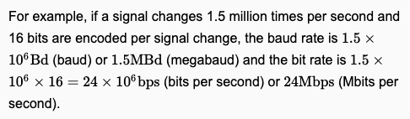
Bit Rate and Bandwidth
Bit rate = baud rate x number of bits per signal change
Or
Bit rate = baud rate x number of bits per symbol

Slide 32
Bandwidth
Bandwidth is the term used to describe the amount of data that can be transmitted along a communication channel.
It relates to the range of frequencies that are available on the carrier wave that carries the data.
The range in this case is the difference between the upper and lower frequencies.
As the range of frequencies increases so does the amount of data that can be transmitted within the same time-frame.

Slide 33
Latency
Latency is the general term used to explain the time delay between an action being instantiated and its results being seen.

Slide 34
Protocol
A protocol is a set of rules. There are a number of rules that have been established in relation to transmission of data. These cover the format in which data should be transmitted and how items of data are identified.

Slide 35


Now tie it all together
Create a knowledge organiser of what you have learnt so far, using the appropriate terms to describe communication methods.
If you aren’t sure what a knowledge organiser is use

Slide 36
What do you know?
Complete the Communication game board at Isaac Computing for this week’s homework.

Slide 37
Useful Links/Media for revising this area

Slide 38
Isaac Computing Resources
Isaac Computing Link

Slide 39
C&D Computing Resources
C&D on YouTube

