Slide 1
Networking

Slide 2
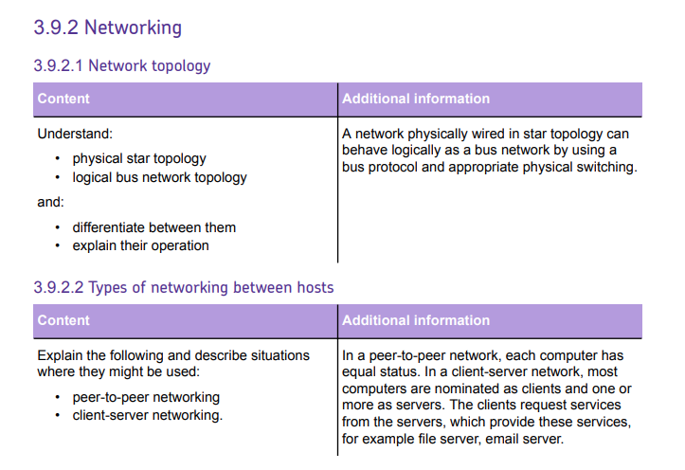


Slide 3
1 Networking

Slide 4
GCSE Recap - Key Terms

Slide 5
What is a network?

Slide 6
What is a network?
A network is a group of devices connected together to communicate with each other and share resources.

Slide 7
What is a LAN?

Slide 8
A local area network (LAN) is a network that connects devices that are located in a small geographical area — an office, a school, etc.

Slide 9
What is a WAN?

Slide 10
A wide area network (WAN) is a network that connects geographically remote devices and LANs — such as the internet.

Slide 11
2 Network Topology

Slide 12
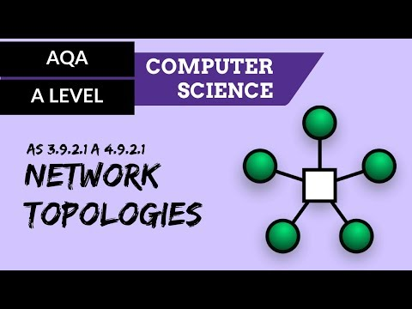

Slide 13
The different arrangements of computer connections and devices are called topologies.
For A Level you need to understand physical STAR and logical BUS topologies

Slide 14
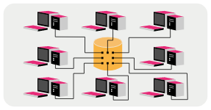
Physical Star Topology
In this topology, UTP (Ethernet) cable is used to connect each computer to a central device, such as a switch, which can send signals to all connected computers.

Slide 15
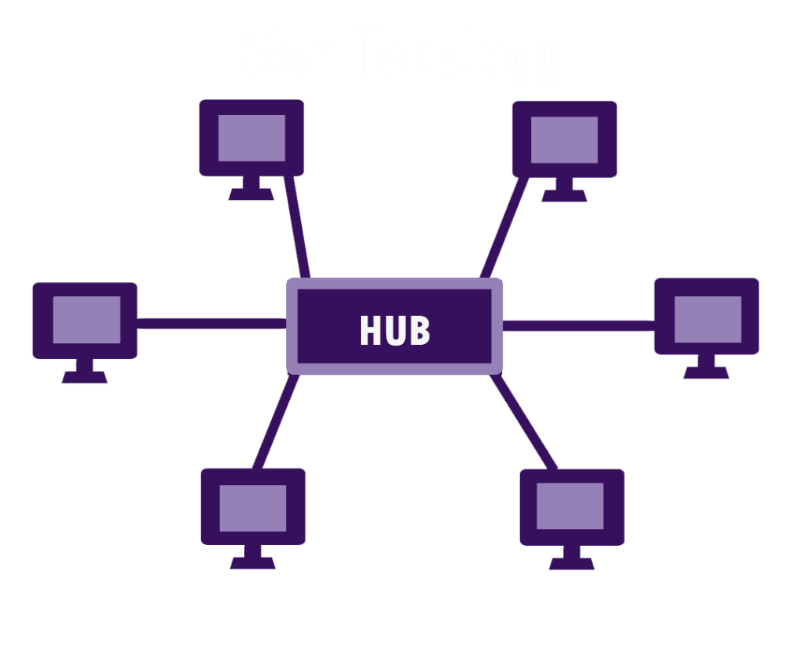
Physical Star Topology
The server (hub) will be a high specification machine with a large amount of processing power and storage capacity.
The clients have access to the server through the cabling or WiFi.

Slide 16
Physical Star Topology
Software may be installed centrally on the server, enabling easy maintenance and upgrading.
An operating system will control user access to the system, as well as other functions such as managing the print queue.
Software can also be installed on clients, which makes loading times slower and maintenance and upgrading harder.

Slide 17
What do you think the advantages of Star Topology are?
Research the advantages and disadvantages of the Star Topology and add them to your notes

Slide 18
Advantages of Star Topology
It has a fast connection speed, as each client has a dedicated cable.
It will not slow down as much as other network types when many users are on-line.
Fault-finding is simpler, as individual faults are easier to trace.

Slide 19
Advantages of Star Topology
It is relatively secure, as the connection from client to server is unique.
New clients can be added without affecting the other clients.
If one cable or client fails, then only that client is affected.

Slide 20
What do you think the disadvantages of Star Topology are?

Slide 21
Disadvantages of Star Topology
It is expensive to set up due to increased cabling costs.
It is difficult to install, as multiple cables are needed. The problem is exaggerated where the LAN is split across a number of buildings.
The switch/server can get congested as all communications must pass through it.

Slide 22
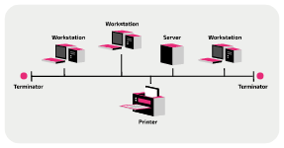
Logical Bus Topology
All of the nodes within the network are connected via one main cable.
If there is a main server, all of the clients connect to it down this main cable.
This cable carries data between the server and the clients, with each client branching off the main bus cable.
The main cable or backbone must allow high-speed data transmission, as all data
must pass down this one channel.

Slide 23
What do you think the advantages of Bus Topology are?
Research the advantages and disadvantages of the Bus Topology and add them to your notes

Slide 24
Advantages of the Bus Topology
It is cheaper to install than star topology as only one main cable is required.
It is easier to install than star topology
It is easy to add new clients by branching them off the main cable.

Slide 25
What do you think the disadvantages of Bus Topology are?

Slide 26
Disadvantages of the Bus Topology
It is less secure than a star network as all data is transmitted down one main cable.
Transmission times get slower when more users are on the network.
If the main cable fails, then all clients are affected.
It is less reliable than a star network due to reliance on the main cable.
It is more difficult to find faults.

Slide 27
3 Types of Networking

Slide 28
Research the following network types
Client Server
Peer to Peer

Slide 29
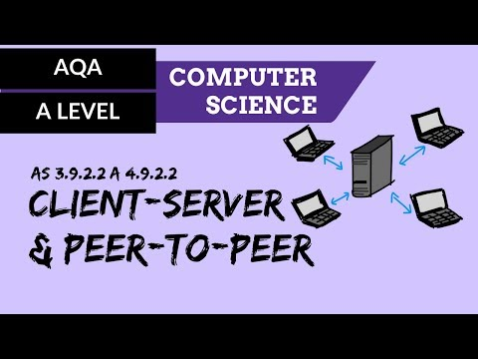

Slide 30
Client-Server Networks
In the star and bus topologies, the diagram shows a main server.
Although the clients have local resources in terms of processing power, and storage capacity, they are controlled by the server.
This means that when new software is installed, for example, it can be installed on the server and then distributed to the clients.

Slide 31
Client-Server Networks
This is the most common way of constructing a LAN with a large number of users.
Servers need to be powerful enough to cope with the demands of the clients, including processing power and storage capacity.
Clients need not be a high specification, commonly clients are known as ‘thin clients’. These will not have cd drives or expansion slots, which reduce the cost of the client.

Slide 32
Client Server Networks
You need to know more about Client Server networks for your A Level and we will look at this in more detail in a separate section.

Slide 33
Peer to Peer Networks
In a peer-to-peer network, no one computer is
in overall control of the network.
Instead the resources of each computer or workstation are available to all the computers in the network.
Each workstation therefore can act either as a client or as the server, depending on the current task.

Slide 34
Peer to Peer Networks
This is more common among smaller networks or for certain applications, such as file-sharing.
P2P networks need no specialist network operating systems
They are commonly used in home networks, giving each computer/device a shared connection to the internet or printer.

Slide 35
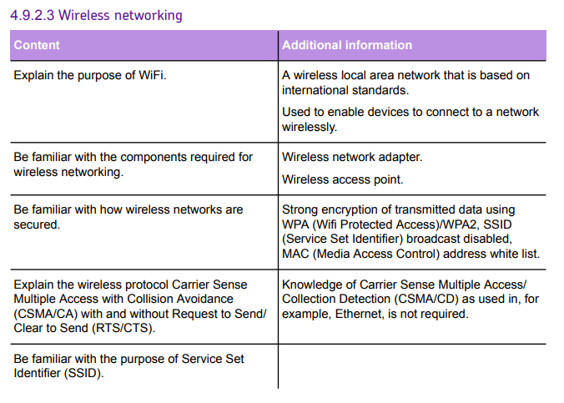
4 Wireless
Networking

Slide 36

When was WiFi first released to the public?

Slide 37
1997 Instead of using dedicated cabling to enable devices to communicate, radio waves were utilised to send data wirelessly.

Slide 38

But what exactly is it?

Slide 39
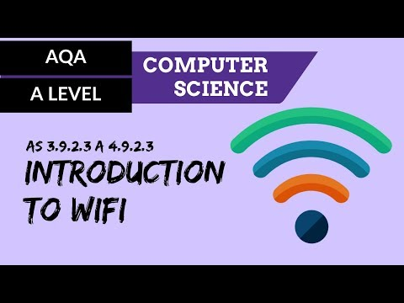

Slide 40
WiFi
A wireless network varies from a wired network in that it does not use cables to make the physical connections between devices.
Instead, the data is sent using radio waves.
Wireless networks can be implemented over small or large geographical distances so it is possible to have wireless LANs (WLAN) and wireless WANs (WWAN).

Slide 41
Advantages of WiFi over wired connections?

Slide 42
Advantages of WiFi
WiFi has the benefit of not having to fix devices in place.
Wireless connectivity allows devices to be moved wherever is convenient
WiFi also has the effect of increasing the flexibility of network connections and their uses, e.g. security cameras in remote locations.

Slide 43
Disadvantages of WiFi over wired connections?

Slide 44
Disadvantages of WiFi
Bandwidth ~ Slower: 54 megabits per second (Mbps) New standards achieve up to 300 Mbps
Security ~ Poor: anyone within range can use it unless kept secure with a security password or key
Interference ~ Can be affected by walls, electronic equipment, distance from router and number of computers connected

Slide 45
How do you connect to a network wirelessly?

Slide 46
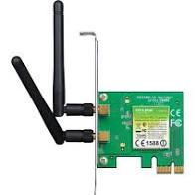
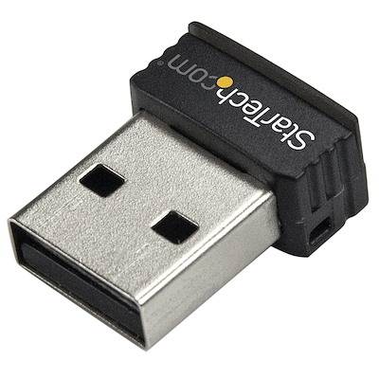
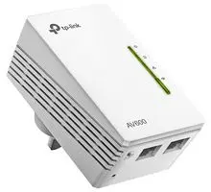
Wireless Networking - Key Components
Wireless network adapter
Enables a device to connect to a network resource or to the internet

Slide 47
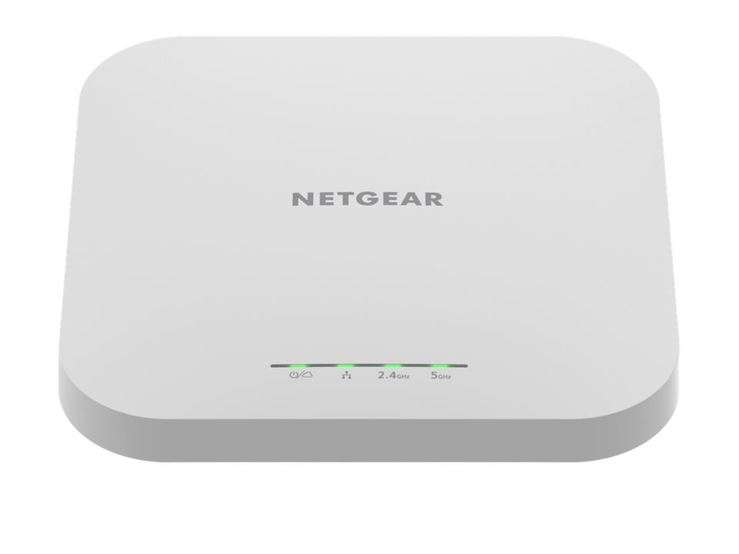
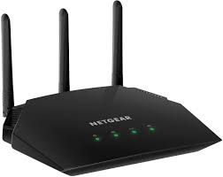
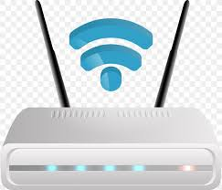
Wireless Networking - Key Components
Wireless access point
A wireless access point (WAP) is a networking device that allows wireless-capable devices to connect to a wired network.

Slide 48
Securing a wireless network
An issue with wireless technology is that it can be less secure than a wired system.
Hackers can intercept radios signals being sent using receiving devices and read the data signals.

Slide 49
Securing a wireless network
WPA/WPA2
SSID
MAC address whitelists
Spend 5 minutes researching each of these security measures.

Slide 50
WPA/WPA2
Wi-Fi Protected Access (WPA) was formally adopted in 2003. The most common WPA configuration is WPA-PSK (Pre-Shared Key). The keys used by WPA are 256-bit, a significant increase over the 64-bit and 128-bit keys used in the WEP system.
WPA has, as of 2006, been officially superseded by WPA2. One of the most significant changes between WPA and WPA2 is the mandatory use of AES algorithms and the introduction of CCMP (Counter Cipher Mode with Block Chaining Message Authentication Code Protocol) as a replacement for TKIP.
How is WPA2 Different from WPA?

Slide 51
Service Set Identifier (SSID)
One of the issues when using wireless networks is ensuring that the various devices are connecting to the correct WLAN.
As all of the data is being sent through radio waves rather than cables, each device needs a way of ensuring that it is connecting to the correct network.
The standard method of doing this is using a Service Set Identifier (SSID), which is a 32 character code which is put into the header of each packet of data being sent.
Each code is unique to the WLAN that is being used and acts as an identifier allowing data to be sent around that WLAN.

Slide 52
MAC Whitelist
All devices that are on a network have what is called a Media Access Control or MAC address. This uniquely identifies each device on the network.
A MAC address is made up of the manufacturer code and a unique device code e.g. 02:32:45:77:89:ab.
A MAC whitelist is an inventory of known MAC addresses that are permitted or denied access to the WIFI network. If you have two smartphones and one laptop that connect to your WIFI network, then the MAC address of each device would be added to the router's MAC whitelist.

Slide 53
CSMA/CA
A protocol for carrier transmission in wireless local networks
Research and document the protocol for CSMA/CA - include a clear flow chart of the CSMA/CA process.

Slide 54
Carrier Sense Multiple Access with Collision Avoidance (CSMA/CA)
Developed to enable various devices to transmit data at high speeds without interfering with each other.
When data is sent around networks, it is sent in frames with all frames being re-assembled at the receiving end.

Slide 55
Carrier Sense Multiple Access with Collision Avoidance (CSMA/CA)
Carrier Sense Multiple Access/with Collision Avoidance (CSMA/CA) is a network contention protocol used for carrier transmission in networks using the 802.11 standard.
CSMA/CA increases network traffic as it requires sending out a signal to the network even before transmitting any real data. This is to listen for any collision scenarios in the network and to inform other devices not to transmit prior to their occurrence.

Slide 56
Carrier Sense Multiple Access with Collision Avoidance (CSMA/CA)
In contrast to the Carrier Sense Multiple Access/Collision Detect (CSMA/CD) protocol, which handles transmissions only after a collision has taken place, CSMA/CA works to avoid collisions.
You are NOT required to know the CSMA/CD protocol for A Level

Slide 57
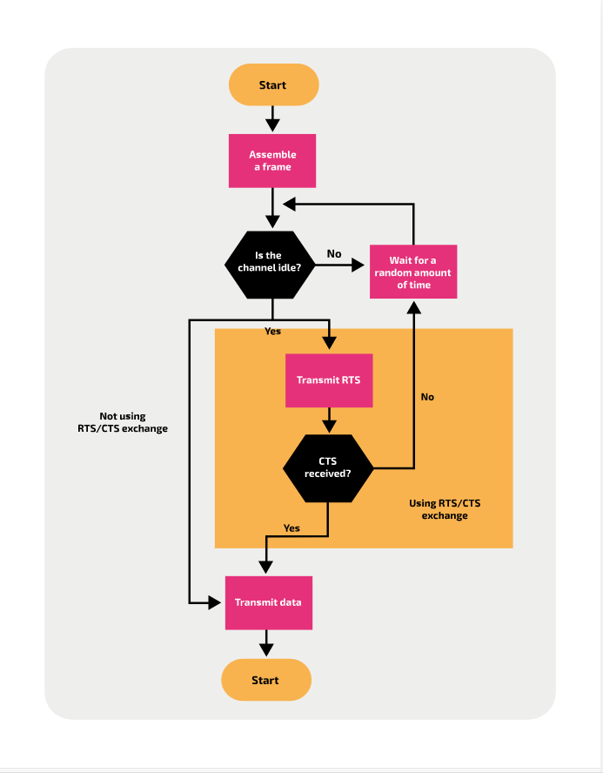
Carrier-sense
The first step is to listen to the frequency band to check for the presence of any other signals. It is here that a decision is made whether to send the message or to try again at a later time.
Collision avoidance
Upon the detection of an existing transmission on a channel, the node — an end device which is either sending or receiving data across the network — that wanted to send will wait for a period of time before trying again. Typically this is a random time within a range.
Transmission
Once the channel is free, the data is sent. Then, the sender needs to receive an acknowledgement message from the receiver to verify that the data was received successfully. Otherwise, the sender will attempt to resend the message.

Slide 58
Using the RTS/CTS exchange avoids the ‘hidden node’ problem.
Research the ‘Hidden Node Problem’ - what is it and why is it an issue?

Slide 59
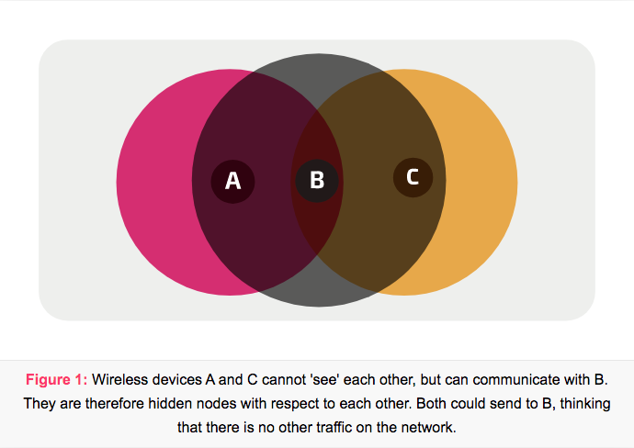
The Hidden Node Problem
Having
In wireless networks, there may be an issue known as the hidden node problem, which interferes with the data transmission.
When a sending device checks whether the channel is idle, it can only check within its broadcast range.

Slide 60
The Hidden Node Problem
However, a device can be out of range from the broadcast of another device, but still be on the network connecting them (i.e. within the range of the WAP of the wireless network).
Therefore, they could both be sending data to the WAP at the same time, but would be unaware of the presence of the other device and, as a result, the WAP would not be able to receive any data due to the data collisions.

Slide 61
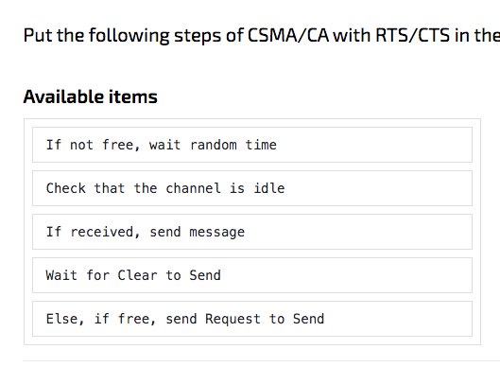
Number the steps of CSMA/CA with RTS/CTS in the order that they operate
A
B
C
D
E

Slide 62
Number the steps of CSMA/CA with RTS/CTS in the order that they operate

Slide 63
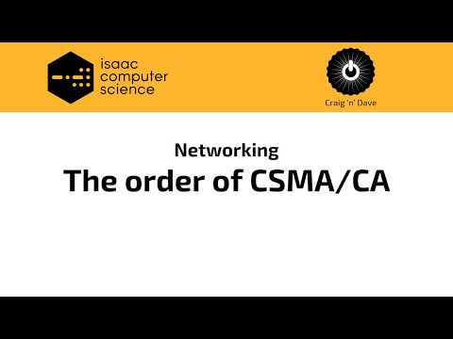

Slide 64
Useful Links/Media for revising this area

Slide 66
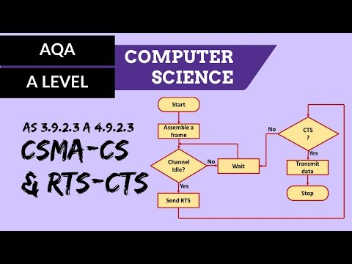

Slide 67
What do you know?
Complete the Communication gameboard at Isaac Computing to highlight any gaps in your learning.
Isaac Computing Gameboard

