Slide 1
AQA
AS Level
Computer Science
Computational thinking
Unit 2
Problem solving and theory of computation

Slide 2
Objectives
Understand what is meant by “computational thinking”
Explore different strategies for problem-solving
Be able to develop solutions to simple logic problems
Be able to check solutions to simple logic problems

Slide 3
What is computational thinking?
Computational thinking is simply working out how to work things out, or:
‘The ability to think logically about a problem and apply techniques for solving it’
It is closely related to the skill of designing algorithms which can be turned into computer programs

Slide 4
Computational thinking
“Computational thinking involves solving problems, designing systems, and understanding human behaviour, by drawing on the concepts fundamental to computer science.”
Jeannette M Wing
Vice President, Head of Microsoft Research International

Slide 5
Sample problem
You are given nine sweets and four paper bags
You are required to place an odd number of sweets in each bag
Can you come up with a solution?
Note: All sweets are to be used and none eaten!

Slide 6
The solution
It’s impossible!
Can you explain why?
If you had 2,675 sweets and 1000 paper bags, would it be possible to find a solution?
Write down a solution if you had 99 sweets and 29 paper bags

Slide 7
Worksheet 1
Try Task 1 on the worksheet

Slide 8
Methods of problem solving
There are many way of solving a problem, including:
simulation
enumeration – list all cases
trial and error
theoretical approach
creative solution
and many more

Slide 9
Simulation problems
Simulation is the process of designing a model of a real system in order to understand the behaviour of the system, and to evaluate various strategies for its operation
Simulation applications include:
Financial risk analysis
Amusement park rides
Population predictions
Managing inventory systems
Queueing problems

Slide 10
Queueing problems
How would you find the optimum number of
Call centre help lines?
checkouts at a new supermarket?
Paypoints on a toll road?
What other queueing problems might need to be solved?

Slide 11
Simulation of queueing systems
A queueing system is described by
The arrival rate
Time between arrivals
Number of servers
Service time
Arrival rate must be less than service rate for a stable system
Calling population
Server
Waiting line

Slide 12
Enumeration example
Finding solutions to anagrams
Enter a word into an “anagram solver” website and it will tell you all the possible anagrams of the word
How does it do this?

Slide 13
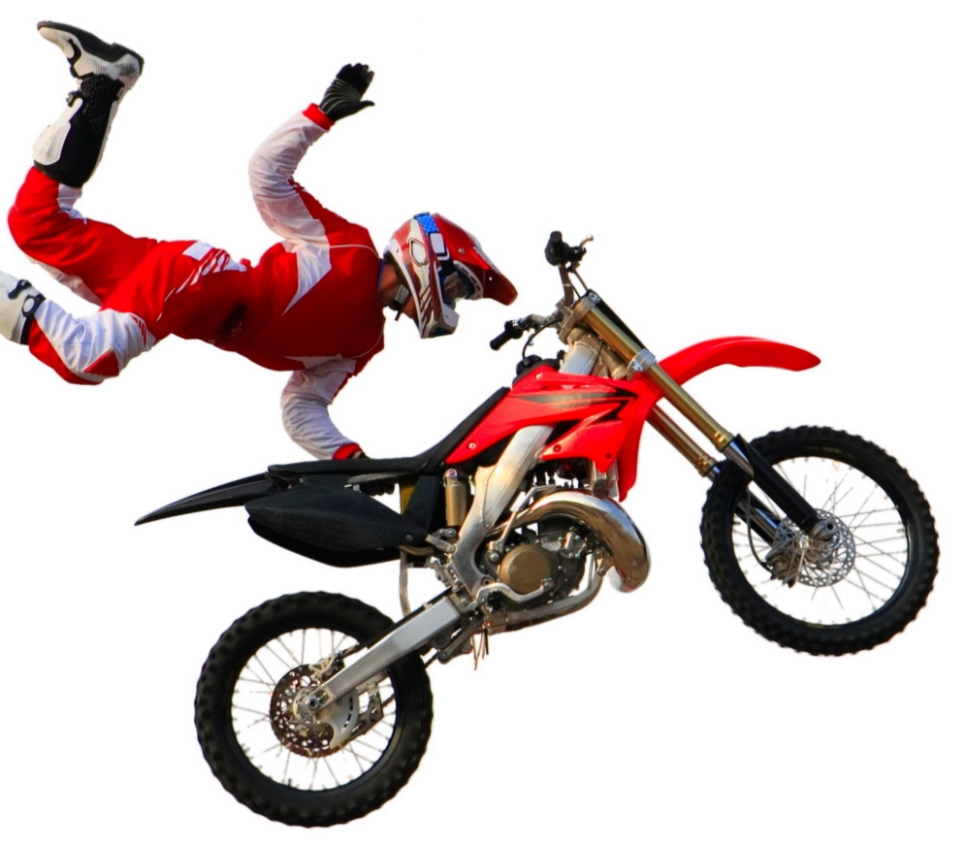
Alternative approaches
Suppose you were a motorbike rider planning a stunt jump over a ravine
You know the height of the jump ramp
You know the length of the run up to the ramp
How can you be sure to clear the gap?
Would you favour a trial and error approach, or a theoretical approach?

Slide 14
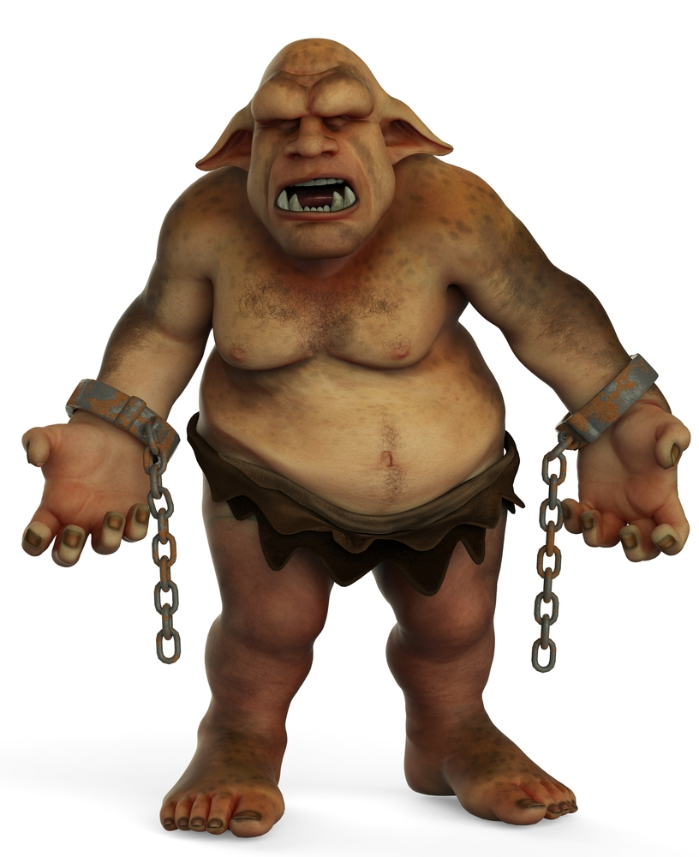
Creative solution
How would you prevent any comments from Internet Trolls from reaching their intended recipients if you ran Twitter?
What would constitute a comment deemed to be from a troll and worthy of concealing from the recipient?

Slide 15
Worksheet 1
Try Task 2 on the worksheet

Slide 16
Strategies for algorithm design
Decrease and conquer
This involves finding a solution to a sequence of smaller, related problems until the instance is small enough to be solved directly
A good example of this is the binary search algorithm. We will revisit that in a later lesson

Slide 17
Sample problem
A well-known celebrity is among a group of people at a gathering. The celebrity knows none of the other guests, but everybody knows the celebrity
How can you identify the celebrity by repeatedly asking the question “Do you know this person?”
The other guests may, or may not know each other

Slide 18
Solution
If there are n (where n = 2 or more) people at the gathering, you can select two people from the group, and ask one of them (Person A) “Do you know this person?” (Person B)
If A knows B, then remove A from the people who could be the celebrity. If A does not know B, remove B from the group who could be the celebrity.
Then solve the problem for the remaining group of n-1 people
Repeat until there are only 2 people left

Slide 19
Worksheet 1
Now try Tasks 3 and 4 on the worksheet

Slide 20
Plenary
There is an infinite number of different real-world problems to be solved, from making this week’s shopping list to deciding on the nation’s best economic strategy for the next decade
Computational thinking is a way of thinking about how to approach problems and finding optimum solutions
Solving logic puzzles, devising algorithms and studying different strategies for problem solving will all help you to think computationally

