Slide 1
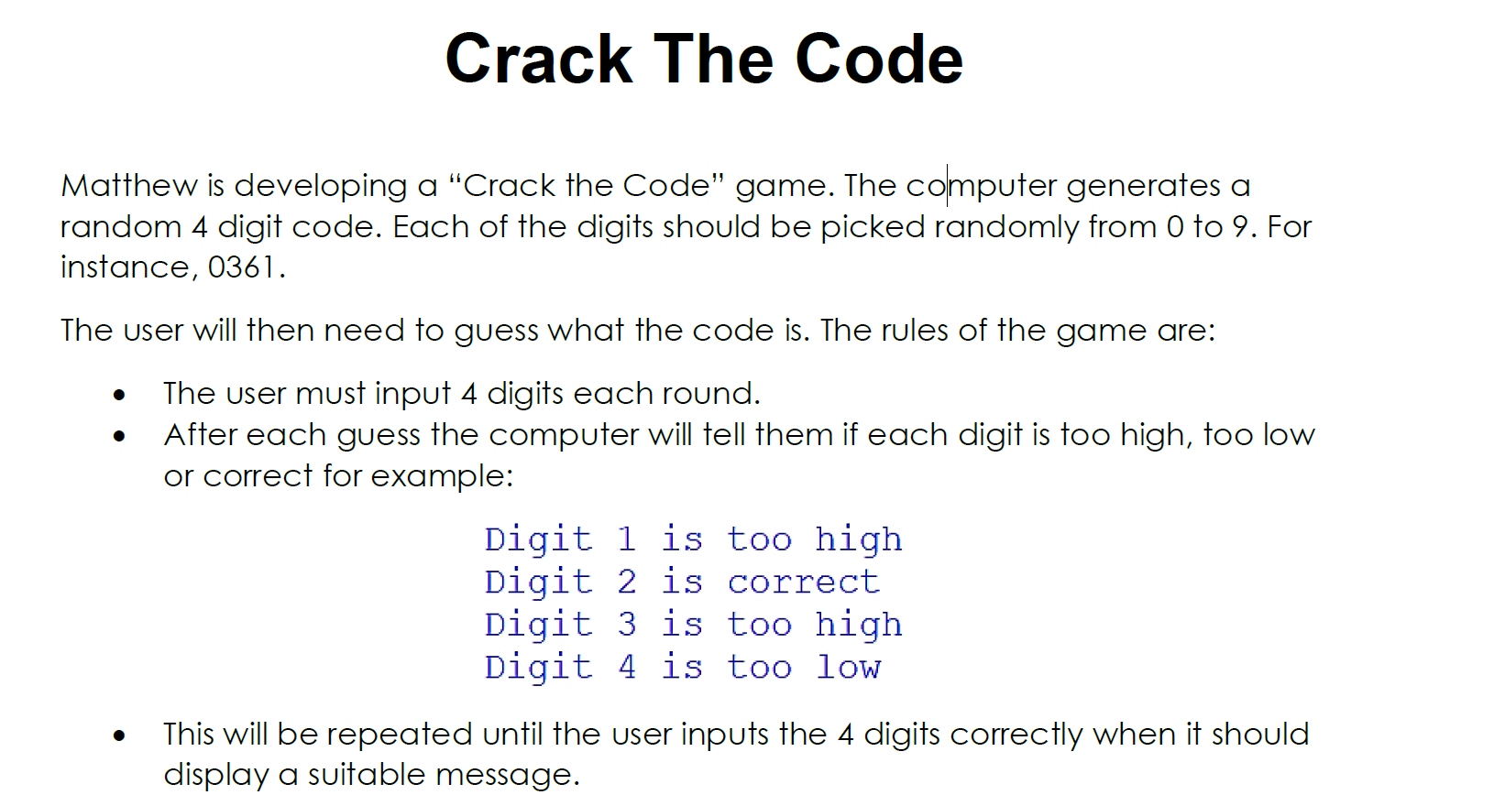
HINTS: You will need:
A library that produces random numbers
A data structure to store the 4 digits
Validation
A digit by digit comparison

