Slide 1
File Handling in Python

Slide 2
File Handling
Data that you want to store needs to be saved to an external source and the easiest way to do that is with a text file.
At A level we deal with 2 file types – text and csv (comma separated values)

Slide 3
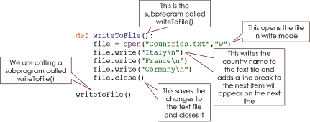
File Handling-
Writing to a file
The first step is to create a text file:
© Nichola Wilkin Ltd 2020

Slide 4
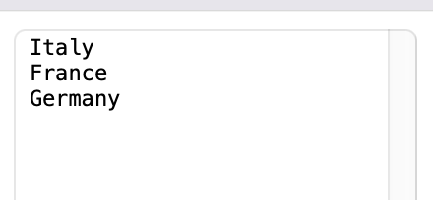
You should now have a text file in the same folder as your Python code is saved.
File Handling-
Writing to a file
© Nichola Wilkin Ltd 2020

Slide 5
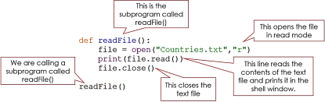
File Handling-
Reading from a file
© Nichola Wilkin Ltd 2020

Slide 6
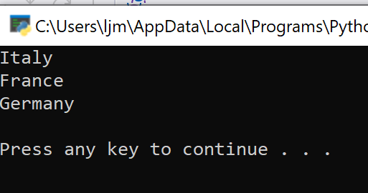
File Handling-
Appending Data to a file
© Nichola Wilkin Ltd 2020

Slide 7
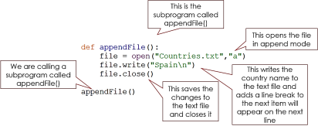
File Handling-
Appending Data to a file
© Nichola Wilkin Ltd 2020

Slide 8
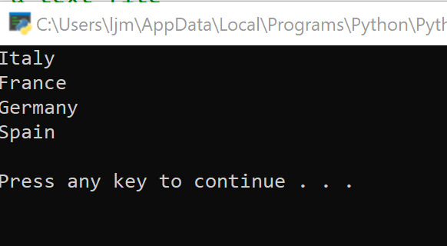
File Handling-
Appending Data to a file
© Nichola Wilkin Ltd 2020

Slide 9
Practice
Create a new program in Python:
The user is shown a menu with 4 options available.
  If they select 1 it will create a new file, overwriting any other files called Countries in that folder.
  If they select 2 they can input a new country and that will get added to the end of the list
  If they select 3 they will see the list in the output window.
  If they select 4 it will stop the loop and quit the program
  and if they enter anything else, it will tell them they made an invalid selection.

Slide 10



Three different ways to look at the same data:

Slide 11
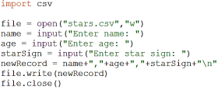
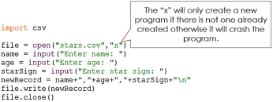
File Handling – writing a CSV file

Slide 12

File Handling – reading a CSV file

Slide 13
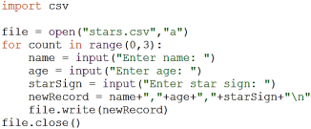
File Handling – appending to a CSV file

Slide 14
More Practice
Complete the programming tasks on Godalming Online, under Secret Messages>>File Handling Revision

Slide 15
For more help….
https://pynative.com/python/file-handling/
https://www.geeksforgeeks.org/file-handling-python/

