Slide 1
AQA
    A Level
      Computer Science
      Paper 1
OOP design principles
  Unit 12
  OOP and functional programming

Slide 2
Objectives
Understand inheritance, polymorphism and overriding
Understand concepts of aggregation
    Composition
    Association
Be aware of object-oriented design principles:
    encapsulate what varies
    favour composition over inheritance
    program to interfaces, not implementation
Be able to draw and interpret class diagrams

Slide 3
Inheritance
Creating a new class based on an existing
class (superclass)
The new class is a subclass of the superclass
  The subclass inherits all the attributes and methods of the superclass and has some of its own attributes
  and / or methods

Slide 4
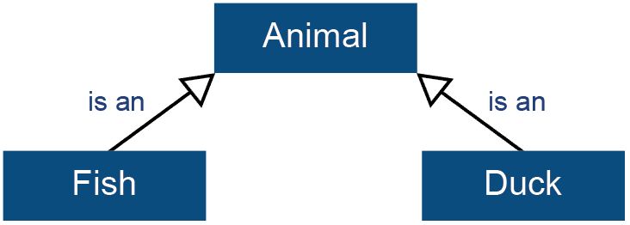
Inheritance example
superclass: Animal
subclass: Fish
subclass: Duck

Slide 5
The superclass Animal
Animal = Class
Public
Constructor(s, n)
Procedure feed()
Function getState()
Function getSize()
Protected
state: String
size: Integer
End Class
Attributes are protected so they can be accessed by subclass

Slide 6
The superclass using Python
class Animal:
def __init__(self, s, n):
self._state = s
self._size = n
def feed(self):
self._size += 1
print(self._state, "fed")
…
All attributes in Python are public.
Python convention uses _attribute to indicate Protected and __attribute to indicate Private
All attributes in Python are public.
All methods in Python are automatically overridable by using a method of the same name in the subclass

Slide 7
The superclass using VB.net
Class Animal
Protected state As String
Protected size As Integer
Public Sub New(ByVal s, ByVal n)
state = s
size = n
End Sub
Public Overridable Sub feed()
size = size + 1
Console.WriteLine(state & " fed")
End Sub
…
End Class
Attributes protected, not private
Method definition can be re-defined in subclass

Slide 8
Declaring a subclass
Superclass
Fish = SubClass(Animal)
Public
Procedure setMaxSize(maxSize)
Private
maxSize : Integer
End Class
Additional method for this subclass only
Additional attribute for this subclass only

Slide 9
Declaring a subclass in Python
    class Fish(Animal):
    def setMaxSize(self, n):
    self.maxSize = n
Superclass
Method for this subclass only

Slide 10
Declaring a subclass in VB.net
Class Fish
Inherits Animal
Private maxSize As Integer
Public Sub setMaxSize (ByVal n As String)
maxSize = n
End Sub
End Class
Superclass
Method for this subclass only

Slide 11
Polymorphism and overriding
Polymorphism:
  a method used in a class hierarchy can behave differently in each class
This is achieved through overriding:
  a method with the same identifier in the superclass can be redefined or extended in a subclass

Slide 12
Access modifiers (specifiers)
In a class definition to implement data hiding
  Public
  Private
  Protected
Member is accessible… | Public | Protected | Private
Within the defining class | Yes | Yes | Yes
Via inheritance | Yes | Yes | No
Via a reference to an object of the class | Yes | Only if it is in a subclass / in the same package (definition varies between languages) | No

Slide 13
Polymorphism example
The feed method may behave differently in the fish class, so it can be re-defined in the subclass
Fish = Subclass(Animal)
Public
Procedure feed Override
size ← size + 2
Output state, " fed"
If size >= maxSize Then
state ← "BIG FISH"
End If
End Procedure
…
End Class
Superclass
Redefined method

Slide 14
Overriding in Python
class Fish(Animal):
def feed(self):
self._size += 2
print(self._state, "fed")
if self._size >= self.maxSize:
self._state = 'BIG FISH'

Slide 15
Overriding in VB.net
Class Fish
Inherits Animal
Public Overrides Sub feed()
size = size + 2
Console.WriteLine(state & " fed")
If size >= maxSize Then
state = "BIG FISH"
End If
End Sub
End Class
Redefines method

Slide 16
Polymorphism example
The feed method from the superclass can be extended in a subclass
Duck = Subclass(Animal)
Public
Procedure feed Override
Animal.feed()
If size = 5 Then
state ← "BIG DUCK"
End If
End Procedure
…
End Class
Redefined method
Calls superclass method before extending definition

Slide 17
Overriding in Python
  class Duck(Animal):
  def feed(self):
  Animal.feed(self)
  if self._size == 5:
  self._state = 'BIG DUCK'
Calls superclass method

Slide 18
Overriding in VB.net
  Class Duck
  Inherits Animal
  Public Overrides Sub feed()
  MyBase.feed()
  If size = 5 Then
  state = "BIG DUCK"
  End If
  End Sub
  End Class
Calls superclass method

Slide 19
Overriding the constructor
in Python
Class Fish(Animal):
def __init__(self, s):
Animal.__init__(self, s, 1)
self.maxSize = 2
Calls superclass constructor

Slide 20
Overriding the constructor in VB.net
Class Fish
Inherits Animal
Private maxSize As Integer
Public Sub New(ByVal s)
MyBase.New(s, 1)
maxSize = 2
End Sub
…
End Class
Calls superclass constructor

Slide 21
Using subclasses
A subclass is treated in the same way as
a superclass
What is the statement to:
  Instantiate an object of class Fish with identifier thisFish ?
  Call the feed method for thisFish ?

Slide 22
Using subclasses (Python)
A subclass is treated in the same way as
a superclass
What is the statement to:
  Instantiate an object of class Fish with identifier thisFish ?
thisFish = Fish('little fish')
  Call the feed method for thisFish ?
thisFish.feed()

Slide 23
Using subclasses (VB.Net)
A subclass is treated in the same way as
a superclass
What is the statement to:
  Instantiate an object of class Fish with identifier thisFish
Dim thisFish As New Fish("little fish")
  Call the feed method for thisFish
thisFish.feed()

Slide 24
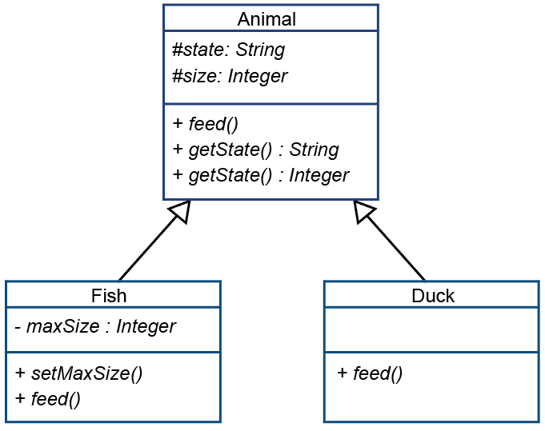
Class diagram with inheritance
Public (+)
private (-)
Protected (#)

Slide 25
Worksheet 2
Complete Tasks 1 and 2 on the worksheet

Slide 26


Association
Composition and aggregation are both
“has a” relationships
  An object contains another object
Composition
  If the containing object is destroyed so are the objects it contains
  Depicted as a filled diamond and a solid line:
Aggregation
  The objects remain when the container object is destroyed
  Depicted as an unfilled diamond and a solid line:

Slide 27



Association examples
A pond has fish
A course has students
A linked list has nodes

Slide 28
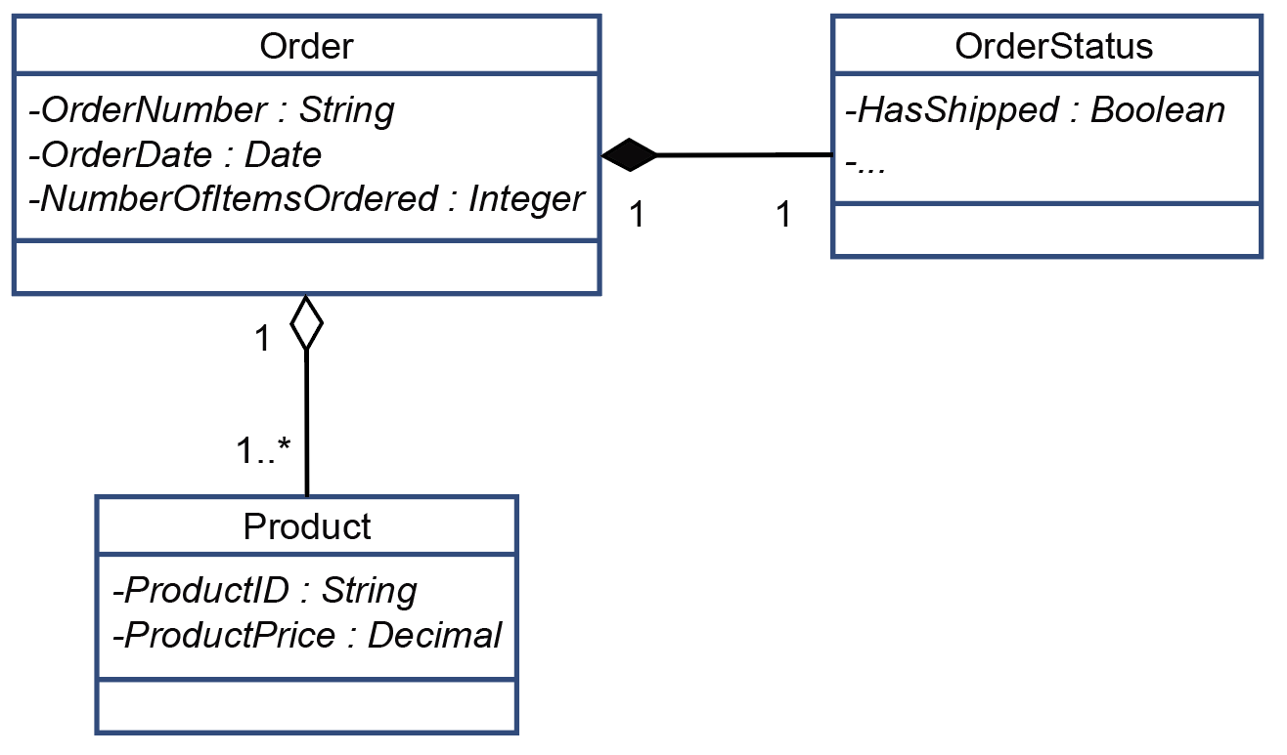

Programming composition and aggregation associations

Slide 29
Programming associations
Order = Class
Private
ProductsOrdered: Array Of Product
Status: OrderStatus
OrderNumber: String
OrderDate: Date
End Class
OrderStatus = Class
Private
hasShipped: Boolean
End Class
Product = Class
Private
ProductID: String
ProductPrice: Currency
End Class

Slide 30
Worksheet 2
Complete Tasks 3 and 4 on the worksheet

Slide 31
Methods
Abstract method:
  consists of only a signature and no implementation
  used to specify that a subclass must provide an implementation of the method
  used to specify interfaces in some computer languages
  shown in VB.net by the keyword MustOverride

Slide 32
Methods continued
Virtual method:
  implementation can be redefined by subclasses
  Shown in VB.net by the keyword Overridable
Static method:
  relevant to all the instances of a class rather than to any specific instance
  has no owning object and does not run on an instance
  receives all information from its arguments
  Shown in VB.net by the keyword Shared
Note: All methods in Python are effectively virtual

Slide 33
OOP design principles
Encapsulate what varies
Favour composition over inheritance
Program to interfaces, not implementation

Slide 34
Encapsulate what varies
To reduce maintenance:
      Consider what aspects are most likely to change in future
      Encapsulate these aspects into separate modules
      When changes are required, only the relevant module needs changing

Slide 35
Composition vs inheritance
Composition is a less rigid relationship between two objects than an inheritance relationship between two objects

Slide 36
Interface
A collection of methods with no implementation
  Is a set of public method signatures
  Cannot include any implementation or data properties
  Reduces dependency on implementation specifics and makes code more reusable
  Generally only used in languages that use the single-inheritance class model (such as VB.net)
Python supports multiple inheritance, so does not use interfaces but uses base classes or abstract base classes

Slide 37
Declaring an interface (VB.net)
An interface is similar to a base class with abstract methods
Public Interface Communicate
Sub OutputMessage(s As String)
Function ReceiveMessage() As String
End Interface

Slide 38
Using an interface (VB.net)
Classes implement the methods in the interface
Public Class implementCommunicate_
Implements Communicate
Private Sub OutputMessage(s As String)_
Implements Communicate.OutputMessage
Console.WriteLine(s)
End Sub
Private Function ReceiveMessage() As String_
Implements Communicate.ReceiveMessage
Dim s As String
Console.Write("What is your message? ")
s = Console.ReadLine()
s = "Message: " & s
Return s
End Function
End Class

Slide 39
Using an interface (VB.net)
Classes implement the methods in the interface
Public Class implementCommunicate2_
Implements Communicate
Private Sub OutputMessage(s As String)_
Implements Communicate.OutputMessage
Console.WriteLine("message reads: " & s)
End Sub
Private Function ReceiveMessage() As String_
Implements Communicate.ReceiveMessage
Dim s As String
Console.WriteLine("Type message on next line ")
s = Console.ReadLine()
Return s
End Function
End Class

Slide 40
Using an interface (VB.net)
Instantiating a class based on an interface
Dim Example1 As Communicate = _
New implementCommunicate()
Dim Example2 As Communicate = _
New implementCommunicate2()
Note:
  The Interface identifier is used in the As part
  The class identifier is used with New

Slide 41
Using an interface (VB.net)
Using an object based on a class with interface is exactly the same as for any object
MessageText = Example1.ReceiveMessage()
Example1.OutputMessage(MessageText)
MessageText = Example2.ReceiveMessage()
Example2.OutputMessage(MessageText)

Slide 42
Advantages of the
object-oriented paradigm
Extensive planning phase makes for better designs
Source code for object is written and maintained independently of other objects
Programmers can use existing objects without needing to know how they were implemented
Good framework for code libraries
Software maintenance easier because of rigidly enforced modular structure

Slide 43
Plenary
Inheritance
  Subclass uses attributes and methods of its superclass
Polymorphism
  implemented through overriding superclass method
Association
  composition and aggregation
Class diagrams are used to show:
  relationships between classes (inheritance, association)
  methods and attributes of each class, including modifiers

