Slide 1
Introduction to Geography
A Level Year 2

Slide 2
WELCOME BACK TO GEOGRAPHY
A reminder of expectations of the department
You must be organised. Get a ring binder and make sure you keep all of your booklets and notes in it.
Bring stationary to class e.g. pens, highlighters, paper.
Bring current booklet(s).
Complete and submit homework on time. Work is set via Teams and your teachers will advise you of submission arrangements to hand work in during a lesson.
If an extension is agreed with your teacher hand in late work to your teacher or via the folders in the corridor outside the office.

Slide 3
College Golden Rules
Arrive to every lesson promptly and prepared with the necessary equipment ​
Mobile phones must be switched off and out of sight unless instructed otherwise by your teacher ​
No food is allowed in classrooms unless there is specific medical requirement. You can have a water bottle on your desk but this must be filled up before the lesson ​
If you arrive late you must knock on the door and wait until the teacher gives permission to enter the room ​
Listen carefully when the teacher is talking ​
Be respectful and kind in your language and behaviour at all times ​

Slide 4
Topics covered:
PAPER 1 – PHYSICAL (40%) | PAPER 2 – HUMAN (40%) | NEA: GEOGRAPHY FIELDWORK INVESTIGATION (20%)
YEAR 1 Coastal systems and landscapes Hazards | YEAR 1 Changing Places Contemporary urban environments | Students complete an individual investigation which must include data collected in the field. The individual investigation must be based on a question or issue defined and developed by the student relating to part of the specification content.
YEAR 2 Hazards Water and the carbon cycle | YEAR 2 Global systems and global governance

Slide 5
Summer Work
You were asked to complete the following over the Summer:
NEA Independent Investigation – Booklets and resources on Godalming Online in the Independent Investigation folder to support you. Remember this is worth 20% of your final A Level grade.
Global Systems and Global Governance – complete the summer work (issued in class) ready for Human Geography lessons commencing this week. Bring to all Geography lessons this week as you will not know which one is Human Geography.
Year 1 Work – ensure all Year 1 booklets and review notes for Changing Places, Contemporary Urban Environments, Coasts and Hazards 1 - 4 are fully completed and filed ready for revision. Bring the Hazards review notes 1-4 to all Geography lessons this week as you will not know which ones are Physical Geography.
Benchmark Preparation - revise and prepare for a Benchmark which will take place in the second week back, week beginning Monday 18th September.

Slide 6
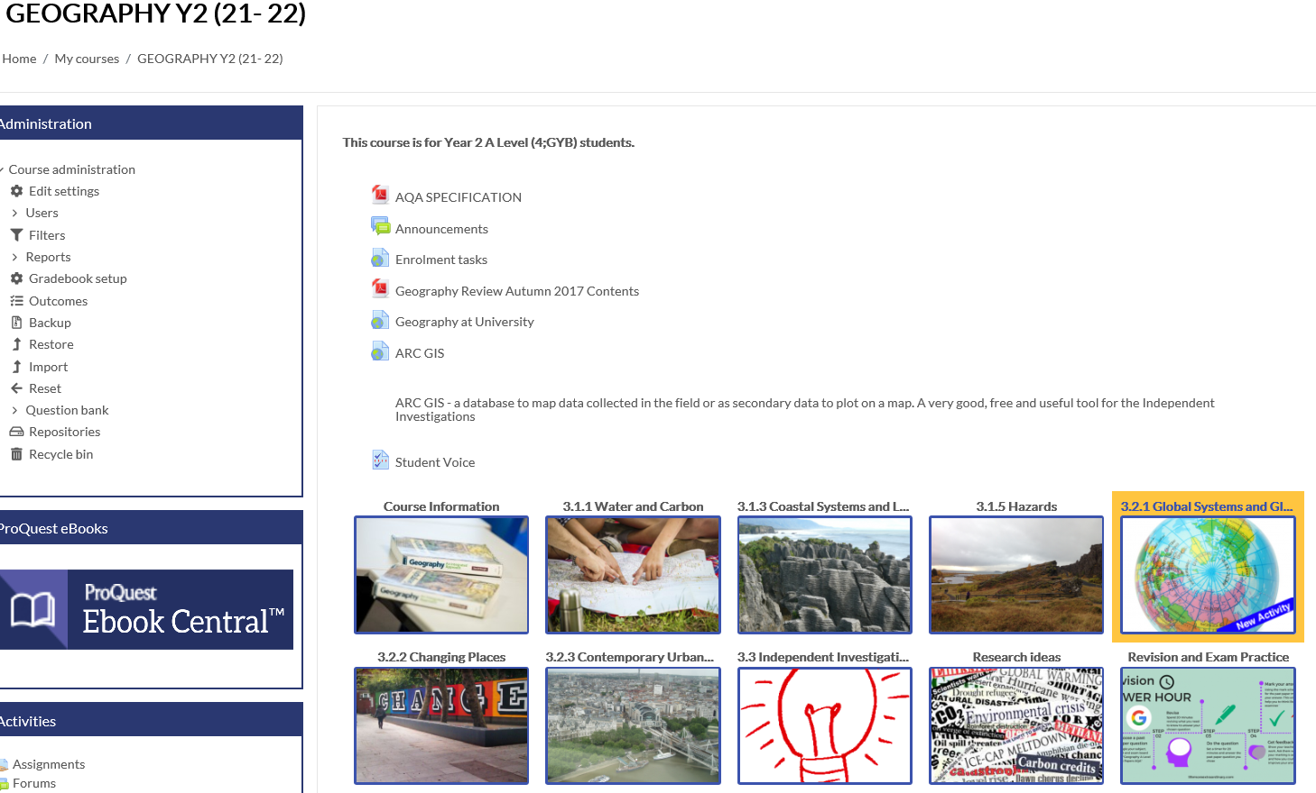
Godalming
Online
REMINDER
All resources are uploaded onto Godalming Online under GEOGRAPHY Y2 (22-23)
Each topic has its own section e.g. Coasts, Changing Places, Hazards etc.
The topics have folders which are numbered in order of teaching e.g. 1 Coast as a system.
Within each folder are the PowerPoints, booklet(s) and resources for that section of the course.
It is your responsibility to keep up with the content. If you are absent from a lesson or need to refer to the PowerPoint/resources to complete class or homework you can find everything you need on Godalming Online..

Slide 7
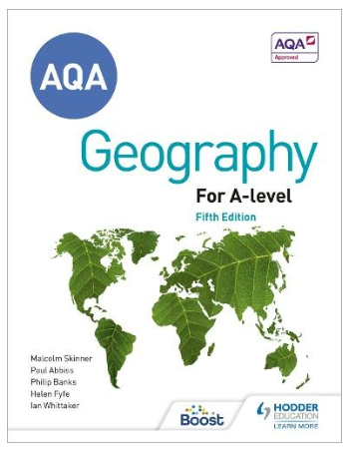
Recommended Text Book
Hodder AQA A Level Geography
ISBN 978-1-3983-1254-8
This is available with other resources in the ILC and also as an eBook on the College VLE.

Slide 8

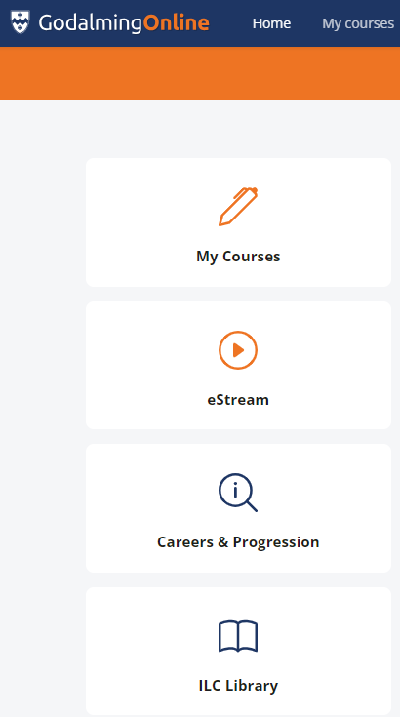
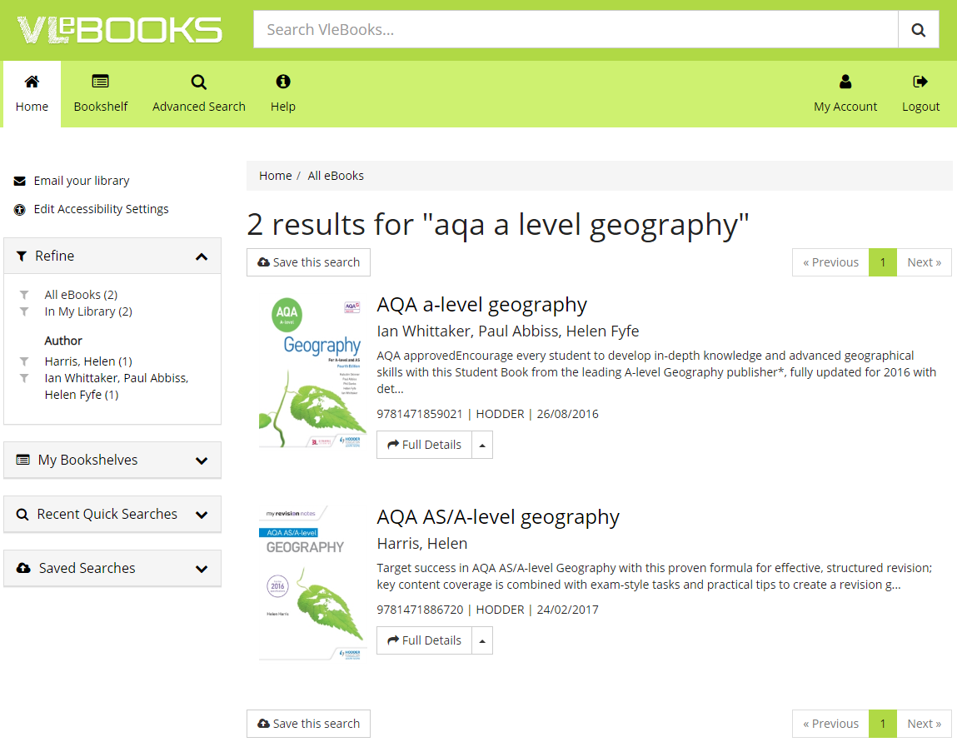
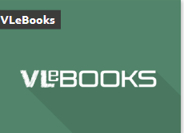
Finding an eBook on VLe using Godalming Online.
Step 3: Type aqa a level geography into the search bar.
Step 1: Go to Godalming Online Home page, select ILC Library
Step 4: Click on the book you want to open where you will have options to read online, download and add to your bookshelf.
Step 2: Click on VLeBOOKS icon and then click on ‘use this link to access Vle books’
Text book
Revision Guide

Slide 9

Geography Review Magazine
Geography Review magazine contains specification specific expertise at A-level.
The magazine includes topical articles, brand new case studies and expert exam advice to deepen your subject knowledge and develop independent learning skills
The college subscribes to the Magazine and it is available in the ILC or online via GOL.
To access via Godalming Online, select ILC Library/select the box/link for ‘Dynamic Learning Hodder Education A-level Magazine Archive’.
Select the Geography Review Magazine Archive or use the search box (advanced search advisable) in the top right-hand corner and click on the magnifying glass symbol to search.

Slide 10
PROVISIONAL ASSESSMENT PLAN
BENCHMARK 5: Week beginning 18th September 2023 Hazards Changing Places Comprised of short and longer exam questions.
BENCHMARK 6: Due to Geography Coursework (NEA worth 20% of final grade) there is no timed assessment at this point in the course A performance grade will be given based on class and homework.
BENCHMARK 7 (MOCK): After February half term 2024 Provisional Content - to be confirmed: Water and Carbon Hazards Global Systems & Global Governance Comprised of short and longer exam questions.

Slide 11
Plan for lessons over the coming weeks
Week Beginning 11th September:
Exam technique – 1 lesson
NEA Turnitin and plagiarism software – 1 lesson
Global Systems and Global Governance – 1 lesson
Week beginning 18th September:
Benchmark Assessments - in 1 of the Geography lessons of the week – your teacher will confirm which lesson
Hazards - in 1 of the Physical Geography lessons of the week – your teacher will confirm which lesson
Global Systems and Global Governance – 1 lesson
Week beginning 25th September onwards:
Topic teaching:
  Physical Geography – 2 lessons per week Hazards
  Human Geography – 1 lesson per week Global Systems and Global Governance
NOTE: Please ensure you bring the correct folders and work to the required lessons

Slide 12
NEA/Independent Investigation – Key Dates
Week beginning 11th September – You will need to have your Independent Investigation work - in 1 of the Physical Geography lessons of the week – your teacher will confirm which lesson. Students were asked to complete this over the summer holidays for final submission.
Lunchtime workshops for students with any final queries regarding your NEA will take place on Thursdays and Fridays every week until the final deadline. These will be in the Geography Department Classrooms at 1.15pm.
All work will need to be run through Turnitin plagiarism, checked and any amendments made prior to the final submission.
Final Deadline for coursework is Friday 6th October. Please be warned that a failure to meet the final coursework deadline is the equivalent to missing the exam.
Full details of Turnitin and submissions will be covered in lessons week beginning 11th September.

Slide 13
Benchmark 5 week beginning Monday 18th September
Human |  | Physical
Changing Places | Tariff | Hazards | Tariff
 | 1 x 6 |  | 4 x 1
 | 1 x 20 |  | 2 x 4
Total Marks | 26 | Total Marks | 12

Slide 14
Resources on GOL to support your benchmark preparation
There are resources available on Godalming Online in the Revision and Exam Practice and Topic Folders to support your revision and preparation for the benchmarks along with the exam technique booklets issued in class last year.
Exam Technique Booklet - Issued in class last year and a copy can be found in the Revision and Exam Practice folder.
Review notes - Review notes sheets have been produced and set as work to complete by your teachers. These can be found under each topic area on GOL.
Practice Exam Questions - Practice questions, mark schemes and model answers for the Changing Places topics.
Hodder Workbook practice questions and answers - Practice questions and answers for all topics covered. These can be found in the Revision and Exam Practice folder.
AQA Exam Questions and Mark Schemes - All AQA published papers and marks schemes. These can be found in the Revision and Exam Practice folder.
Changing Places Learning Grids (issued at the end of last term) and Answers – Can be found in the Revision and Exam Practice folder.

Slide 15
The exam papers for the A-Level
Paper 1: | Paper 2: | NEA - Coursework
Physical Geography | Human Geography | Independent Investigation
40% of A Level grade | 40% of A Level grade | 20% of A Level grade
2 hour 30 minutes exam | 2 hour 30 minutes exam | 3000 – 4000 words
120 marks | 120 marks | 60 marks
Questions on Water and Carbon worth 36 marks | Questions on Global Systems and Global Governance worth 36 marks
Question on Coasts worth 36 marks | Questions on Changing Places worth 36 marks
One Question on Hazards worth 48 marks | Questions on Contemporary Urban Environments worth 48 marks

Slide 16
Geography A Level Exam Paper Structure
Paper 1 – Physical Geography (120 MARKS)
TOPIC | Section | Question and marks | Total
Water and carbon cycles | A (Question 1) | 4 (AO1)
 |  | 6 (AO3)
 |  | 6 (AO1 2 marks, AO2 4 marks)
 |  | 20 (AO1 10 marks, AO2 10 marks) | 36
Coastal systems and landscapes | B (Question 3) | 4 (AO1)
 |  | 6 (AO3)
 |  | 6 (AO1 2 marks, AO2 4 marks)
 |  | 20 (AO1 10 marks, AO2 10 marks) | 36
Hazards | C (Question 5) | 4 (AO1)
 |  | 6 (AO3)
 |  | 9 (AO1 4 marks, AO2 5 marks)
 |  | 9 (AO1 4 marks, AO2 5 marks)
 |  | 20 (AO1 10 marks, AO2 10 marks) | 48

Slide 17
Paper 2 – Human Geography (120 MARKS)
TOPIC | Section | Question and marks | Total
Global systems and global governance | A (Question 1) | 4 (AO1)
 |  | 6 (AO3)
 |  | 6 (AO1 2 marks, AO2 4 marks)
 |  | 20 (AO1 10 marks, AO2 10 marks) | 36
Changing places | B (Question 2) | 4 (AO1)
 |  | 6 (AO3)
 |  | 6 (AO1 2 marks, AO2 4 marks)
 |  | 20 (AO1 10 marks, AO2 10 marks) | 36
Contemporary urban environments | C (Question 3) | 4 (AO1)
 |  | 6 (AO3)
 |  | 9 (AO1 4 marks, AO2 5 marks)
 |  | 9 (AO1 4 marks, AO2 5 marks)
 |  | 20 (AO1 10 marks, AO2 10 marks) | 48
Timing = 120 marks in 2 hours 30 minutes

Slide 18
Other considerations:
Please check your college email regularly and empty your deleted files regularly to ensure you get all of your mail.
Phones must be put in bags unless we explicitly ask you to use them in class.
The college’s minimum attendance is 90%. Any absence must be authorised by a parent/guardian by either ringing into college or emailing attendance@godalming.ac.uk It is your responsibility to catch up on any work missed.
Under Course Information on Godalming Online you will find the following:
  Geography A Level Course Handbook which includes information about the department, course, student scheme of work, and 50:50 help and advice.
  Geography Department Assessment Policy.

Slide 19
50:50
Homework does not necessarily need to be completed at home! You can use free periods during the day to complete these tasks outside of lessons.
To keep a good work/life balance, you might like to treat College as a 0900 to 1600 day and use your free periods in the library completing tasks.
Along with work set by teachers, in the Course Handbook and displayed in the classroom are suggestions of additional work to do each week.
The department has a 50/50 Team with channels for each topic areas where you can find links to resources, news reports and video clips to support your independent learning.
50/50 is a good way of thinking about this: 50% of the time spent on the subject will be spent in lesson but to be successful over the two years you should be matching this with the same amount of time in your own independent study of the subject.

Slide 20
Remember:
We are here to help and support you.
If you are not sure about any of the content being covered please get in touch, sooner rather than later.
It is not good enough to turn up to a lesson without homework claiming that you didn’t understand – check early and ask your teacher.
Use Godalming online – lots of supporting material can be found on there.
Prepare thoroughly for benchmark assessments – these are very important as seen this year.
Come to a Department Workshop lunchtimes for some help. These will be advertised within the department.
The A Level Geography Handbook containing information about the course, assessment policy etc. can be found on GOL under Course Information.

Slide 21

Geography Lunchtime Workshops:
NEA Support
Come to Room 911/912 at 1.15pm on Thursdays and Fridays.
Thursday 14th & Friday 15th September
Thursday 21st & Friday 22nd September
Thursday 28th & Friday 23rd September
Thursday 5th October
Open to all Second Year Geography Students

