Slide 1
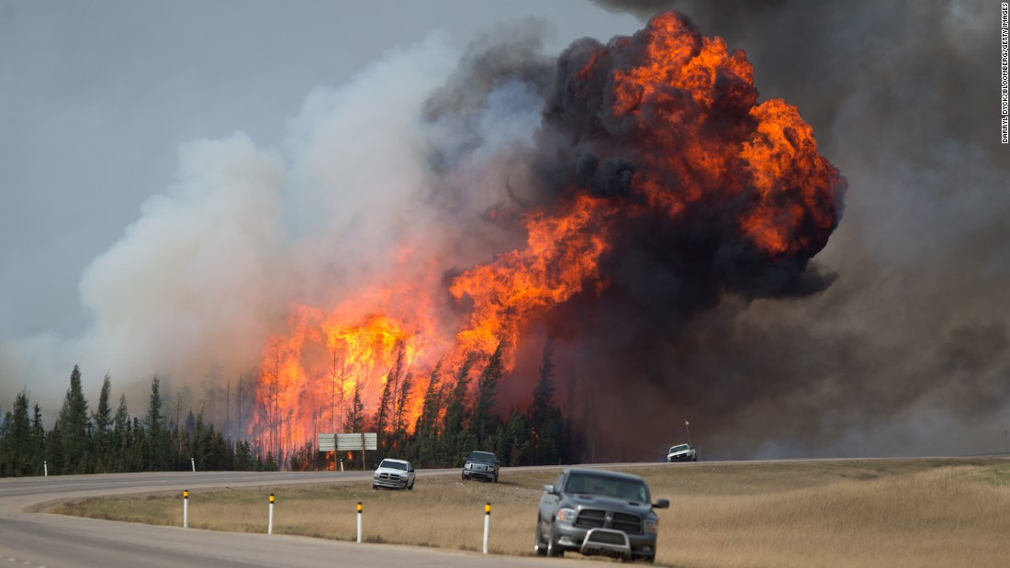
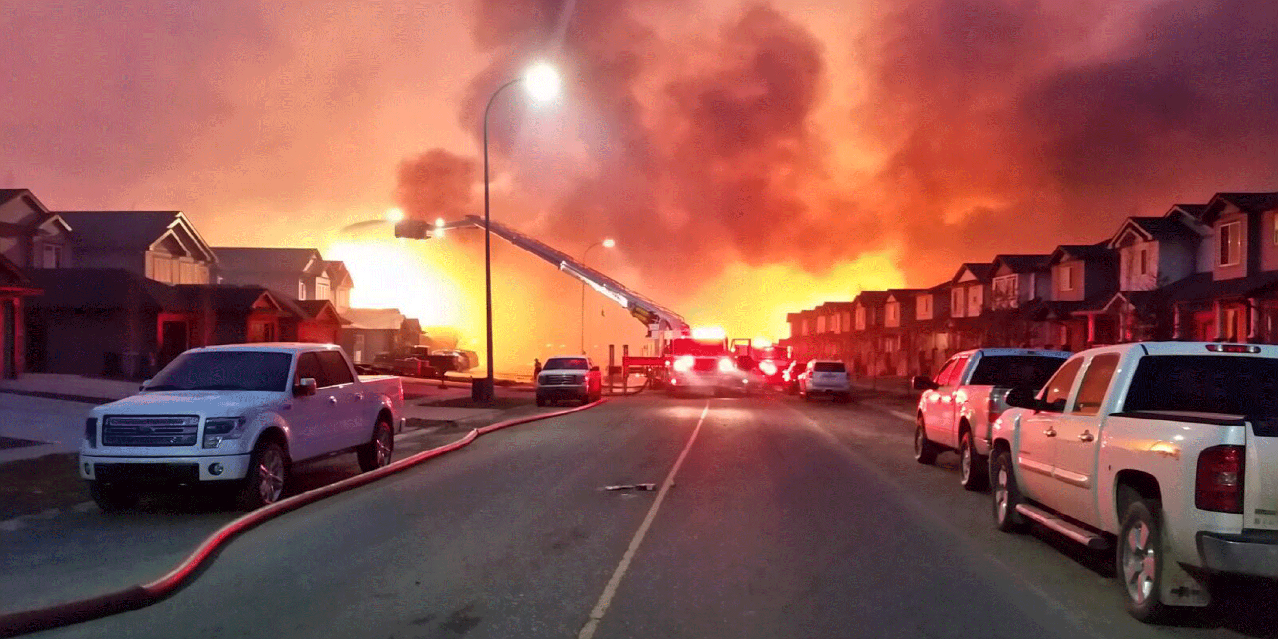
Wildfire case study: Alberta 2016

Slide 2
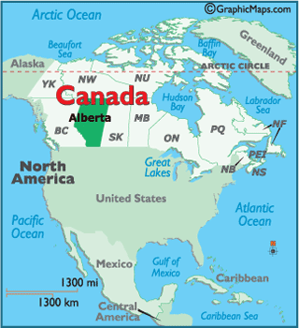
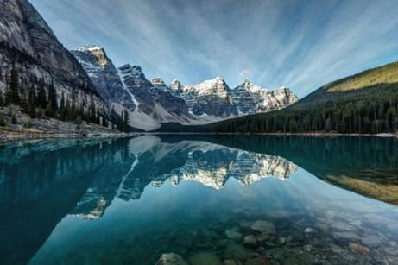
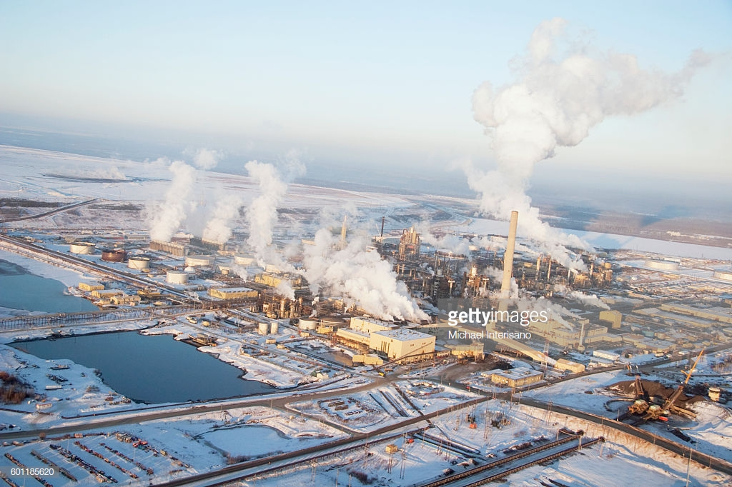
Alberta, Canada
https://www.youtube.com/watch?v=ThFCg0tBDck

Slide 3
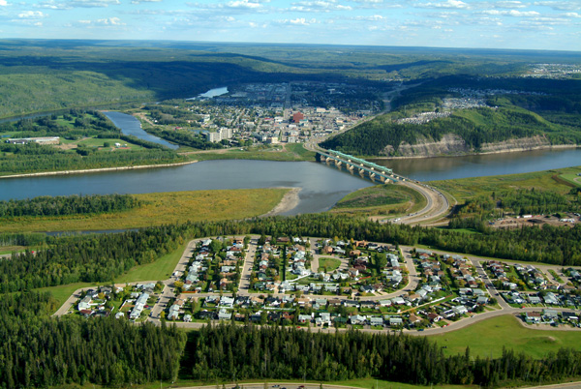
Fort McMurray, Alberta
In May 2016 a huge wildfire nicknamed ‘the Beast’ swept across parts of Canada’s Alberta province, forcing the evacuation of 90,000 residents from the city of Fort McMurray. The fire devastated the city, destroying 2,400 homes and businesses. Incredibly, no one was killed or injured as a direct result of the fire. Analysts suggest that this fire could turn out to be Canada’s most costly disaster.

Slide 4
Watch the special report on the wildfire:
https://www.youtube.com/watch?v=GCAt5ssX_xY
Make notes on both the impacts and the response.

Slide 5
Wildfire case study: Alberta 2016

Slide 6
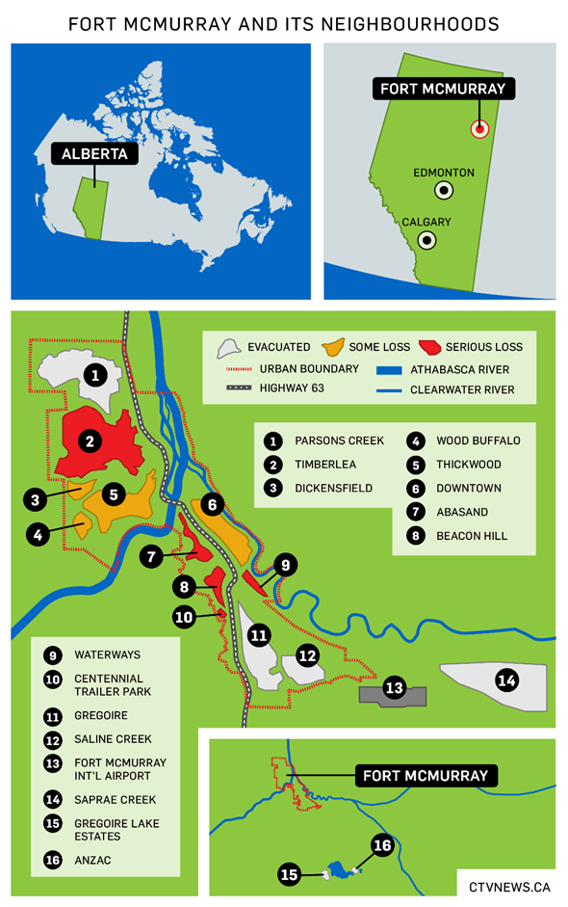
Study this map of fire-affected areas in Fort McMurray.
What would have been the difficulties in evacuating people from the different neighbourhoods?
Using your knowledge on wildfire spread suggest how the fire was able to ‘jump’ across roads and the 1km wide river.

Slide 7
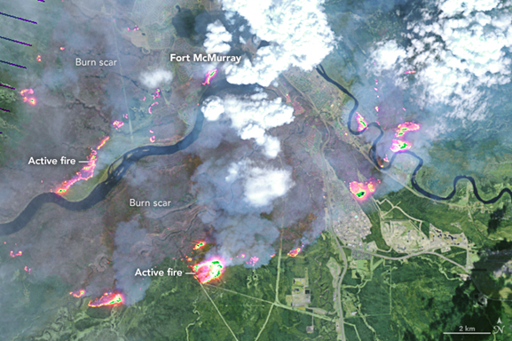
Annotate the thermal fire map image below to show how the locations of the fires presented problems for firefighters trying to contain and control the spread of the fire:

Slide 8
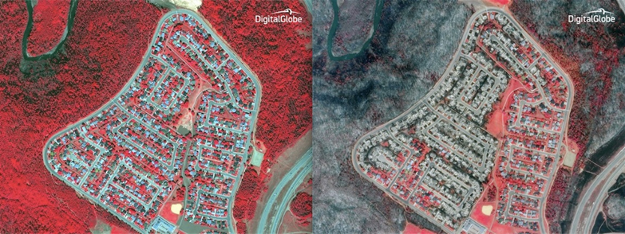
Annotate the satellite image to describe the impacts of fire on the vegetation and suggest why some areas appear to have been unaffected:
Beacon Hill, before and after (red is healthy vegetation)

Slide 9
Case Study report
What does the specification require?
You need to carry out a case study at a local scale of a specified place in a hazardous setting to illustrate the physical nature of the hazard and analyse how the economic, social and political character of its community reflects the presence and impacts of the hazard and the community’s response to the risk.

Slide 10
What to do:
Describe the spatial setting of the wildfire. Location of Fort McMurray, Alberta. Include annotated maps and images.
Assess the perception of the wildfire, and the factors affecting those perceptions at a range of scales – eg, magnitude, frequency, population characteristics etc.
Explain the causes of the wildfire; outline the favourable conditions that increased the fire hazard prior to ignition.
Explain and assess the social, economic, political and environmental impacts of the wildfire, including impacts on other natural systems (e.g. water cycle). Annotated photographs will be helpful.
Outline the main challenges facing the residents of Fort McMurray in the weeks and months after the wildfires.
Explain, assess and justify the response to the wildfire – including the factors affecting this response.
Describe and analyse how the economic, social and political character of the community affects the impacts and the community’s response to the hazard.

Slide 11
Use the information on the Fort McMurray wildfire included in your booklet and on Godalming Online, as well as information gathered from your own research, to help you write up your case study report. This should include both qualitative and quantitative data from a range of secondary sources.
You can present your case study in a variety of formats.
Useful websites:
http://cases.open.ubc.ca/fort-mcmurray-and-the-fires-of-climate-change/
https://www.tutor2u.net/geography/blog/canadian-wildfire-human-and-physical-factors-contributing-to-the-record-conflagration
https://ymcawun.files.wordpress.com/2015/04/fort-mcmurray-wildfire-case-study-final-jan-6-2017.pdf
Videos:
Great short clip on sense of community since the fire: https://www.youtube.com/watch?v=iOTVywa2w-Q
Teens with PTSD: https://www.youtube.com/watch?v=ncPu-tBmP94

Slide 12
Questions on Alberta Wildfire Home Learning Task
What was the perception of wildfire before the event? Why was this the perception?
Outline the favourable conditions that increase the fire hazard prior to ignition. Consider the fire triangle.
Name 2 impacts under each of the following: social, economic, political and environmental. Link to other natural systems.
Assess the impacts of the wildfire – which was the most significant? Justify your choice.
Name the main challenges facing residents of Fort McMurray.
Assess the response to the wildfire – which was the most successful? Justify your choice.
How did the economic, social and political character of the community affect the impacts and response?

Slide 13
Home Learning Task
In pairs/threes use your Alberta wildfire case study research to discuss and answer the following questions.
How have people’s perception of wildfire hazard and sense of place of Fort McMurray, Alberta changed? What factors have affected this?
Outline the favourable conditions that increased the fire hazard prior to ignition.
Identify 4 impacts of the hazard. Which do you think was the greatest impact of the wildfire? Give reasons for your choice.
Outline the main challenges facing the residents of Fort McMurray in the weeks and months after the wildfires.
Assess the effectiveness of the response - was the response effective? What evidence is there to justify the response?

Slide 14
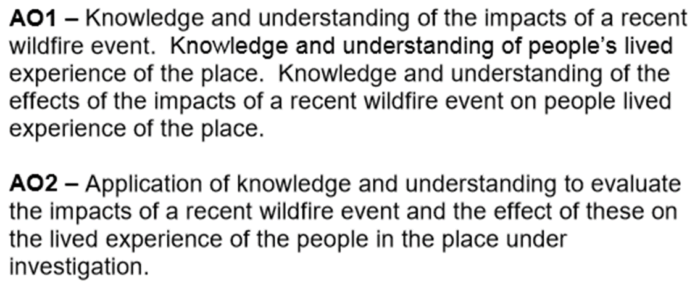
Assess the impacts of a recent wildfire event upon people’s lived experience of the place. (9 marks)
Consider several options or arguments and weigh them up so as to come to a conclusion about their effectiveness or validity.
Impacts of the Alberta wildfire case study
Synoptic link with
Changing Places
AO1 – 4 marks
AO2 – 5 marks
TASK:
Use the case study research to identify impacts of the Alberta wildfire and how they have affected people’s lived experience.
Plan the question using the P – Point E - Explain E - Evidence L - Link structure.

Slide 15
Assess the impacts of a recent wildfire event upon people’s lived experience of the place. (9 marks)
Consider several options or arguments and weigh them up so as to come to a conclusion about their effectiveness or validity.
Impacts of the Alberta wildfire case study
Synoptic link with
Changing Places
TASK:
Use your case study research to identify impacts of the Alberta wildfire and how they have affected people’s lived experience.
Plan the question using the P – Point E - Explain E - Evidence L - Link structure.

Slide 16
Assess the impacts of a recent wildfire event upon people’s lived experience of the place. (9 marks)
TASK: Use your case study research to identify impacts of the Alberta wildfire and how they have affected people’s
lived experience.
Plan the question using the P – Point E - Explain E - Evidence L - Link structure.
Note: Impacts can be primary/secondary, environmental, social, economic, political.
What were the impacts of the Alberta wildfire?
How have these impacts affected people’s lived experience?
Concluding statement: Overall assessment will reflect on the degree to which different aspects of people’s lived experience was affected by the wildfire.

Slide 17
Self Assessment – add the following before uploading your answer to Teams.
Read your answer:
Have you included a brief introduction? Are key terms defined?
Did you follow the PEEL structure?
Is there a clear concluding statement answering the question?
Give yourself marks for:
AO1 (4 marks)
AO2 (5 marks)
What went well? www
What could you do to improve your answer? ebi
Level the answer and give a total out of 9 marks:
L1 1-3 - basic
L2 4-6 - clear
L3 7-9 - detailed

