Slide 1
Multi-hazardous environments
Case study of a multi-hazardous environment beyond the UK to illustrate and analyse the nature of the hazards and the social, economic and environmental risks presented, and how human qualities and responses such as resilience, adaptation, mitigation and management contribute to its continuing human occupation.
Key questions:
What hazards does Haiti face and why does it face them?
Why is Haiti so vulnerable?
What has been done to reduce the risk of hazards?
How effective have the responses to hazards been in Haiti?

Slide 2
What hazards are there? Brainstorm as many as you can think of and add to the table below.
Geophysical hazards | Climate related hazards
Earthquakes Landslides Volcanoes Mass movements (dry) | Floods Storms Extreme temperature Wildfires Drought
Which of these do you think occur the most frequently? Which do you think have the most severe impacts?

Slide 3
Approximately how many more times likely is it that a climate related hazard has occurred rather than a geophysical one?
Based on your knowledge of earthquakes and volcanoes why do you think that this is?
What can we say about the pattern of climate related and geophysical hazards between 1998 and 2017?

Slide 4
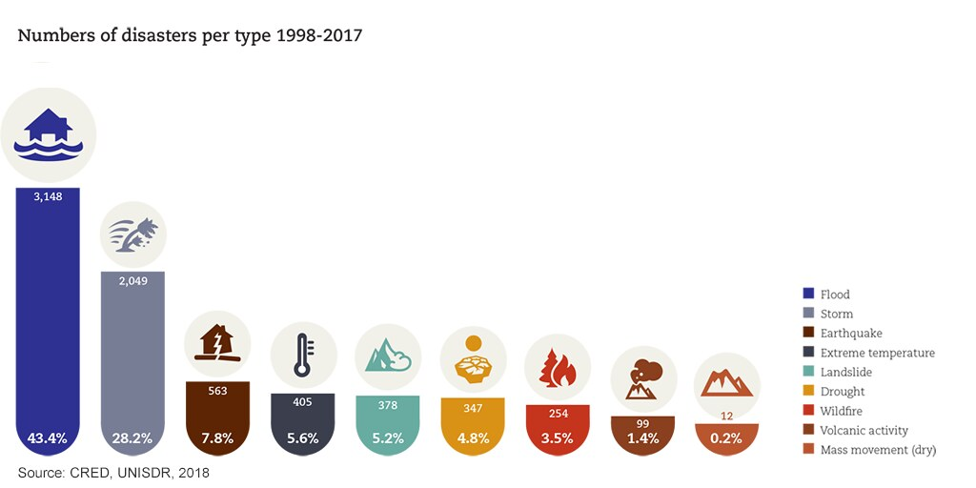

Slide 5
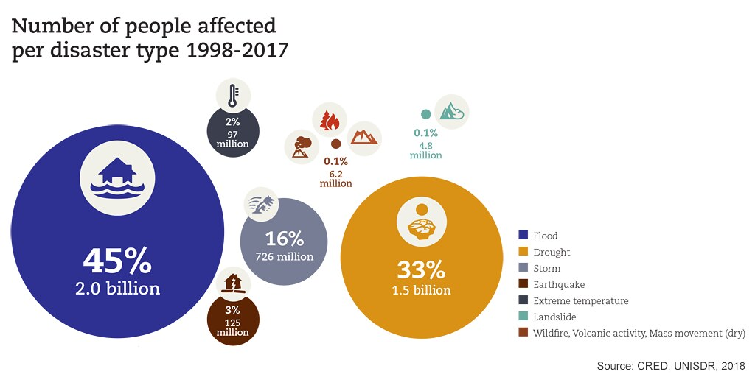

Slide 6
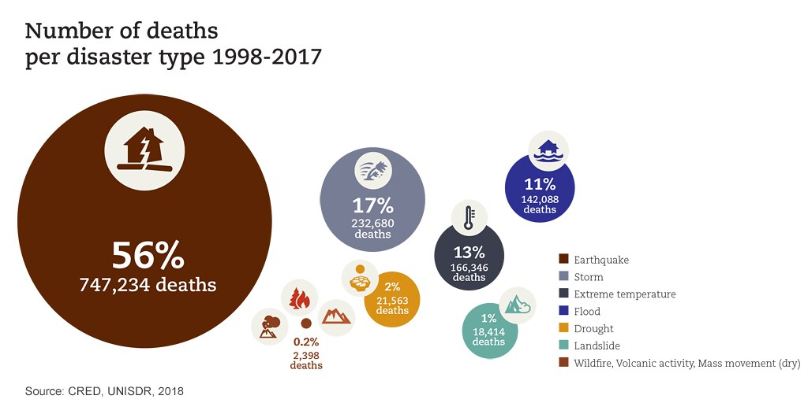

Slide 7
Type of disaster | Rank Number of disasters | Rank Number of people affected | Rank Number of deaths
Flood
Storm
Earthquake
Extreme temperature
Landslide
Drought
Wildfire
Volcanic activity
Mass movement (dry)
Use the previous 3 images to complete this table
Use the 3 figures and the table to analyse the data.
Which hazards are likely to increase in number/severity with climate change?

Slide 8
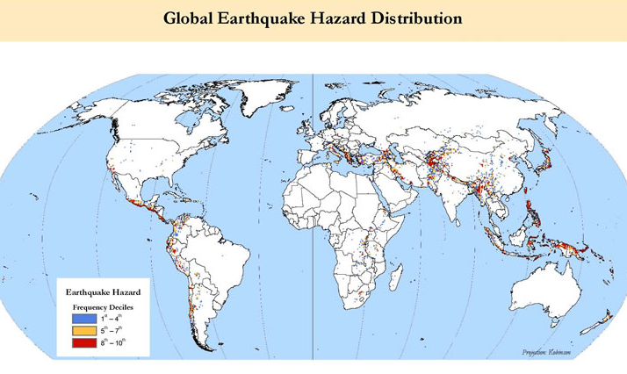

Slide 9
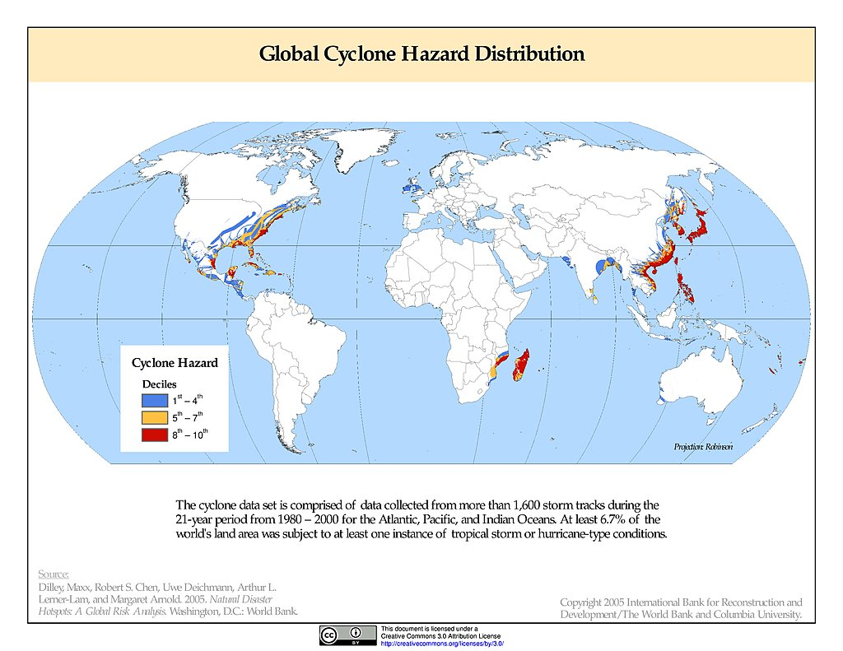

Slide 10
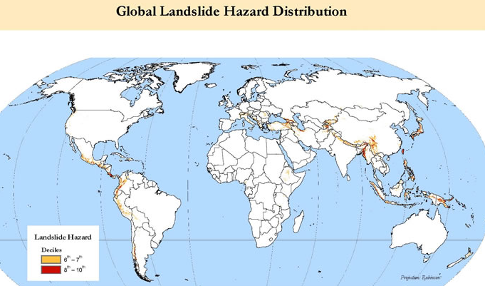

Slide 11
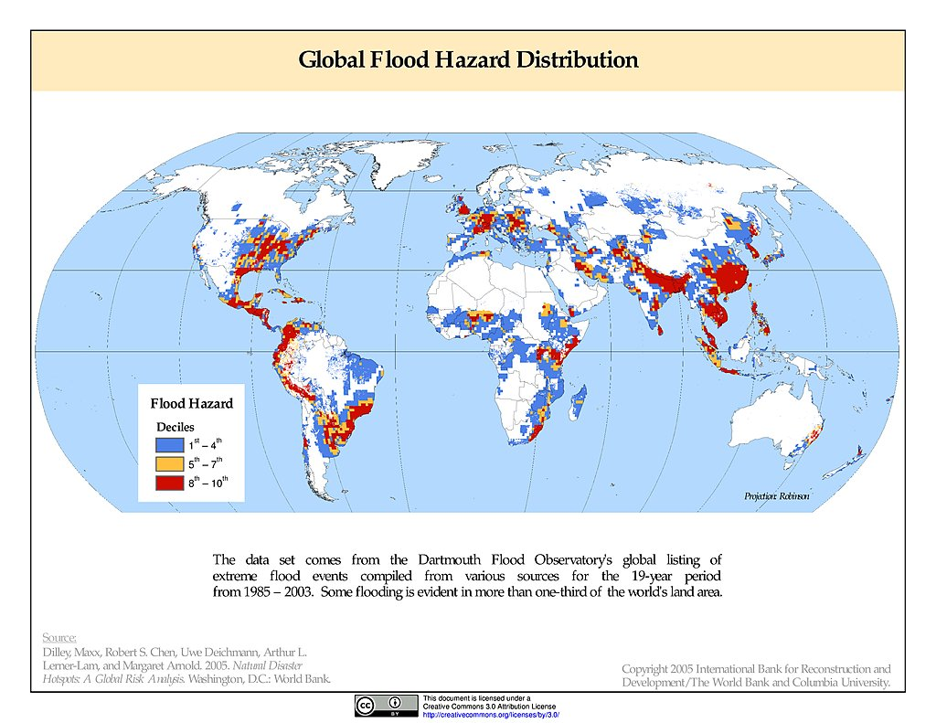

Slide 12
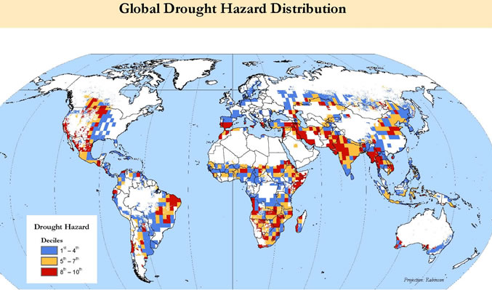

Slide 13
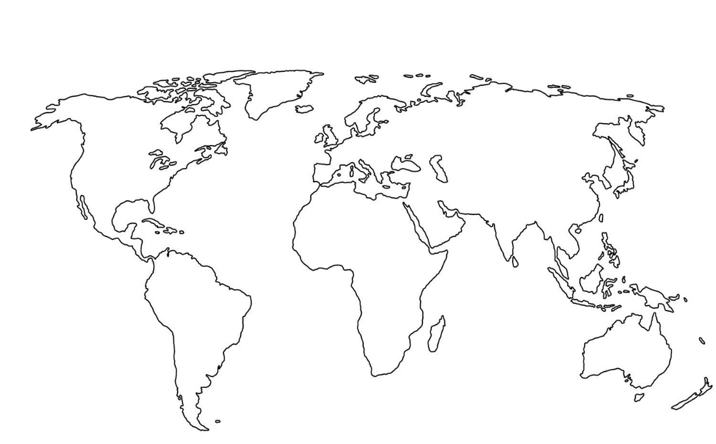
Examine the distribution maps of the different hazards. On the blank outline map, locate the locations of the countries most exposed to multiple hazards. (Use an atlas to help)
Create a key to show the number of hazards and plot these on the map.
For each location annotate the hazards that they experience. Is there a pattern in the distribution of the most exposed countries to multiple hazards?

Slide 14
What factors do you think influence this distribution pattern?
Physical factors | Human factors

Slide 15
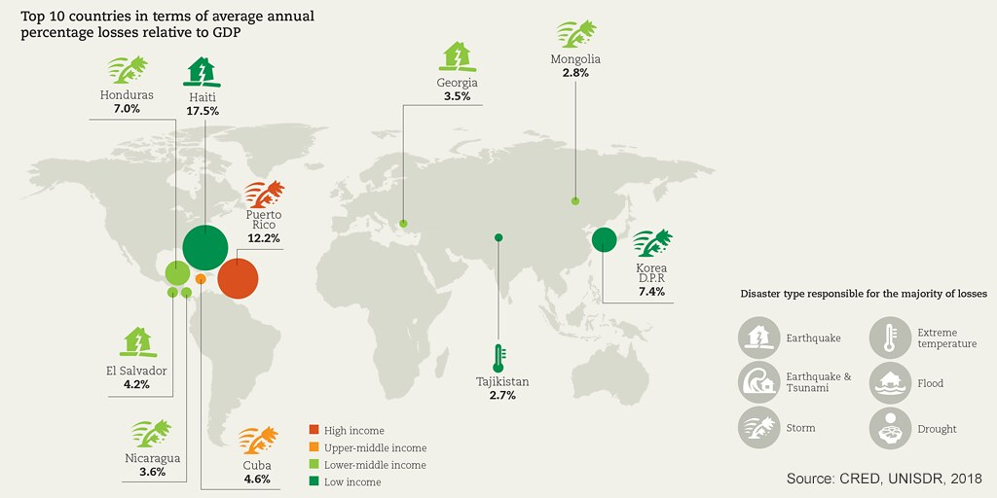
Analyse the map above. (Remember to use PADL and refer to all the types of information included in the map making links between them)

Slide 16
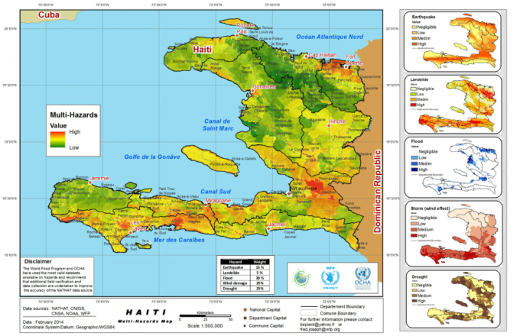
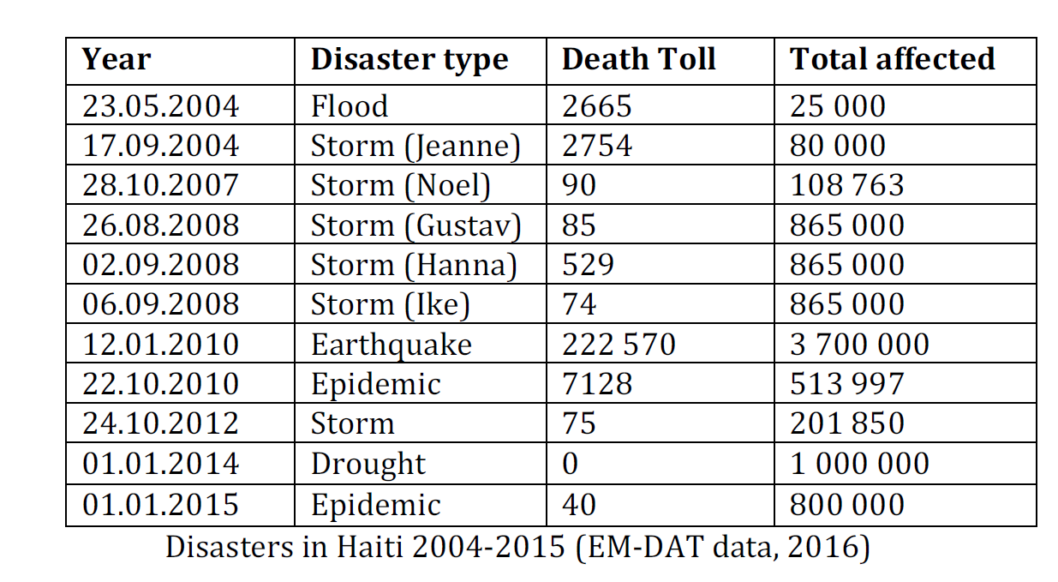
Analyse these two figures

Slide 17
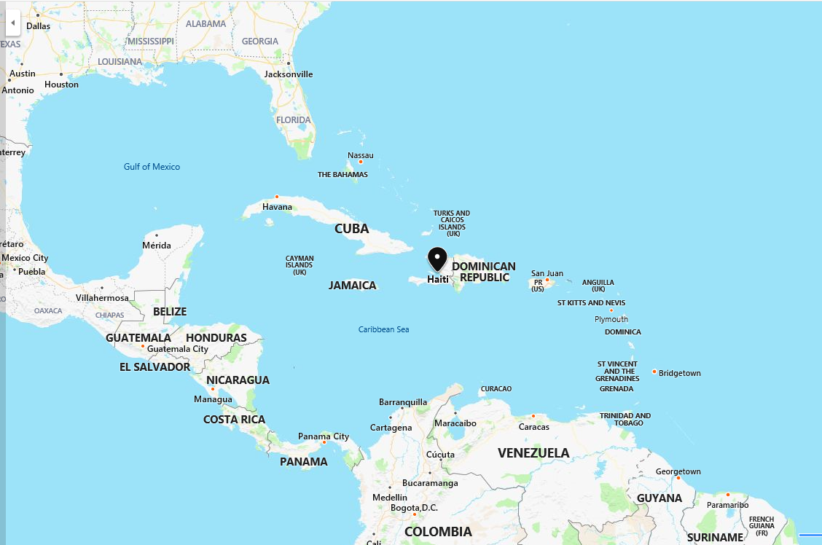
Haiti
The Caribbean island of Haiti, located on the island of Hispaniola is a disaster hotspot.
The island is relatively small, with a population of 10.6 million. Haiti is situated in a seismically active zone, intersected by two fault lines on a conservative margin and lies in an active hurricane region. 60 per cent of Haiti is mountainous and due to deforestation, landslides and mudslides are common.
Deforestation has been rapid over the last fifty years and is a result of Haitians cutting trees down to use as fuelwood and charcoal for cooking.
Due to its high level of socio-economic, environmental and political vulnerability, Haiti struggles to cope in most disaster situations.
Haiti is the least developed country in the western hemisphere, with a GDP of £1,300 per capita.
The people of Haiti are particularly vulnerable to hazards as they mostly live in poor quality housing, with high levels of poverty (77 per cent living on less than US$2 a day) and are concentrated on the flood-prone coastal areas (at population densities of up to 40 000 km2 in Port-au-Prince).
Additionally, Haiti suffers from political instability that further increases its vulnerability to disasters, unable to effectively prepare for disasters.
Watch the clip and make notes on why Haiti is vulnerable to hazards.
https://www.youtube.com/watch?v=IK9ITxQOITg
Use the information on this slide and the information on the Tutor 2 U handout on GoL to explain why Haiti is vulnerable to hazards

Slide 18
The two main hazards that Haiti faces are Hurricanes and Earthquakes.
Using the Tutor2U resources, outline the cause and frequency of both these hazards and the impacts that they have had.

Slide 19
Resilience, adaptation, mitigation and management
What is NDRMS and what did it do to prepare for the hazards it faces?
Evaluate how well it coped with the 2008 hurricane season.
How did NDRMS cope with the 2010 earthquake?
What were the responses to the 2010 earthquake? Evaluate them?

Slide 20
With reference to a multi-hazardous environment that you have studied, assess the view that the underlying cause(s) leading to the hazards is human activity rather than physical factors. [20 marks] 2018

