Slide 1
International trade
And markets

Slide 2
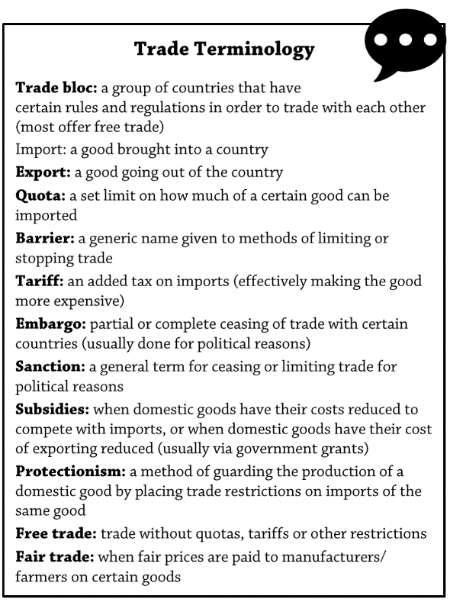
INTERNATIONAL TRADE AND ACCESS TO MARKETS
Learning Objectives:
Students are able to define the term ‘trade’
Students are aware of barriers to trade and understand the term ‘protectionism’
Students can describe and explain general patterns in world trade between HICs, NEES and LICs.
Students understand the global trends in Foreign Direct Investment (FDI)
KEY WORDS:

Slide 3
Introduction – global trade
Trade is the movement of goods and services from producers to consumers. It spans many different sectors of industry and is measured by the movement of these items from one country to another.
  Physical trade takes place in primary products (food, energy and raw materials) and also secondary goods (manufactured products ranging from processed food to electronics).
  The tertiary sector is a highly diverse range of service products and includes trade in legal, educational and other professional services; people also consume digital services such as online games and on-demand TV.
The notion of comparative advantage is why most nations trade – countries should specialize in providing goods and services that they excel at producing. They trade surpluses for things they are not good at producing.
Theoretically, production should increase in each country, and globally, because each country is concentrating on what it does best.
https://www.youtube.com/watch?v=Tzjn-v99fZw

Slide 4
Global Trade – Development characteristics?
BRIC and MINT group members belong in this category
World Bank’s ‘middle-income’ group of countries.
Classified by the World Bank as having high average incomes (GNI per capita) of US$12,736or above (2015 values).
Life expectancy is still low (50-60 yrs)
Attracting investment from the world’s transnational corporations.
Classified by the World Bank as having low average incomes (GNI per capita) of US$1045 or below (2015 values).
Transport infrastructure is improving rapidly
Conflict and weak governance
Life expectancy is typically in the 75-85 years range
Attracting investment from TNCs – 80 countries belong to this category

Slide 5
Global Trade – trading characteristics?
Agriculture and raw materials very important
Trade in hi-tech manufacturing remains important (e.g. Germany)
Rapid factory expansion and industrialisation
Great variation in goods and services specialisations
India and Philippines important global hubs for call centre services
4/5ths of GDP is derived from trade in services (UK)
Office work has over-taken factory employment
Food prices fluctuate year to year – therefore a need to diversify trade, e.g. tourism in Rwanda (mountain gorillas)
China – workshop of the world

Slide 6
Global Trade
TASK: What do you think has been the main driver of global economic integration over the past 200 years?
Regional Trade Agreements emerged (RTAs) and after WW2, the General Agreement on Trade and Tariffs in 1947 was established - now the World Trade Organisation or WTO (1995) with the aim to lower barriers to international trade.
WTO had a philosophy of non-tariff barriers:
  Free trade – trade without quotas, tariffs or other restrictions. Reaching agreements on average trade tariffs has led to an increase in world trade at a faster rate than global economic growth.
https://www.youtube.com/watch?v=J-qGCZ4wmxs (Definition and need for free trade)
One consequence of global systems (such as the WTO) has been to bring countries together into trading blocs, which support free trade agreements between member countries without incurring protectionist measures, such as tariffs or charges.
Free trade agreements and market principles are criticised by some: https://www.youtube.com/watch?v=M4Sz1NNvepk

Slide 7
Free trade
Encourages FDI, increases economic growth as trade increases, transfer of technology & knowledge
Outsourcing increases – issues? Environmental impacts?
Benefit of FDI, job creation, better technology and infrastructure, but also exploitation of workers, environment, raw materials etc.
Pros?
Cons?
Impact of free trade on LICs?

Slide 8
Barriers to trade
Protectionism –
  A deliberate policy by government to impose restrictions on trade in goods and services with other countries – usually done with the intention of protecting home-based industries from foreign competition.
  Used by governments in both developed and developing countries to protect their established or emerging industries
  Used within trade blocs, so countries outside the trade bloc have to pay an additional tariff to trade within the trade bloc. Opponents of trade blocs argue that by offering unfair advantages to member countries, they restrict the development of the global economy.
  https://www.youtube.com/watch?v=wFO8FDvLoms
Barriers to trade:
  Import licence
  Import quotas
  Subsidies
  Voluntary export restraints
  Embargoes
  Trade restrictions
1. Trade barriers are used by countries as a ‘protectionist’ measure. What are countries trying to protect (AO1) (4 marks)
2. Identify TWO types of external trade barrier protecting an economy and explain how they work (AO1,AO2) (6 marks)

Slide 9
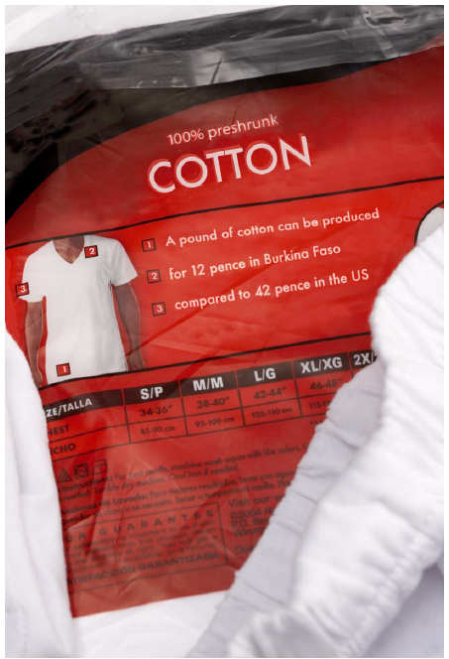
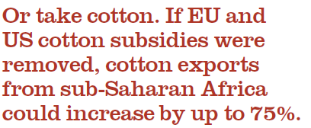
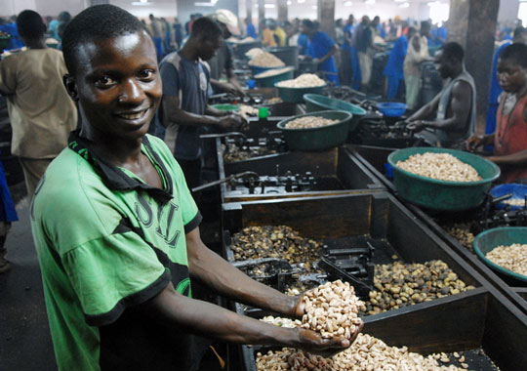
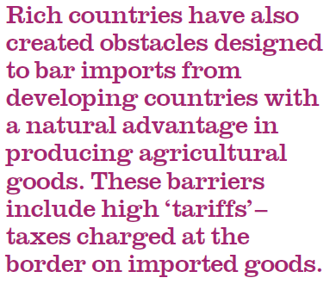
Barriers to Trade: Examples
Cashew nuts - Mozambique

Slide 10
Global features and trends in the volume and pattern of trade and investment
Analyse the general patterns in world trade

Slide 12
The poorest 49 countries only account for 0.6% of global trade compared to 37% of the top exporting countries
Differences are exaggerated by type and limited range of exports from LDEs – dominated by primary products - food and timber. Single market economies are vulnerable to price fluctuations.
World merchandise exports (manufactured consumer goods) have been dominated by North America, Europe and East Asia. China is now the world’s leading exporter.
1993-2013 - trend is that developed economies are seeing a down-turn in merchandise exports.
The emerging economies – BRICS increasing markedly

Slide 13
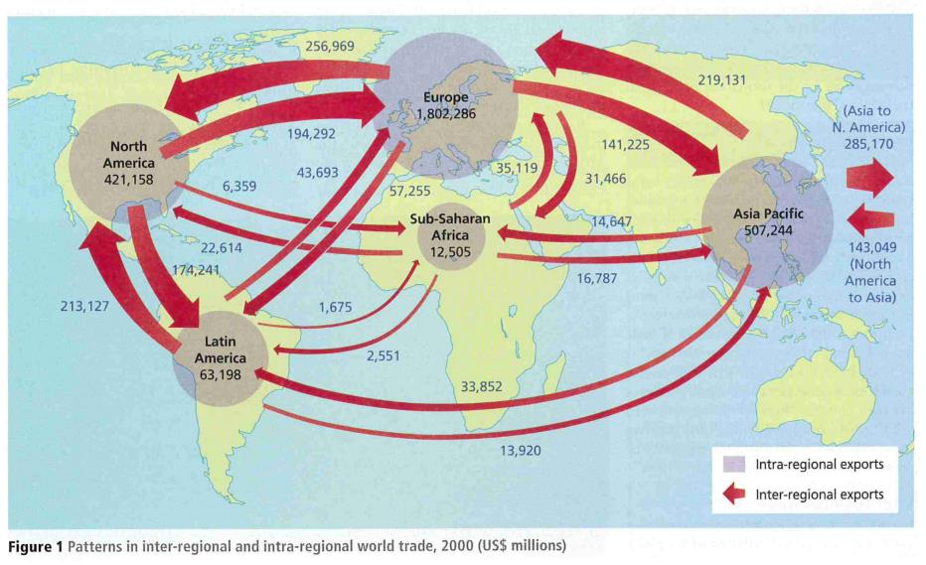
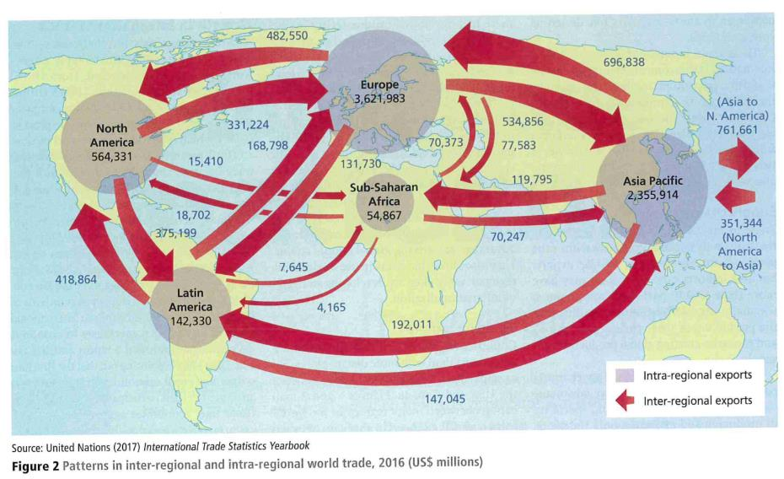
Trends in volume and patterns
Figures 1 and 2 show two patterns of trade: inter-regional trade (between regions) and intra-regional trade (between countries within regions – in this case continents) from 2000 to 2016. Which regions dominate world trade and why?
TASK: Analyse the data in Figures 1 and 2 (6 marks).
Answer the question and then discuss further using the Geography Review Article on the next slide

Slide 14
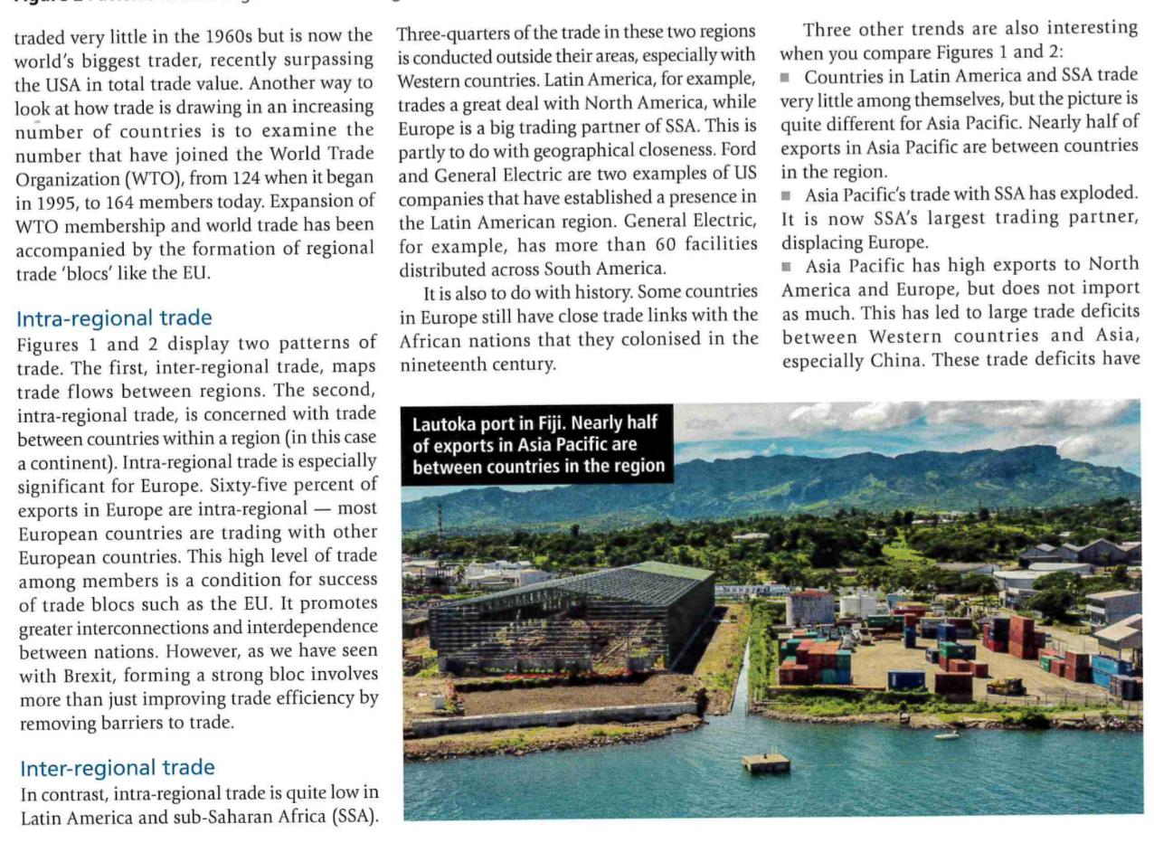
Trading patterns
(explained):
fuelled anti-globalisation views.

Slide 15
Trade patterns
From the maps and data– international trade patterns are dominated by a few large economic blocs – North America, Europe and Asia-Pacific region.
Emerging economies (such as China, India, Brazil) are challenging this dominance. China is now the world’s largest trader, surpassing the US in total trade value in 2018.
Value of world merchandise trade increased by more than 7% per year on average between 1980 and 2011, reaching a peak of US$18 trillion in 2013.
The growth of international trade has stalled in recent years, in 2018 the value of world trade in goods was US$19.48 trillion - a small increase on 2013.
Value in world trade of services was US$5.8 trillion in 2018
Further reading – textbook pages 306-308 in Hodder VLE

Slide 16
Trade patterns – current drivers
Greater integration of economies has impacted the pattern of global trade. There are a number of factors driving current patterns of global trade:
Comparative advantage – specialise at lower cost
Proximity – trade with neighbours – think why?
Agglomeration – some industries cluster to share skills and information
Market size and strength – exporters drawn to larger, more affluent markets
Geopolitical relationships – political alliances are important for trade
Further reading – textbook pages 306-308 in Hodder VLE

Slide 17
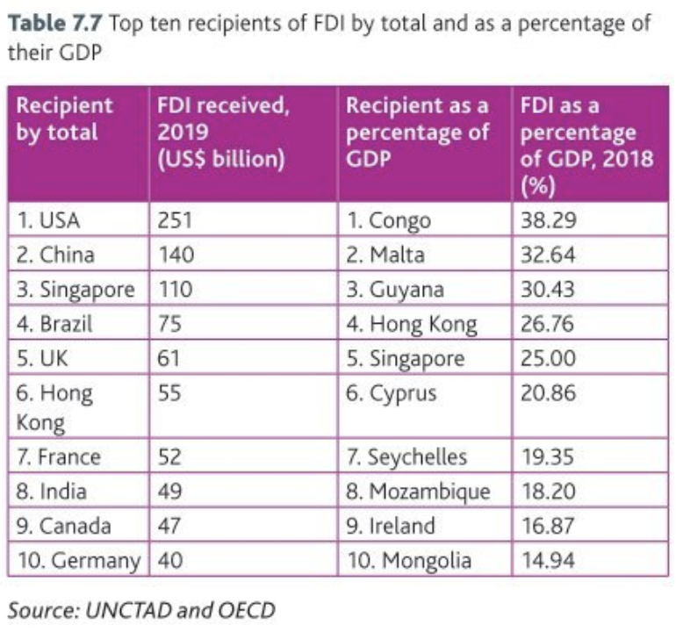
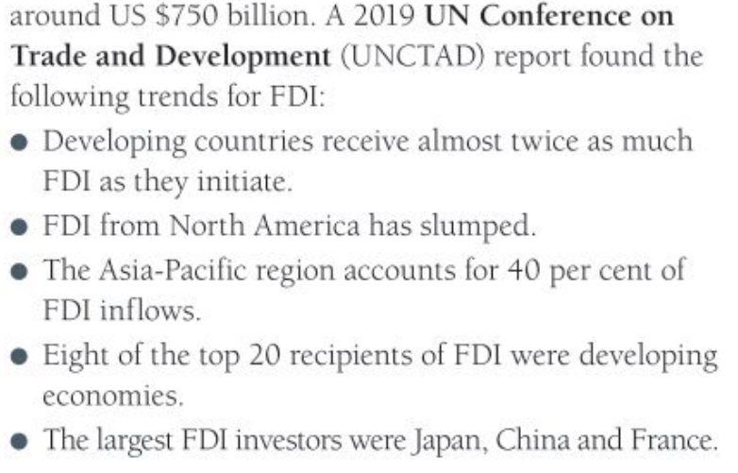
Trends in foreign investment
What is Foreign Direct Investment?
  The money invested into a country by TNCs or other national governments.
A report by the UN Conference on Trade and Development (UNCTAD, 2019) showed that inflows of global FDI totalled US$1.39 trillion in 2019, a small increase on 2013 (US$1.45 trillion). FDI to developed economies fell to US $640 billion. Flows to developing countries remained stable at US$750 billion.

Slide 18
What do you think attracts investors to invest in certain countries over others?
Manufacturing industries - for example, foreign motor companies investing in the USA and UK or offshoring and outsourcing investment in China and India
Natural resource development - investment from mining corporations, for example, in Brazil, Congo, Guyana and Mongolia
Financial business services - attract investment in Singapore and Hong Kong
Large and accessible consumer markets - attract both manufacturers and service providers, for example, the EU is a single market of 500 million people
Lower business taxes - attract investment to Ireland and Cyprus, which have relatively low taxes and are also part of the large EU market; this also demonstrates that in some cases it is a combination of factors that attracts foreign investment.

Slide 19
Summary of Trends in volume and patterns
Demography, investment, technology, energy, other natural resources, transportation costs and institutions are fundamental economic factors that all shape the overall nature of trade and explain why countries trade.
For example, the world is experiencing dramatic changes in the size and composition of populations. Many EMEs have an increased proportion of young adult workers, whereas many HDEs have an ageing population – all with different needs and spending habits.
Regulations, protectionism and high transportation costs can limit trade – and can lead to anti-globalisation and industrial decline for some

Slide 20
Trade Patterns: summary
TASK – Study Figure 3 and choose 2 factors and explain HOW they might influence the volume and patterns of international trade and investment (1 positive and 1 negative)

Slide 21
Further Guidance: References
International Trade deals ‘in the news’
Students can take this study further by undertaking independent research. They can investigate some recent news stories that link well with the study of globalisation.
Markets update Shares soar as Trump hints at possible US-China trade deal https://www.theguardian.com/business/2018/nov/02/shares-soar-as-trump-hints-at-possible-us-china-trade-deal
World Bank update New Zealand – best place to do business: https://www.theguardian.com/business/2018/oct/31/new-zealand-is-best-place-to-do-business-but-uk-slips-to-ninth-report-world-bank
Trade war: Quick guide to US-China trade war: https://www.bbc.co.uk/news/business-45899310

